Slide 1
Terminal
python -m venv venv
venv/Scripts/activate
Git init
Git add .gitignore main.py
git commit -m "Initial Commit“
git remote add origin git@github.com:MohamadCh1/PythonExercises.git
git branch -M main
git push -u origin main
git checkout –b dev
Or git branch dev and then git checkout dev

Slide 2
Terminal
Git merge dev
pip freeze > requirements.txt
pip install -r requirements.txt

Slide 3
Numpy
Import numpy as np
Creating a numpy array
Np.array([1,2,3]) or np.arrange(1,199,5) or np.ones(size) or np.Zeros(size)
array_5 = np.random.randint(10, size=(7,2))
array_6 =np.random.random((3,5))
array_1d.shape, array_1d.ndim, array_1d.dtype, array_1d.size, type(array_1d)
Get information about the array
np.random.seed(42)
unique_numbers = np.unique(array_8)
Print unique number in an array
Np.square(array)

Slide 4
Numpy
Np.mean(array) np.max(array) np.std(array) np.variance(array) np.transpose(arr)
To get som mathematical inform about this array such as mean max min standard deviation variance and transpose
Np.dot(array1,array2)
Dot product for 2 arrays
Np.sort(array1)
For sorting
array_14 = np.random.normal(0, 1, size=(3,3))

Slide 5
Matplotlib
import matplotlib.pyplot as plt
%matplotlib inline
To apply each cell using it
plt.plot(x, y)
To Plot the line
fig, ax = plt.subplots()
ax.plot(x, y)
To plot the line
ax.set(title=“title”, xlabel=“xlabel”,ylabel=“ylabel”)
Setting the information
Fig.savefig(“Give it a name”)

Slide 6
Matplotlib
ax.scatter(z, np.exp(z))
To make a scatter plot
fav_foods = {"pizza": 10, "sushi": 15, "pasta": 8}
ax.bar(fav_foods.keys(), fav_foods.values())
To make a bar chart
ax.barh(fav_foods.keys(), fav_foods.values(),color="lightgreen")
To make a horizontal bar chart
ax.hist(z)
To make a histogram
fig, ((ax1, ax2), (ax3, ax4)) = plt.subplots(nrows=2, ncols=2)
To make 4 subplots in one image with 4 different chart (you can acces them by name ax1,ax2 and so on….)

Slide 7
3d Cluster Plotting
m1 = df1.drop(columns = ['Country']).values # Feature Combination : Health - Trade - Finance
m2 = pca_df2.values # PCA Data
fig = plt.figure()
ax = fig.add_subplot(111, projection='3d')
x = np.array(df1['Health'])
y = np.array(df1['Trade'])
z = np.array(df1['Finance'])
ax.scatter(centroids[:,0],centroids[:,1],centroids[:,2],marker="X", color = 'b')
ax.scatter(x,y,z,c = y)

Slide 8
Seaborn
import seaborn as sns
We use sns framework to display the heat map for the results
Scattering KMeans
labels_sample = km_sample.labels_
customer_data['label'] = labels_sample
sns.scatterplot(x='Annual_Income_(k$)', y='Spending_Score', hue='label', data=customer_data)
plt.scatter(centroids['Annual_Income_(k$)'], centroids['Spending_Score'], c='black')
ax = sns.boxplot(data = data[numerical_features[i]],color = colors[0])
sns.distplot(data[numerical_features[i]],color = colors[0])

Slide 9
Seaborn
ax = sns.barplot(x = 'country',y = 'income', data = data.sort_values(ascending = False,by = 'income').iloc[161:166],palette = colors,edgecolor = 'black');
plt.title('Countries with Low Income/Person')
for rect in ax.patches:
ax.text(rect.get_x() + rect.get_width()/2, rect.get_height(), int(rect.get_height()), horizontalalignment='center', fontsize = 12)

Slide 10
Pandas
Import pandas as pd
Colors = pd.Series([“Red”, “Blue”])
Create a Pandas Series
Car_data = pd.DataFrame({“Car Type” : cars, “Colors” : colors})
To create a dataframe from the dictionary I have
Car type, Colors are the name of columns
The cars, colors is the values
Cars_sales = pd.read_csv(“car-sales.csv”)
Read csv file
Cars_sales.to_csv(“Newcar-sales.csv”)
Save to a csv file

Slide 11
Pandas
Cars.head()
To print the first 5 row
Cars.tail()
Print the last 5 rows
Cars.loc[label] Cars.iloc[numeric]
The first one use label to access and the second one is the but using numeric
Cars[“colors”]
To access specific row
Cars[cars[“odometer”]>10000]
To make condition on row
cars_sales.groupby("Make").mean(numeric_only=True)

Slide 12
Pandas
cars[“odometer”].mean() to get the average of that column
Series = pd.Series([250,345,577])
Series.mean()
cars_sales.info()
Get info about types and number of nun null values and so on
cars.describe()
Get more info about numeric values like mean std min max and so on
Cars.dtype
Get the datatypes
Cars.column
Return columns

Slide 13
Pandas
car_sales.isna().sum() or car_sales.isnull().sum()
Check the number of missing value
centroids = customer_data.sample(n=K)
To make a datarame of n points randomly choosed
mask = customer_data['CustomerID'].isin(centroids['CustomerID'].tolist())
This mask gets the points that are centroids
X = customer_data[~mask]
Get all data points that are not centroids
final_dataset = ratings.pivot(index='movieId',columns='userId',values='rating’)
Making a pivot table for a special features in my dataset

Slide 14
Pandas
new_news_dataset['preprocessed_news_text'] = new_news_dataset['news_text'].apply(preprocess_text)
Apply This finction to all the dataset

Slide 15
Scikit Learn Preprocessing Library
# Import Pipeline from sklearn's pipeline module
from sklearn.pipeline import Pipeline
# Import ColumnTransformer from sklearn's compose module
from sklearn.compose import ColumnTransformer
# Import SimpleImputer from sklearn's impute module
from sklearn.impute import SimpleImputer
# Import OneHotEncoder from sklearn's preprocessing module
from sklearn.preprocessing import OneHotEncoder

Slide 16
Scikit Learn Preprocessing Library
Pipline used to make a pipline that finally contain the preprocessor and model so when I want to train and score it preprocess (clean) training and testing data then fit and score
Simple Imputer replace missing values (nan or None) by mean or median or the most_frequent value or constant value
The ColumnTransformer in scikit-learn is used when you want to apply different preprocessing steps to different columns of your dataset — especially when you have mixed data types (e.g., numerical and categorical features)

Slide 17
Scikit Learn Preprocessing
categorical_features = ["Make", "Colour"]
categorical_transformer = Pipeline(steps=[
("imputer", SimpleImputer(strategy="constant", fill_value="missing")),
("onehot", OneHotEncoder(handle_unknown="ignore"))])
door_feature = ["Doors"]
door_transformer = Pipeline(steps=[
("imputer", SimpleImputer(strategy="constant", fill_value=4))])
numeric_features = ["Odometer (KM)"]
numeric_transformer = Pipeline(steps=[
("imputer", SimpleImputer(strategy="median"))])

Slide 18
Scikit learn preprocessing
preprocessor = ColumnTransformer(transformers=[
("cat", categorical_transformer, categorical_features),
("door", door_transformer, door_feature),
("num", numeric_transformer, numeric_features)])
model_pipeline =
Pipeline(steps=[("preprocessor", preprocessor),("model", Ridge())])
model_pipeline.fit(car_X_train, car_y_train)
model_pipeline.score(car_X_test, car_y_test)

Slide 19
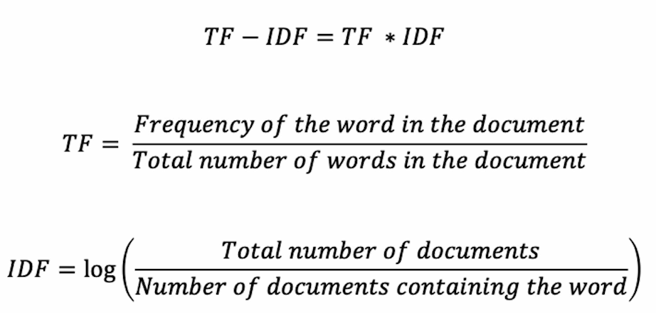
TfidfVectorizer
from sklearn.feature_extraction.text import TfidfVectorizer
Import TfidfVectorizer Which is used to transform words to numbers
Just how it works

Slide 20
TfidfVectorizer
#fit all teh data to vectorizer
vectorizer = TfidfVectorizer()
X = vectorizer.fit_transform(new_news_dataset['preprocessed_news_text']).toarray()

Slide 21
Normalization and Standardizaton
from sklearn.preprocessing import MinMaxScaler,StandardScaler
mms = MinMaxScaler()
ss = StandardScaler()
df1['Health'] = mms.fit_transform(df1[['Health']])

Slide 22
PCA
from sklearn.decomposition import PCA
pca = PCA()
pca_df2 = pd.DataFrame(pca.fit_transform(df2))
plt.step(list(range(1,10)), np.cumsum(pca.explained_variance_ratio_))
plt.plot(np.cumsum(pca.explained_variance_ratio_))
plt.xlabel('Eigen Values')
plt.ylabel('Ratio of Variance Explained')
plt.title('Variance Covered by each Eigen Value')
plt.show()

Slide 23
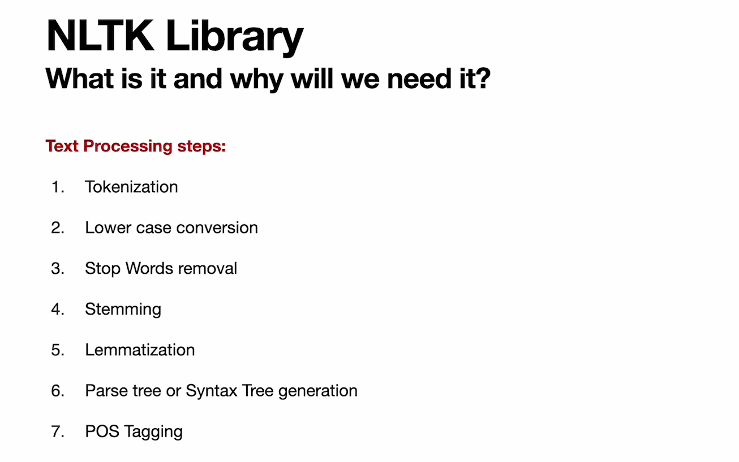
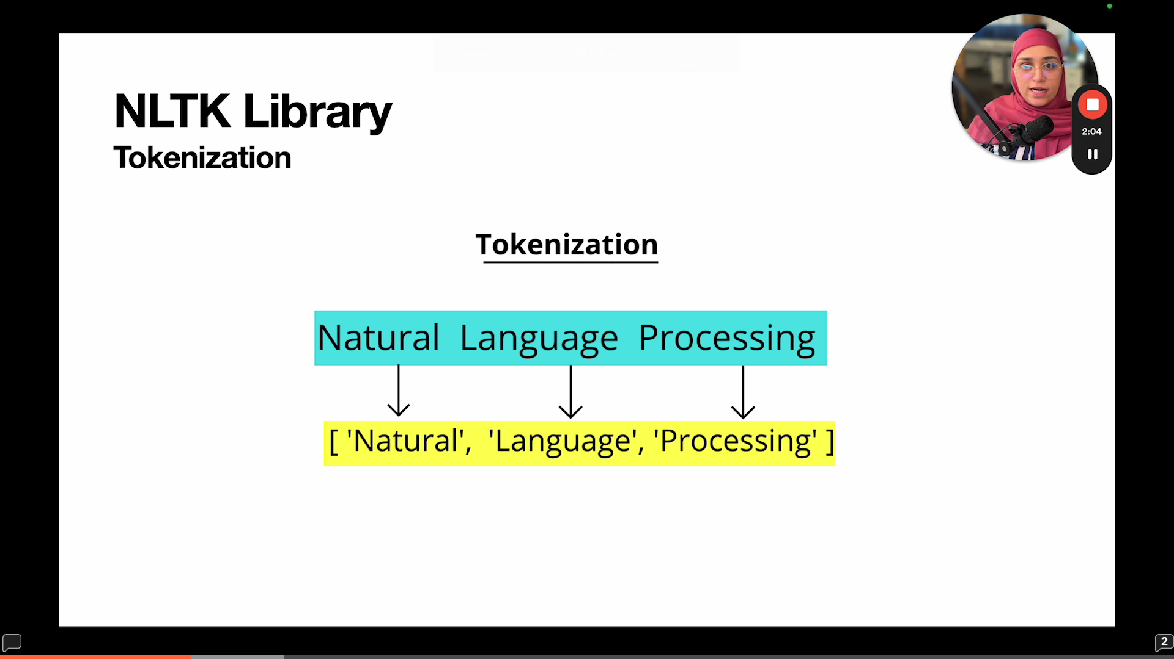
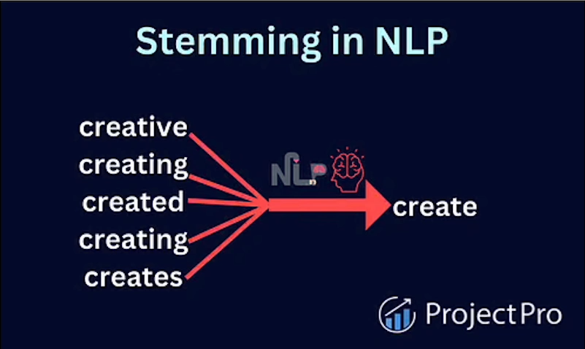
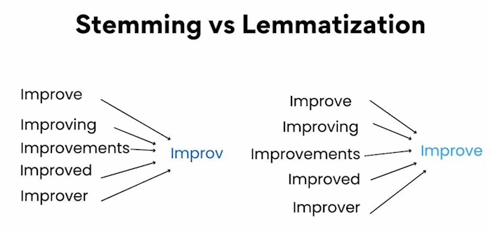

Slide 24
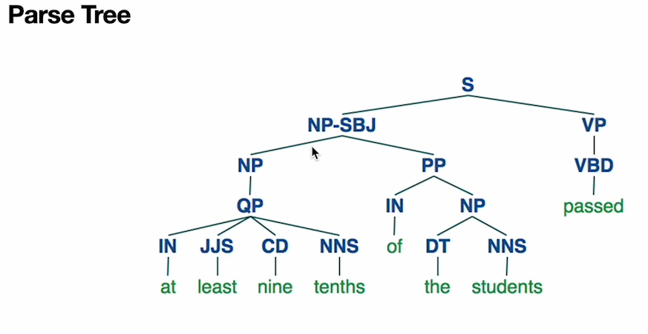
NLTK

Slide 25
NLTK Preprocessing (Used For Text Processing)
import nltk
from nltk.corpus import stopwords
from nltk.stem.porter import PorterStemmer
nltk.download('stopwords’)
nltk.download('punkt’)

Slide 26
NLTK Preprocessing (Used For Text Processing) (Tokenizing & Steming)
Ps = PortStemmer() -> Initialize the stemer
def preprocess_text(text):
text = text.lower() ->lower the text
text = nltk.word_tokenize(text) ->tokenize The text
word_arr = [] -> initiate the words array
for i in text: -> loop over all text
if i.isalnum(): -> check if the text is alpha numeric
if i not in nltk.corpus.stopwords.words('english') and i not in string.punctuation:
word_arr.append(i)
text = word_arr[:] ->copy the array of word_arr to text array
word_arr.clear() ->clear the list
for i in text:
word_arr.append(ps.stem(i)) #stemmatize the proccessed text
return " ".join(word_arr)

Slide 27
Scikit Learn
from sklearn.model_selection import train_test_split
X_train, X_test, y_train, y_test = train_test_split(X, y, test_size=0.2, random_state=42)
X_train.shape, X_test.shape, y_train.shape, y_test.shape
Model Training
from sklearn.ensemble import RandomForestClassifier
clf = RandomForestClassifier()
clf.fit(X_train, y_train)
y_preds = clf.predict(X_test)
clf.score(X_train, y_train)
clf.score(X_test, y_test)

Slide 28
Scikit learn
from sklearn.svm import LinearSVC
from sklearn.svm import SVC
from sklearn.neighbors import KNeighborsClassifier
from sklearn.linear_model import LogisticRegression
from sklearn.tree import DecisionTreeClassifier
from sklearn.ensemble import RandomForestClassifier

Slide 29
Scikit learn Best Model Check
models = {"LinearSVC": LinearSVC(),
"KNN": KNeighborsClassifier(),
"SVC": SVC(),
"LogisticRegression": LogisticRegression(),
"RandomForestClassifier": RandomForestClassifier(),
"DecisionTreeClassifier": DecisionTreeClassifier()}
results = {}
np.random.seed(42)
for model_name, model in models.items():
model.fit(X_train, y_train)
results[model_name] = model.score(X_test, y_test)

Slide 30
Scikit Learn Plotting and Model Evaluation
Plotting a Bar Chart
results_df = pd.DataFrame(results.values(), results.keys(), columns=["accuracy"])
results_df.plot.bar()
Model Evaluation
from sklearn.metrics import confusion_matrix, classification_report
from sklearn.metrics import precision_score, recall_score, f1_score
print(classification_report(y_test, y_preds)) (Print Classification Report)
precision_score(y_test, y_preds) (Get Accuracy)
recall_score(y_test, y_preds) (Recall)
f1_score(y_test, y_preds) (F1 Score)

Slide 31
Scikit Learn Model Evaluation (Confusion Matrix)
from sklearn.metrics import confusion_matrix
confusion_matrix(y_test, y_preds)
import seaborn as sns
def plot_conf_mat(y_test, y_preds):
fig, ax = plt.subplots(figsize=(3,3))
ax = sns.heatmap(confusion_matrix(y_test, y_preds),annot=True,cbar=False)
plt.xlabel("True label")
plt.ylabel("Predicted label")
bottom, top = ax.get_ylim()
ax.set_ylim(bottom + 0.5, top - 0.5)
plot_conf_mat(y_test, y_preds)

Slide 32
Scikit Learn Model Evaluation
from sklearn.metrics import mean_absolute_error
from sklearn.metrics import mean_squared_error
from sklearn.metrics import r2_score
mse = mean_squared_error(car_y_test, car_y_preds)
mae = mean_absolute_error(car_y_test, car_y_preds)
r2 = r2_score(car_y_test, car_y_preds)

Slide 33
Unsupervised Scikit Learn
from sklearn.cluster import KMeans
Import kmeans
km_sample = KMeans(n_clusters=3)
Use if for k = 3
km_sample.fit(customer_data[["Spending_Score" , "Annual_Income_(k$)" ]])
We need to give it two features: Annual income and spending

Slide 34
Elbow Method
Distortions = []
it's the cost function value that we need to calculate
K = range(1,11) #test it on 10 iterations
for k in K:
kmeanModel = KMeans(n_clusters=k) #calculate kmeans
kmeanModel.fit(X)
distortions.append(sum(np.min(cdist(X, kmeanModel.cluster_centers_, 'euclidean'), axis=1)) / X.shape[0])
The cdist computes the Euclidean distance between each data point and the cluster centers.
The np.min function finds the minimum distance for each point, and the sum of these minimum distances is computed.

Slide 35
Elbow Method
# Plot the elbow
plt.plot(K, distortions, 'bx-')
plt.xlabel('k')
plt.ylabel('Distortion')
plt.title('The Elbow Method showing the optimal k')
plt.show()

Slide 36
Silhouette Score
from sklearn.metrics import silhouette_score
sil_avg = []
range_n_clusters = [2, 3, 4, 5, 6, 7, 8]
for k in range_n_clusters:
kmeans = KMeans(n_clusters = k).fit(X)
labels = kmeans.labels_
sil_avg.append(silhouette_score(X, labels, metric = 'euclidean')) #todo: add other values for metric we can test
plt.plot(range_n_clusters,sil_avg,'bx-')
plt.xlabel('Values of K')
plt.ylabel('Silhouette score')
plt.title('Silhouette analysis For Optimal k')
plt.show()

Slide 37
Agglomorative clustering
from sklearn.cluster import AgglomerativeClustering
cluster_hierarcial = AgglomerativeClustering(n_clusters=3, linkage='ward’)
#use Agglomorative clustering from scikit learn library, with 3 clusters and linkage ward
cluster_hierarcial.fit_predict(X)
hiearachy_labels = cluster_hierarcial.labels_
plt.figure(figsize=(10, 7))
plt.scatter(X[:, 0], X[:, 1], c= hiearachy_labels, cmap='rainbow') #plot the clusters
plt.title('Agglomerative Hierarchical Clustering’)
silhouette_score_hierarchy = silhouette_score(X, hiearachy_labels) #calculate silhoutte score

Slide 38
DBSCAN
from sklearn.cluster import DBSCAN
db = DBSCAN(eps = 0.080, min_samples = 8).fit(m1)

Slide 39
Hyperparameter Tuning
from sklearn.model_selection import RandomizedSearchCV
param_dist = {'n_neighbors': np.arange(1, 31),
'weights': ['uniform', 'distance'],
'metric': ['euclidean', 'manhattan', 'minkowski’]}
random_search = RandomizedSearchCV(knn, param_distributions=param_dist, n_iter=10, cv=5, random_state=42)
random_search.fit(X_train, y_train)
print("Best Parameters:", random_search.best_params_)
best_knn = random_search.best_estimator_
y_pred = best_knn.predict(X_test)
print("Test Accuracy:", accuracy_score(y_test, y_pred))

Slide 40
Joblib Library
from joblib import dump, load
dump(clf, "heart-disease-model.joblib")
loaded_model = load("heart-disease-model.joblib")
print(f"Loaded model score: {loaded_model.score(X_test, y_test)}")

Slide 41
Scipy
from scipy.sparse import csr_matrix
csr_data = csr_matrix(final_dataset.values)
final_dataset.reset_index(inplace=True)

Slide 42
SHC Clustering Algorithm (Hierarchical)
import scipy.cluster.hierarchy as shc
plt.figure(figsize=(16, 10))
plt.title('News Dendogram')
dend = shc.dendrogram(shc.linkage(X, method='ward'))

Slide 43
Plotting the world map with data
Import plotly.express as px; import kaleido
df1['Class'].loc[df1['Class'] == 0] = 'No Help Needed'
df1['Class'].loc[df1['Class'] == 1] = 'Help Needed'
df1['Class'].loc[df1['Class'] == 2] = 'Might Need Help'
fig = px.choropleth(df1[['Country','Class’]], locationmode = 'country names’, locations = 'Country',
title = 'Needed Help Per Country (World)’, color = df1['Class'],
color_discrete_map = {'Help Needed':'Red’, 'No Help Needed':'Green’, 'Might Need Help':'Yellow'})
fig.update_geos(fitbounds = "locations", visible = True)
fig.update_layout(legend_title_text = 'Labels',legend_title_side = 'top',title_pad_l = 260,title_y = 0.86)
fig.show(engine = 'kaleido')

