Slide 1
A Multi-Agent, Retrieval-Augmented AI System
for Lebanese Legal Research
Trilingual (Arabic · English · French) · Grounded · Rigorously Benchmarked
Thesis Presentation · July 2026

Slide 2
1. Motivation & Problem
Why an AI system for Lebanese law
• Lebanese law is trilingual — official language is Arabic, but practice mixes French and English; sources are scattered and hard to search.
• Access to justice — ordinary citizens cannot easily understand their rights or obligations.
• Professional burden — lawyers spend hours locating the correct articles and relevant precedents for a case.
• Reliability gap — generic chatbots invent article numbers and cannot be trusted for legal citation (hallucination).
• Goal — answer legal questions by RETRIEVING the correct law, then writing a grounded, cited answer whose accuracy can be measured.

Slide 3
2. Research Objectives
• Multi-agent design: can specialised agents (retrieval, analysis, reasoning, writing) outperform a single LLM?
• Trilingual retrieval: how well can the system find the right law across Arabic / English / French?
• Trustworthiness: can every legal claim and citation be grounded and verified against the corpus?
• Adaptivity: can the output adapt to the user — citizen, lawyer, or judge?
• Rigorous evaluation: build a benchmark that proves accuracy objectively, against a source of truth.

Slide 4
3. System Overview
• What it does: A pipeline of specialised AI agents turns a legal question into a grounded, cited answer.
• Approach: Retrieval-Augmented Generation (RAG) over the Lebanese Penal Code + court rulings.
• Languages: Arabic, English, and French; the answer is written in the question's language.
• Trust: every article the answer relies on is checked against the corpus; a hallucination rate is reported.
• Delivered as: a Streamlit web app + a rigorous, reproducible benchmark to measure quality.

Slide 5
4. Architecture — The Agent Pipeline
0
Orchestrator
1
Query Understanding
2
Research (RAG)
3
Analysis
4
Reasoning
5
Citation
6
Writing
• Orchestrator → classifies the question type AND the user type; routes the whole pipeline.
• Query Understanding → detects language / domain / facts as validated structured data.
• Research → retrieves the most relevant articles and rulings (hybrid search).
• Analysis → extracts applicable provisions, grounded against the retrieved text.
• Reasoning → applies the law to the facts (chain-of-thought).
• Citation · Writing → formats + verifies citations, then writes the final answer in the user's shape & language.

Slide 6
5. How the Agents Are Instructed (System Prompts)
Each agent has a role-specific system prompt that fixes its behaviour
• Role-specific: each agent gets a dedicated system prompt defining its single job and its rules.
• Structured: entry agents return VALIDATED structured objects (tool-use), not free text — no fragile parsing.
• Anti-hallucination: every generative prompt forbids inventing law: 'cite ONLY articles supplied to you'.
• Language-locked: the writer is told to answer entirely in the query's language, with role-specific sections.
• Externalised: prompts are stored in files and versioned, so they can be tuned and compared.
Orchestrator (system prompt)
Read the user input, classify it, return a
routing decision. You never answer directly.
Classify TWO things:
A) query_type: general | case_analysis
B) user_type : citizen | lawyer | judge
Writing / Analysis (rules)
Only cite articles supplied to you;
never invent legal references.
Write the ENTIRE memorandum in the
query's language ONLY.

Slide 7
6. Structured Outputs & Grounding
• Schema-validated: Orchestrator & Query-Understanding emit typed objects via tool-use (Pydantic schema) — the model MUST return valid fields.
• Grounding check: the Analysis agent tags each extracted provision as grounded / ungrounded by matching its article number to the retrieved text.
• Citation filter: the Citation agent verifies each article against a master corpus index and drops loosely-related neighbours.
• Closed set: the Writer receives a CLOSED set — it may cite only those verified numbers.
Routing schema (tool-use)
class RoutingDecision:
query_type: str # general | case
user_type : str # citizen|lawyer|judge
detected_language, legal_domain,
extracted_facts[], pipeline_config
Closed-set constraint (writer)
CITATION CONSTRAINT: You may cite ONLY
these article numbers: 547, 549.
Do NOT mention any other article.

Slide 8
7. Adaptive Output — Who Is Asking?
The Orchestrator detects the user type and shapes the answer accordingly
• 👤 Citizen (general question) → a plain, jargon-free answer to their question.
• ⚖️ Lawyer → a structured advisory memorandum (defence-oriented) for a client's case.
• 👨‍⚖️ Judge (gives facts, wants ruling) → a formal judicial DECISION: facts → applicable law → reasoning → verdict.
• The user can select the role, or the Orchestrator infers it from the phrasing (e.g. 'my client' → lawyer).

Slide 9
8. Corpus & Data Foundation
• Bilingual corpus: Lebanese Penal Code — 417 Arabic + 242 English articles + 54 Court of Cassation rulings = 713 indexed documents.
• Ingestion: a reproducible pipeline reads the sources, embeds them, and records exactly what was indexed.
• Extensible: new sources (contract law, French texts) are auto-indexed by the same pipeline.
• Provenance: every article keeps a validated number — later used as the 'gold answer' in the benchmark.

Slide 10
9. Retrieval (RAG)
• Method: Hybrid search = keyword (BM25) + meaning (dense embeddings) — chosen by benchmark evidence.
• Embeddings: multilingual sentence-transformer (mpnet), running locally and free.
• Cross-lingual: articles and rulings are searched in separate pools; the article number makes matches language-agnostic.
• Evidence over intuition: a popular English re-ranker was TESTED and REJECTED — it hurt this Arabic/legal corpus.

Slide 11
10. Trust & Anti-Hallucination
• Grounding: each provision is checked against the retrieved text; ungrounded ones are flagged.
• Citation verification: every cited article number is verified against the corpus index (no invented citations).
• Closed citation set: the memo may cite ONLY verified articles it was given (precision-first).
• Trust metric: each answer reports a hallucination rate and a grounding rate.

Slide 12
11. The Web Application (UI)
Built with Streamlit — three working areas
• 🔗 End-to-End Pipeline: ask a question, pick your role, run all 7 agents; see the memo, sources, trust indicators, tokens/cost.
• 🔬 Individual Agents: run and inspect each agent in isolation (inputs, outputs, retrieved chunks) for debugging.
• 📊 Benchmarking: generate test questions, enter reference answers, and score the system against a source of truth.
• Design principle: step-by-step transparency — every agent's output, timing, and cost are shown live.

Slide 13
11. UI — Pipeline View in Detail
• Role selector: Citizen / Lawyer / Judge / Auto-detect — changes the output shape.
• Per-agent panels: each of the 7 steps shows a ✅, its time, and its output (expandable).
• Grounding & citations: provisions marked grounded/ungrounded; citations shown ✓ verified / ⚠ unverified.
• Memorandum: rendered as a clean document — right-to-left for Arabic, in the query's language.
• Cost & trust summary: tokens, USD cost, latency, grounding rate, and hallucination rate per run.
• Download: full results (JSON) and the memorandum are downloadable.

Slide 14
Part II
Benchmarking
The core scientific contribution

Slide 15
12. Benchmark — Why It Matters
• Motivation: a legal AI is only credible if its accuracy can be MEASURED, not just claimed.
• Compare: prove whether the multi-agent design beats a single-LLM baseline.
• Quantify: quantify how often the system finds the right law and cites the right articles.
• Rigour: turn subjective impressions into objective, repeatable, defensible numbers.
• Guide design: test every design decision (search method, embedding, re-ranker) with data.

Slide 16
13. Generating Benchmark Questions
A dedicated generation agent builds grounded questions from the real corpus
• Step 1 — sample real Penal-Code articles (and rulings) from the corpus.
• Step 2 — the LLM writes realistic questions answerable from THOSE articles, in a target language.
• Step 3 — it returns each question WITH the article numbers it is based on (the gold answer).
• Step 4 — gold numbers are validated against the corpus index; invalid ones are dropped.
• Step 5 — batched (~10 questions / call) for efficiency; deduped; mixes general + case questions.
• Result: questions are grounded in real law, so each has a known, checkable correct answer.
Generation prompt (excerpt)
From these Lebanese Penal Code articles:
- Article 549: ...
- Article 547: ...
Generate N diverse questions in {language}.
Set gold_articles to those article numbers
(choose only from: 547, 548, 549).
Mix general questions and case scenarios.

Slide 17
14. Benchmark — What Is Measured
Layer | Metrics | Question it answers
Retrieval | Precision@k, Recall@k, MRR, nDCG, hit-rate | Does it find the correct article?
Citations | Precision, Recall, F1 vs. gold articles | Does the answer cite the right articles?
Answer quality | LLM-as-judge 1–5 (correctness, citations, completeness, clarity) | Is the final answer sound & well written?
Reference-based | Judge compares answer vs. a human source-of-truth answer | Does it match the expert answer?
Efficiency | Latency, tokens, cost per query | Is it practical to run?
Statistics | Mean ± 95% CI, paired significance tests | Are differences real, not chance?

Slide 18
15. The Evaluator Agent — Judging Against the Source of Truth
An independent LLM judge scores each answer relative to the user's ground-truth answer
• What it is: a second, independent LLM (Claude, temperature 0), separate from the answering agents.
• Depends on the reference: the user provides the correct expert answer per question — the SOURCE OF TRUTH.
• How it scores: the judge compares the AI answer AGAINST that reference — it does NOT score on its own opinion.
• Rubric: 4 dimensions 1–5 (legal correctness, citation quality, completeness, clarity), judged vs. the reference.
• Why it matters: grounds evaluation in human expertise → objective & reproducible; REQUIRED for a judged run.
Judge prompt (reference-based)
You are a Lebanese legal evaluation expert.
Compare the AI answer against the
REFERENCE (ground-truth) answer.
REFERENCE answer: "..." (from the user)
AI answer: "..."
Score 1-5, judged AGAINST the reference:
legal_correctness, citation_quality,
completeness, clarity
Return ONLY JSON.

Slide 19
16. Benchmark — The Workflow in the App
• 1 · Generate: set the number of questions; the generator produces grounded questions, shown 10 per page.
• 2 · Reference: review them, then type the source-of-truth answer in the editable table (required).
• 3 · Select: choose systems — Multi-Agent vs Single-Agent vs No-RAG.
• 4 · Run: each system answers; the judge scores every answer against the reference.
• 5 · Results: per-system scores, per-dimension table, charts, citation metrics, and downloadable JSON.

Slide 20
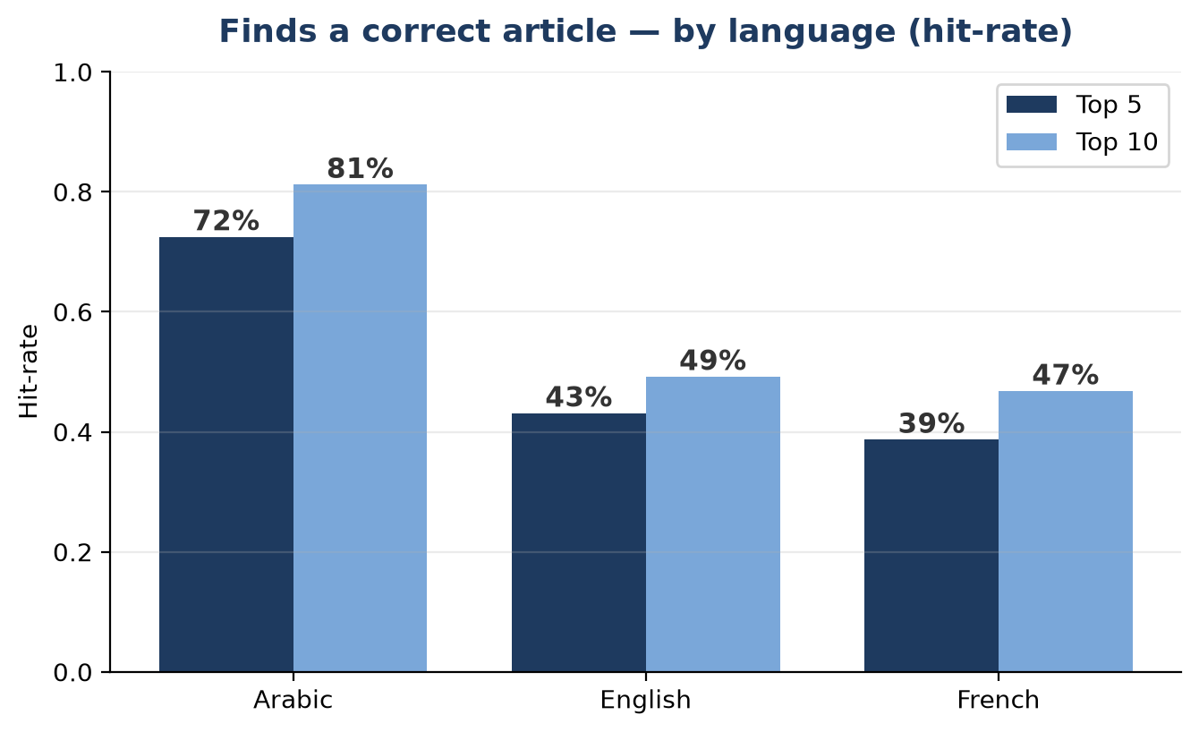
17. Results — Accuracy by Language
• Arabic (primary legal language): 72% of correct articles in the top 5, 81% in the top 10.
• English / French: lower — the corpus is Arabic-primary; closing this is the main next step.
• Note: the article-number metric fairly credits cross-lingual matches.

Slide 21
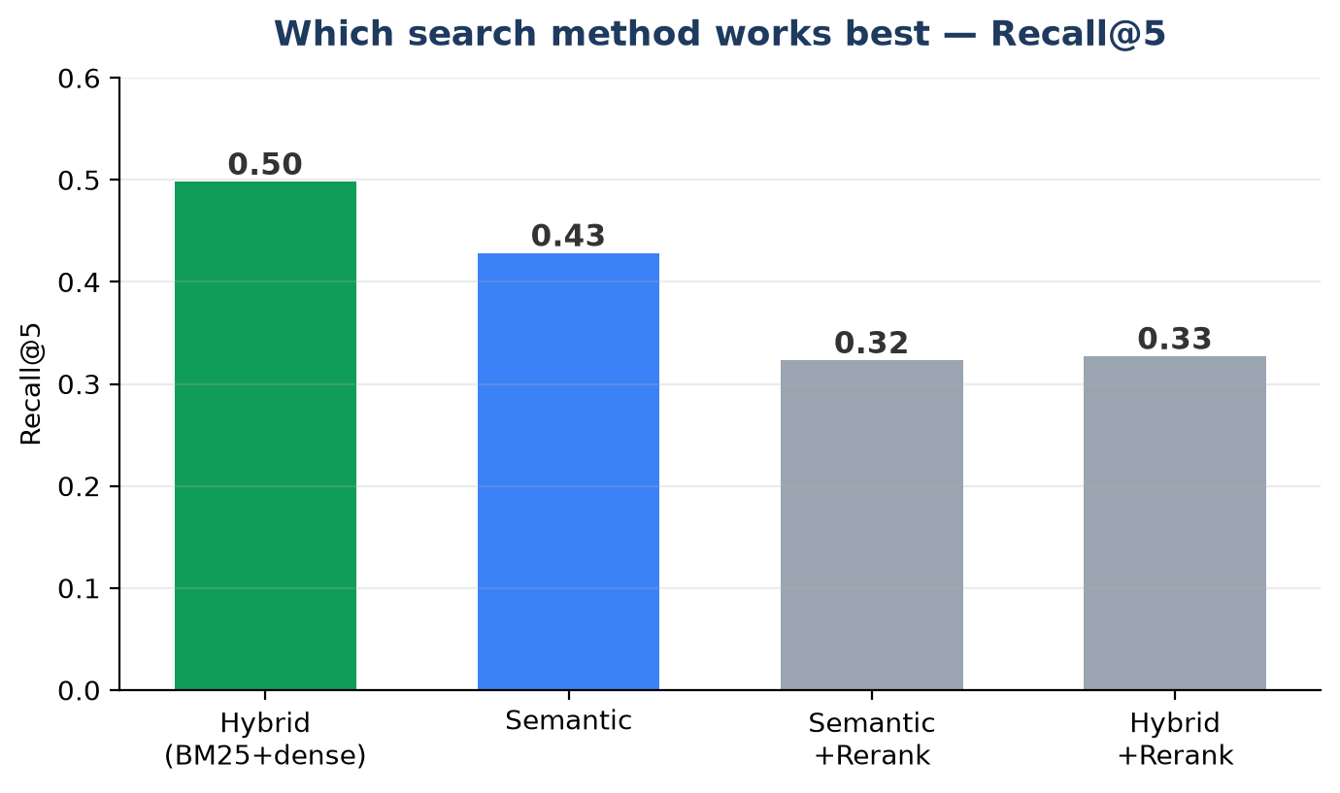
18. Results — Search Method & Answer Quality
• Best method: hybrid (keyword + meaning) finds the correct law most often — chosen default.
• Rejected by data: a popular English re-ranker made results worse and was removed.
• Answer quality: final memoranda rated ~4.6/5 for legal quality by the judge.
• Practical: ~2–3 minutes, ~$0.12 per full answer.

Slide 22
19. Key Findings
• Multi-agent works: specialised agents produce grounded, well-structured answers (~4.6/5).
• Evidence-based engineering: hybrid > semantic; the re-ranker hurts; the embedding is validated — all decided by the benchmark.
• Bottleneck identified: answer quality is bounded by retrieval recall — if the article isn't found, it can't be cited.
• Precision fix, measured: tightening citations raised citation-F1 ~3× (0.04 → 0.13) on the same questions.

Slide 23
20. Engineering & Reproducibility
• Standardised model: Claude Sonnet 4.5 (selectable: 4.6 / Opus / Haiku).
• Headless pipeline: the full system runs without the UI for batch evaluation.
• Tests + CI: unit tests and GitHub Actions run automatically on every change.
• Telemetry: tokens, cost, and latency tracked per agent.
• Reproducible: one command rebuilds the index; the benchmark is regenerable.
• Version-controlled: all work committed and pushed to GitHub.

Slide 24
21. Limitations & Future Work
• Limitation: English/French retrieval lags Arabic (~40% vs 72%).
• Scope: corpus is criminal (Penal) law only; single-article gold is strict for multi-article questions.
• Next — retrieval: evaluate the built-in cross-lingual translation; test stronger multilingual embeddings.
• Next — corpus & rigor: add contract law + French texts (pipeline supports it); collect expert reference answers at scale.
• Next — agents & eval: structured reasoning, a verifier agent, and a full statistical comparison run.

Slide 25
22. Conclusion & Contributions
✓ A working trilingual legal AI for Lebanese law: grounded, cited, adaptive to the user.
✓ A rigorous benchmark of grounded questions with validated gold answers and multi-metric scoring.
✓ Reference-based evaluation — answers judged against a human source of truth, not the judge's opinion.
✓ Evidence-based design — every retrieval choice proven (or rejected) by measurement.
✓ Trust by construction — grounding, citation verification, and a reported hallucination rate.
✓ Reproducible & engineered — tests, CI, telemetry, and a usable web application.

