Slide 1
Lebanese Legal AI
Project Update & Benchmark Report
Multi-Agent Retrieval-Augmented System · June 2026

Slide 2
At a Glance
• Strong on Arabic — finds a correct article 72% of the time in its top 5 results (81% in top 10).
• Writes well — the memoranda it writes are rated 4.6/5 for legal quality.
• Rigorous — search method and settings were chosen from benchmark evidence, not guesswork.
• Honest next step — English/French retrieval and exact-citation precision — both with a fix already scoped.
Arabic: 72% / 81% hit-rate (top 5 / 10) | Answer quality: 4.6 / 5

Slide 3
How the System Works
A pipeline of specialised AI agents — one job each
• Orchestrator → decides the question type (general law vs. a case to assess).
• Query Understanding → detects language & domain, extracts the facts.
• Research (RAG) → retrieves the most relevant articles and rulings.
• Analysis → extracts the applicable provisions and checks them against the sources.
• Reasoning → applies the law to the facts.
• Citation → formats and verifies every article number.
• Writing → produces the final memorandum, in the question's language.
• Trust layer → flags any claim not found in the sources (a 'hallucination rate').

Slide 4
What Was Updated This Phase
• Models: standardised on Claude Sonnet 4.5 (+ selector for 4.6 / Opus / Haiku).
• Corpus: added the English Penal Code — now bilingual (713 documents).
• Trust: grounding + citation verification + hallucination rate.
• Retrieval: hybrid search adopted by evidence; harmful re-ranker removed.
• Experience: answers in the question's language; Arabic shown right-to-left.
• Engineering: reproducible pipeline, tests, CI, and cost/time tracking.

Slide 5
The Benchmark — How It Works
• Grounded: 196 questions generated from the REAL corpus — each with its correct article number(s) as the 'gold answer', validated automatically.
• Realistic: Arabic, English, French; 204 distinct articles; general questions + case scenarios.
• Objective: an answer is correct if it retrieves the right article number (so it fairly tests cross-lingual search).
• Measured: retrieval (hit-rate, recall, ranking), citation accuracy, answer quality (1–5), cost, and statistical confidence.
• Why: to turn 'the answers look good' into objective, repeatable, defensible numbers.

Slide 6
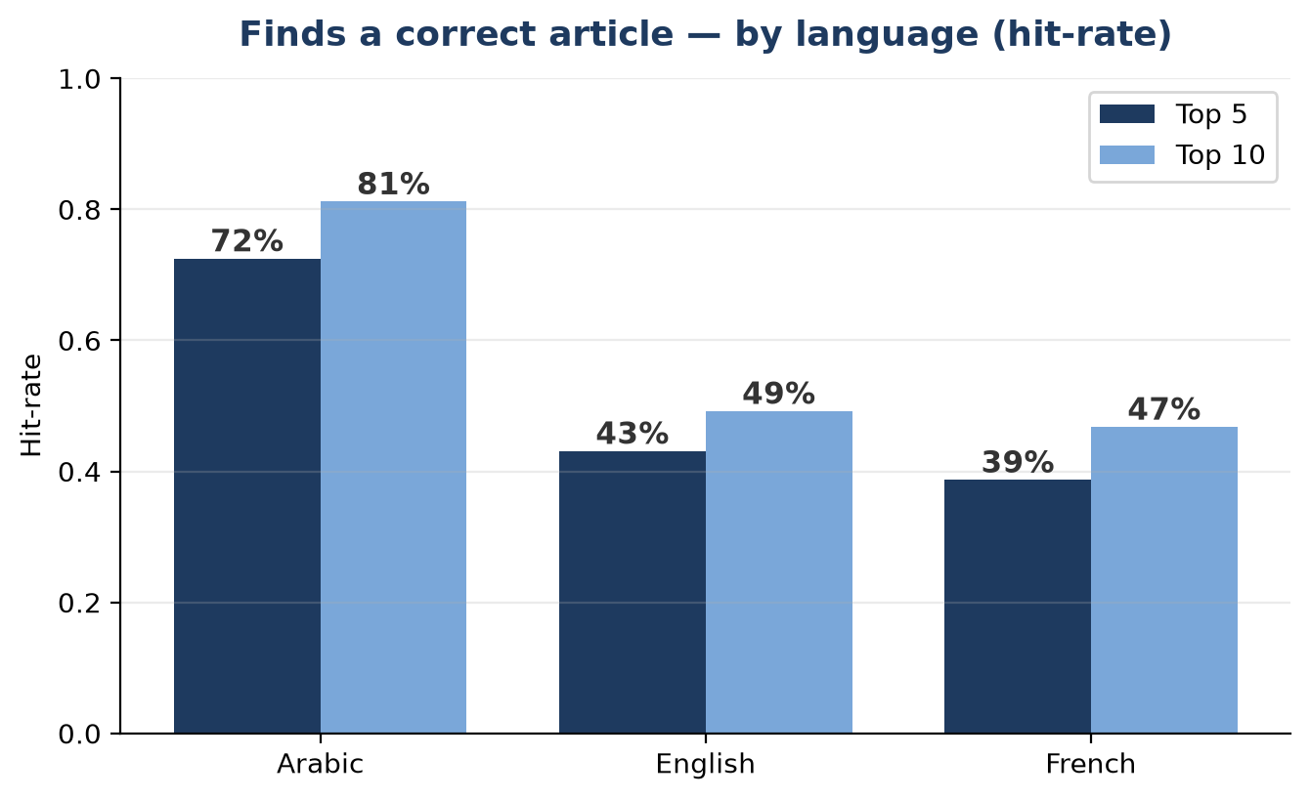
Results — Accuracy by Language
• Arabic is Lebanon's official legal language — and the corpus is Arabic-primary.
• Arabic: 72% of correct articles appear in the top 5; 81% in the top 10.
• EN / FR: lower (corpus is Arabic-heavy); a cross-lingual fix is already built.

Slide 7
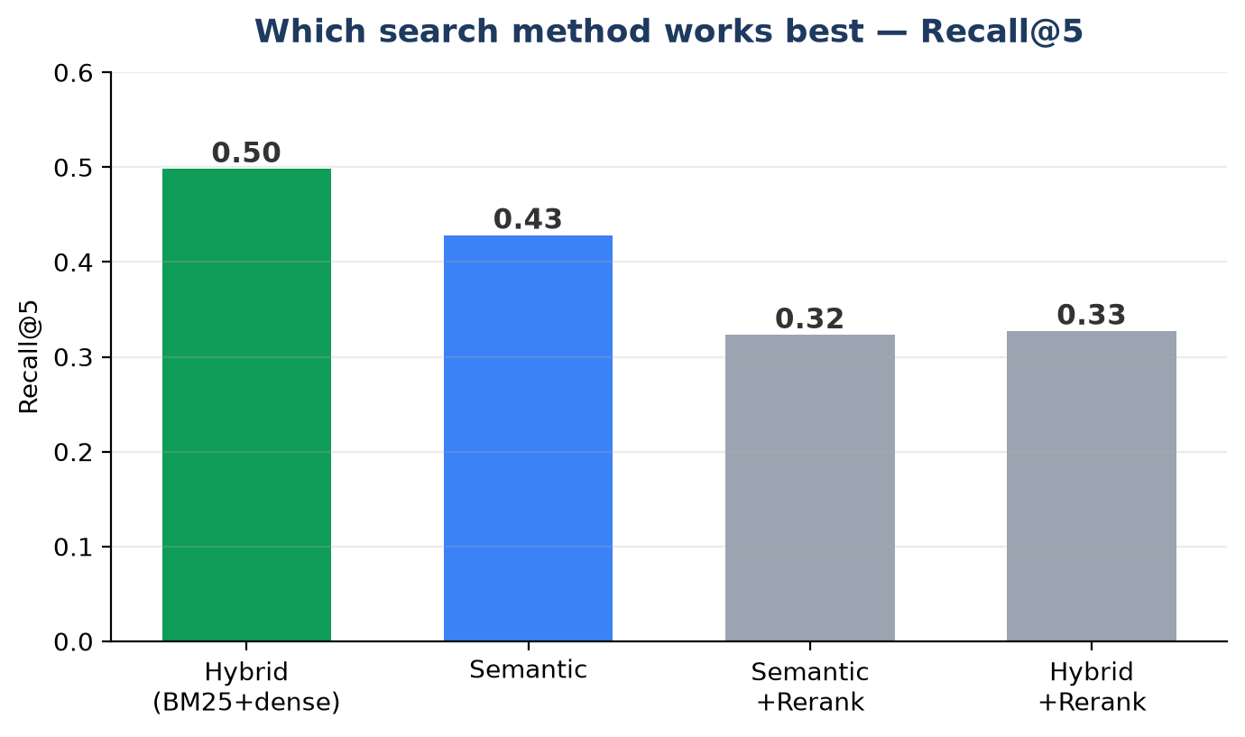
Results — Search Method & Answer Quality
• Best method: Hybrid (keyword + meaning) finds the correct law most often — the default.
• Rejected: a popular English re-ranker made results WORSE here, so it was removed.
• Answer quality: final memoranda rated 4.6/5 for correctness, citations, completeness, clarity.
• Practical: ~3 minutes, ~$0.12 per full answer.

Slide 8
Findings & Next Steps
• Findings: Strong on Arabic (72% / 81%); writes high-quality memoranda (4.6/5).
– design choices made by evidence (hybrid in, re-ranker out).
• Next: Raise English/French retrieval (evaluate the built-in cross-lingual translation).
– Improve citation precision (cite only directly-applicable articles).
– Run the full evaluation for final multi-agent vs. baseline numbers.
– Expand the corpus to contract law and French legal texts.

