Slide 1
CSCE526301 - Knowledge Engineering
LLM-Powered
Knowledge Graph Extractor
With Provenance, Event Reification, and Importance-Ranked Visualization
Mohamad Jehad Motaz Khachfa
ID: 800241913
The American University in Cairo
1 / 19

Slide 2
CONTENTS
Table of Contents
3. The Problem
12. Complexity Slider
4. A Short History
13. Evaluation — Three Passages
5. Project Goals
14. Real Example — Microsoft
6. System Architecture
15. Real Example — Climate Science
7. Hybrid Schema
16. Real Example — Mark Twain
8. The Prompt
17. What Worked
9. Aliases and Deduplication
18. Future Work
10. Provenance and Output Formats
19. Summary
11. Interactive Visualization
CSCE526301 · LLM-Powered Knowledge Graph Extractor
2 / 19

Slide 3
MOTIVATION
The Problem
• Knowledge Acquisition Bottleneck (Feigenbaum, 1977)
• Knowledge graphs are useful for search, QA, and reasoning.
• But building them by hand is slow and expensive.
Goal of this project
Take a paragraph of English text and return a clean, typed, evidence-backed knowledge graph the user can read and explore.
3 / 19

Slide 4
BACKGROUND
A Short History
• Rule-based (1990s–2000s): regex, parsers, hand-crafted patterns. Precise, brittle.
• Statistical / embeddings (2010s): TransE, RotatE. Learn from existing graphs, cannot read new text.
• LLM-based (2020s): GPT, Claude, Gemini. Read free text, but hallucinate and invent relation names.
This project sits in the third generation — with explicit controls to keep the output usable.
4 / 19

Slide 5
SCOPE
Project Goals
• Open entity types discover what the text is about
• Closed relation vocabulary 23 named relations
• Evidence source sentence for every node and edge
• Interactive visualization filters, search, importance ranking
• RDF / Turtle export with reified provenance
5 / 19

Slide 6
PIPELINE
System Architecture
User pastes text
Next.js frontend / /extract route
Node.js backend
LLM provider (Anthropic / OpenAI / Gemini)
normalizeGraph() · dedup · alias merge · validate
Cytoscape.js graph + Turtle / JSON-LD export
6 / 19

Slide 7
KNOWLEDGE MODEL
Hybrid Schema
Entity types: OPEN
Relations: CLOSED
The LLM picks the type (Person, Company, Mountain, Award, …). The system adapts to any domain.
23 fixed relations. The LLM must pick one, or mark the edge as [FALLBACK] for an audit.
Readable (consistent edges) AND flexible (any text works).
7 / 19

Slide 8
THE PROMPT
Five Parts of the Contract
• Decision rules when to pick which relation
• Event reification “X received Y in 2009” → an Award event node
• Aliases merge “Microsoft”, “MSFT”, “the company”
• Deduplication one node per real-world entity
• Confidence + [FALLBACK] model self-reports certainty per edge
The prompt is the contract with the LLM. Five named parts, ~1k tokens.
8 / 19

Slide 9
IDENTITY
Aliases and Deduplication
• aliases field on every node {label: "Mark Twain", aliases: ["Samuel Clemens", "Clemens"]}
• normalizeGraph() merges nodes that share an alias
• Pronouns “he”, “the company” resolved to the canonical entity
• UI aliases shown as small grey pills in the side panel
9 / 19

Slide 10
EXPORT
Provenance and Output Formats
• JSON nodes, edges, evidence, confidence, aliases
• Turtle / RDF edges as rdf:Statement reifications, kg:evidence, kg:confidence (PROV-O)
• PNG one-click export of the current graph view
Downstream tools can verify WHY each fact is in the graph, not just WHAT it claims.
10 / 19

Slide 11
UI
Interactive Visualization
• 5 layouts Force · Concentric · Hierarchy · Circle · Grid
• Live search highlights matching nodes
• Relation chips hide / show each of the 23 relations
• Hide individual entities with one-click restore
• Edge labels on hover or always
• Date nodes on/off — clean ‘paper-ready’ view
• Zoom · Fit · PNG standard controls in the toolbar
11 / 19

Slide 12
UI
Importance-Ranked Complexity Slider
• Node score score = degree + 2 × mention_count
• Level 1 only the most central + most-mentioned entities
• Max level the full graph
Use case
Scan the big picture at level 1, then open up gradually — without losing the underlying graph.
12 / 19

Slide 13
RESULTS
Evaluation — Three Passages
Passage
Entities
Edges
Microsoft (short, 4 sentences)
6
5
Climate Science (Concept heavy)
25
20
Mark Twain (biographical)
14
17
• Short, clear text → small, accurate graph
• Long encyclopedic text → complexity slider becomes essential
• Biographical text → aliases and event reification both trigger
13 / 19

Slide 14
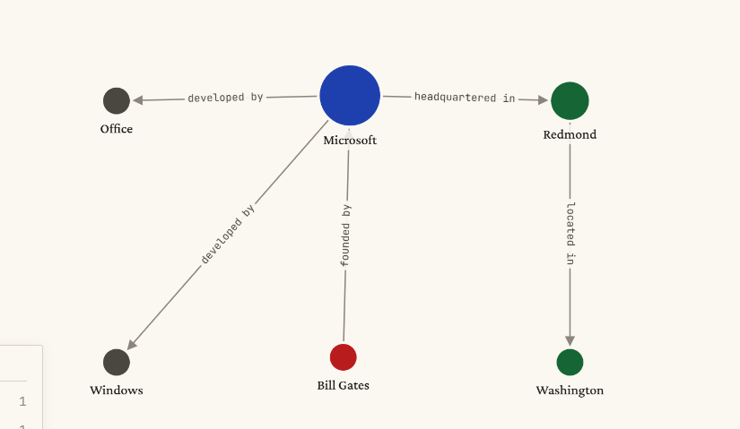
FINDINGS
Real Example
• Text : Microsoft is headquartered in Redmond, Washington. Bill Gates founded the company, which develops Windows and Office.
• Output:
14 / 19

Slide 15
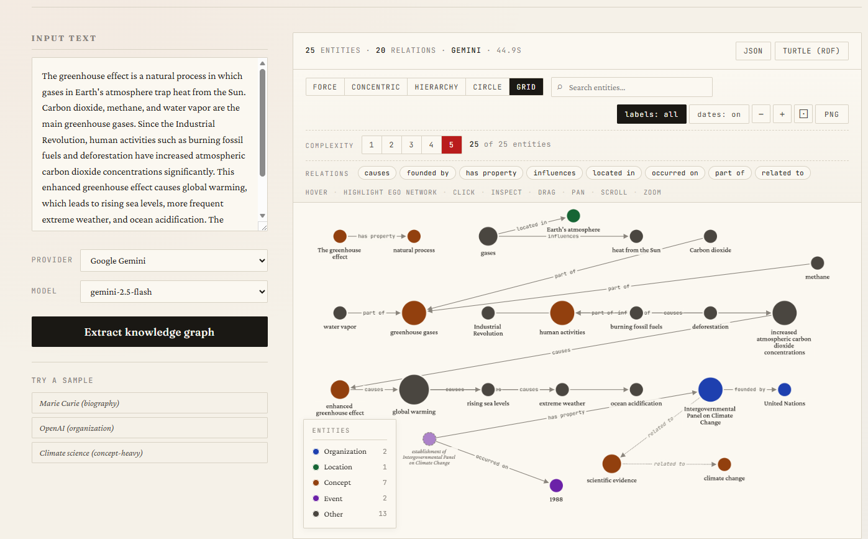
Real Example
FINDINGS
15 / 19

Slide 16
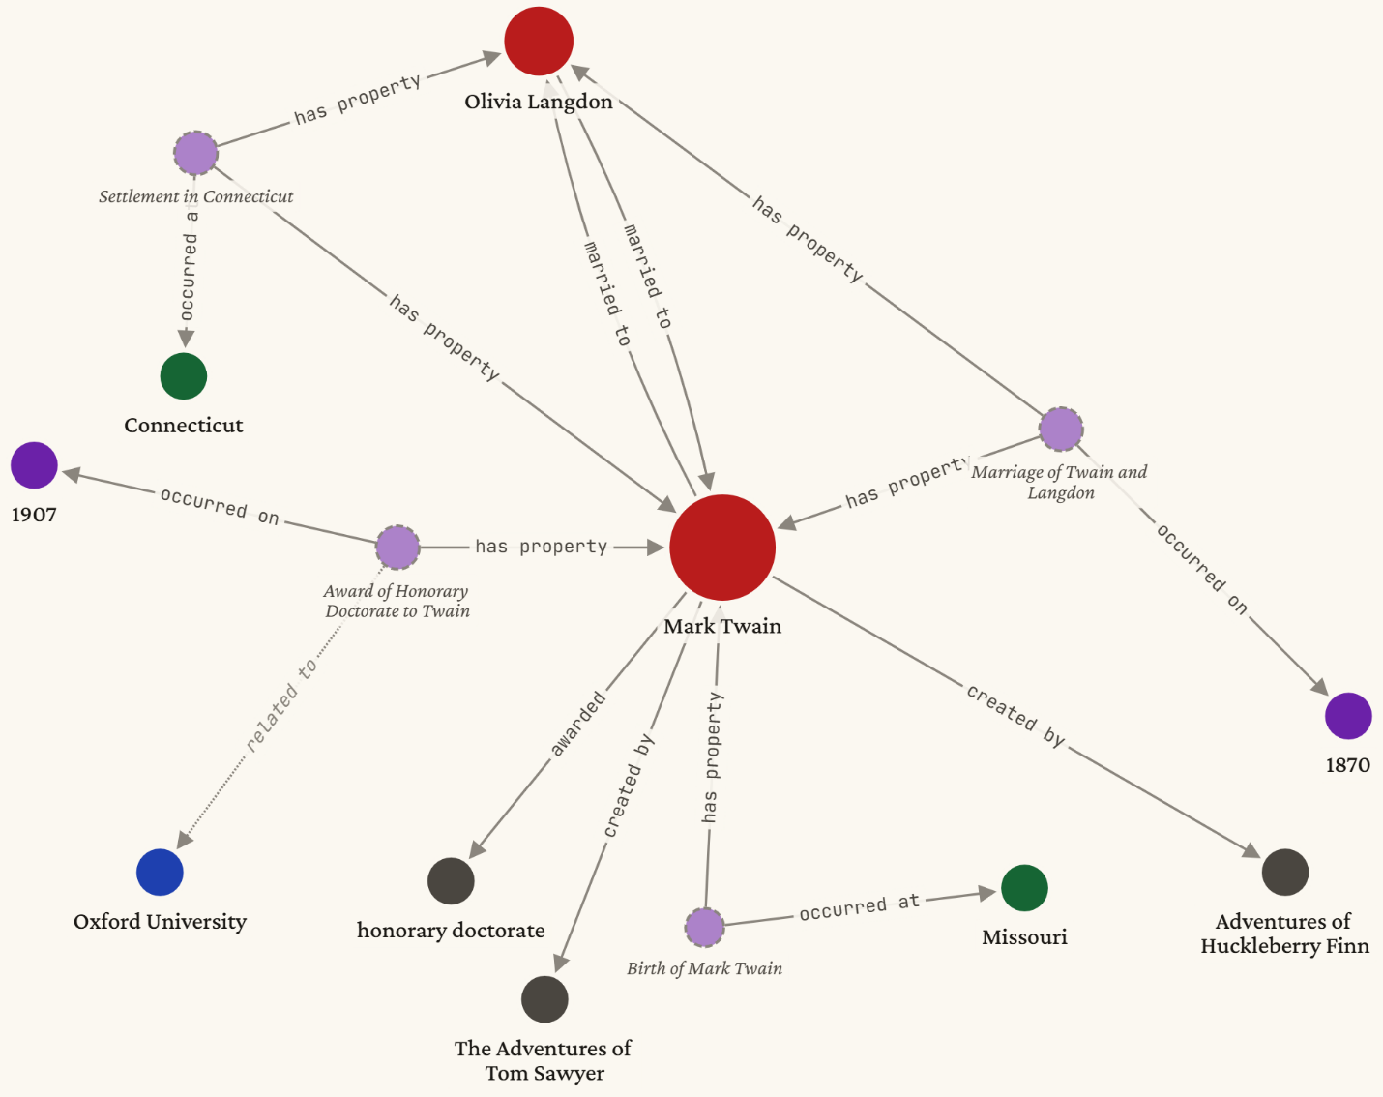
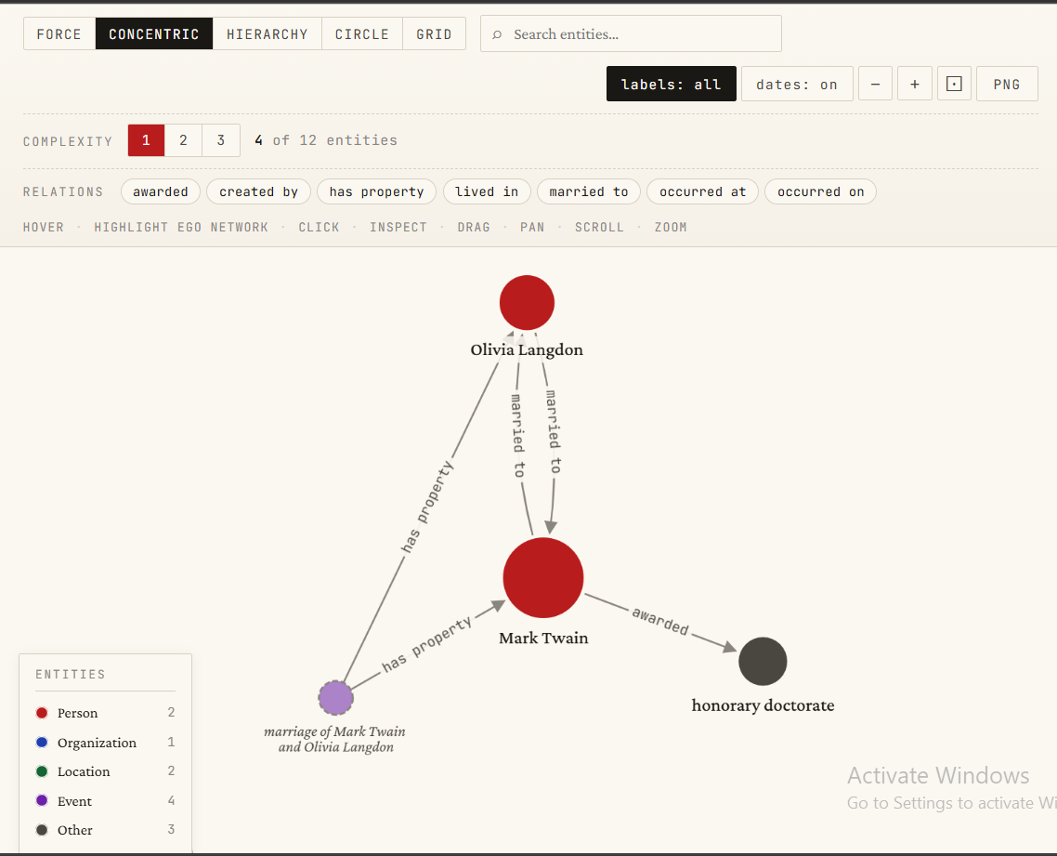
FINDINGS
Real Example
• Text : Mark Twain, born Samuel Clemens in Missouri, wrote The Adventures of Tom Sawyer and Adventures of Huckleberry Finn. He married Olivia Langdon in 1870, and the couple settled in Connecticut. Twain received an honorary doctorate from Oxford University in 1907..
Level 1
Level 3
16 / 19

Slide 17
FINDINGS
What Worked
• Controlled vocabulary + [FALLBACK] kept the graph readable AND auditable.
• Aliases reduced duplicates on biographical text.
• Complexity slider was the most useful UI feature for long paragraphs.
• Per-edge provenance made the graph clickable down to the source sentence.
17 / 19

Slide 18
ROADMAP
Future Work
• Quantitative evaluation against gold-standard datasets (TACRED, DocRED).
• Cross-document entity linking — merge nodes across multiple texts.
• Domain-specific vocabularies loaded as plug-ins.
• Confidence calibration via a separate scoring model.
• Multi-language extraction.
18 / 19

Slide 19
WRAP-UP
Summary
• Working LLM-based knowledge graph extractor.
• Hybrid schema: open entity types, closed relation vocabulary.
• Provenance, confidence, aliases, and event reification built in.
• Interactive visualization with layouts, filters, search, and importance ranking.
• Reproducible: source code, prompt, schema, and exports all available.
Thank you.
19 / 19

