Slide 1

MediTracker
Never miss a dose. Never lose sight of the people you care for.
Presented by Mohamad Khatib

Slide 2
A problem hiding in plain sight
Medication non-adherence is one of the most common — and costly — failures in chronic care.
~50%
125,000
$100–300B
10–25%
of chronic-disease patients
don't take medication as prescribed
preventable deaths per year
linked to non-adherence (U.S.)
in avoidable healthcare spending
every year
of hospitalizations attributable
to missed medication
Source: Duke Health, AJMC, and peer-reviewed adherence research

Slide 3
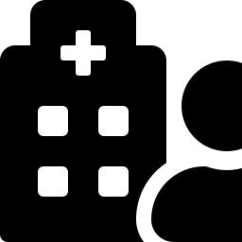


It's not just forgetfulness — it's a visibility problem
When a patient lives alone, or family can't be there at every dose, no one knows whether a treatment plan is actually being followed — until a missed dose has already caused a setback.
Patient logs a dose
MediTracker checks in
automatically, every minute
MediTracker closes that gap: it gives a linked caregiver a passive, real-time view of whether doses are taken, skipped, or missed — without the patient having to report anything.
Caregiver is notified instantly

Slide 4


Meet MediTracker
A mobile app that helps patients stay on track with their medication — and gives the people who care about them peace of mind.
For patients
For caregivers
For everyone
One tap to log a dose. Flexible schedules for any routine. No paper, no memory required.
See a loved one's adherence in real time — without asking, calling, or checking in.
Automatic missed-dose alerts mean nothing slips through the cracks, even on a busy day.

Slide 5



A patient's day with MediTracker
1
2
3
4
Open the app
➜
Tap to log
➜
Get reminded
➜
Review history
See exactly which medications
are due today, at a glance.
Mark a dose taken or skipped
in a single tap — no forms.
A gentle notification arrives
right when a dose is due.
See the full adherence record
any time, no paper trail.

Slide 6

What a caregiver sees
Once a patient approves the connection, a caregiver gets a live window into their care — without ever needing to ask.
Simple, consent-based linking
Full adherence visibility
A patient invites a caregiver (or vice versa) — nothing is visible until both sides agree.
See a linked patient's medication list and history — taken, skipped, or missed.
Instant alerts
Full control
Get notified the moment a dose is taken, skipped, or automatically flagged as missed.
Either side can end the connection at any time — access is never assumed, only granted.

Slide 7


Why it matters
Nothing falls through the cracks
Built for real routines
Peace of mind for families
Missed doses are caught automatically — no one has to remember to check.
Daily, specific days, fixed intervals, or as-needed — schedules match how people actually take medication.
Caregivers stay informed without hovering, calling, or asking.
Effortless for patients
Private by design
A clear history, always on hand
One tap to log a dose. No paperwork, no complicated setup.
A caregiver only ever sees what a patient has explicitly approved.
A full adherence record is ready any time — for a family conversation or a doctor's visit.

Slide 8
Who it's for
Patients managing chronic conditions
Families and caregivers at a distance
Care organizations and home-care providers
Hypertension, diabetes, and other long-term treatments that depend on consistent daily routines.
Adult children, spouses, or guardians who can't always be there in person at dose time.
Anywhere adherence needs to be visible across many patients without manual check-ins.

Slide 9
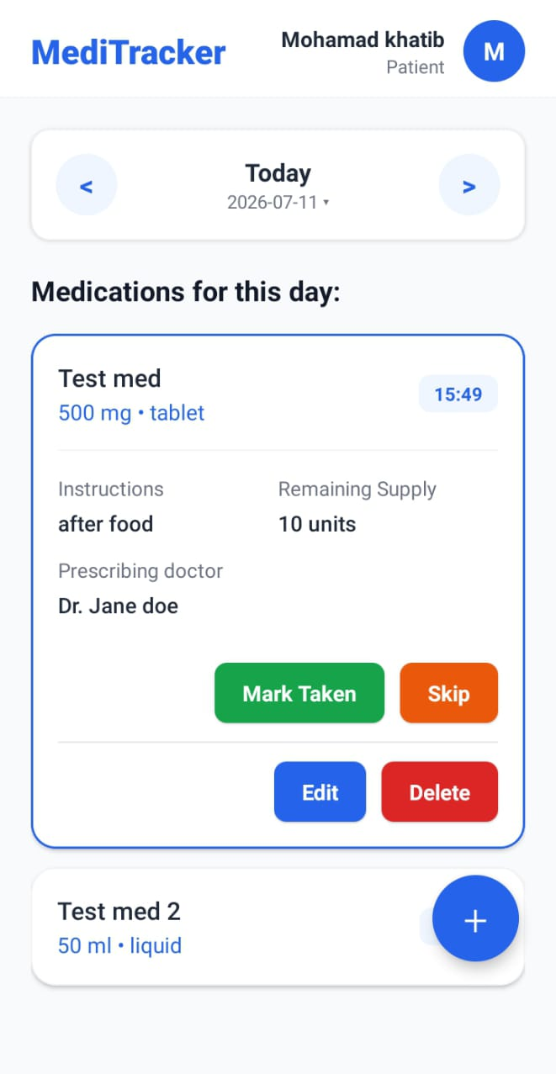
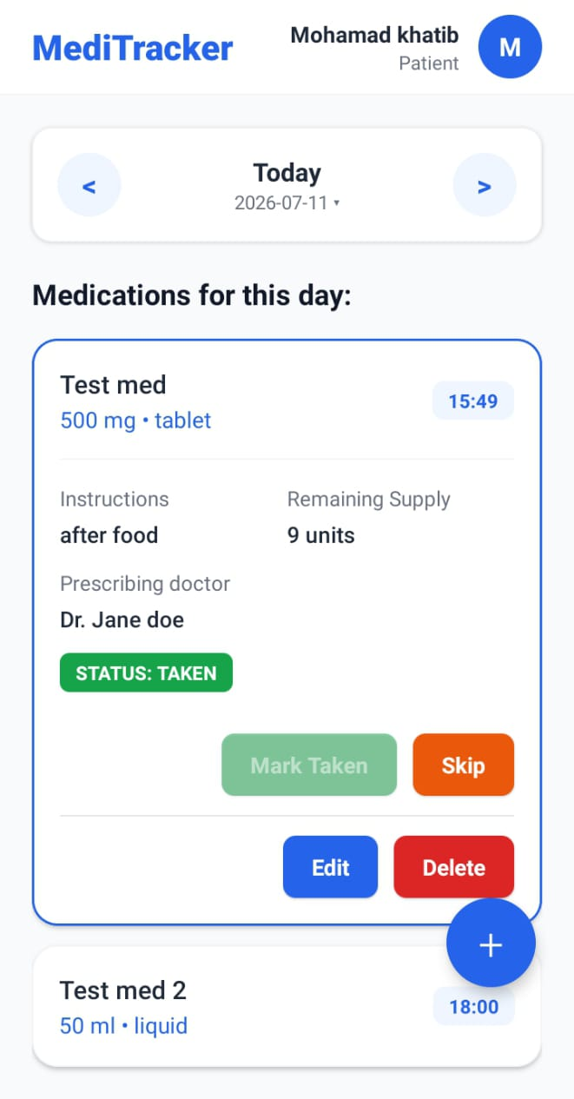
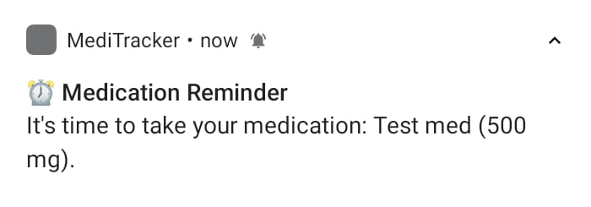
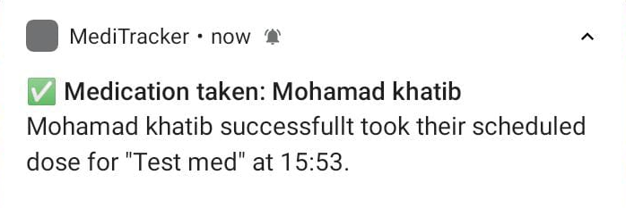
See it in action
From scheduling a dose to keeping a caregiver in the loop — real screens, four steps.
15:49
15:53
➜
➜
➜
1. Medication added
2. Reminder fires
3. Dose logged
4. Caregiver notified
Dosage, schedule, and
instructions all in one place.
A local notification reminds
the patient right on time.
One tap — Mark Taken —
and it's recorded.
The linked caregiver is
alerted instantly.

Slide 10
Let's help people stay on track
MediTracker is ready to bring reliable medication adherence and caregiver peace of mind to the people you serve.

