Slide 1




TEAM MEMBERS
MOHAMED REDA KILANY: 2200566
JONATHAN ATEF MORES : 2200589
IBRAHIM RAMZY IBRAHIM: 2200545
MOHAMED HASSANY ALABD: 2200576

Slide 2

PROJECT
INTRODUCTION
The main part of the game is the snake which the user is supposed to navigate throughout the screen. While navigating, as the snake eats a fruit, it grows in length. The score is displayed based on the length of the snake. The game ends if the snake hits its own body or hits the wall.
GAME COMPONENTS:
The Snake Sprite: The user controls this using a controller. Wall Sprites: The boundary of the game. Apple Sprites: These are the food items the snake is supposed to eat to grow in length. Score Display: This score starts from 0 and increases by one every time the snake consumes an Apple.

Slide 3
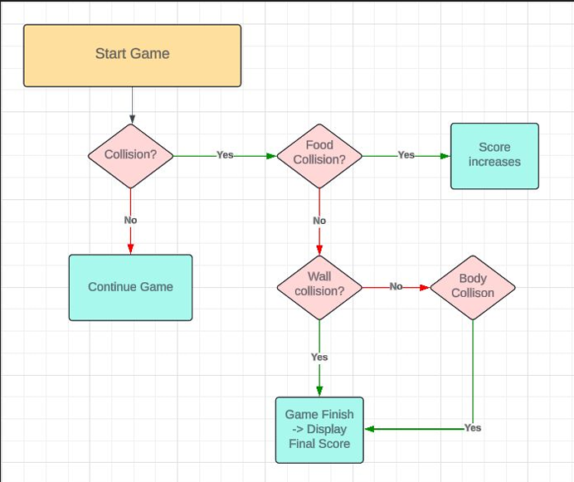
GAME RULES
AND LOGIC

Slide 4
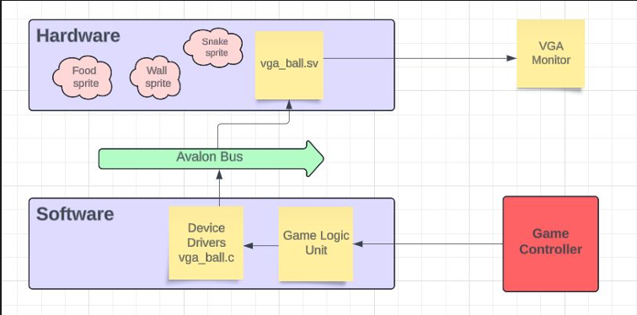
SYSTEM
OVERVIEW
Hardware part of the project includes the design and implementation of modules for VGA image display, control input via the controller. Specifically, the game logic unit transmits data concerning each object's position and status to the hardware via the device drivers. The hardware peripherals, upon receiving this data, process and decode it to produce the appropriate visual outputs.
The software portion consists of the device drivers and the game logic unit. The game logic manages several key functions, including the display of Apple sprites, Snake sprites, score calculation, food eating, and wall collision detection. The device drivers serve as the bridge connecting the hardware components—such as the controller and VGA monitor—to the logic control unit.

Slide 5
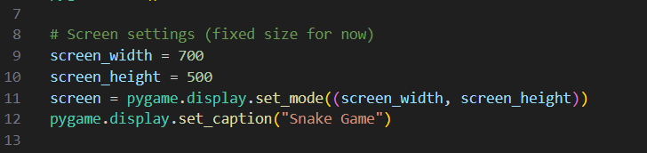
DISPLAY HARDWARE
INTERACTION
DESCRIPTION:
THIS SECTION INITIALIZES THE GAME WINDOW, WHICH IS DISPLAYED ON YOUR MONITOR.
PYGAME.DISPLAY.SET_MODE() CREATES A SCREEN OBJECT THAT ALLOWS THE GAME TO RENDER GRAPHICS.
PYGAME.DISPLAY.SET_CAPTION() SETS THE TITLE OF THE GAME WINDOW.

Slide 6

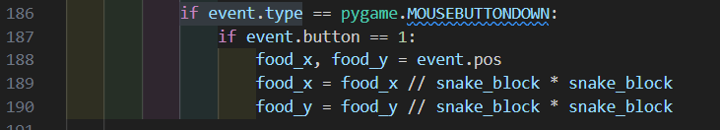
INPUT DEVICES INTERACTION (MOUSE AND KEYBOARD)
The game listens for mouse and keyboard events:
Mouse: Tracks where the player clicks and uses it for food placement.
Keyboard: Detects specific keys like 'Q' for quitting the game.

Slide 7
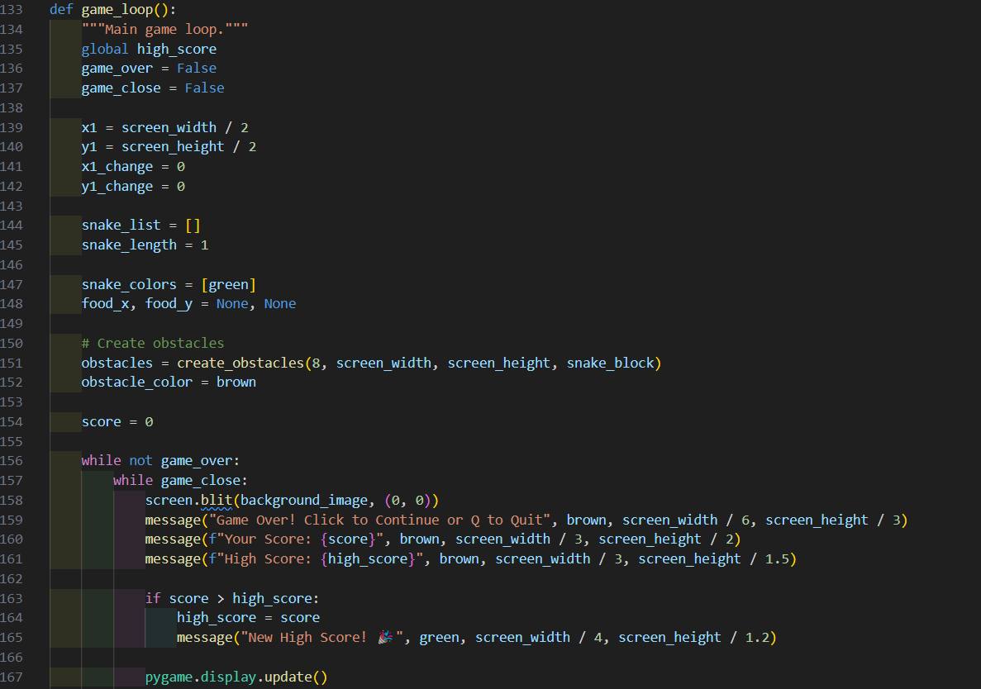
LOGIC
GAME
THE GAME_LOOP() FUNCTION ORCHESTRATES ALL GAMEPLAY OPERATIONS, INCLUDING INPUT HANDLING, UPDATING POSITIONS, COLLISION DETECTION, AND RENDERING UPDATES.
THIS LOGIC GOVERNS HOW THE SOFTWARE MANAGES THE GAME'S STATE AND FLOW.

Slide 8
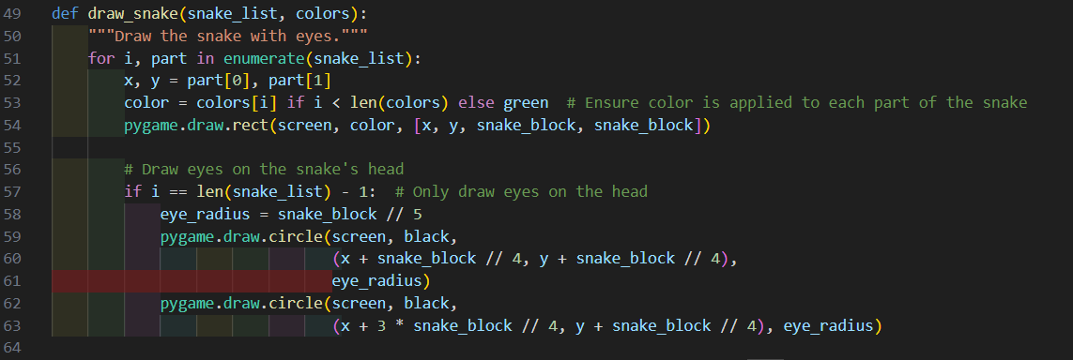
RENDERING GRAPHICS
THE DRAW_SNAKE() FUNCTION HANDLES GRAPHICAL RENDERING OF THE SNAKE ON THE SCREEN, INCLUDING ITS BODY, COLOR, AND EYES.
IT USES PYGAME.DRAW FUNCTIONS TO VISUALLY REPRESENT THE SNAKE DYNAMICALLY AS IT GROWS.

Slide 9
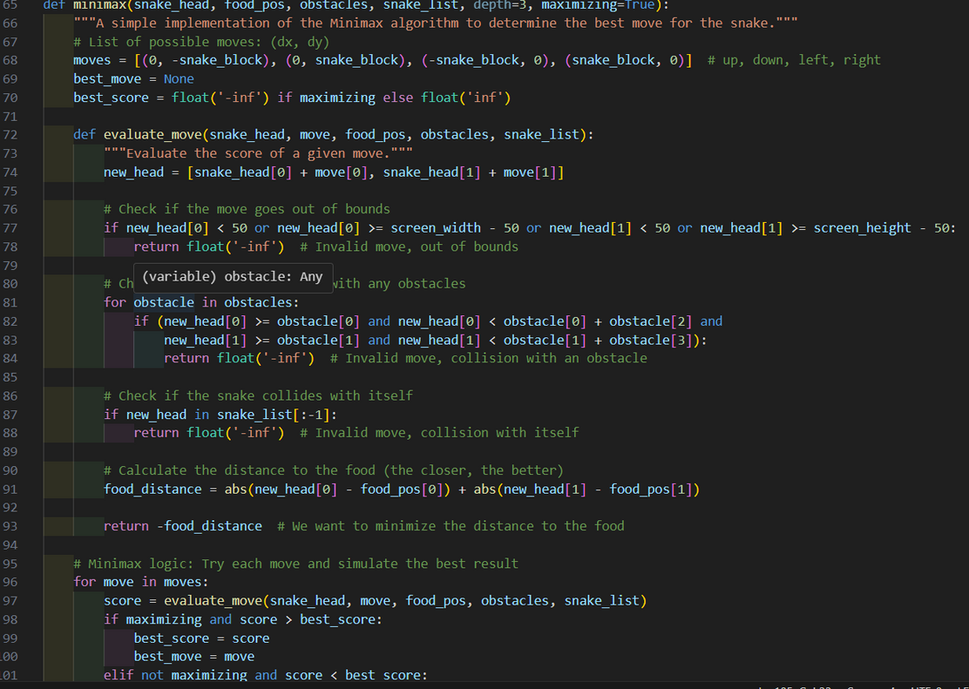
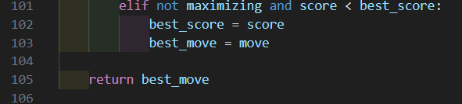

AI
DECISION-MAKING
THE AI_MOVE() AND MINIMAX() FUNCTIONS IMPLEMENT AI LOGIC TO DETERMINE THE BEST MOVE FOR THE SNAKE.
THIS SOFTWARE FEATURE ADDS INTELLIGENCE TO THE GAME, ALLOWING THE SNAKE TO AUTOMATICALLY NAVIGATE TOWARD THE FOOD WHILE AVOIDING OBSTACLES.

Slide 10
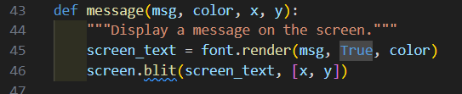
USER INTERFACE
THE MESSAGE() FUNCTION HANDLES USER INTERFACE ELEMENTS BY RENDERING TEXT (E.G., GAME OVER MESSAGES AND SCORES) ON THE SCREEN.
IT IMPROVES USER INTERACTION BY PROVIDING FEEDBACK AND INSTRUCTIONS.

Slide 11
CONCLUSION
THE SNAKE GAME IS A TESTAMENT TO THE HARMONIOUS INTEGRATION OF SOFTWARE AND HARDWARE COMPONENTS TO DELIVER AN ENGAGING USER EXPERIENCE. BY LEVERAGING HARDWARE SUCH AS THE CPU, GPU, KEYBOARD, AND DISPLAY, ALONGSIDE CAREFULLY DESIGNED SOFTWARE LOGIC, WE CREATE A RESPONSIVE AND VISUALLY APPEALING GAME.
KEY TAKEAWAYS INCLUDE:
THE IMPORTANCE OF EFFICIENT HARDWARE INTERACTION TO ENSURE SMOOTH PERFORMANCE.
THE ROLE OF SOFTWARE DESIGN, SUCH AS GAME LOGIC, AI, AND GRAPHICAL RENDERING, IN DEFINING THE USER EXPERIENCE.
HOW COLLABORATION BETWEEN THESE LAYERS RESULTS IN A SEAMLESS GAMING ENVIRONMENT.
THIS PROJECT NOT ONLY DEMONSTRATES THE FUNDAMENTALS OF GAME DEVELOPMENT BUT ALSO HIGHLIGHTS HOW COMPUTATIONAL POWER AND PROGRAMMING COME TOGETHER TO TURN IDEAS INTO REALITY. THANK YOU!

Slide 12
THANK'S

