Slide 1
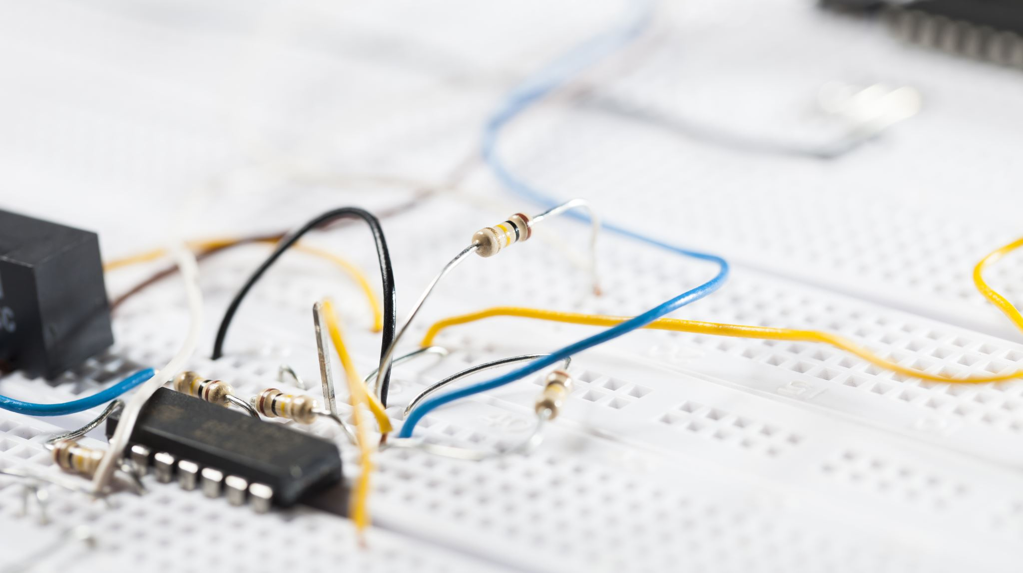
Design and Implementation of Arithmetic and logic Units

Slide 2


Circuit Design basic idea

Slide 3





We have 2 inputs
each consists of 3 bits

Slide 4


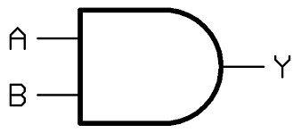
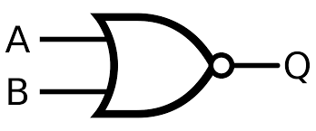
for the two inputs A and B
Using logic gates
We will make
Addition
subtraction
And
OR

Slide 5
In order to do that we need some components

Slide 6
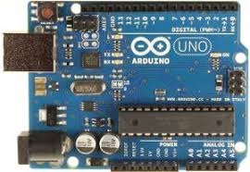
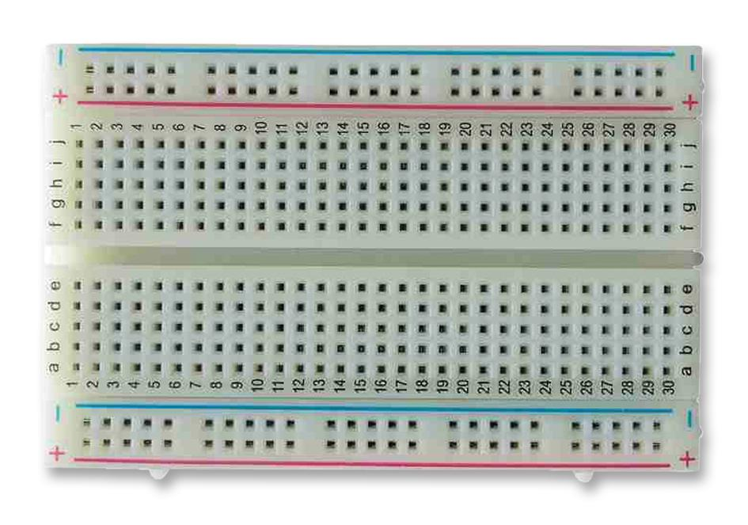
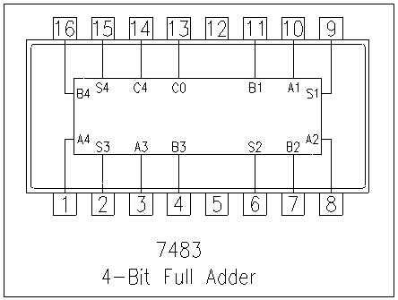
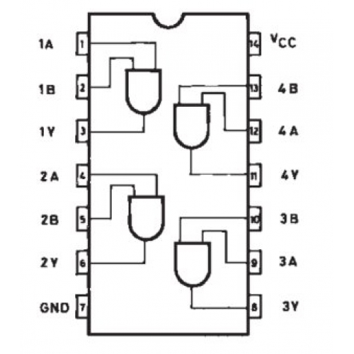
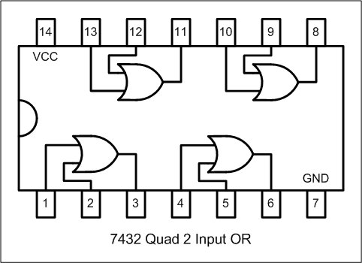
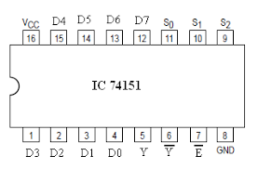
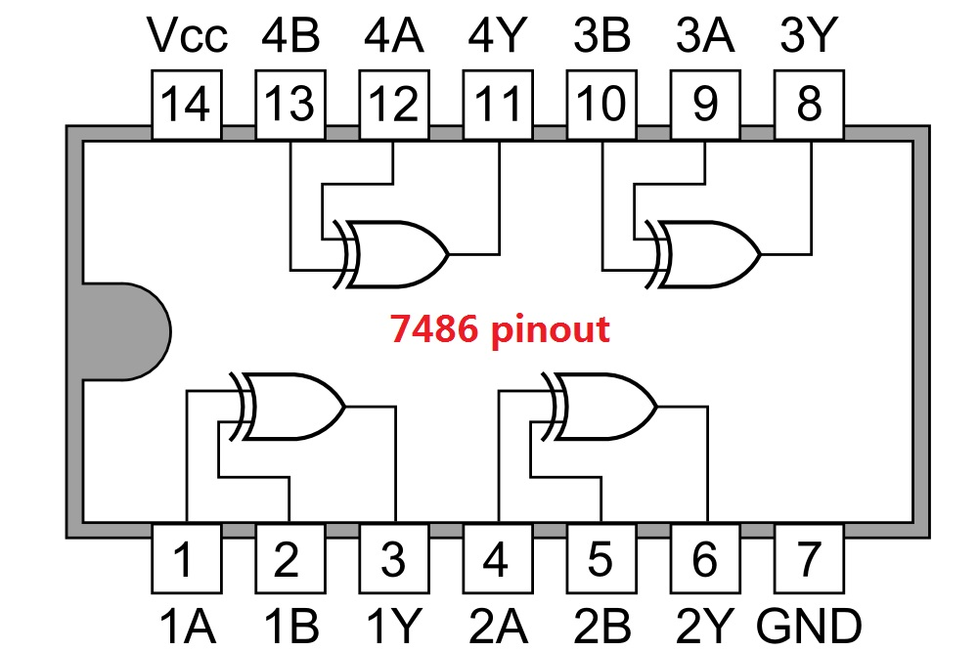
Arduino uno
1 Full adder IC (7483)
3 Breadboard
4 Multiplexer IC 8x1 (74151)
1 XOR IC (7486)
1 AND IC (7408)
1 OR IC (7432)

Slide 7
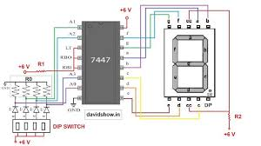
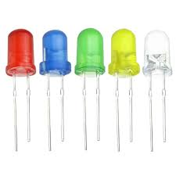
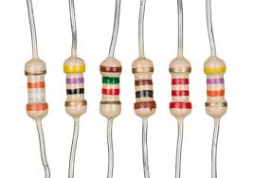
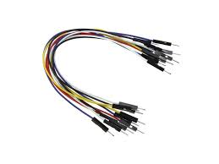
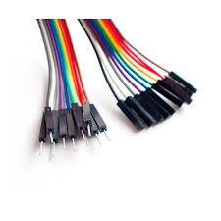
BCD to seven segment decoders (7447 )
and 7-segment display
6 LEDs (2 Red) (2 Green) (2 Yellow)
Resistor
Male- Male jumpers
Male – Female Jumpers

Slide 8

Circuit Design

Slide 9
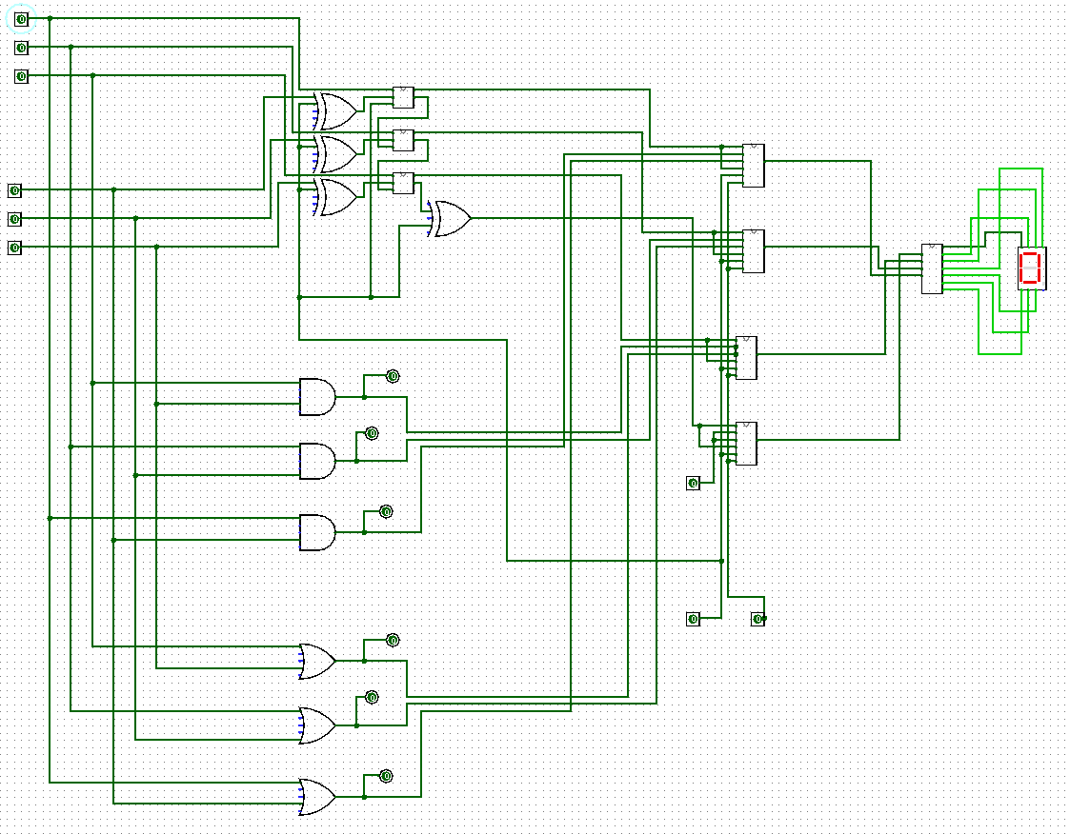

Slide 10
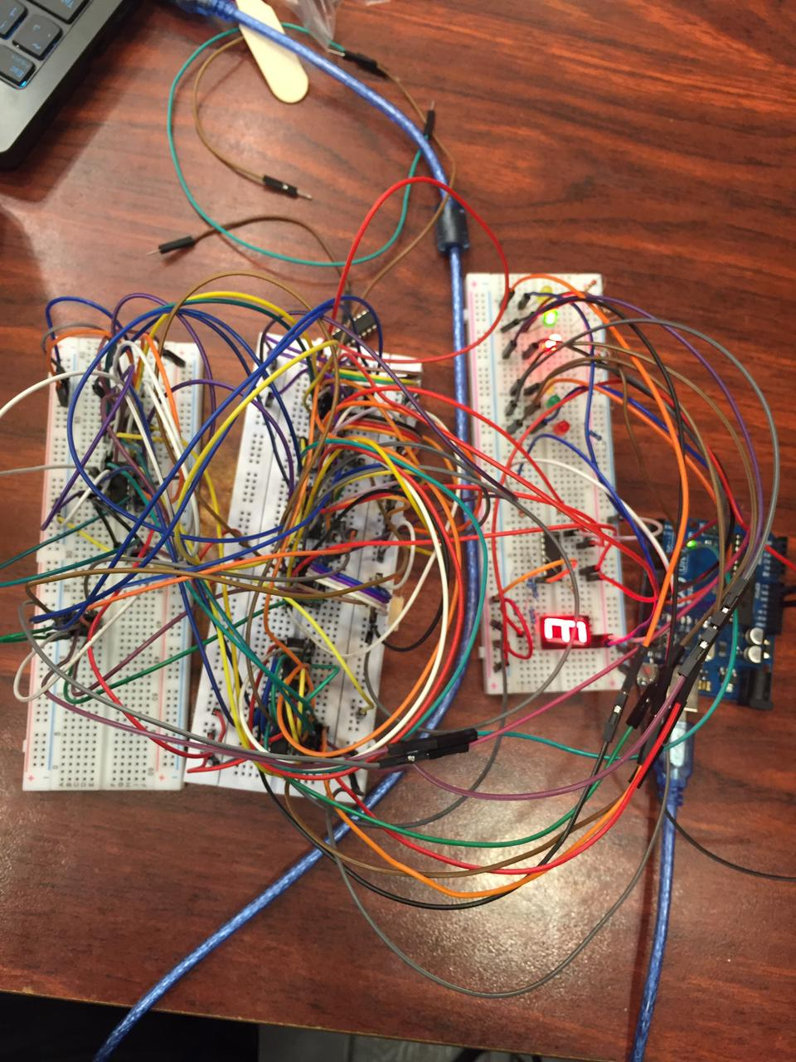

Slide 11
At A=3 and B = 2

Slide 12
Addition
Selectors are 0 & 0

Slide 13
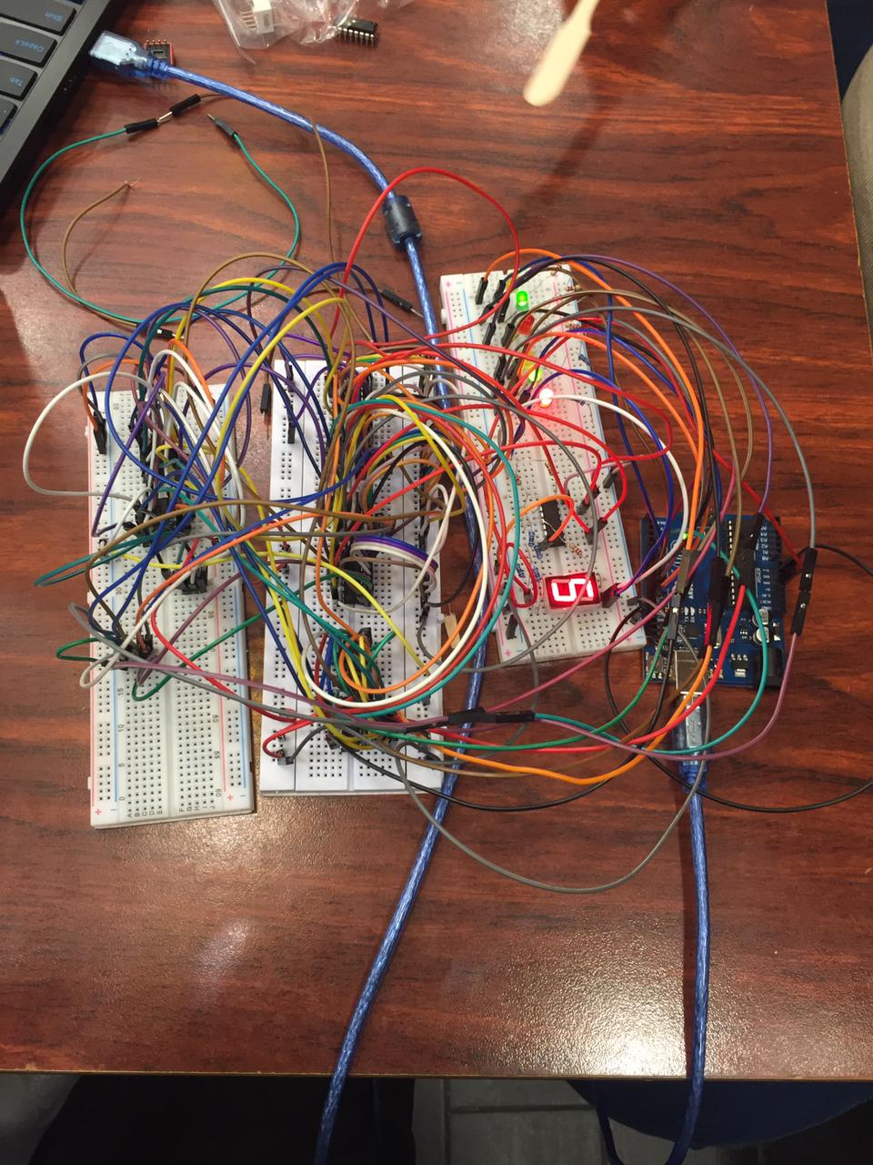

Slide 14
Subtraction
Selectors are 1 & 1

Slide 15
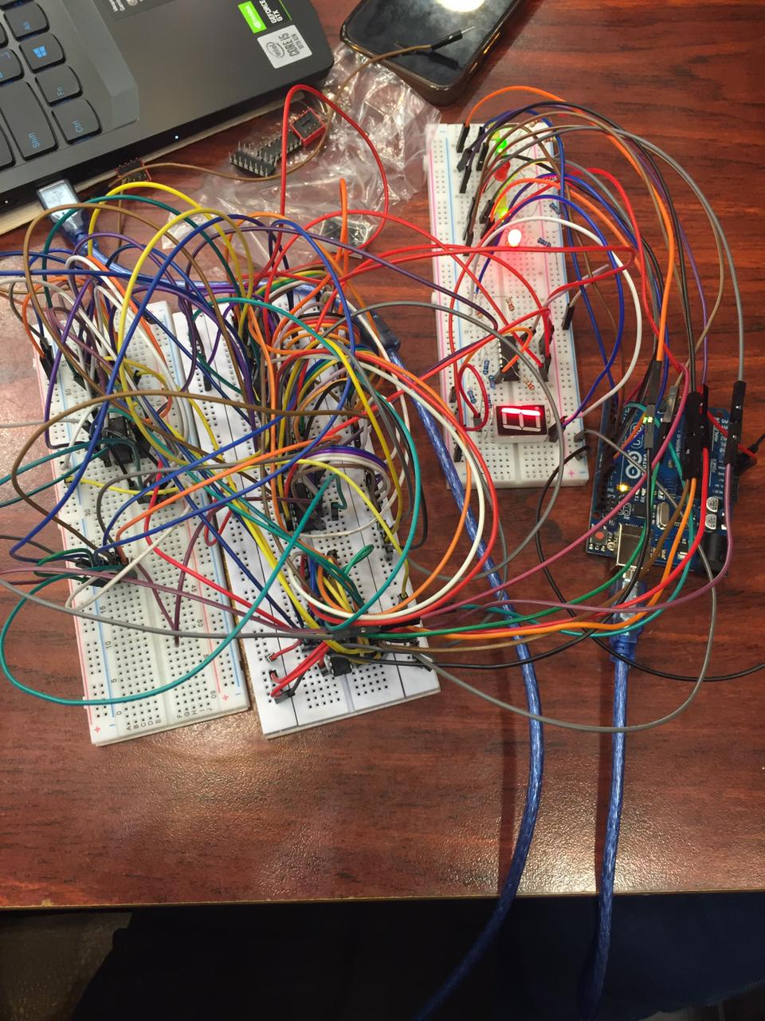

Slide 16
AND
Selectors are 0 & 1

Slide 17
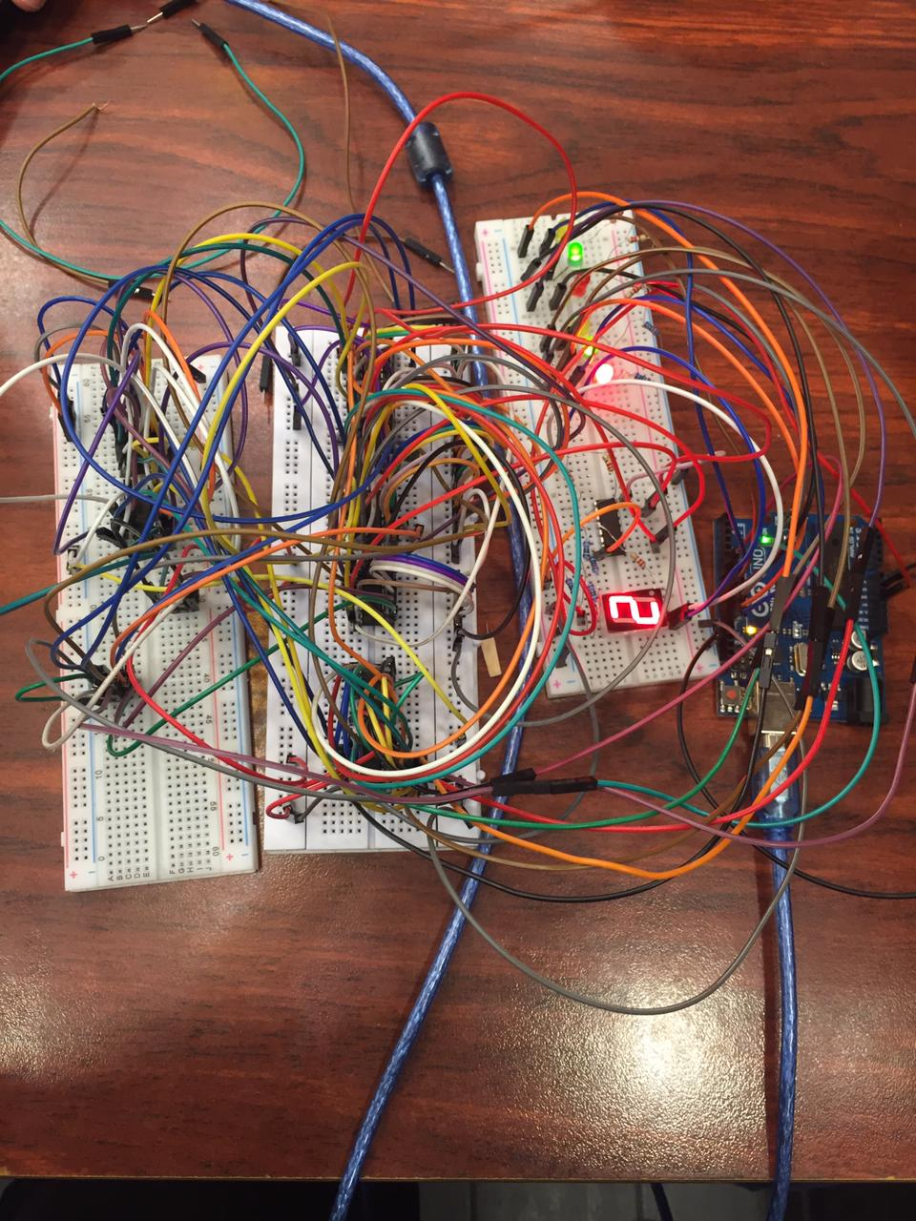

Slide 18
OR
Selectors are 1 & 0

Slide 19
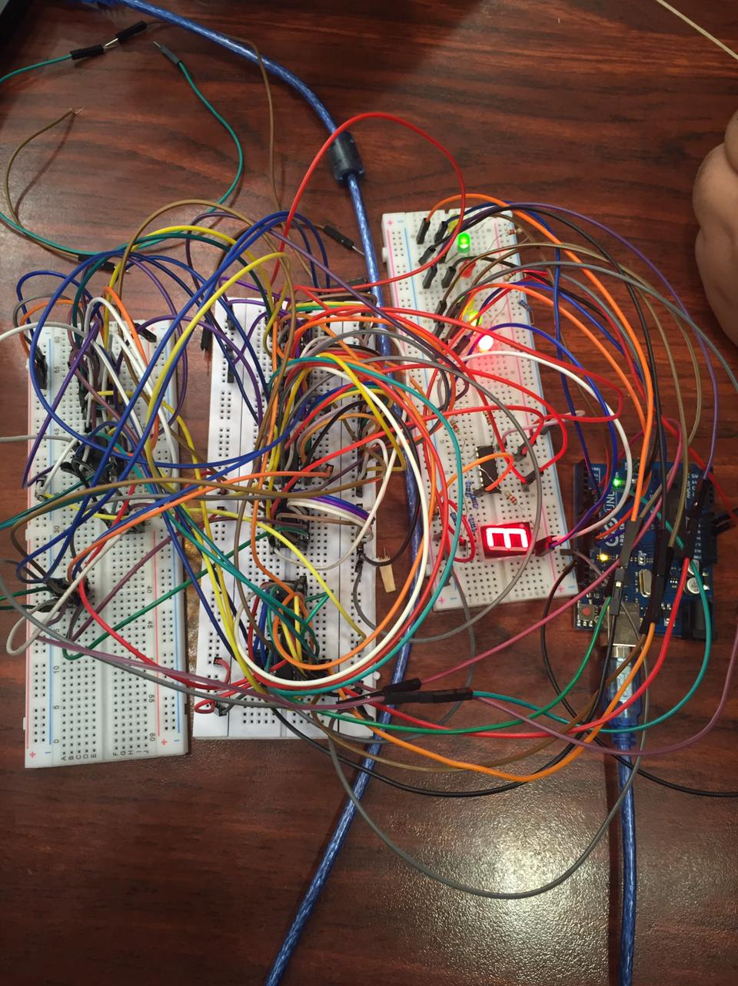

Slide 20

Thank You

