Slide 1
Traffic –Light Control system
PROJECT PRESENTATION

Slide 2
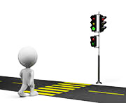
INTRODUCTION
The controller to be designed controls the traffic lights of a 2 lanes intersecting.
One permits cars to go from north to south
The other allows cars to move from east to west.
A pedestrian traffic light is installed beside each traffic light.

Slide 3
Objective
Our aim is to design an error free traffic control system that Safely, effectively directs traffic for streets intersection.
The concern is minimization of traffic congestion, better regulation of traffic and minimization of travel time.

Slide 4
Project Requirements
Use the following:
Timers: at least two timers to configure the span of the traffic lights.
GPIO: LEDs as outputs, and push buttons as input.
Interrupts: interrupts for the push buttons and timers

Slide 5
What are Embedded Systems?
Embedded Systems are computing systems with tightly coupled hardware and software integration, which are designed to perform a specific task.
Any device that includes a programmable computer but is not itself a general-purpose computer is an embedded system.
In simple terms, any device using a Microprocessor for control and automation is an Embedded System.

Slide 6
Why is traffic light an Embedded System?
Traffic Lights contain a controller.
The controller is appointed to control the changing of the lights accordingly.
It consists of small no. of integrated chips (IC’s) which are programmed to perform a specific task.
It also contains a timer which helps the controller to indicate to change the light after a specific time interval

Slide 7
Benefits
Advantages are reduction in vehicle operating cost
more efficient use of engines
Lower environmental pollution from vehicle emissions
Safe regulation of traffic in rush hour as well as in normal daily traffic.

Slide 8
Benefits
Reduce collisions, both vehicular and pedestrian.
Encourages travel within the speed limit to meet green lights.
Reduce unnecessary stopping and starting of traffic - this in turn reduces fuel consumption, air pollution, noise and vehicle wear and tear.
Reduce driver frustration and 'road rage'.

Slide 9





Software used
IAR Program
Hardware used
Tiva c
Jumpers
Resistors
Pushbutton switch
Breadboard
LEDs

Slide 10
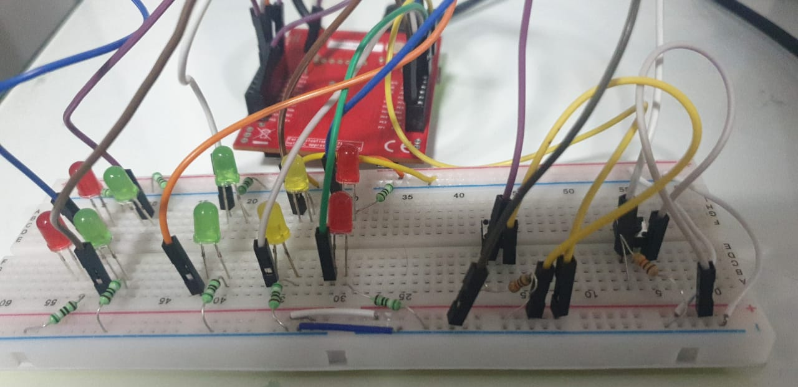
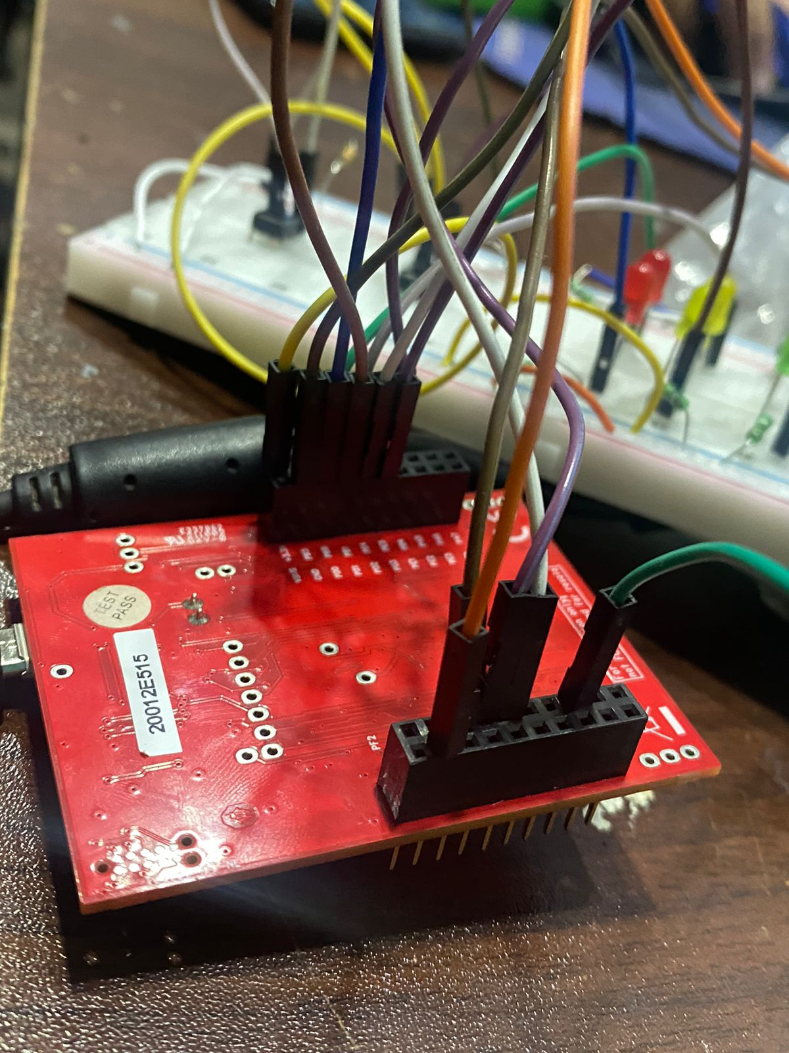
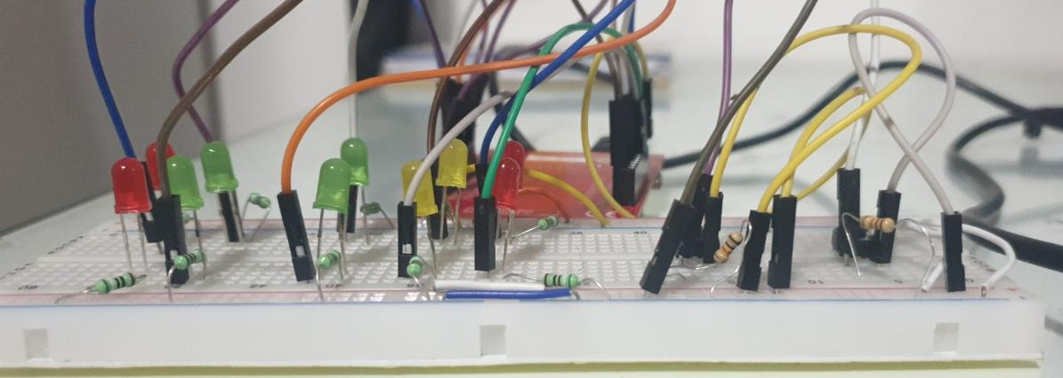
Circuit Design

Slide 11
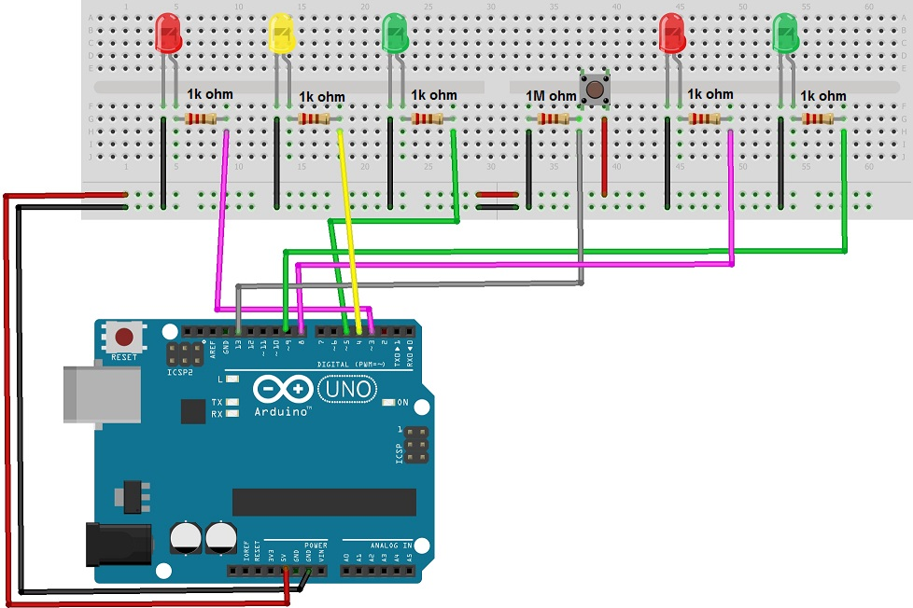
Circuit Schematic Design

Slide 12
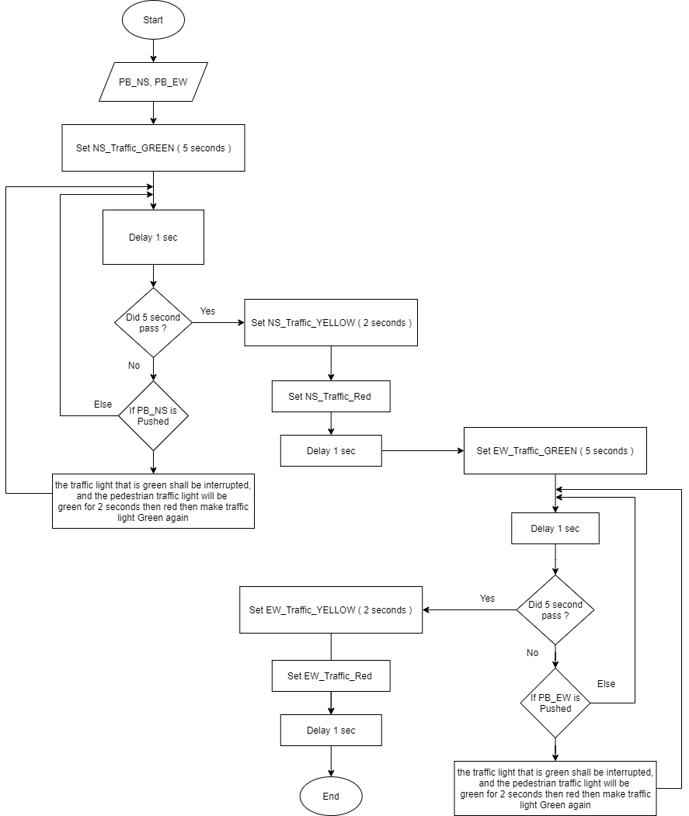
Flow Chart

Slide 13
How it works
The states depend upon the following push button and timer values :

Slide 14

How it works

Slide 15

How it works

Slide 16

How it works

