Slide 1
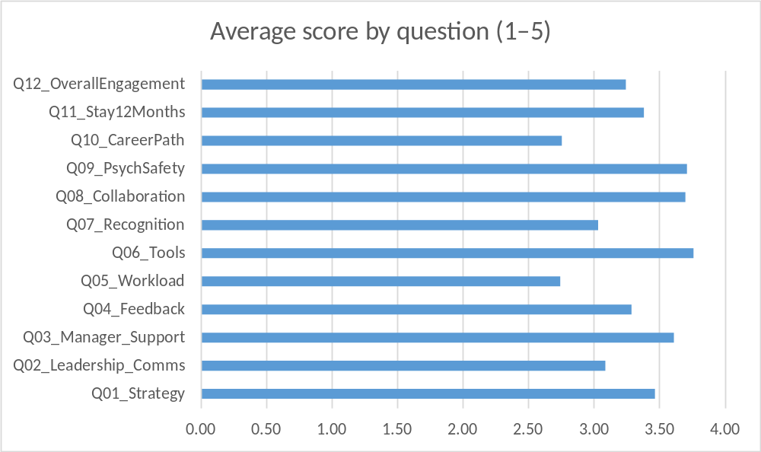
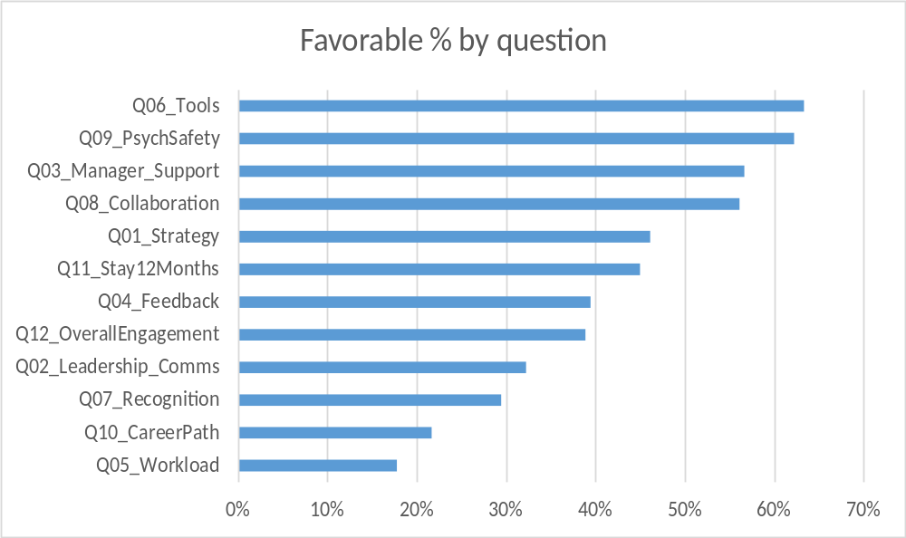
Employee Engagement Dashboard
Summary of results (n=180) • Nov 2025

