Slide 1
PWM Drawer
By: Mohamed Ahmed Mansour

Slide 2
intro:
• What is a PWM?
Pulse Width Modulation (PWM) is technique by which the width of a pulse is varied while keeping the frequency constant.
• Why PWM?
Most microcontrollers have a logic out of 0 or 1, which is translated to 0 or 5 volts. Instead of encoding the amplitude of a signal for communication, the pulse width is used for the transmission.

Slide 3
APPlications:-
• DC Motors
• Audio Devices
• Analog Waveforms
• Dimming LEDs
• Pumps
• Hydraulics
• And this project!

Slide 4
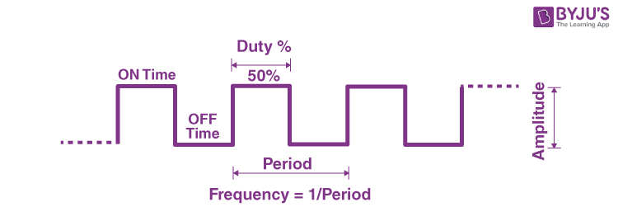
Fundamentals:
• PWM signal consists of
- Frequency
- Duty Cycle
• Frequency is represented as the number of cycles per one second
• Duty Cycle is represented as the ratio of high and low in a period.

Slide 5
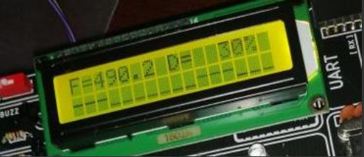
• The project aim is to mimic an Oscilloscope in an LCD. Visualizing how a duty cycle looks at a range of 10 on a 16x2 LCD. In this example, the duty cycle is 30% with the frequency of 490.2 Hz

Slide 6

Thank You!

