Slide 1
TECHNICAL OVERVIEW · PILOT READINESS
Wholesale Order
Parser
Human-controlled automation for Egyptian Arabic wholesale orders
Traceable by design · human authority by default
Notes:
[Sources]
- README.md — product positioning and human-review contract
[/Sources]

Slide 2
Automation finds the neighborhood; the operator owns the decision
On a 400-SKU catalog of close variants, an automatic top-1 pick is not safe enough. The value is a short, high-recall shortlist with explicit human authority.
48.4%
92.7%
100%
top-1 accuracy
on close variants
correct SKU appears
inside the shown top-5
approved lines require
a signed human decision
02
Notes:
[Sources]
- README.md — measured accuracy table
- app/database.py — approval provenance enforcement
[/Sources]

Slide 3
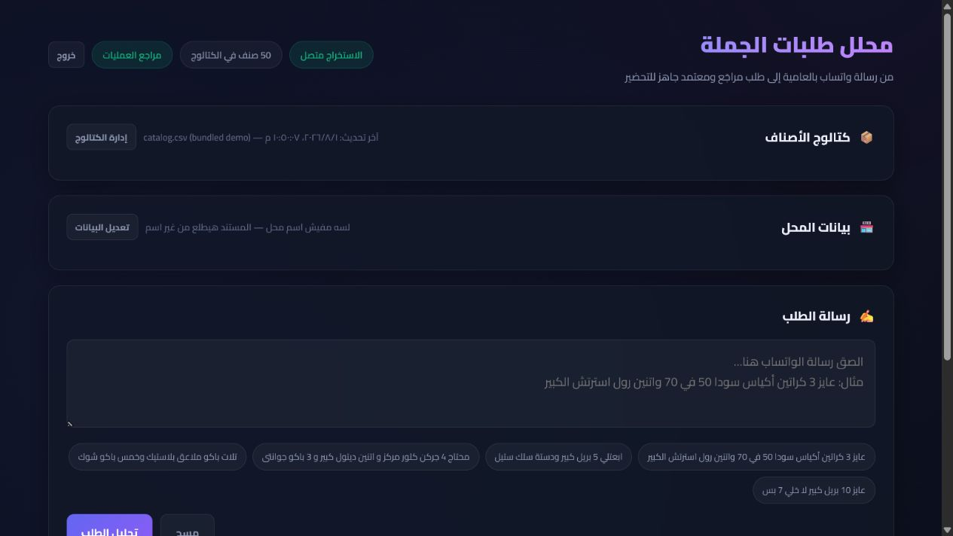
The operator starts with the order exactly as the customer sent it
EVIDENCE · ORDER INTAKE
Dialect, abbreviations, mixed units, and product nicknames stay visible. The model produces structure without hiding the original message.
Why it matters: every later decision remains traceable to customer language.
03
Notes:
[Sources]
- linkedin-shot-01-input.png
- app/templates/index.html — order intake UI
[/Sources]

Slide 4
Inference informs; humans authorize
01 · UNDERSTAND
02 · NARROW
03 · PROVE
Gemini extracts
product · quantity · unit
RapidFuzz returns
the top-5 candidates
Operator confirms, corrects,
or rejects every line
Bounded input, retries, explicit unresolved text
The shortlist is advisory; no SKU is auto-approved
One transaction freezes the audit trail and export snapshot
04
Notes:
[Sources]
- README.md — architecture and product flow
- app/extractor.py
- app/matcher.py
- app/database.py
[/Sources]

Slide 5
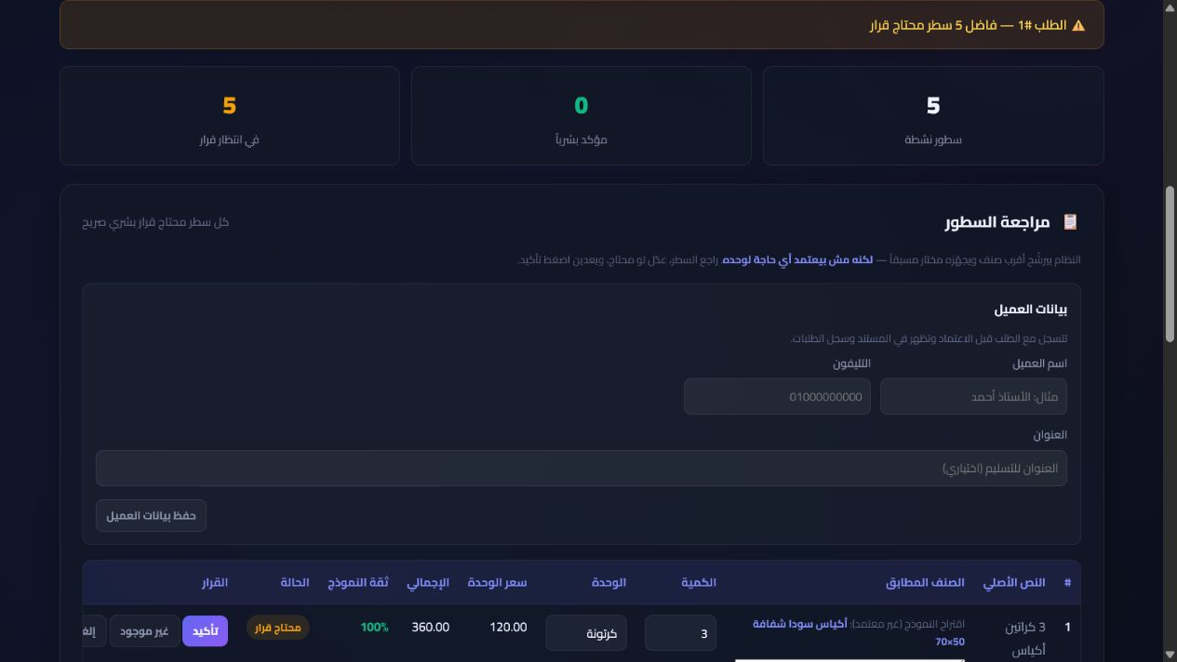
The shortlist accelerates review; it never replaces it
EVIDENCE · HUMAN REVIEW
Each line exposes the original text, proposed match, quantity, unit, price, confidence, and decision controls. Pending lines block approval.
Commercial authority stays with a signed-in operator, not a confidence score.
05
Notes:
[Sources]
- linkedin-shot-02-review.png
- app/database.py — line-decision and approval gates
[/Sources]

Slide 6
The current build clears every release gate
Measured locally on 4 Aug 2026 after the security hardening in this audit. The live Gemini test stays separate because it consumes quota.
329
0
0
offline tests passed
known dependency vulnerabilities
Ruff findings remaining
06
Notes:
[Sources]
- Local pytest run: 329 passed
- Local pip-audit: no known vulnerabilities
- Local Ruff run: all checks passed
[/Sources]

Slide 7
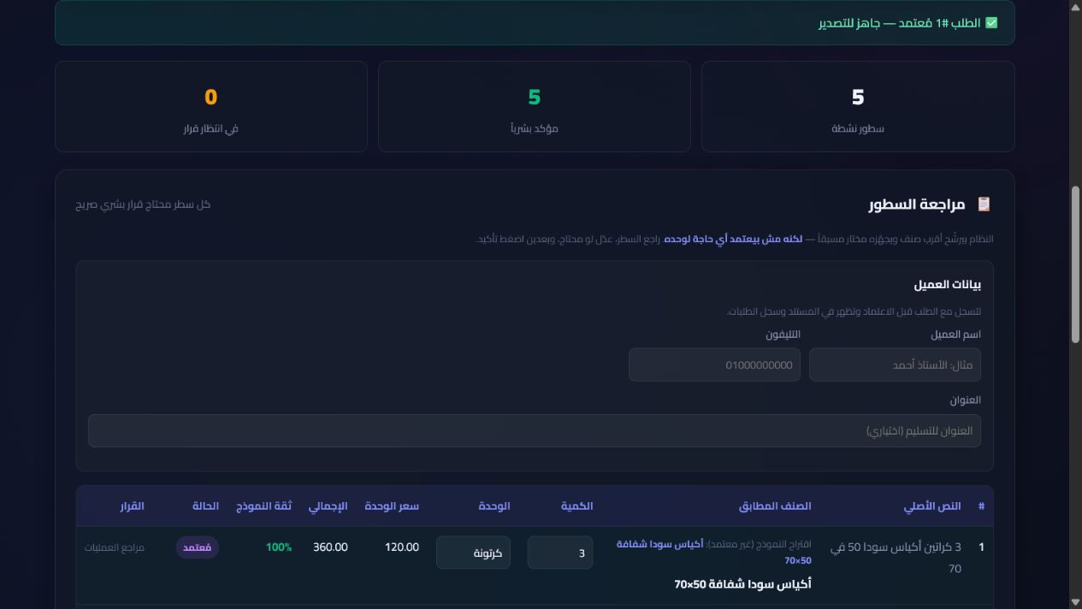
Approval freezes a warehouse-ready, attributable record
EVIDENCE · APPROVED STATE
Approval, audit event, financials, and the immutable line snapshot commit together. Later catalog changes cannot rewrite history.
Exports re-check provenance and record their own audit event before bytes leave the system.
07
Notes:
[Sources]
- linkedin-shot-03-approved.png
- app/database.py — immutable approved snapshot
- app/main.py — POST-only audited exports
[/Sources]

Slide 8
Security is enforced in the request path
The design closes the most likely failure modes for a single-tenant pilot while naming what remains out of scope.
CONTROL | ENFORCEMENT | RISK CLOSED | EVIDENCE
Authentication | Signed session on every data route | Anonymous access | Route-table tests
Human authority | Session identity + action id + decision | Forged reviewer | Transactional audit
Browser boundary | CSRF + CSP + anti-framing + no-store | Cross-site writes / UI embedding | Security tests
Output safety | HTML escaping + CSV formula neutralisation | Stored XSS / spreadsheet injection | Regression tests
Export integrity | POST + provenance re-check + frozen snapshot | State-changing GET / catalog drift | Export audit hash
Supply chain | Ruff · pip-audit · CodeQL · Dependabot | Known vulnerable dependencies | GitHub gates
08
Notes:
[Sources]
- SECURITY.md
- app/security.py
- app/main.py
- .github/workflows/ci.yml
- .github/workflows/codeql.yml
[/Sources]

Slide 9
RECOMMENDATION
Pilot-ready —
with explicit boundaries
01 Set production secrets + HTTPS-only cookies
02 Mount persistent storage for SQLite
03 Keep one merchant per deployment
04 Choose repository visibility and license before public release
Notes:
[Sources]
- DEPLOY.md — production checklist
- SECURITY.md — known limitations and publication rules
[/Sources]

