Slide 1
Training Spiking Neural Networks to play Atari Games
Notes:
Hello This Mohamed and This is my screencast that covers my third year project about Training Spiking Neural Networks to play Atari Games . This project was supervised by professor steve furber

Slide 2
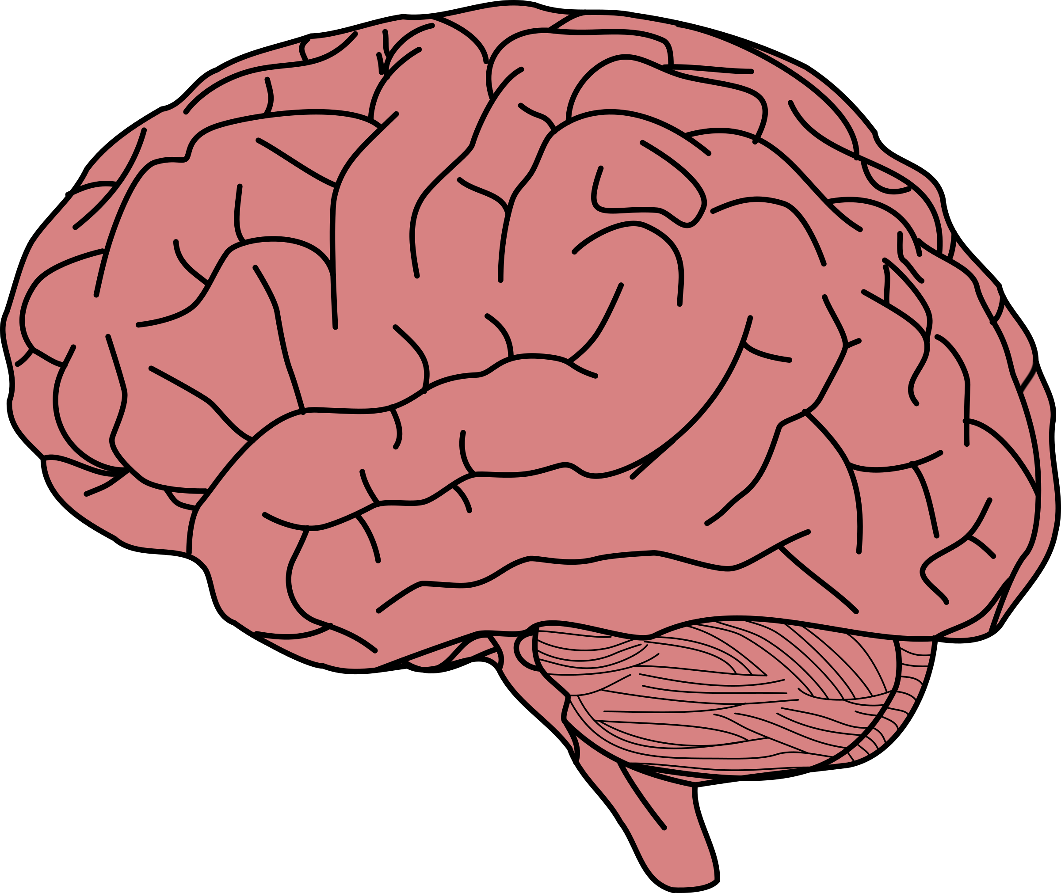
Better-Learning
Power-Efficiency
Online-Learning
Unsupervised
10 – 20 Watts of power
Robustness
Humans can afford to lose 10% of their brain
One-shot learning
Notes:
To answer the questions researchers try to make a model that simulates the human brain more closely , why the brain

Slide 3
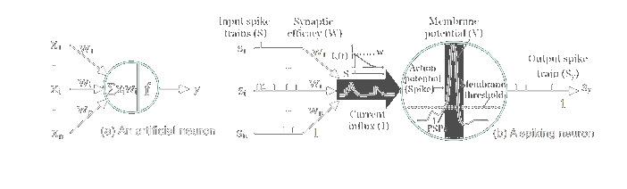
Spiking Neural Networks
Leaky-Integrate and Fire Neurons
Notes:
Take in spikes produce spikes

Slide 4
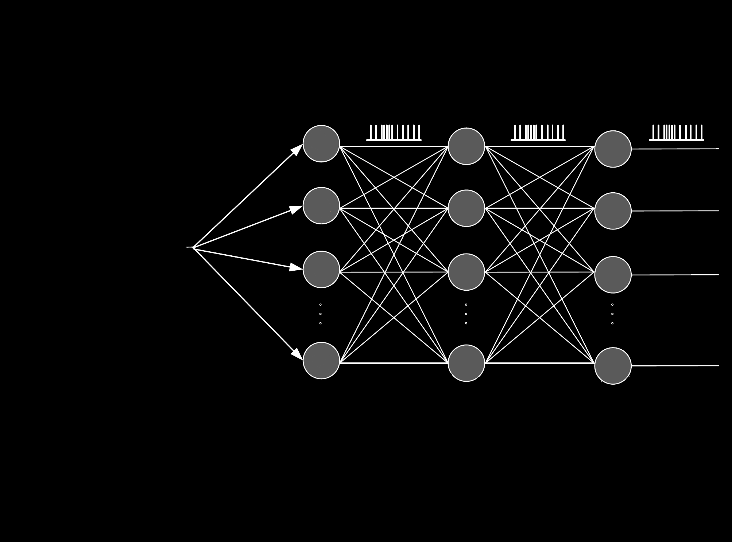
Spiking Neural Networks
Sparsification Over Time
Fewer memory lookups
Cheaper computation
Notes:
Problems in training , encoding decoding

Slide 5
Experiments
Using Spike-Timing-Dependent-Plasticity (STDP)
STDP + Lateral inhibition
Dopamine-Modulated-STDP (MSTDP)
CNN
Deep-Spiking-Q-Learning
Deep-Spiking-Q-Learning Trained with backprop

Slide 6
Experiments
Using Spike-Timing-Dependent-Plasticity (STDP)
STDP + Lateral inhibition
Dopamine-Modulated-STDP (MSTDP)
CNN
Deep-Spiking-Q-Learning
Deep-Spiking-Q-Learning Trained with backprop

Slide 7
Experiments
Using Spike-Timing-Dependent-Plasticity (STDP)
STDP + Lateral inhibition
Dopamine-Modulated-STDP (MSTDP)
CNN
Deep-Spiking-Q-Learning
Deep-Spiking-Q-Learning Trained with backprop

Slide 8
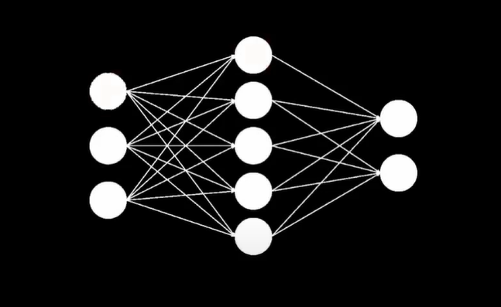
Setup 1 (STDP)

Slide 9
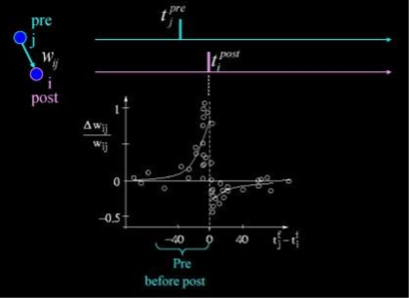
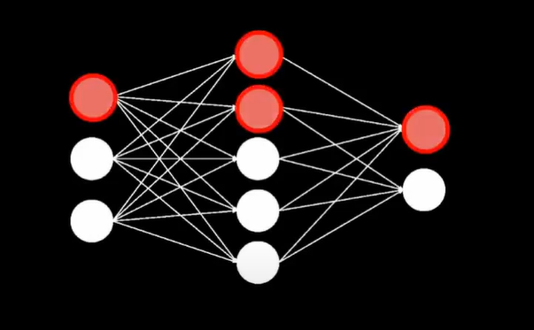
Setup 1 (STDP)

Slide 10
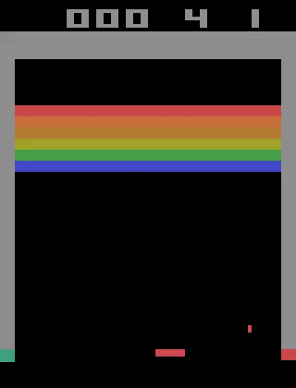
Setup 1 (Credit Assignment Problem)

Slide 11
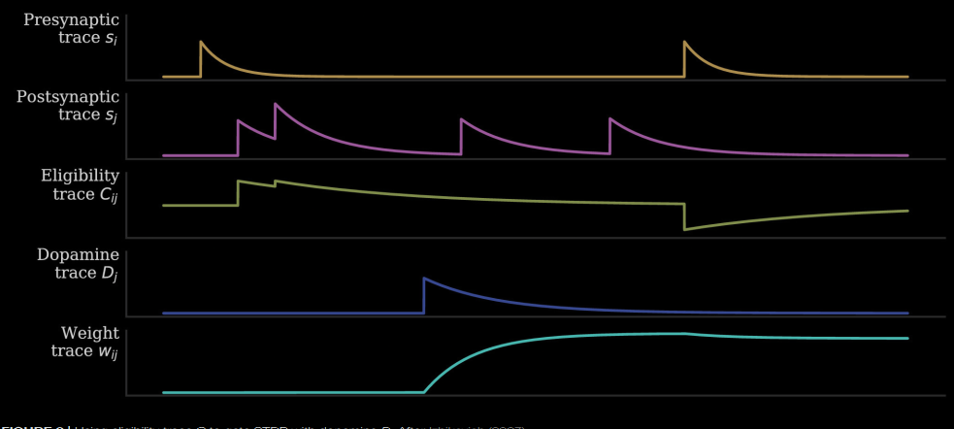
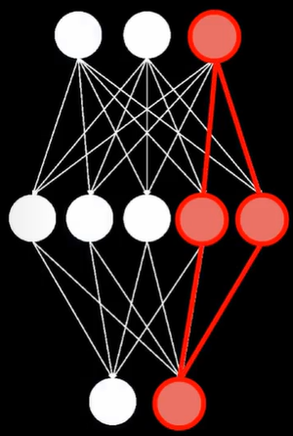
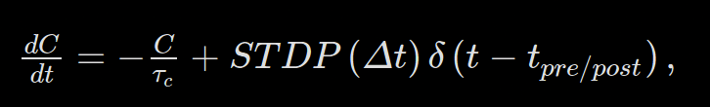
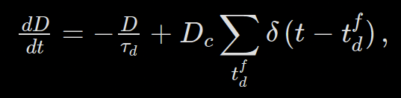
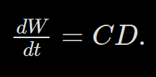
Setup 1 (MSTDP)

Slide 12
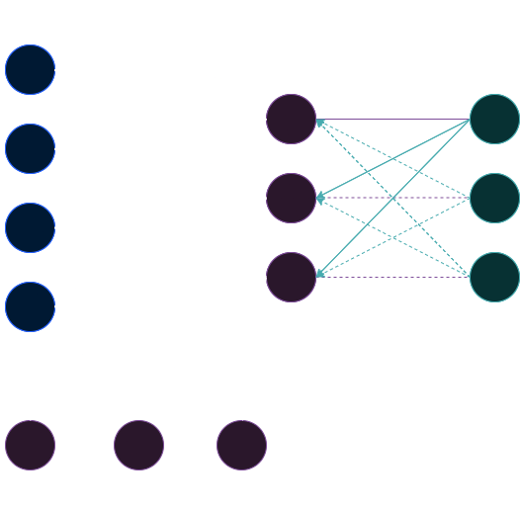
Network

Slide 13

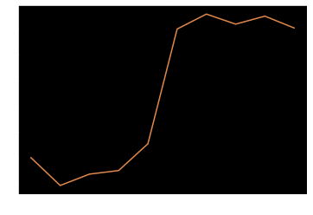
Results

Slide 14
Critique
Better Feature Extraction using a CNN
Catastrophic Forgetting
Better Dopaminergic Spiking Conditions

Slide 15

Setup 2 (Q-learning)
The Q value of the action given its state
Exploration Stage
Experience Replay
Bellman’s equation

Slide 16
Setup 2 (Backpropagation on SNN)
Membrane Threshold set to Infinite
Membrane voltages are differentiable can perform SGD and use surrogate gradients in order to optimize

Slide 17
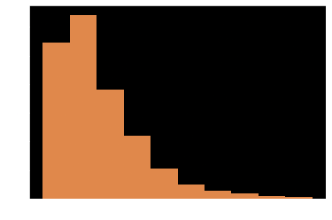
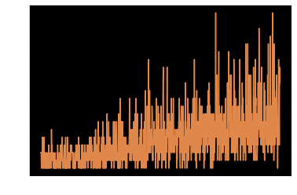
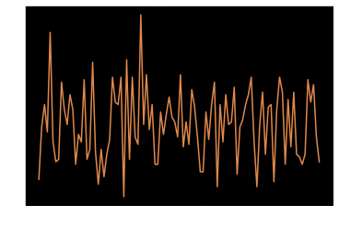
Deep-Spiking-Q-Learning Results
More inefficient than MSTDP needing more frames to achieve similar results
Best performance overall

Slide 18
Critique
Fluctuates too much because of the moving target problem
Poor Feature Extraction
Poor reward function

Slide 19
Conclusion
Jumpstart to future idea
Work on dimensionality reduction or encoding data in a more biological way.

