Slide 1
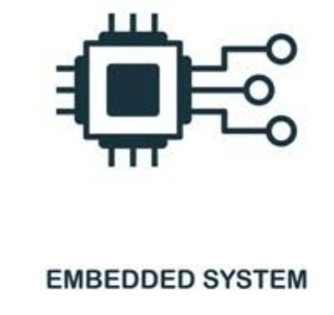




Embedded system Course
By
Microsoft Students Partner | MSP

Slide 2
Operators
By:
SE/Mohamed Abdelwahed
Eng/Hala Farag Nady

Slide 3
Main points:
Arithmetic Operators
Relational Operators.
Logical Operators.
Bitwise Operators.
Size of .
Comma.

Slide 4
1) Arithmetic Operators
Addition (+).
Subtraction(-).
Multiplication(*).
Division(/).
Modulus(%).
increment , decrement(++,--). Sooooo emportant x++ → Post Increment (Do any operation then increment). ++x → Pre Increment (Increment first then do any operation). ex:- int x = 10, y = 20; z = x+++y; → z = 30 note:- x++ → so its faster than (x=x+1)

Slide 5
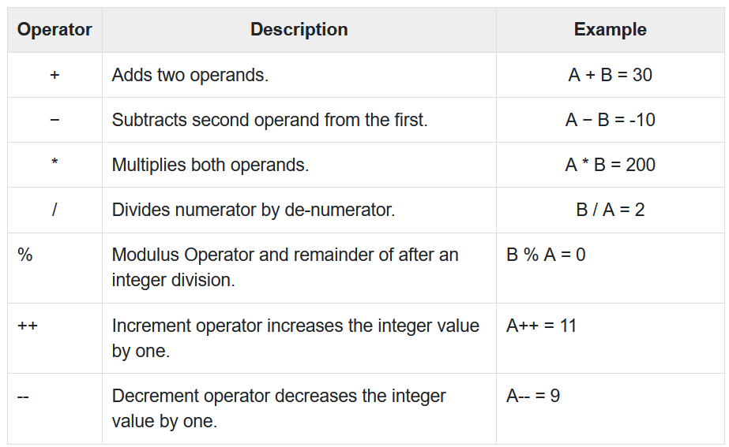
The following table shows all the arithmetic operators supported by the C language. Assume variable A holds 10 and variable B holds 20

Slide 6
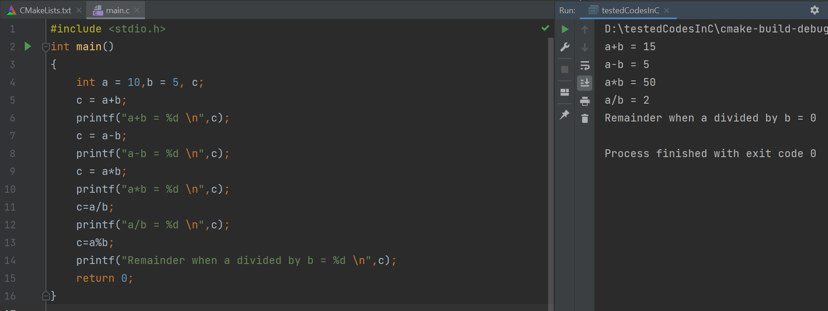

Slide 7
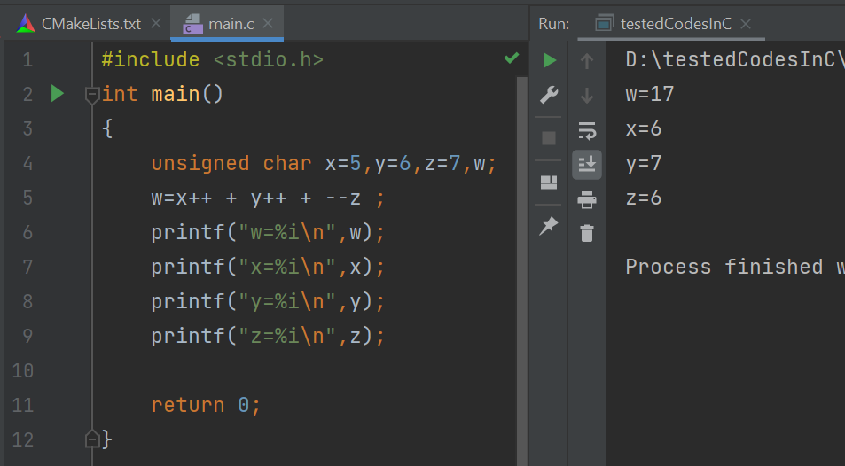
Explain the output !

Slide 8
2) Relational Operators.
(increment) ++
(decrement) --
(less than) <
(greater than) >
(greater than or equal) >=
(less than or equal) <=
result True or False

Slide 9
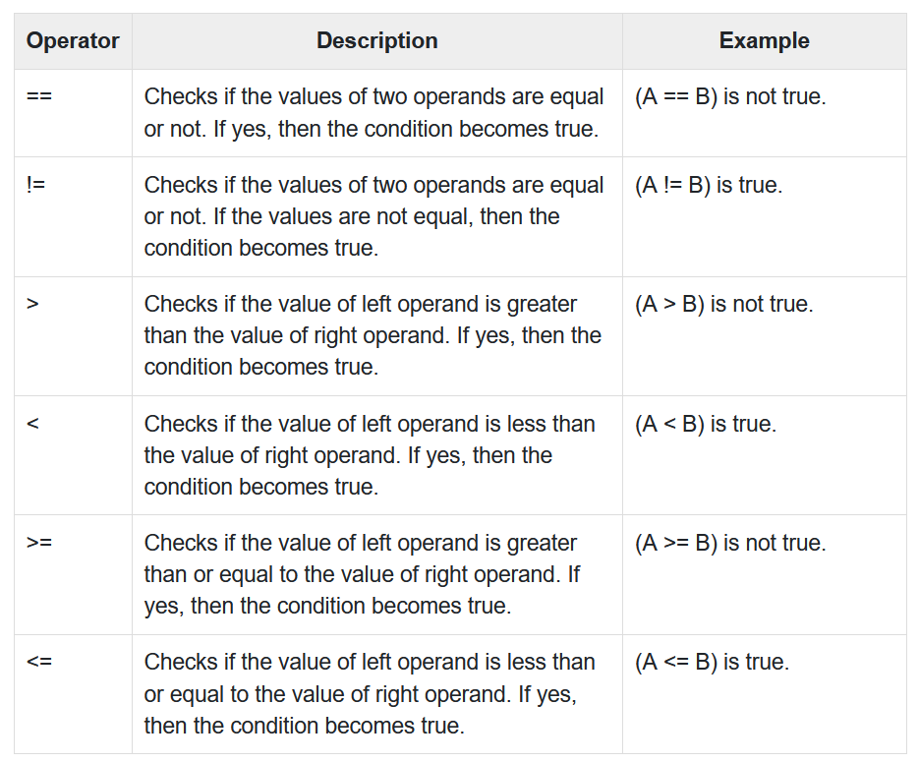
The following table shows all the arithmetic operators supported by the C language. Assume variable A holds 10 and variable B holds 20

Slide 10
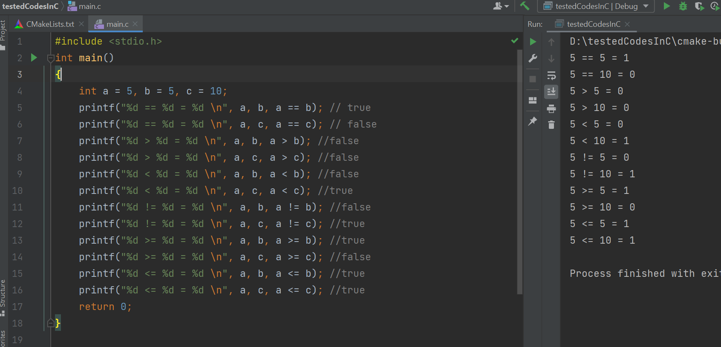
Revision Your Understanding :

Slide 11
3) Logical Operators
1) Logic OR (||). 2) Logic NOT (!). 3)Logic AND (&&).
Ex:- int x=2,y=3,z;
z=x||y;
Printf(“%d/n”,z);
z=x&&y;
Printf(“%d/n”,z);
z=x!y;
Printf(“%d/n”,z);
*** True → any value other than zero. *** False → always = 0. “Instead of 1 and 0 will be true and false (logic)”.

Slide 12
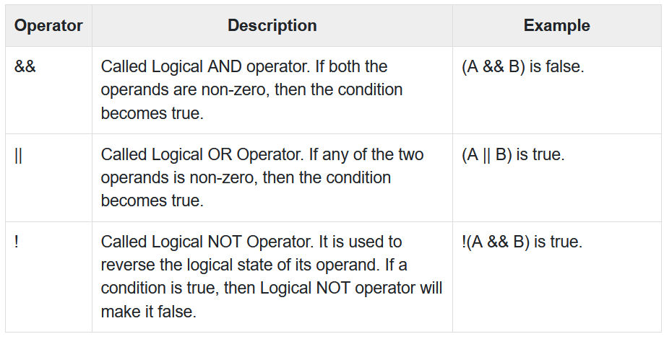
Following table shows all the logical operators supported by C language. Assume variable A holds 1 and variable B

Slide 13
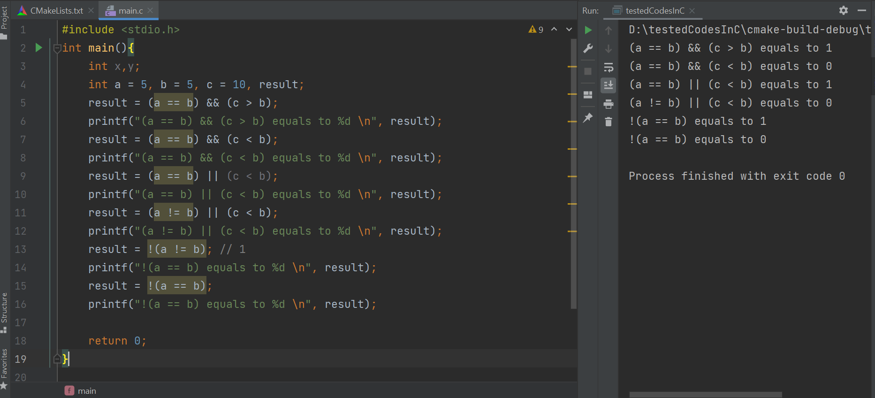

Slide 14
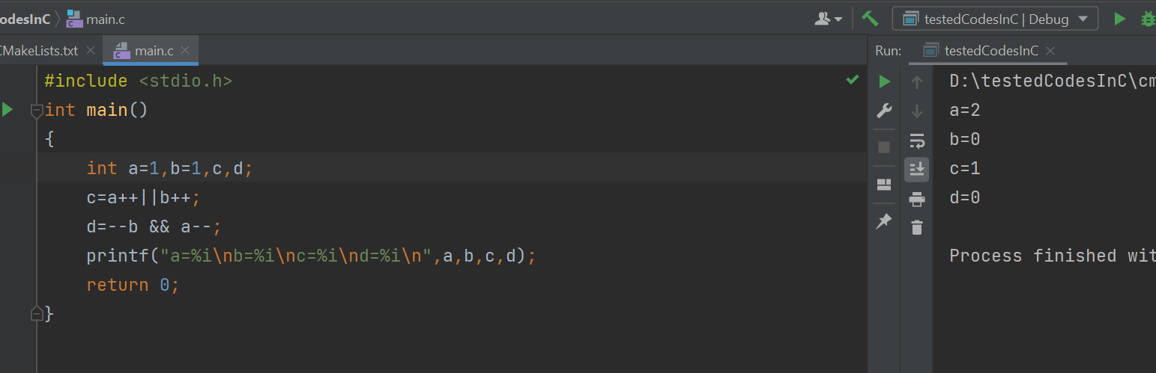
Explain the output !

Slide 15
4) Bitwise Operators.
Dealing with Binary
1)AND(&). Ex: int x=2,y=3,z;
z=x&y; 2)OR(|). Printf(“%d/n”,z);
3)XOR(^). z= x|y; 4)Not(!). Printf(“%d/n”,z); 5)Shift Right ( >> ) . z=x^y; 6)Shift Left ( << ) . Printf(“%d/n,z); 7)Logic complement (~).

Slide 16
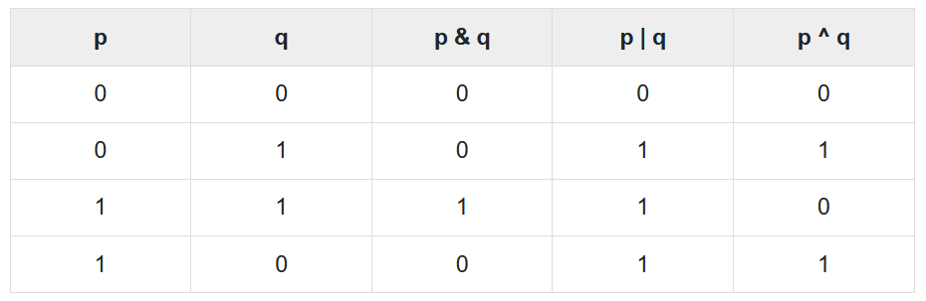
Bitwise operator works on bits and perform bit-by-bit operation. The truth tables for &, |, and ^ is as follows −

Slide 17
Assume A = 60 and B = 13 in binary format, they will be as follows −
A = 0011 1100
B = 0000 1101
-------------------------
A&B = 0000 1100
A|B = 0011 1101
A^B = 0011 0001
~A = 1100 0011

Slide 18
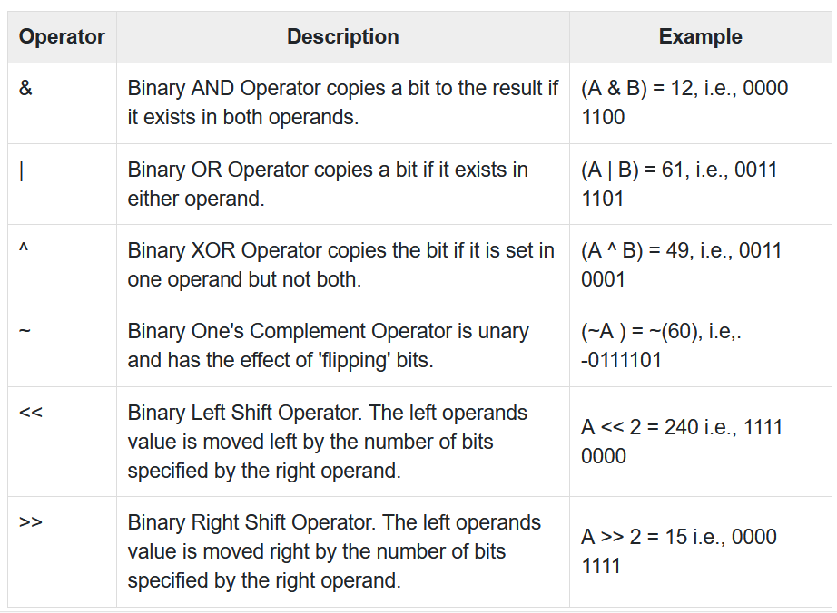
The following table lists the bitwise operators supported by C. Assume variable 'A' holds 60 and variable 'B' holds 13

Slide 19
Appliction Of Bitwise:-
1-set bit. [ x=x|(1<<n) ] هنقلب قيمة البت من 0الى1
2-clear bit. . [ x=x&(~(1<<n) ) ] هنقلب قيمة البت من 1الى 0
3-toggle bit. . [)x^(1<<n)(] بتغير الحالة الى هى فيها من0الى1 اوالعكس
4-read bit. . [x=)x&(1<<n)(>>n] البت رقم كذا إقرأ
5-rotate left. . [ x=(x>>n)|(x<<n-عددهم) ] بص على عددالبت كذا من اليمين وحطهم زي ماهم ف الشمال
6-rotate right. . [ x=(x<<n)|(1>> n-عددهم)] بص على عددالبت كذا من الشمال وحطهم زي ماهم ف اليمين

Slide 20
ex: unsigned char x; x=128;
x=(x<<3)|(x>>5);
Printf(“%d / n” , x);
X|=x(1<<7);
Printf(“%d/n ”, x);
Printf(“%I/n” ,sizeof (x));

Slide 21
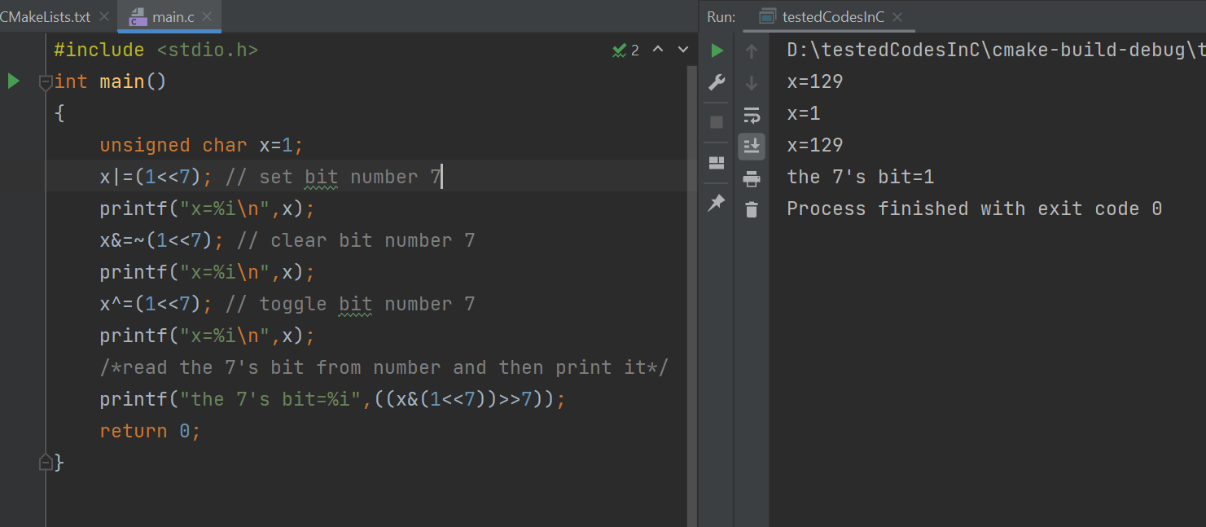

Slide 22
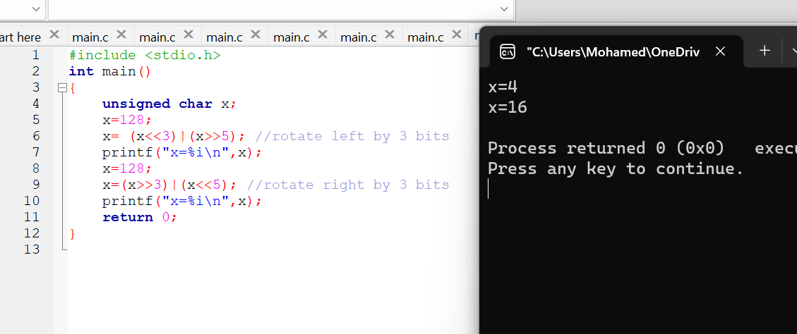

Slide 23
5)Size of :-بنعرف بيه حجم اي variable
float x;
printf("%d\n",sizeof(x));
printf("%d\n",sizeof(x++));

Slide 24
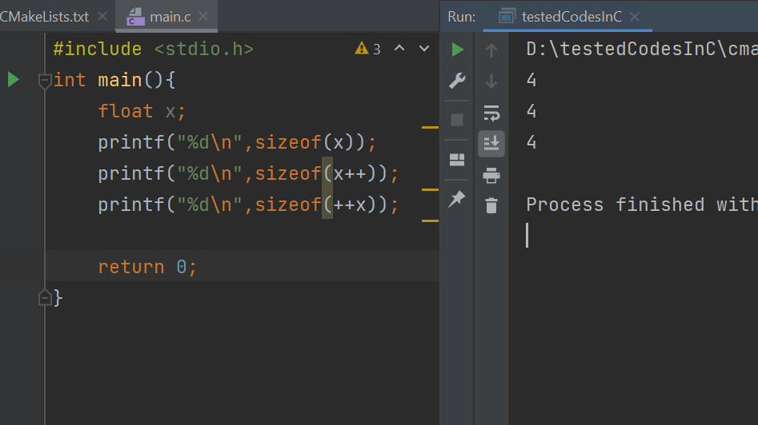

Slide 25
6)comma operator:- used as a separator.
float x , y , z ;

Slide 26
Notes:-
X+=2 x=x+2
X*=5 x=x*5
Special case :-
Shift right signed(-)
هنضيف وحااايد مش اصفااار
https://www.tutorialspoint.com/cprogramming/c_operators.htm#

Slide 27
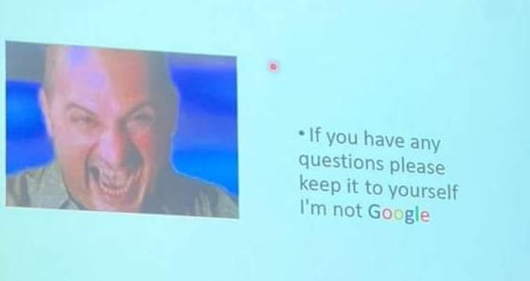

Slide 28

Contacts: https://www.linkedin.com/in/mohamed-abdelwahed-2ba176219/
Thanks

