Slide 1

RoverBot
2023 - 2024
Prepared by
Mohamed Adam Jemal

Slide 2
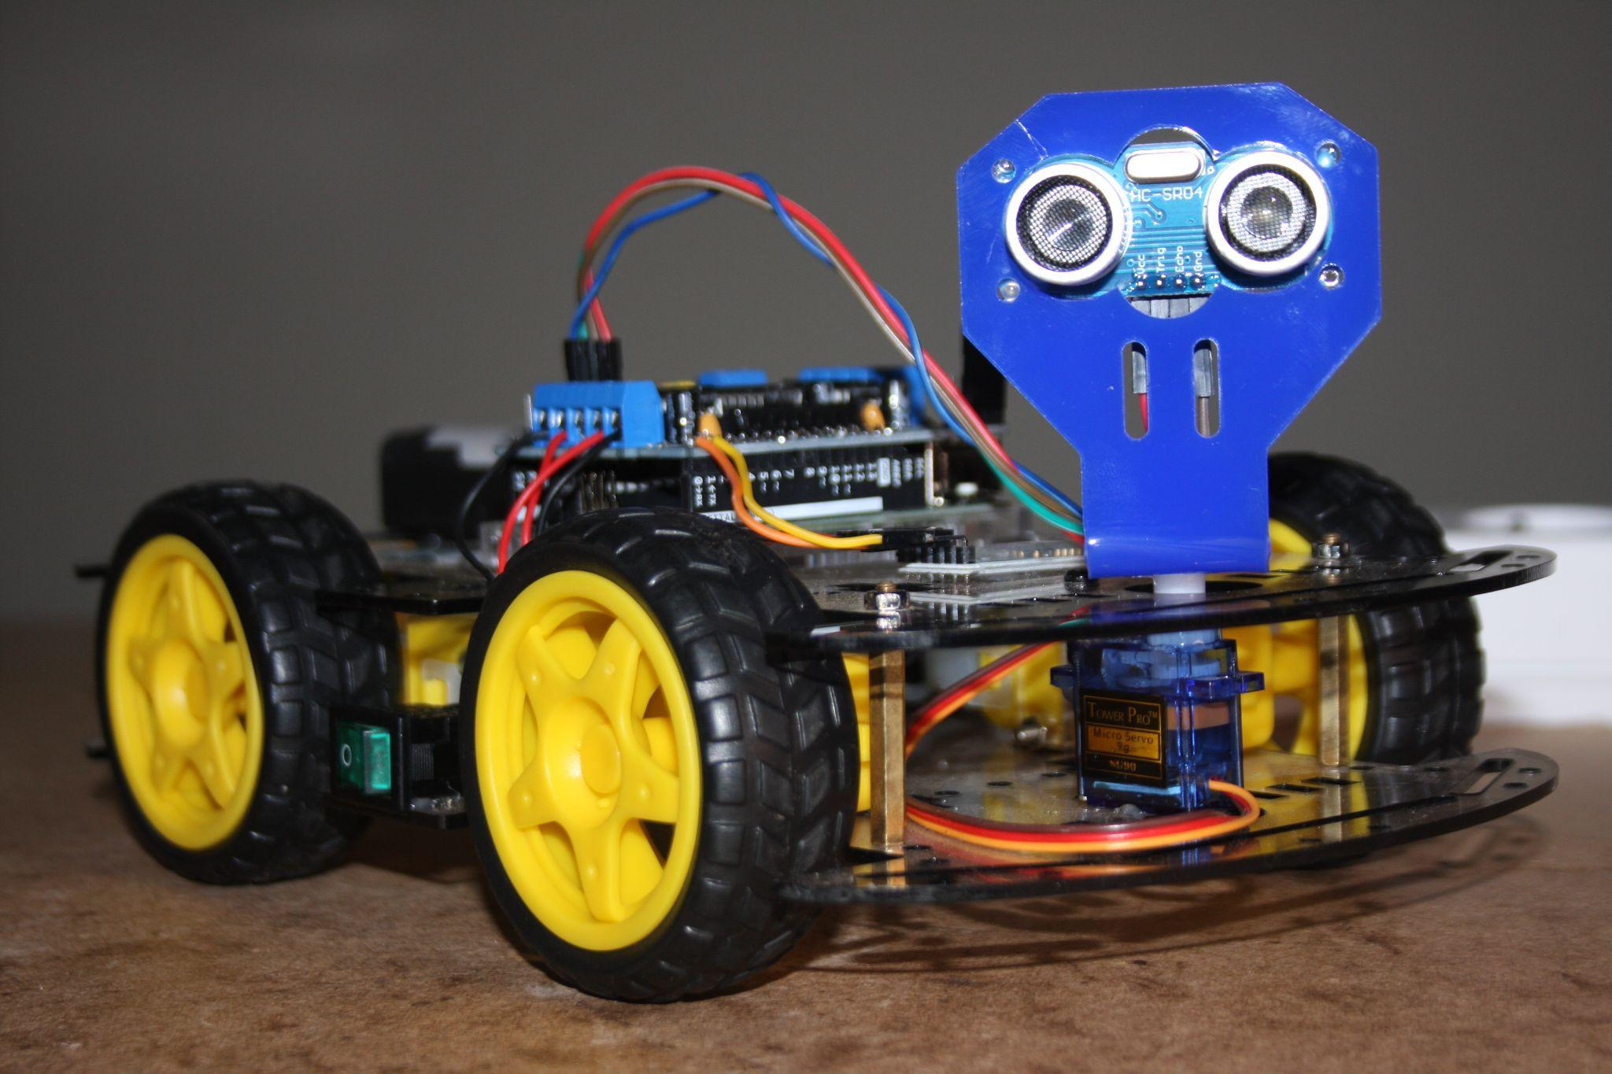
INTRODUCTION
WELCOME TO “RoverBot” PRESENTATION
PLAN
I. HARDWARE
1. PIECES USED
2. TOOLS USED
3. HARDWARE ASSEMBLY PROCESS
4. FINAL APPEARANCE
II. SOFTWARE
III. ACQUIRED SKILLS
1. HARD SKILLS
2. SOFT SKILLS
IV. PRESENTATION VIDEO OF “RoverBot”
V. ACKNOWLEDGEMENT

Slide 3
HARDWARE

Slide 4
HARDWARE
Pieces used
Piece(s) | Datasheets Links
Arduino Uno Rev3 | Arduino Uno Rev3
L293D motor driver shield | L293D Based Arduino Motor Shield
Robot Car Kit 4WD | Robot Car Kit 4WD | Joy-IT
4X gear motors and 4 Wheels | Gear Motor
Servo Motor (Tower Pro SG90) | SG90 Servo Datasheet pdf - Micro Servo. Equivalent, Catalog

Slide 5
HARDWARE
Bluetooth Module (HM-10 BLE 4.0) | HM-10 BLE 4.0 Bluetooth Module
Ultrasonic sensor (HC-SR04) | Ultrasonic Ranging Module HC - SR04
2X 18650 Battery (3200mAh) with holder | Panasonic NCR18650BD 3200mAh 3C Battery
ON/OFF Switch | ON-OFF switch black 16A-250V TES-13 ADAJUSA
Jumper wires | PRODUCT DATASHEET

Slide 6
HARDWARE
Tools used
Tools | Links
Multimeter | Multimeter - Wikipedia
Soldering Iron | Soldering iron - Wikipedia
Glue Gun | Hot-melt adhesive - Wikipedia
Nut and bolts | Nut (hardware) - Wikipedia Bolt (fastener) - Wikipedia
Screwdriver | Screwdriver - Wikipedia
Pliers | Pliers - Wikipedia
Adhesive tape | Adhesive tape - Wikipedia

Slide 7
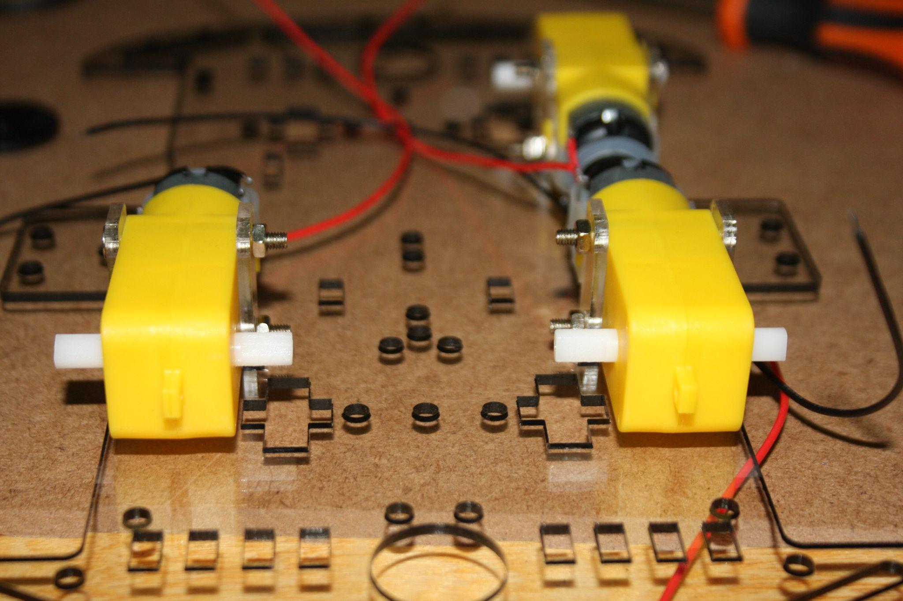
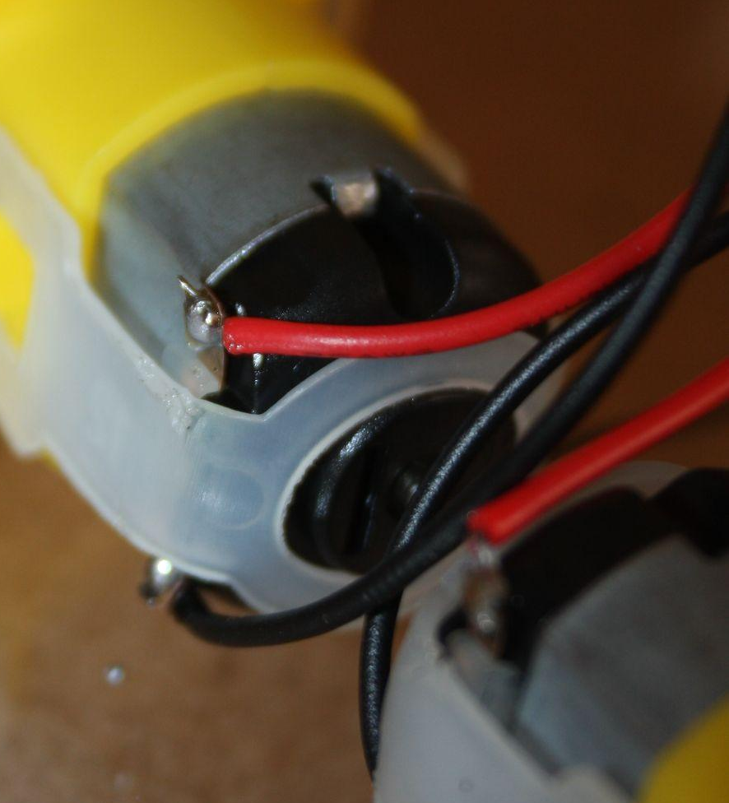
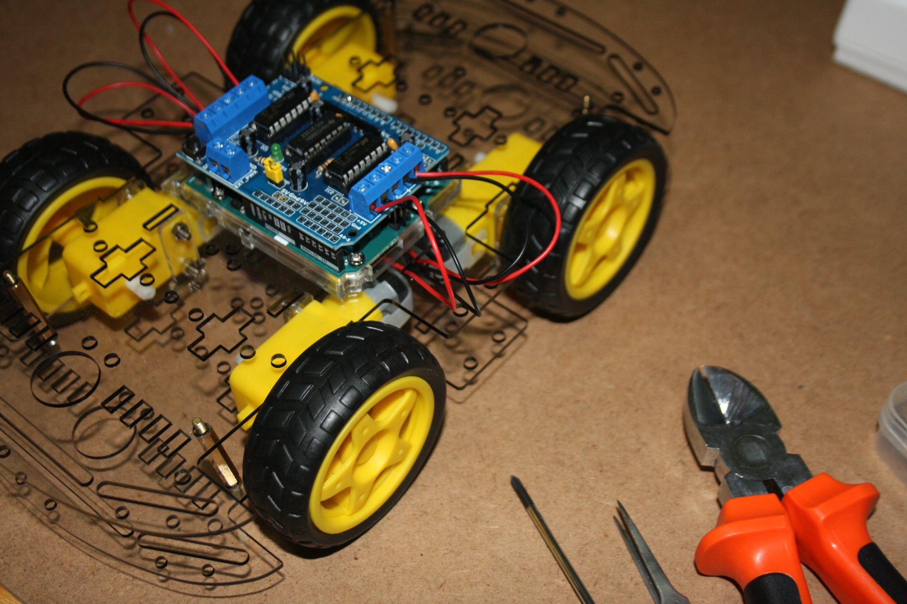
HARDWARE
Hardware Assembly Process
Mounting of the motors on the chassis
Soldering the wires to the motors
Mounting of the Arduino Uno board (with L293D motor driver shield) on the chassis

Slide 8
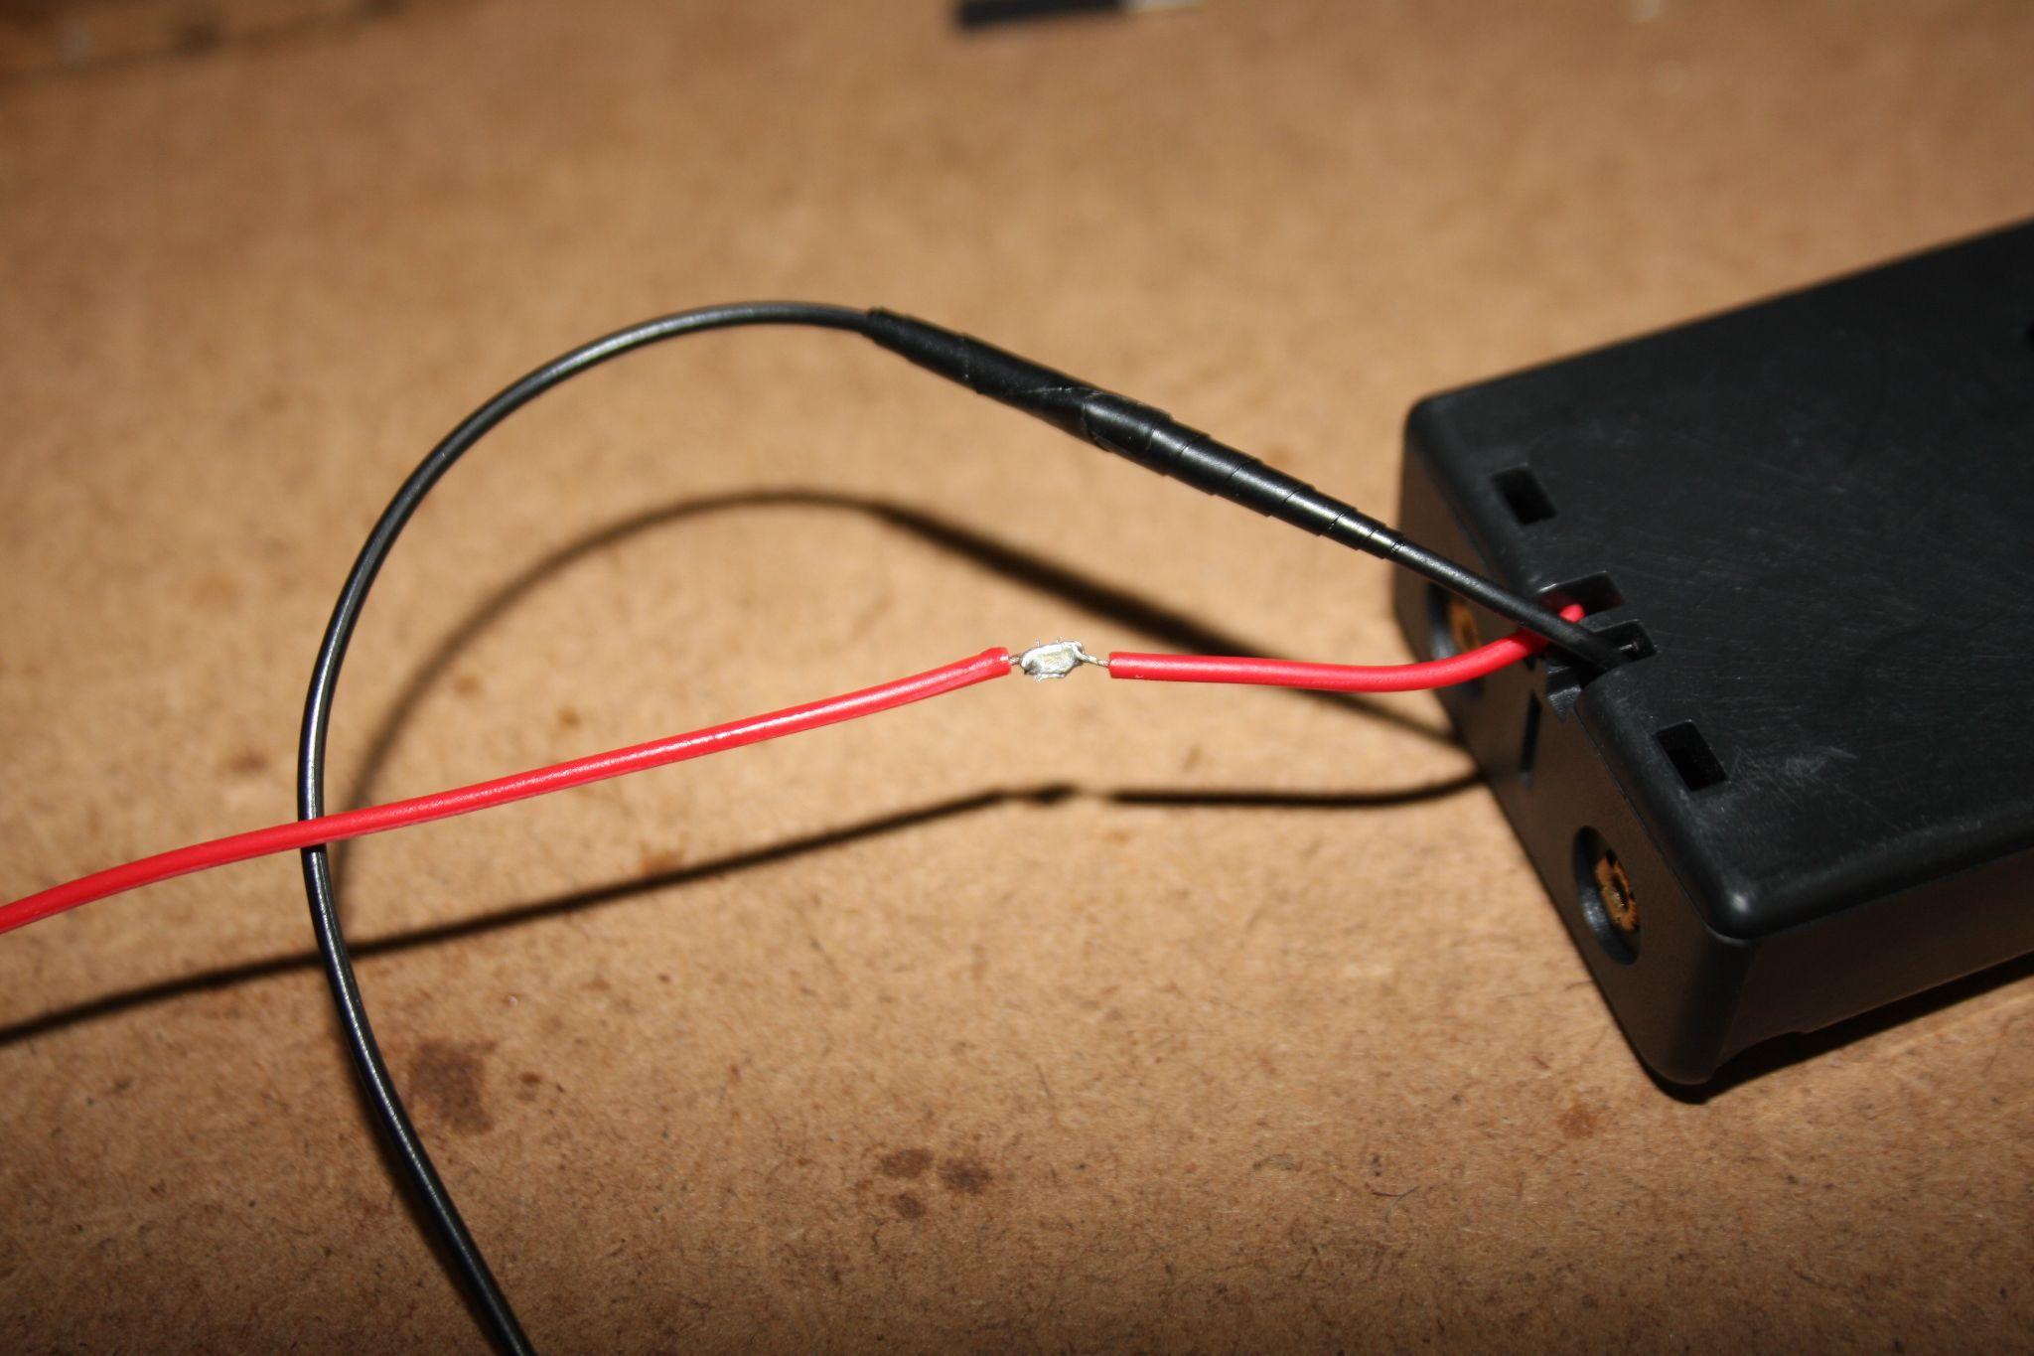
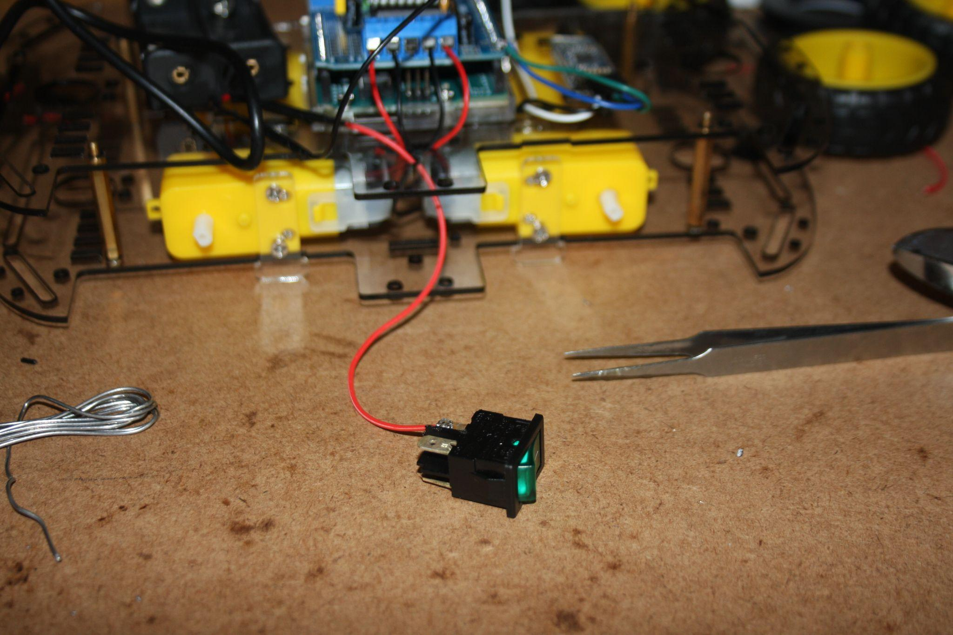
HARDWARE
Hardware Assembly Process
Soldering the battery holder wires
Soldering the wires to the switcher
Mounting of the Arduino Uno board (with L293D motor driver shield) on the chassis

Slide 9
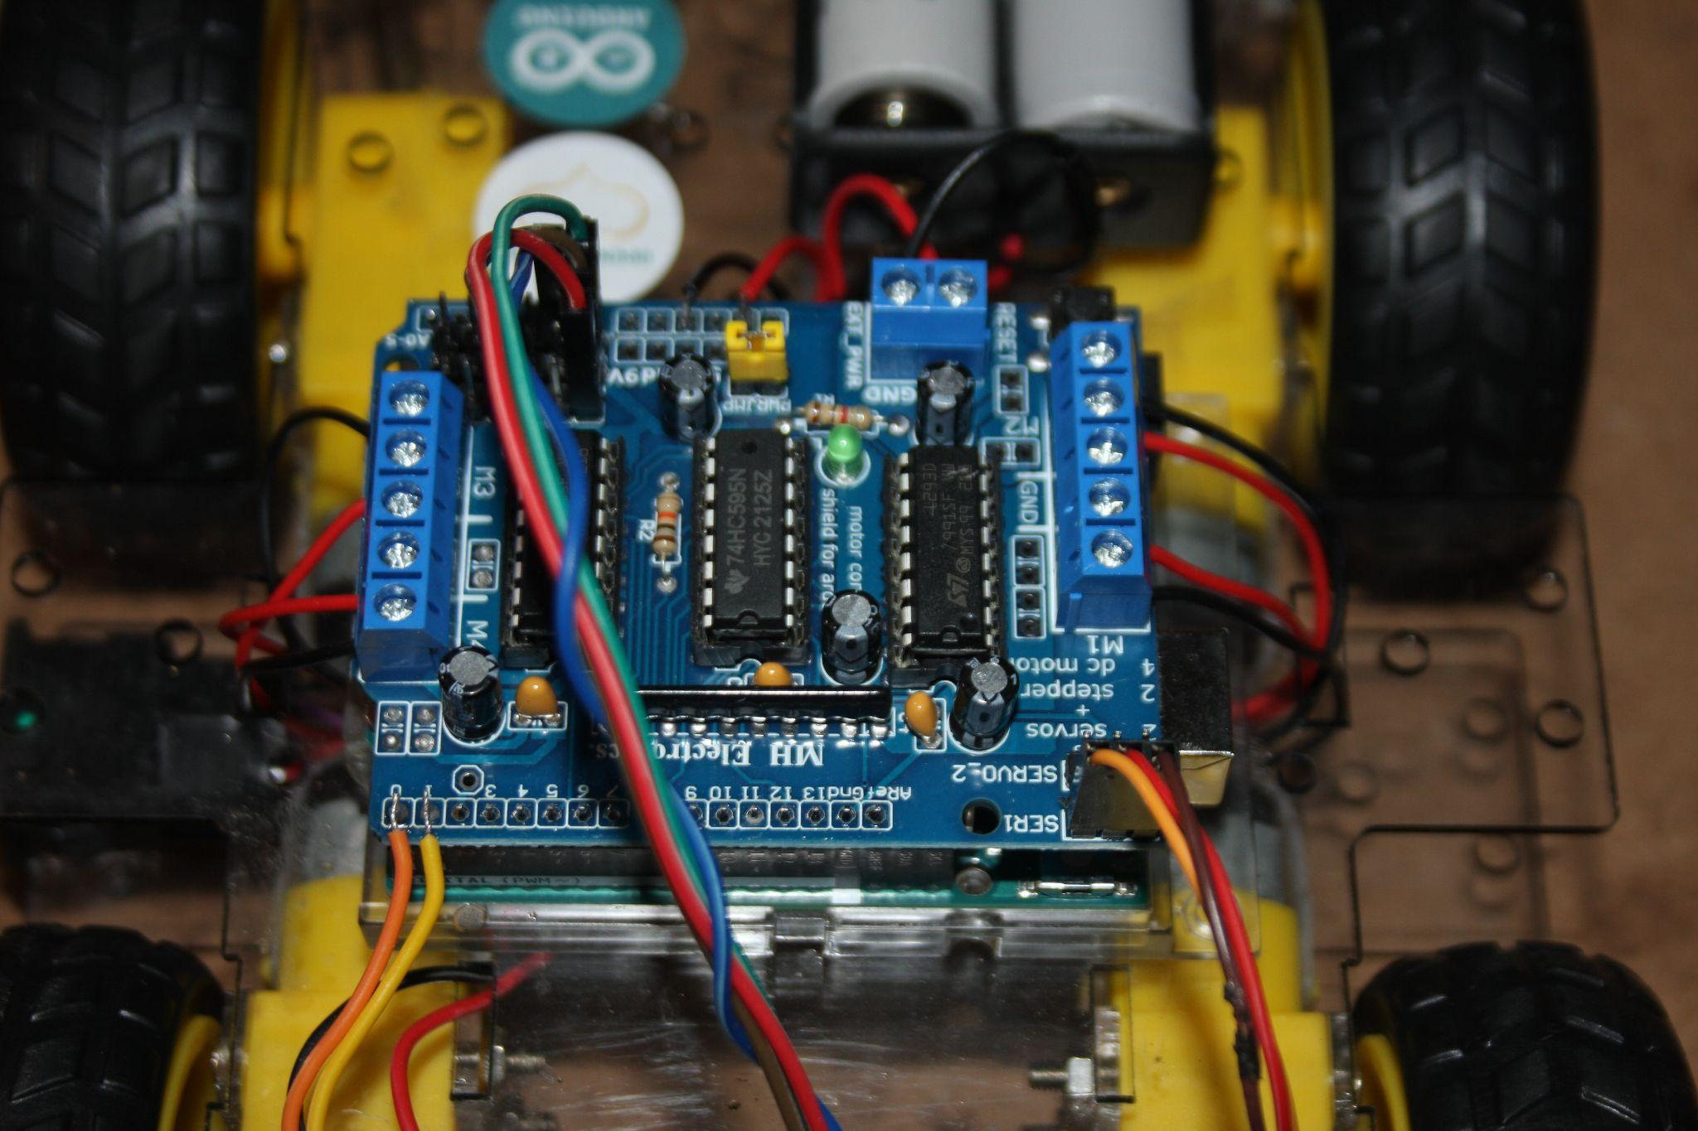
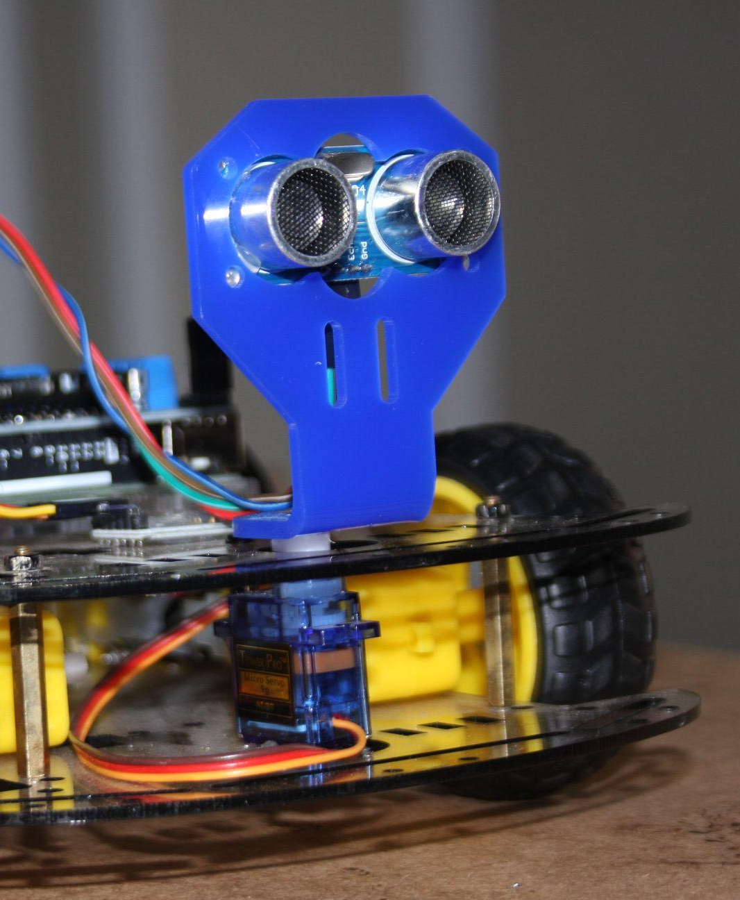
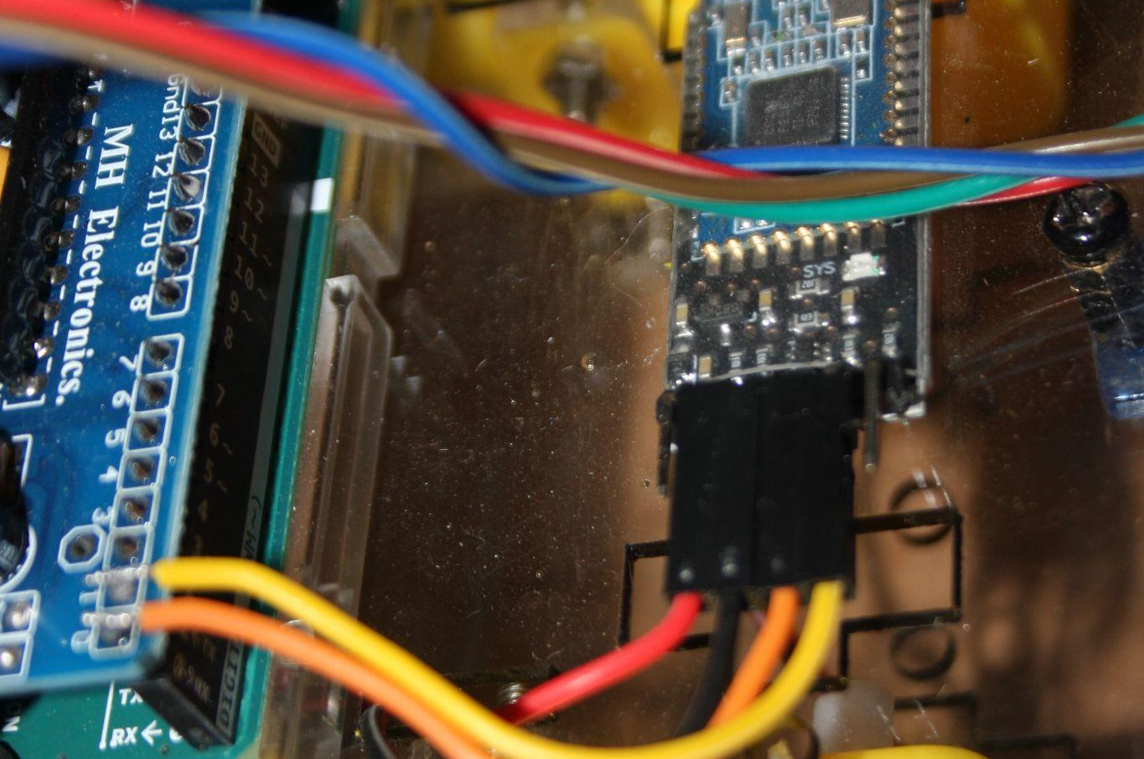
HARDWARE
Hardware Assembly Process
Connecting all wires to the L293D shield
Assembling the ultrasonic sensor and the servo motor
Setting up the HM-10 Bluetooth module

Slide 10
HARDWARE
Final Appearance
Hi I’m “RoverBot”

Slide 11
SOFTWARE

Slide 12
SOFTWARE
Code Link : Arduino IDE ( INO FILE ) Or TXT FILE
Code explanation
#include <AFMotor.h> // Include the AFMotor library for motor control
#define CUSTOM_SETTINGS
#define INCLUDE_GAMEPAD_MODULE
#include <Dabble.h> /* Include the Dabble library for Bluetooth
Communication */
#include <Servo.h> /* Include the Servo library for servo motor control */
#include <NewPing.h> /* Include the NewPing library for the ultrasonic sensor */
Inclusion of libraries

Slide 13
SOFTWARE
NewPing uls_sensor1(A0, A1, 400); /* Create an object of the NewPing class for ultrasonic sensor with the AnalogPin 0 as Trig pin and the AnalogPin1 as an EchoPin and a max distance of 400cm*/
Servo servo1; // Create a Servo object for the servo motor
AF_DCMotor motor1(1); // Create AF_DCMotor objects for motor1
AF_DCMotor motor2(2); // Create AF_DCMotor objects for motor2
AF_DCMotor motor3(3); // Create AF_DCMotor objects for motor3
AF_DCMotor motor4(4); // Create AF_DCMotor objects for motor4
Creating Objects

Slide 14
SOFTWARE
/* Function to make RoverBot move forward */
void forward() {
motor1.run(FORWARD);
motor2.run(FORWARD);
motor3.run(FORWARD);
motor4.run(FORWARD);
}
/* Function to make RoverBot move backward */
void backward() {
motor1.run(BACKWARD);
motor2.run(BACKWARD);
motor3.run(BACKWARD);
motor4.run(BACKWARD);
}
Movement functions
// Function to make RoverBot turn right
void right() {
motor1.run(FORWARD);
motor2.run(FORWARD);
motor3.run(BACKWARD);
motor4.run(BACKWARD);
}
// Function to make RoverBot turn left
void left() {
motor1.run(BACKWARD);
motor2.run(BACKWARD);
motor3.run(FORWARD);
motor4.run(FORWARD);
}

Slide 15
SOFTWARE
// Function to stop all RoverBot motors
void stop() {
motor1.run(RELEASE);
motor2.run(RELEASE);
motor3.run(RELEASE);
motor4.run(RELEASE);
}
Movement functions

Slide 16
SOFTWARE
// Function to measure the forward distance using the ultrasonic sensor
unsigned int mes_dist_forward() {
unsigned int distance = uls_sensor1.ping_cm();
return distance;
}
/* Function to measure the distance to the right using the servo and ultrasonic sensor */
int mes_dist_right() {
servo1.write(10);
delay(1000);
unsigned int dist_right = uls_sensor1.ping_cm();
delay(300);
servo1.write(90);
return dist_right; }
/* Function to measure the distance to the left using the servo and ultrasonic sensor */
int mes_dist_left() {
servo1.write(170);
delay(1000);
unsigned int dist_left = uls_sensor1.ping_cm();
delay(300);
servo1.write(90);
return dist_left; }
Distance measurement functions

Slide 17
SOFTWARE
/* Function to choose between turning to the right or the left based on the longest distance captured by the ultrasonic
Sensor */
void search() {
if (mes_dist_right() >= mes_dist_left()) {
right();
delay(350);
forward();
} else {
left();
delay(350);
forward();
}
}
Distance measurement functions

Slide 18
SOFTWARE
Setup function
void setup() {
Dabble.begin(9600, 0, 1); // Initialize Dabble for Bluetooth communication
motor1.setSpeed(255); // Set motor speeds
motor2.setSpeed(255);
motor3.setSpeed(255);
motor4.setSpeed(255);
servo1.attach(10); // Attach the servo to pin 10
servo1.write(90); // Set the initial position of the servo (rotation degree)
}

Slide 19
SOFTWARE
Loop function
bool obs_mode = true; /* Initialize RoverBot to the Autonomous Mode (Obstacles avoiding Mode) */
void loop() {
Dabble.processInput(); // Process Bluetooth input from Dabble app
if (GamePad.isCrossPressed()) {
obs_mode = false; // deactivate the Autonomous Mode
} else if (GamePad.isTrianglePressed() || (obs_mode)) {
obs_mode = true; // activate the Autonomous Mode
if (mes_dist_forward() >= 33) {
forward();
} else {
stop();
delay(500);
search();
forward();
}
} else {
if ((GamePad.isUpPressed()) && (mes_dist_forward() >= 33)) {
forward();
} else if (GamePad.isDownPressed()) {
backward();
} else if (GamePad.isRightPressed()) {
right();
} else if (GamePad.isLeftPressed()) {
left();
} else {
stop();
}
}
}

Slide 20
ACQUIRED SKILLS

Slide 21
ACQUIRED SKILLS
Hard Skills
Programming :
Writing code for “Roverbot” enhances my coding skills, particularly in C++, which includes several libraries and Object-Oriented Programming.
Electronics Knowledge :
Building and assembling “RoverBot” requires an understanding of electronic components, circuits, and wiring. I learned how to use Arduino, L293 motor driver shield, Bluetooth module, sensors, and motors, and how to connect and control them.
Soldering :
There is no doubt that soldering is necessary in the electronics field. That’s offered me the opportunity to acquire basic soldering skills.
4. Troubleshooting :
While I was working on the Robot Car , I encountered several issues and bugs. Troubleshooting and debugging RoverBot behavior helped me develop my precise observation and fixing skills.
5. Data Analysis:
Since Roverbot uses sensors to collect data (e.g., distance measurements), it is necessary to analyze this data to make decisions. This improved my data analysis skills.

Slide 22
ACQUIRED SKILLS
Soft Skills
Stress management :
Managing stress and pressure correctly can bring out the best in individuals, leading to heightened performance and the ability to excel under challenging conditions.
Problem Solving :
Building and programming a Robot involves solving various technical problems and challenges, enhancing your problem-solving and persistence abilities. As well as my focusing ability because dealing with electronics components is extremely sensitive in terms of voltage, amperage and more.
Creativity :
Designing my Roverbot's functionality and appearance allows me to exercise my creativity in engineering and design choices.
Project Management :
Planning and executing a robotics project teaches project management skills such as time management, task prioritization, and goal setting.
Presentation Skills:
Sharing my project with others, whether in a presentation, report or video, improves my ability to convey complex technical information to a general audience.
Resourcefulness :
Limited resources or unexpected challenges may require being resourceful in finding creative solutions and workarounds.

Slide 23
PRESENTATION VIDEO OF
“RoverBot”

Slide 24

PRESENTATION VIDEO OF “RoverBot”
Video Purpose :
This video was created to explain how “RoverBot” actually acts in real world.
The capabilities and control of “RoverBot” are thoroughly explained in the video.
Video Link (For PDF Version) : https://drive.google.com/file/d/1pXUqYOhvQ6C1ip4mzgITkAk81Kv5wtOX/view?usp=sharing

Slide 25
ACKNOWLEDGEMENT

Slide 26
ACKNOWLEDGEMENTS
{ }
Thank you for your Attention. It’s an honor to share this project with you. I hope that you enjoy it.
Special Thanks to
My parents
Dear aunt, Dr. Sana Belguith
Dear brothers, Youcef Barraj and Yacine Barraj

