Slide 1
Multiplication/Division Circuit (Sequential and Combinational Implementation)
VERILOG

Slide 2
Our Team roles
Our Team
Mohamed Adel Melad AbdElhameed
Waseem Emile
Mohamed Salah Hmaida
01
02
Combinational implementation
Sequential implementation
Producing Presentation
03
Testbenches

Slide 3
TABLE OF CONTENTS
01
03
INTRODUCTION
System Block Diagram
02
04
Problem Definition
Results

Slide 4
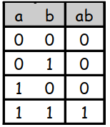
INTRODUCTION
Multiplication :
■ It’s just repeated addition.
■ If we have adders, we can do multiplication also.
♦ Remember that the AND operation is equivalent
to multiplication on two bits

Slide 5
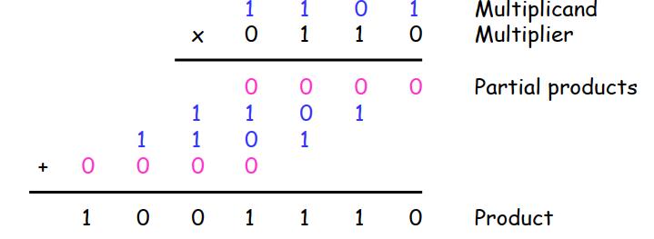
Problem Definition
Multipliers are very complex circuits. ■ In general, when multiplying an m-bit number by an n-bit number: » There are n partial products, one for each bit of the multiplier » This requires n-1 adders, each of which can add m bits (the size of the multiplicand) ■ The circuit for 32-bit or 64-bit multiplication would be huge >> Multiplication and division by powers of 2 can be handled
with simple shifting

Slide 6
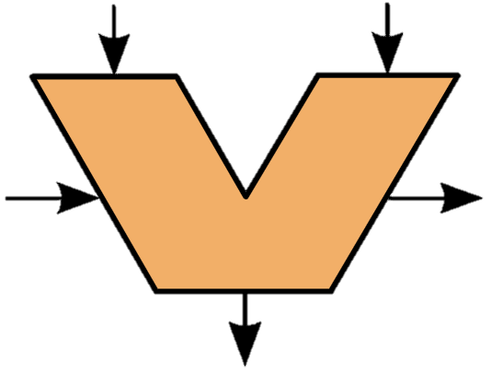
System Block Diagram
clk
In1
“11”
clk
Reg2
rst
‘0’
‘0’
Controller
AddorSub
crtlRegMode
slin
AluC
Adder/Sub
accLoad
AluOut
In2
clk
clk
Reg1
RegAcc
rst
reg1Out(N-1)
regAccOut(0)
reg1Out
regAccOut

Slide 7
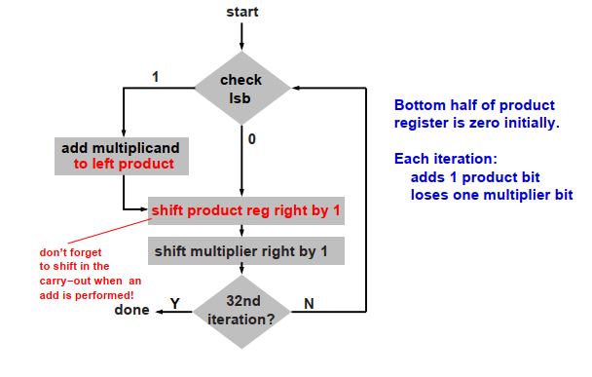
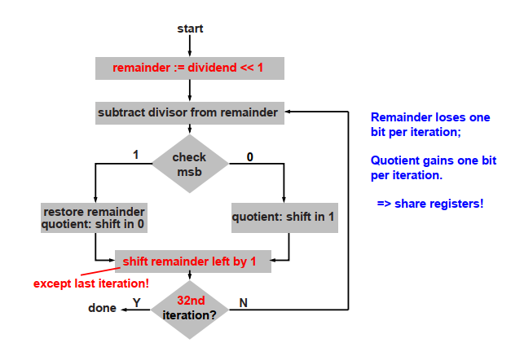
How does it work
Multiplication
Division

Slide 8
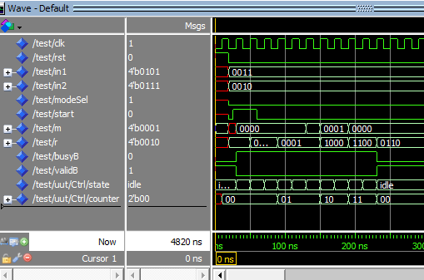
Results
3 x 2 = 6(0110)

Slide 9
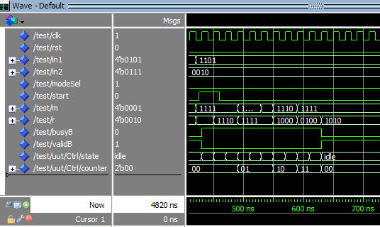
Results
-3 x 2 = -6(1010)

Slide 10
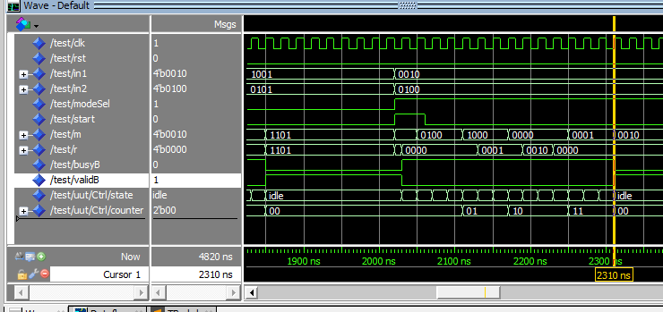
Results
4 / 2 = 2 (0010)

Slide 11
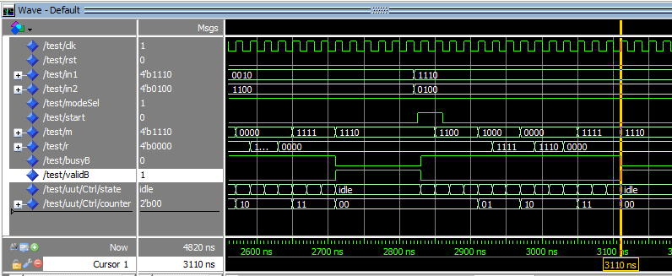
Results
4 / -2 = -2 (1110)

Slide 12
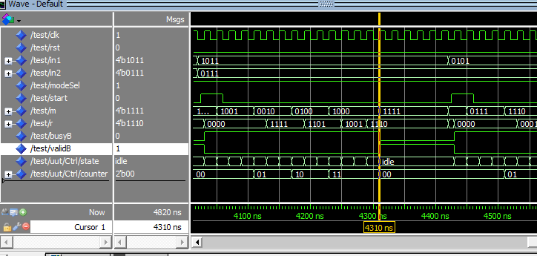
Results
7 / -5 = (m= 1111)(r = 1110)

Slide 13
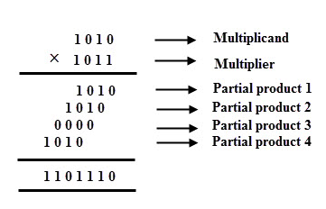
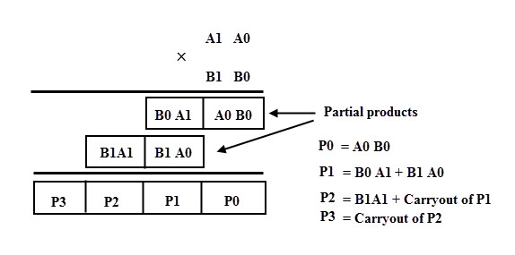
Combinational Implementation
Binary Multiplication

Slide 14
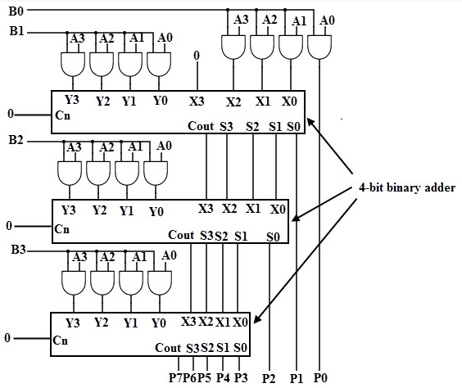
How does it work
Binary Multiplication

Slide 15
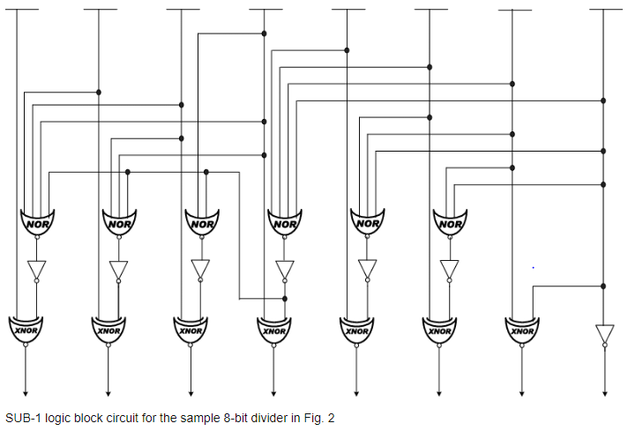
How does it work
Binary Multiplication

Slide 16
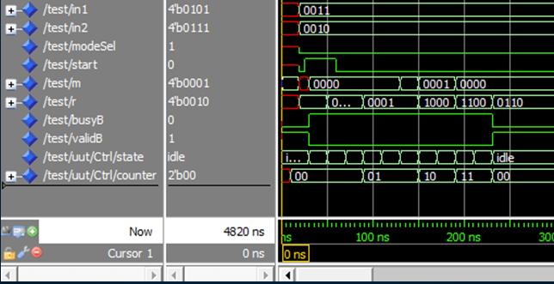
Results
3 x 2 = 6(0110)

Slide 17
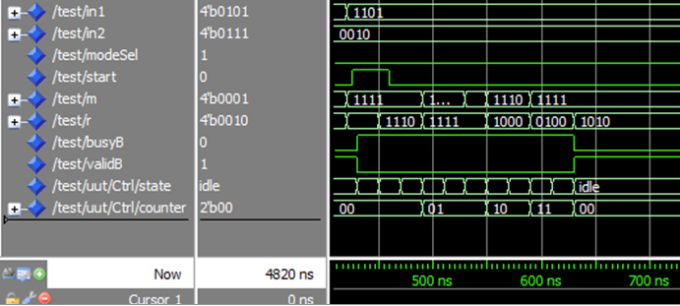
Results
-3 x 2 = -6(1010)

Slide 18
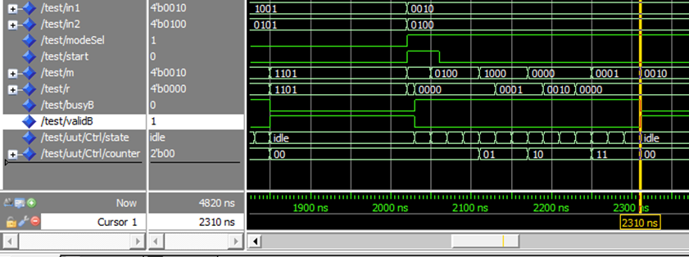
Results
4 / 2 = 2 (0010)

Slide 19
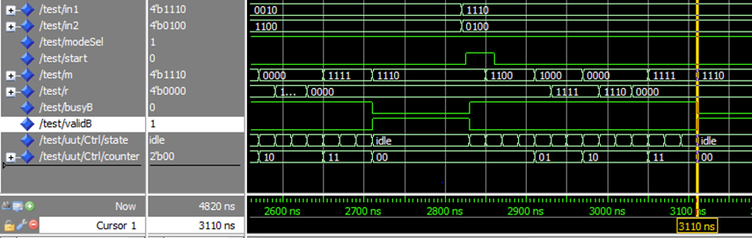
Results
4 / -2 = -2 (1110)

