Slide 1
Smart Home
ITI – Summer Training Final Project

Slide 2
Team Members
Mohamed Adel Mohamed Shalaby
Hazim Emad Ismail Mahmoud Ahmed

Slide 3
Agenda
1
Introduction
2
Microcontroller 1
Microcontroller 2
3
4
Microcontroller 3
5
Simulation

Slide 4
Introduction

Slide 5
Introduction
This is a Smart Home project based on three atmega32 microcontrollers.
These microcontrollers communicate with each other using two different communication protocols, USART and SPI

Slide 6
Introduction
This project supports the following features :
User interface with keypad and LCD to take user choices
Login system with the capability of changing password
The user can control various smart systems and choose to enable or disable them
These systems are Air Conditioner, Lights, Door and Music
There is another automatic system which is Gas/Smoke detection with alarm
Display all systems stats and the current temperature degree on another LCD

Slide 7
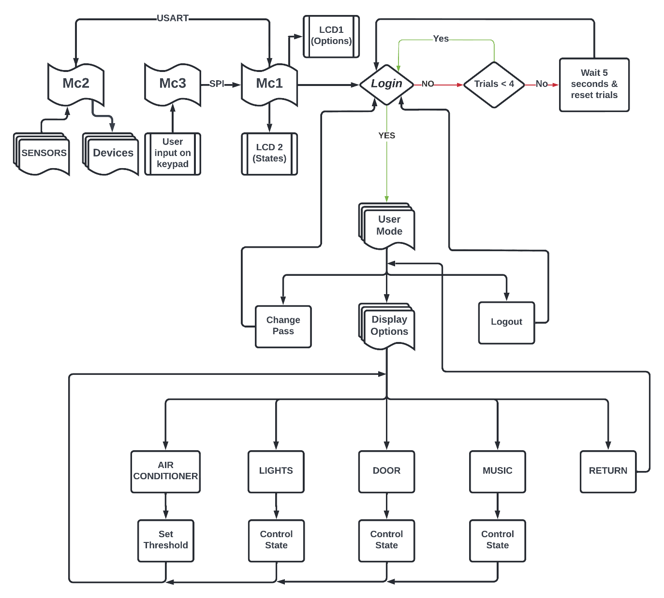
Overview

Slide 8
Introduction
Architecture
APP
RTOS
HAL
MCAL
Microcontroller

Slide 9
Microcontroller 1

Slide 10
Microcontroller 1
Login system
User has 3 tries to enter the correct combination for the ID and password using the keypad.
Each time the combination is incorrect, LCD 1 should display “Try Again!”.
If all combination trials are exhausted, LCD 1 should display “Please Try Again Later!” , and the user is granted three more tries after 5 seconds.
If the user manages to login, the user mode options should be displayed on LCD 1.

Slide 11
Microcontroller 1
User Mode
The user can choose from three things:
Display options: shows all the configurable systems.
Change pass: the user can update his/her password.
Logout: user returns to the login screen.

Slide 12
Microcontroller 1
Display Options:
AC : allows the user to edit the threshold required to enable the fan system.
LDR : allows the user to enable the automatic light system controlled by the LDR.
DOOR : allows the user to open and close the door which consists of a servomotor.
MUSIC : allows the user to enable the music system which is handled by the speaker and power/audio generator.
RETURN : user goes back to the user mode screen.
Wrong user inputs are also handled.

Slide 13
Microcontroller 1
Communication Protocols:
Microcontroller one sends the user-edited data to and receives display data from Microcontroller two using USART.
Data is sent as a register file with each control reserving a bit except for the temperature threshold which is sent alone.
USART alternates between sending and receiving every 150ms to optimally run the code without noticeable delays.

Slide 14
Microcontroller 1
Communication Protocols:
Microcontroller one receives numbers entered on the keypad from Microcontroller 3 over SPI.
SPI starts as soon as the user confirms the inputted number.
The sent number is stored in a buffer until Microcontroller 1 receives it.
Microcontroller 3 is the master while Microcontroller 1 is the slave in this process.

Slide 15
Microcontroller 2

Slide 16
Microcontroller 2
This microcontroller is responsible of all sensors data.
We used RTOS by implementing simple scheduler to handle different tasks.
Using USART protocol every 150ms :
It sends sensors readings and systems stats to microcontroller 1
It receives control signals from microcontroller 1 to control different modules like : (Door, Critical Temperature, Music and Lights).

Slide 17
Microcontroller 2
Initialization
Scheduler based on Timer 2 peripheral
Input/Output pins direction for all sensors and devices
USART protocol to communicate with microcontroller 1
ADC peripheral to
read temperature using LM35 sensor
read light intensity using LDR sensor
Timer 1 on Fast PWM mode to control the door motor

Slide 18
Microcontroller 2
Scheduler Tasks :
Communication with microcontroller 1
Control Gas/Smoke System
Control Air Conditioner System
Control Lights System
Control Door System
Control Music System
Start the Scheduler
Scheduler Dispatcher in the main super loop to switch between tasks

Slide 19
Microcontroller 2
Communication with microcontroller 1 :
This task will be executed every 150ms
It receives control signals from MC1 as follows :
Critical temperature which controls the FAN
Control LDR Signal
1
0
Turn On LDR System
Turn Off LDR System

Slide 20
Microcontroller 2
Control Door Signal
Control Music Signal
1
0
Open The Door
Close The Door
1
0
Turn On Music System
Turn Off Music System

Slide 21
Microcontroller 2
Communication with microcontroller 1 :
It transmits systems stats like follows :
Current Temperature Degree
LDR System
1
0
LDR System is turned on
LDR System is turned off

Slide 22
Microcontroller 2
Door Status
Music System
Gas/Smoke Status
1
0
The Door is Opened
The Door is Closed
1
0
Music System is turned on
Music System is turned off
1
0
Gas/Smoke detected
No detection of Gas/Smoke

Slide 23
Microcontroller 3

Slide 24
Microcontroller 3
Keypad
User interacts with the system using the keypad.
User can type any number then press “#” to confirm that he/she has finished typing.
User can delete a number by pressing the “*” button.

Slide 25
Simulation

Slide 26
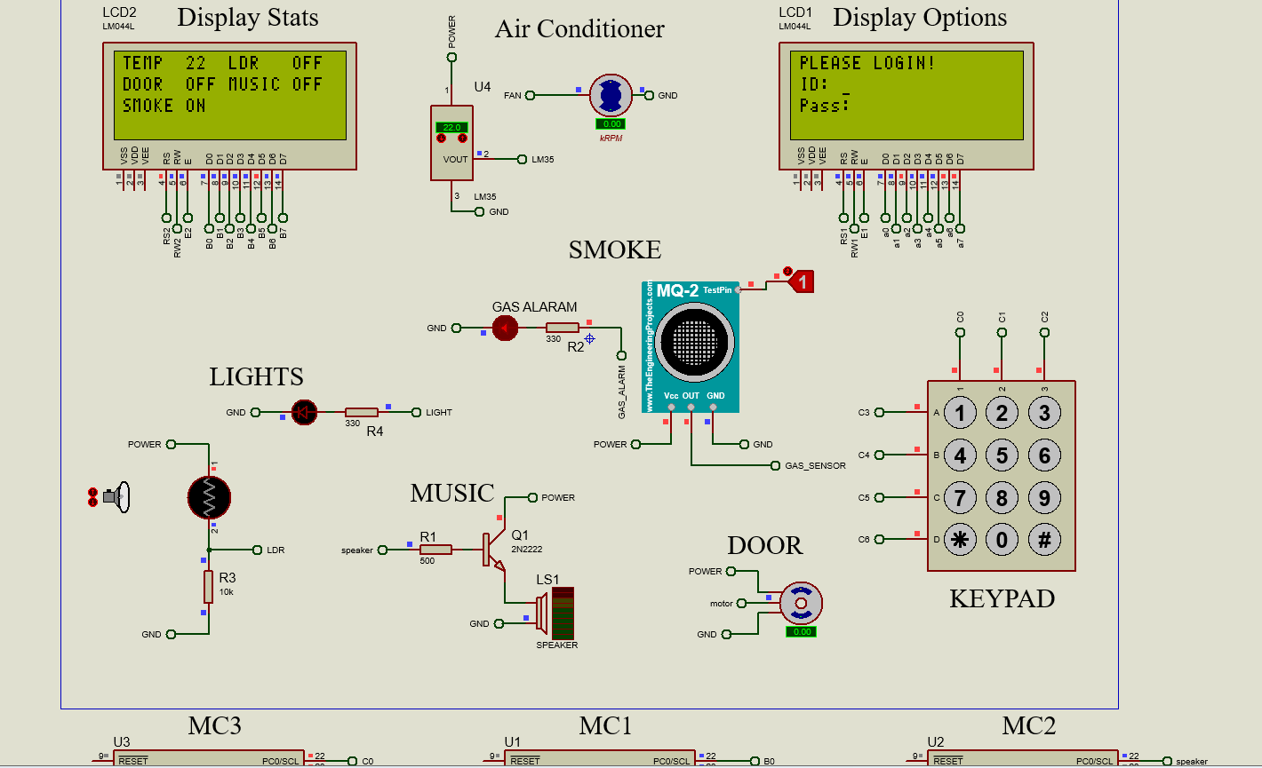

Slide 27
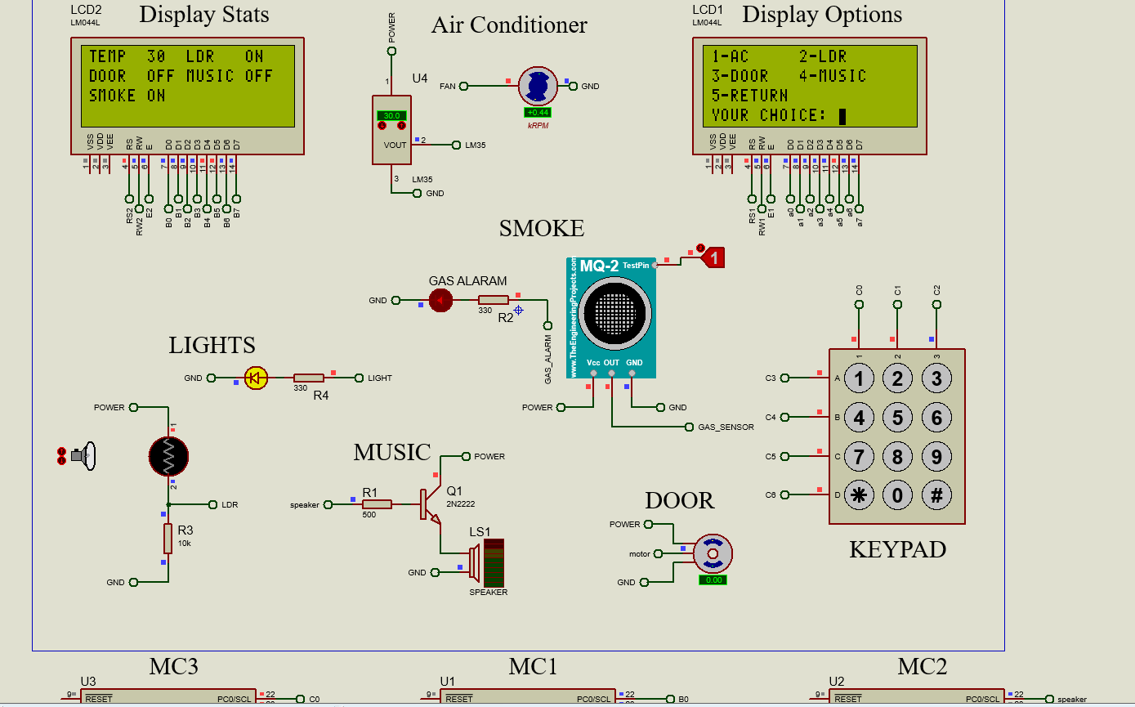

Slide 28
Thanks

