Slide 1

Department of Computer Science and Engineering
JP Nagar, Kothanur, Bengaluru - 560076
SwaraVeda: A Community-Driven Digital Archive for Endangered Indian Dialects
Academic year 2025 – 2026 Odd (5th) semester
Mini Project (BCS586)
Review 2 Presentation
Presented by:
LAKSH YADAV 1RF24CS094
MIKUL SWAMY 1RF24CS103
MOHAMAD AASHIM 1RF24CS105
MOHAMED ALI 1RF24CS106
Under the Guidance of:
Mrs. Priyanka K R
Assistant Professor
Dept. of CS&E
RVITM

Slide 2
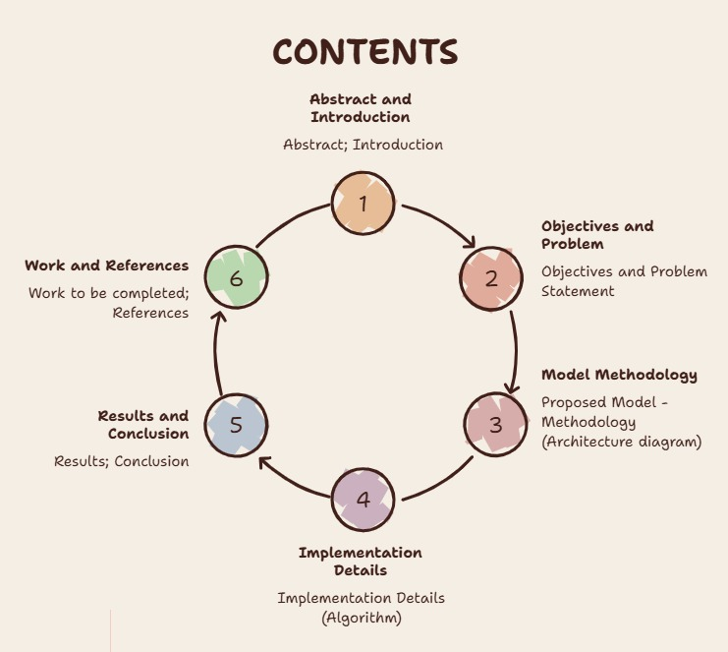

Slide 3
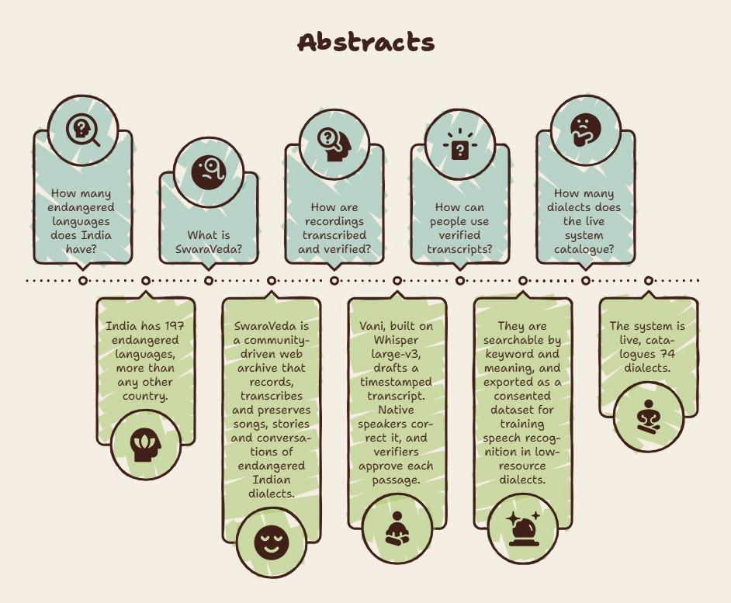

Slide 4
Introduction
Many Indian dialects are purely oral: no written texts, no dictionaries, no speech technology
Elders carry songs, rituals and knowledge (e.g. Tulu paddanas) that are lost when they are
Speech AI works for Hindi, Kannada or Tamil, but not for Tulu, Toda, Kodava or Santali
Manual transcription is slow and needs native speakers, so recordings sit unused
SwaraVeda pairs an AI first draft (Vani) with community correction, so every recorded hour becomes verified, searchable text

Slide 5
Objectives and Problem Statement
Problem statement: There is no simple, consent-aware platform where communities can record endangered dialects, get machine-drafted transcripts, correct and verify them, and turn them into a reusable dataset for speech technology.
Objectives
Collect recordings in the browser or by upload, with explicit speaker consent, even without internet
Pre-process audio and generate timestamped transcripts automatically with Vani
Let native speakers correct, and verifiers approve, every passage
Make the archive searchable by words and by meaning, with passage playback
Export corrected, consented data to train speech models for these dialects

Slide 6
Proposed Model - Methodology (Architecture diagram)
Web client
React + TypeScript, Vercel
recording, offline queue
REST + JWT
REST API (FastAPI)
auth, recordings, review,
search, export • Render
audio, text
Vani AI services
Whisper large-v3 (speech)
Llama 3.3 • MiniLM embeddings
signed upload
SQL
Object storage
Supabase Storage
audio files
Database
PostgreSQL + pgvector
(Supabase)
Audio pre-processing
ffmpeg: 16 kHz mono,
high-pass, loudness
Methodology: from a voice to verified, searchable text
1. Record &
consent
2. Pre-process
3. Transcribe
(Vani)
4. Correct
5. Verify
6. Search &
export

Slide 7
Implementation Details (Algorithm)
Algorithms used in the existing literature related to SwaraVeda
Work | Algorithm | How it was used | Drawback
Povey et al., 2011 (Kaldi) | HMM–GMM / HMM–DNN acoustic model + n-gram language model | Phone models decoded with a pronunciation lexicon (WFST); long the standard for Hindi, Tamil and other Indian-language ASR | Needs a pronunciation dictionary, written text and hundreds of transcribed hours, which unwritten dialects do not have
Baevski et al., 2020 (wav2vec 2.0) | Self-supervised contrastive pre-training + CTC fine-tuning | Learns speech features from unlabelled audio, then fine-tunes ASR on as little as 10 min – 1 h of labelled speech | Every new language still needs labelled transcripts and GPU fine-tuning; plain characters, no punctuation or translation
Javed et al., 2022 (IndicWav2Vec, AI4Bharat) | wav2vec 2.0 pre-trained on 40 Indian languages + CTC + n-gram LM | State-of-the-art ASR for 9 major Indian languages on Indian benchmarks | Covers scheduled languages only; dialects such as Tulu, Toda or Kodava are not supported
Pratap et al., 2023 (Meta MMS) | wav2vec 2.0 + CTC with small per-language adapters | Speech recognition for 1,100+ languages, trained mostly on New Testament readings | Read, religious speech: weak on spontaneous songs, stories and conversation
Radford et al., 2023 (Whisper) | Encoder–decoder Transformer, weakly supervised on 680k hours | Multilingual transcription, timestamps and translation in one model | About 100 languages and none of these dialects; may hallucinate on unseen languages; heavy compute
Reimers & Gurevych, 2019–20 (Sentence-BERT) | Siamese BERT, mean pooling, cosine similarity; multilingual by distillation | Sentence embeddings for semantic search and clustering in 50+ languages | Trained on high-resource text; weaker on dialect, code-mixed and transliterated text
Ardila et al., 2020 (Mozilla Common Voice) | Crowd-sourced read speech, validated by community votes | Volunteers read given sentences; a clip with 2 up-votes is accepted | Needs written sentences to read aloud, so it cannot capture oral songs, stories or unwritten dialects
Gap SwaraVeda fills: Whisper drafts with a related-language hint, native speakers correct and verify, and the archive becomes the labelled dataset these methods lack.

Slide 8
Implementation Details (Algorithm)
Transcription with Vani — input: recording R with audio file, dialect D
If a job for R is queued or running, return it; otherwise create job J
Download R’s audio (up to 200 MB)
a ← ffmpeg(audio): mono, 16 kHz, high-pass 80 Hz, loudness −18 LUFS, Opus 32 kbps
S ← Whisper-large-v3(a, language = D.asr_language) → timestamped segments
Replace R’s segments with S; R.status ← transcribed
For each segment s: s.embedding ← MiniLM(s.text) (384-dimensional)
J.status ← completed (progress 5 → 25 → 70 → 85 → 100 %); on error J.status ← failed
Also: keyword search with PostgreSQL full-text ranking; search by meaning with pgvector cosine distance; corrections are re-embedded; offline recordings wait in IndexedDB and upload when the connection returns.

Slide 9
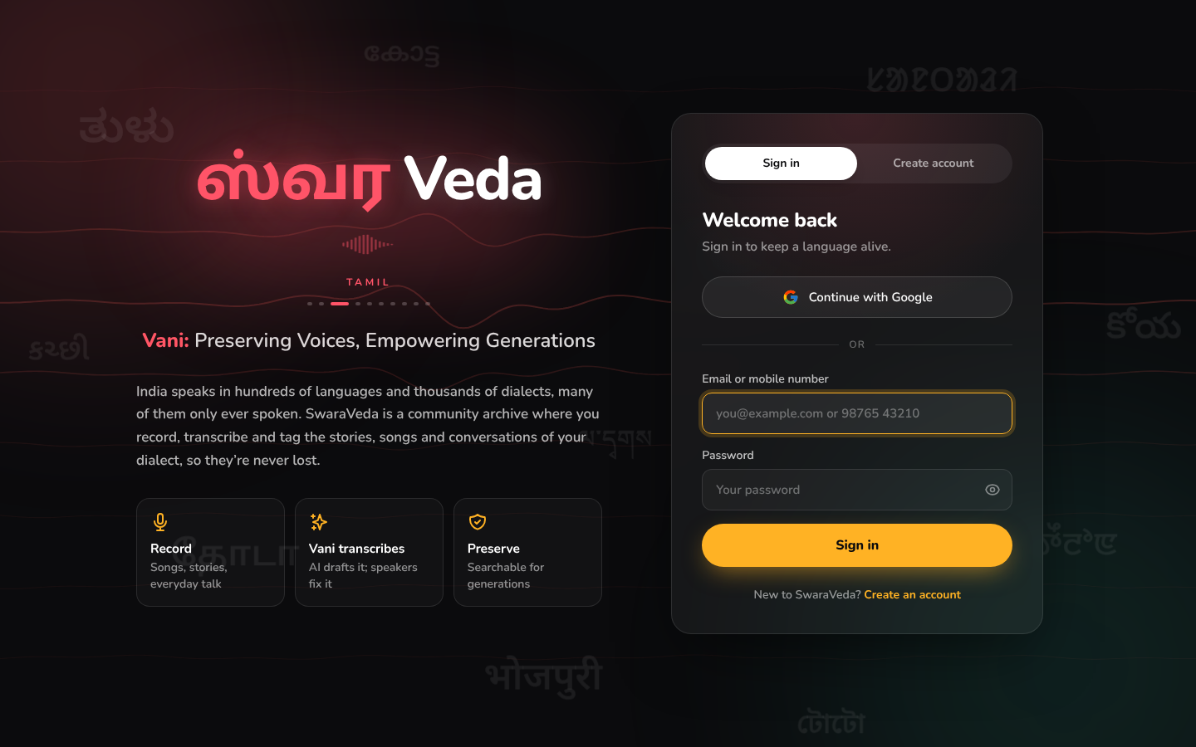
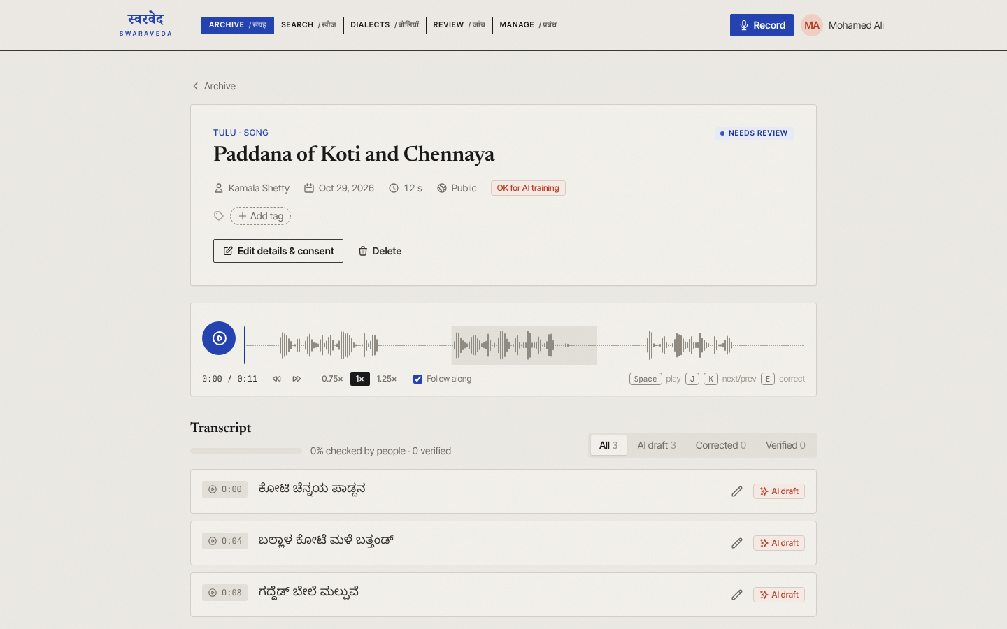
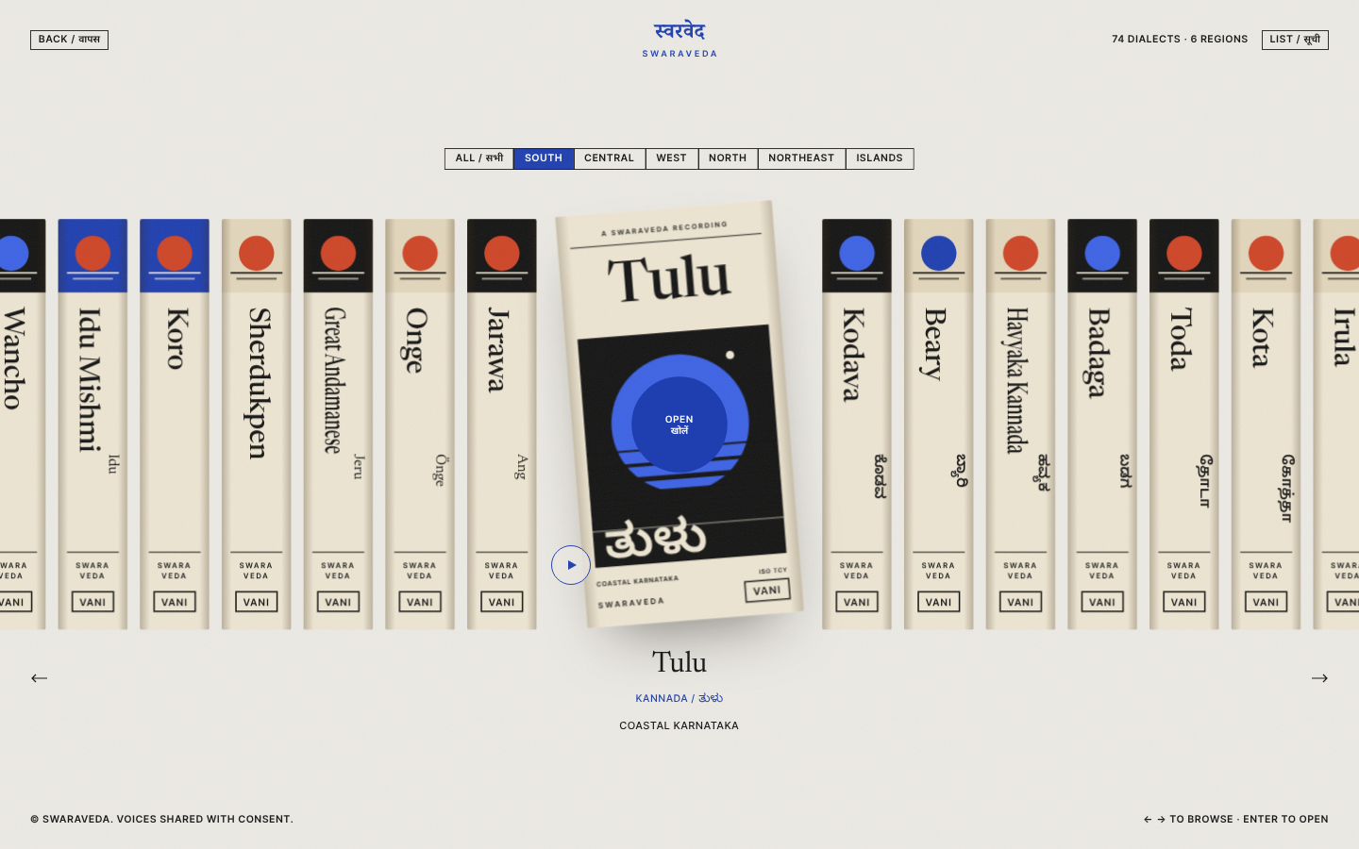
Results
Sign-in page: logo in 10 scripts
Recording page: Vani’s transcript
Dialect shelf: 74 dialects
Deployed live: swara-veda.vercel.app with a FastAPI server on Render and a Supabase database
74 dialects catalogued with region, script, ISO code and Vani’s language hint
100+ automated tests pass, plus tests on real PostgreSQL; end-to-end browser tests show no errors
Pre-processing: a 2 MB stereo WAV becomes 24 KB before it is sent to Whisper
Works offline: recordings are saved on the device and upload by themselves later

Slide 10
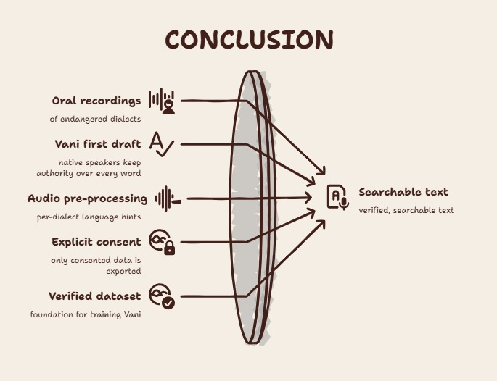

Slide 11
Work to be completed
Field data: record with Tulu and Kodava speakers; correct and verify the transcripts
Storage setup: finish the cloud storage configuration so uploads work on the live server
Dataset dashboard: show how many verified hours Vani has for each dialect
Speakers: tell speakers apart in a recording (diarization)
Accessibility: interface in Kannada, Hindi and other Indian languages
Train Vani: fine-tune Whisper on the exported dataset and measure word error rate

Slide 12
References
UNESCO, Atlas of the World’s Languages in Danger, 3rd ed., Paris: UNESCO Publishing, 2010.
A. Radford, J. W. Kim, T. Xu, G. Brockman, C. McLeavey and I. Sutskever, “Robust Speech Recognition via Large-Scale Weak Supervision,” Proc. ICML, 2023.
N. Reimers and I. Gurevych, “Sentence-BERT: Sentence Embeddings using Siamese BERT-Networks,” Proc. EMNLP-IJCNLP, 2019.
N. Reimers and I. Gurevych, “Making Monolingual Sentence Embeddings Multilingual using Knowledge Distillation,” Proc. EMNLP, 2020.
H. Bredin et al., “pyannote.audio: Neural Building Blocks for Speaker Diarization,” Proc. ICASSP, 2020.
pgvector: open-source vector similarity search for PostgreSQL, github.com/pgvector/pgvector.
SIL International, ISO 639-3 code tables, iso639-3.sil.org.
D. Povey et al., “The Kaldi Speech Recognition Toolkit,” Proc. IEEE ASRU, 2011.
A. Baevski, H. Zhou, A. Mohamed and M. Auli, “wav2vec 2.0: A Framework for Self-Supervised Learning of Speech Representations,” Proc. NeurIPS, 2020.
T. Javed et al., “Towards Building ASR Systems for the Next Billion Users,” Proc. AAAI, 2022.
V. Pratap et al., “Scaling Speech Technology to 1,000+ Languages,” Journal of Machine Learning Research, 2024.
R. Ardila et al., “Common Voice: A Massively-Multilingual Speech Corpus,” Proc. LREC, 2020.

Slide 13
Thank You!

