Slide 1
Department of Computer Science and Engineering
JP Nagar, Kothanur, Bengaluru - 560076
SwaraVeda: A Community-Driven Digital Archive for Endangered Indian Dialects
Academic year 2025 – 2026 Odd (5th) semester
Mini Project (BCS586)
Review 2 Presentation
Presented by:
Name- USN
Name - USN
Name - USN
Name - USN
Under the Guidance of:
Name
Designation
Dept. of CS&E
RVITM

Slide 2
Contents
Abstract
Introduction
Objectives and Problem Statement
Proposed Model - Methodology ( Architecture diagram)
Implementation Details (Algorithm)
Results
Conclusion
Work to be completed
References

Slide 3
Abstract
India has 197 endangered languages, more than any other country, and most of its dialects exist only as speech. SwaraVeda is a community-driven web archive that records, transcribes and preserves the songs, stories and conversations of endangered Indian dialects.
Speakers record or upload audio with explicit consent. The audio is cleaned and Vani, the project’s speech AI agent built on Whisper large-v3, drafts a timestamped transcript. Native speakers correct it in a listening editor and verifiers approve each passage.
Verified transcripts become searchable by keyword and by meaning, and are exported as a consented dataset for training speech recognition in low-resource dialects. The system is live, catalogues 74 dialects and works offline.
Keywords: endangered languages, speech recognition, Whisper, crowdsourcing, semantic search, language documentation

Slide 4
Introduction
Many Indian dialects are purely oral: no written texts, no dictionaries, no speech technology
Elders carry songs, rituals and knowledge (e.g. Tulu paddanas) that are lost when they are
Speech AI works for Hindi, Kannada or Tamil, but not for Tulu, Toda, Kodava or Santali
Manual transcription is slow and needs native speakers, so recordings sit unused
SwaraVeda pairs an AI first draft (Vani) with community correction, so every recorded hour becomes verified, searchable text

Slide 5
Objectives and Problem Statement
Problem statement: There is no simple, consent-aware platform where communities can record endangered dialects, get machine-drafted transcripts, correct and verify them, and turn them into a reusable dataset for speech technology.
Objectives
Collect recordings in the browser or by upload, with explicit speaker consent, even without internet
Pre-process audio and generate timestamped transcripts automatically with Vani
Let native speakers correct, and verifiers approve, every passage
Make the archive searchable by words and by meaning, with passage playback
Export corrected, consented data to train speech models for these dialects

Slide 6
Proposed Model - Methodology (Architecture diagram)
Web client
React + TypeScript, Vercel
recording, offline queue
REST + JWT
REST API (FastAPI)
auth, recordings, review,
search, export • Render
audio, text
Vani AI services
Whisper large-v3 (speech)
Llama 3.3 • MiniLM embeddings
signed upload
SQL
Object storage
Supabase Storage
audio files
Database
PostgreSQL + pgvector
(Supabase)
Audio pre-processing
ffmpeg: 16 kHz mono,
high-pass, loudness
Methodology: from a voice to verified, searchable text
1. Record &
consent
2. Pre-process
3. Transcribe
(Vani)
4. Correct
5. Verify
6. Search &
export

Slide 7
Implementation Details (Algorithm)
Transcription with Vani — input: recording R with audio file, dialect D
If a job for R is queued or running, return it; otherwise create job J
Download R’s audio (up to 200 MB)
a ← ffmpeg(audio): mono, 16 kHz, high-pass 80 Hz, loudness −18 LUFS, Opus 32 kbps
S ← Whisper-large-v3(a, language = D.asr_language) → timestamped segments
Replace R’s segments with S; R.status ← transcribed
For each segment s: s.embedding ← MiniLM(s.text) (384-dimensional)
J.status ← completed (progress 5 → 25 → 70 → 85 → 100 %); on error J.status ← failed
Also: keyword search with PostgreSQL full-text ranking; search by meaning with pgvector cosine distance; corrections are re-embedded; offline recordings wait in IndexedDB and upload when the connection returns.

Slide 8
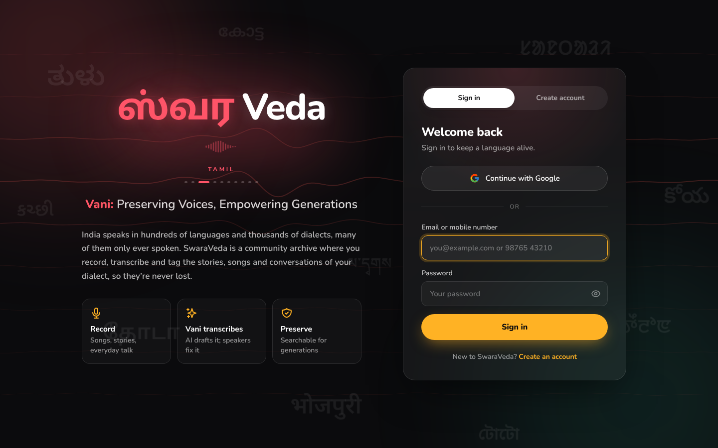
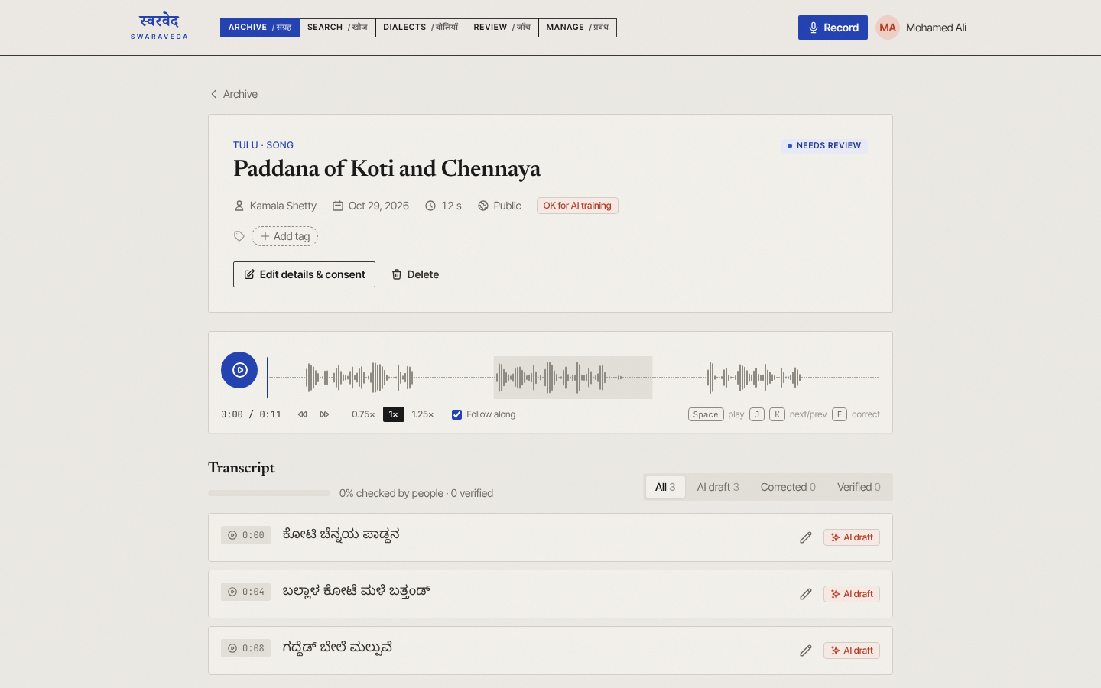
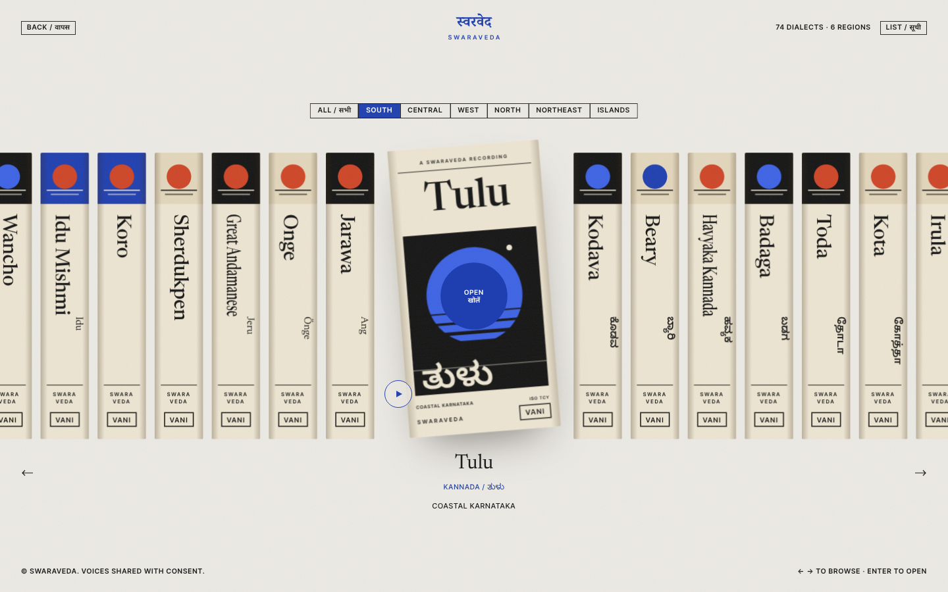
Results
Sign-in page: logo in 10 scripts
Recording page: Vani’s transcript
Dialect shelf: 74 dialects
Deployed live: swara-veda.vercel.app with a FastAPI server on Render and a Supabase database
74 dialects catalogued with region, script, ISO code and Vani’s language hint
100+ automated tests pass, plus tests on real PostgreSQL; end-to-end browser tests show no errors
Pre-processing: a 2 MB stereo WAV becomes 24 KB before it is sent to Whisper
Works offline: recordings are saved on the device and upload by themselves later

Slide 9
Conclusion
SwaraVeda turns oral recordings of endangered dialects into verified, searchable text
Vani does the first draft; native speakers keep authority over every word
Audio pre-processing and per-dialect language hints make a general speech model usable for low-resource dialects
Consent is explicit and enforced: private recordings stay private and only consented data is exported
The verified dataset is the foundation for training Vani to understand these dialects directly

Slide 10
Work to be completed
Field data: record with Tulu and Kodava speakers; correct and verify the transcripts
Storage setup: finish the cloud storage configuration so uploads work on the live server
Dataset dashboard: show how many verified hours Vani has for each dialect
Speakers: tell speakers apart in a recording (diarization)
Accessibility: interface in Kannada, Hindi and other Indian languages
Train Vani: fine-tune Whisper on the exported dataset and measure word error rate

Slide 11
References
UNESCO, Atlas of the World’s Languages in Danger, 3rd ed., Paris: UNESCO Publishing, 2010.
A. Radford, J. W. Kim, T. Xu, G. Brockman, C. McLeavey and I. Sutskever, “Robust Speech Recognition via Large-Scale Weak Supervision,” Proc. ICML, 2023.
N. Reimers and I. Gurevych, “Sentence-BERT: Sentence Embeddings using Siamese BERT-Networks,” Proc. EMNLP-IJCNLP, 2019.
N. Reimers and I. Gurevych, “Making Monolingual Sentence Embeddings Multilingual using Knowledge Distillation,” Proc. EMNLP, 2020.
H. Bredin et al., “pyannote.audio: Neural Building Blocks for Speaker Diarization,” Proc. ICASSP, 2020.
pgvector: open-source vector similarity search for PostgreSQL, github.com/pgvector/pgvector.
SIL International, ISO 639-3 code tables, iso639-3.sil.org.

Slide 12
Thank You!

