Slide 1
Temperature Control DC Fan

Slide 2
Names
Name | ID
Mohamed Ali Sayed | 191900165
Kirolos Osama Ayad | 191900016
Islam Osama Elsayed | 191900044
Abanoub Ibrahem thabet | 191900276
Alaa mostafa | 191900082

Slide 3
TABLE OF CONTENTS
01
02
Description of the project
Components
03
04
Operations
IDE’

Slide 4
TABLE OF CONTENTS
05
06
Code requirements (Pseudo code)
What have been done
07
Simulation

Slide 5
01
Description of the project

Slide 6
MY LATEST EXPERDescription of the project
A Temperature Controlled DC Fan is a system which automatically turns on a DC Fan when the ambient temperature increases above a certain limit.
Generally, electronic devices produce more heat. So this heat should be reduced in order to protect the device. There are many ways to reduce this heat. One way is to switch on the fan spontaneously.

Slide 7
02
Components

Slide 8
Components
Atmega16 Microcontroller
LM35 Temperature Sensor
L293D Motor Driver
1
2
3
4
DC Fan

Slide 9
Operation

Slide 10
Operation
Fan that works by sensing heat from overheating into three levels according to the heat level sensed by (lm35)
Low speed: 30 - 65 °C
mid speed: 65 - 90 °C
High speed: 90°C or higher

Slide 11
IDE’s
1) Microchip Studio. 2) Protecus.

Slide 12
Code requirements (Pseudo code)
Configure pins (Input and Output).
Check If the temperature that the sensor reads bigger than or equal to 30°C and less than or equal to 65°C then play the fan on the lowest speed.
Elseif temperature that the sensor reads bigger than or equal to 66°C and less than or equal to 90°C then play the fan on the middle speed.
Elseif temperature that the sensor reads bigger than or equal to 91°C then play the fan on the Hight speed.
Else the fan won’t work as the temperature is little than 30°C.

Slide 13
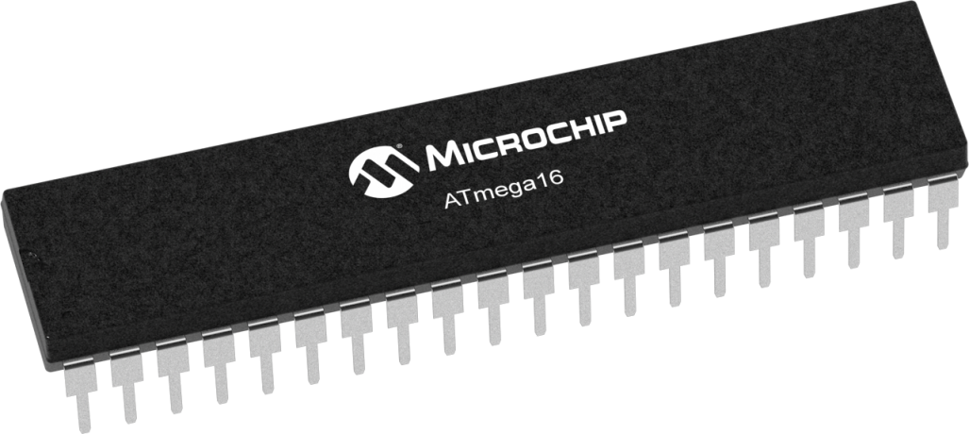
What have been done
Bought the components.
Simulation have been done on Protecus .
Started the code ,but not finished.

Slide 14
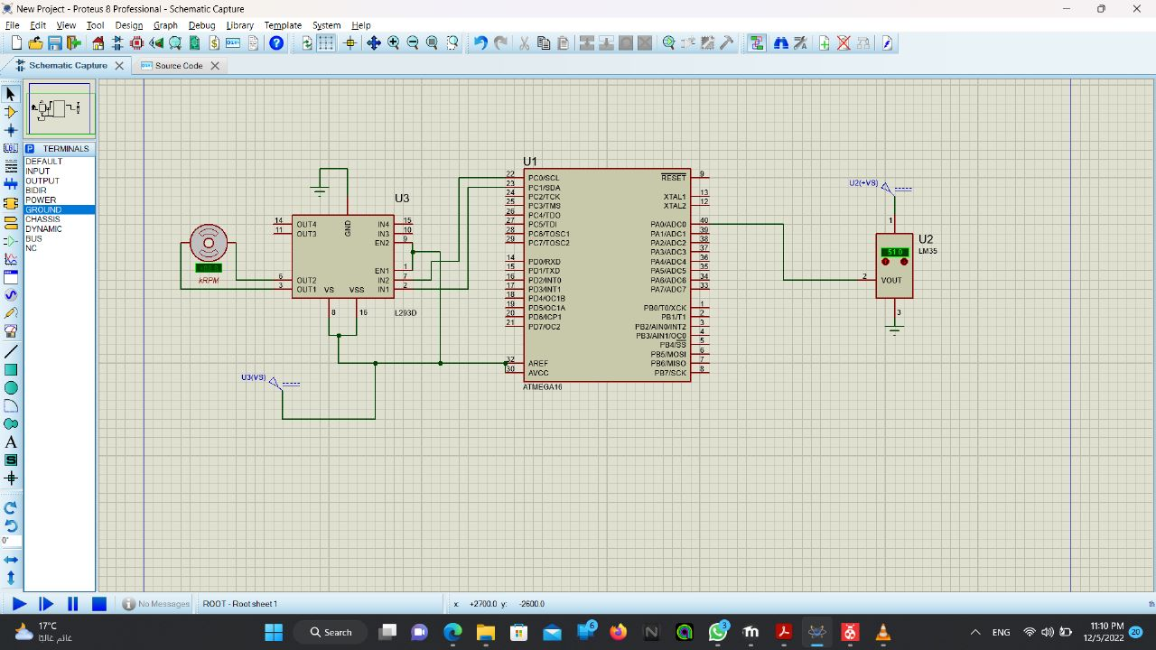
Simulation

Slide 15
THANKS!
Submitted to:
Dr.Amr Zamel

