Slide 1
Top ten artists in number of albums
From this query we find that “Iron Maiden” who is the artist have most number of albums where that equal 21 albums.
In top ten artist in number of albums we can note that “U2” and “Metallica” have equal number of albums.

Slide 2
Top ten music genre
This query show us that “Rock” genre is the most common music genre in based on our database

Slide 3
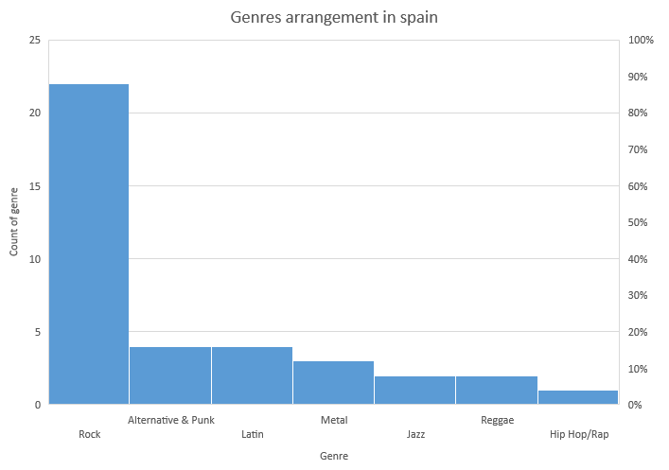
Genre arrangement in Spain
In Spain the most popular genre is Rock followed by Alternative & Punk and Latin genre.

Slide 4
Percentage of sales per employee
All invoices in our database was done by three employees.
“jane peacock” is the best employee where he make total invoices with value 833.04 .

