Slide 1

Hr module
Supervisor : Mr. Abdulrahman Hamdy

Slide 2

هنا هنحط صورتنا مجمعة وشوية اسهم لما اجيلكم :D
ملاحظة لو لقيت الخط عادي و الفورمات بايظ دا بسبب الاوبونتو عشان انا عاملة الpresentation على ويندوز
احنا هنعرض على ويندوز so لو اي حد هيعدل على حاجة يعدلها من على الويندوز :D

Slide 3

AGENDA
Vision .
Why Open Source ?
Why Odoo ?
Technologies .
HR Process .
HR Module .
Features .
Live Demo.

Slide 4

Vision
The main project goal is to make complete hr system using automated ERP in Egypt to dispense the whole paper process along with its complications .
Make an effective utilization of human resources .

Slide 5

Why Open Source ?
More secure and stable than proprietary software .
Open source keeps costs down .
Open source improves quality .
Open source delivers business agility .
Open source gives us more flexibility when we release updates more frequently .

Slide 6
Why Odoo ?
For its integration .
For its functionalities .
For its modularity .
For it’s flexibility .
It is friendly, clear, intuitive and easy to use.
Provides multi-languages .
Full suit for business apps .
It is Open source .

Slide 7




Technologies

Slide 8
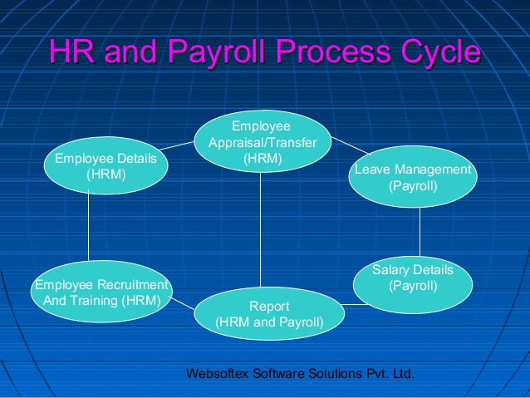
Hr process

Slide 9
HR Module
Payroll .
Attendance .
Employee directory .
Leaves .
Timesheets .
Contract .
Expenses .

Slide 10
Features
Calculate salary according to Egyptian working law by deviding the salary to base and variable and subtract all taxes from it .
Giving the employee 21 days as payed holidays .
Any unpaid holidays will subtract from the salary .
make sign in and sign out at specified time .
Any late will subtract from the salary according to Egyptian working law .
Any overtime will add to the salary according to Egyptian working law.
Adding employee experiences and any licenses he had token .

Slide 11
Features cont.
Hankteb klam keter hena la taklako .. :D

Slide 12
Live Demo

