Slide 1

Week 1:Introduction to LLVM
Mohamed Ashraf-Iyad Wael
14 July 2025

Slide 2
What is LLVM?
LLVM originally stood for Low Level Virtual Machine.
1. Low Level
Unlike high-level VMs (e.g., JVM), LLVM operates closer to machine code.
Uses Static Single Assignment (SSA) form for efficient optimizations.
Provides RISC-like virtual instructions (similar to assembly).
2. Virtual Machine (Historical Context)
Included a JIT compiler, enabling dynamic execution (like Java’s JIT).
Example: Generate LLVM IR at runtime → Optimize → Execute immediately.
LLVM IR acts as a machine-neutral instruction set (like Java bytecode).

Slide 3
What is LLVM?
LLVM Today More Than a Virtual Machine
LLVM is a modular collection of libraries for building frontends (e.g., Clang), optimizers (IR passes), backends (x86, ARM), and tooling (linkers, debuggers, formatters).
LVM supports JIT but is mostly used for static compilation (JIT is Optional)
Used as the core for modern languages like C/C++ (Clang), Swift, Rust, Julia, Kotlin Native, and domain-specific compilers like MLIR-based AI accelerators.
Rich Intermediate Representation (LLVM IR) SSA-based, and architecture-neutral. Designed for deep analysis and optimization, unlike stack-based bytecode (e.g., JVM).

Slide 4
What is LLVM?
LLVM Project Structure
LLVM Core Libraries Define and manipulate LLVM IR, run optimization and analysis passes, and generate both target-independent and target-specific machine code.Examples:opt – LLVM Optimizer, llc – LLVM Static Compiler, lld – LLVM Linker and lldb – LLVM Debugger
Clang (Frontend): Parses C/C++/Objective-C source code into an Abstract Syntax Tree (AST), converts it to LLVM IR, and passes it to the optimizer and backend.
MLIR (Multi-Level IR): A flexible infrastructure for building domain-specific IRs. Used in AI, hardware synthesis, and compilers. MLIR integrates into the LLVM pipeline and lowers to LLVM IR.

Slide 5
What is Clang?
Clang is the official C/C++/Objective-C frontend for LLVM, responsible for converting source code into Abstract Syntax Tree then into llvm IR.
1. Building Abstract Syntax Tree (AST) stage in Clang:
Lexical Analysis (Tokenization) breaks the source into tokens: keywords, identifiers, literals, symbols.
ex:- int x = 5 + 3 → int, x, =, 5, +, 3, ;
Parsing (Syntax Analysis) uses a recursive-descent parser to match tokens against C/C++ grammar rules, It verifies correct syntax and builds the AST as it goes.
Finaly the AST A hierarchical, tree-like structure representing the logical structure of the program.

Slide 6
What is Clang?
2. Lowering AST to LLVM IR stage in Clang:
The process begins with Clang’s CodeGen module creating an LLVM Module to hold the generated IThe module acts as a container where all IR instructions will be stored.
Clang recursively visits each AST node (like expressions, declarations, or control flow) and emits equivalent LLVM IR.
Variables become load/store operations, arithmetic turns into add/mul instructions, and function calls map to call.
Loops and conditionals require special handling to meet LLVM’s Static Single Assignment (SSA) rules. Clang inserts phi nodes at merge points (like after if-else) to combine values from different paths. Each variable reassignment gets a new SSA name (e.g., %x1, %x2), ensuring no variable is written twice.

Slide 7
LLVM IR
What is LLVM IR?
LLVM IR is a low-level, platform-independent code format between source code and machine code.
IR exists as human-readable .ll files.
Uses Static Single Assignment (SSA), meaning each variable is assigned exactly once, aiding optimization.
IR instructions are simple, typed, and resemble assembly—e.g., add i32 %a, %b.
Can be translated into any architecture (x86, ARM, GPU) via LLVM's code generators.

Slide 8
LLVM IR
How to generate .ll file for c/c++ code?
need to download Clang + LLVM 18.1.6 (Release LLVM 18.1.6 · llvm/llvm-project).
Included Tools Compilers: clang, clang++, clang-cl (MSVC-compatible mode), Tools: llc (IR → assembly), opt (IR optimizer), lld (linker).
Command needed (clang -S -emit-llvm test.cpp -o test.ll)
-clang:Clang compiler (frontend for C/C++)
-S:Output in text form, not binary
-emit-llvm:Generate LLVM IR instead of machine code
-test.cpp: input file
-o test.ll: Output file LLVM IR in text form

Slide 9
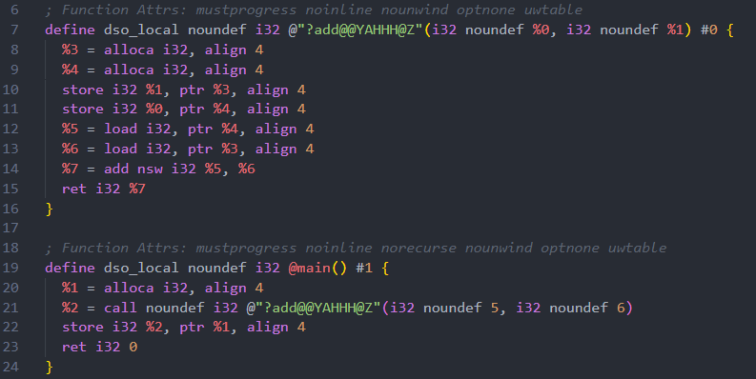
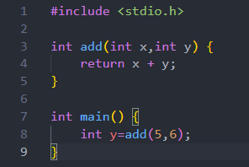
LLVM IR
Example 1 with no optmization:-

Slide 10
LLVM IR
Example 1:-
define: This is a function definition.
noundef i32: Returns a 32-bit integer.
@"?add@@YAHHH@Z": Mangled name for add(int, int)
i32 %0, i32 %1: Parameters x and y .
Note:LLVM IR %1, %2, etc. are temporary registers in IR we have infinity registers also no reassignment (SSA)and they are local scope.
alloca: Stack memory allocation for local variables return address.
store: Store input values into their respective local variables.
load: Load x and y from memory.
add nsw: Add x and y, using "No Signed Wrap" (undefined if overflow).
ret i32 %7: Return the sum.
call :to call a function.

Slide 11
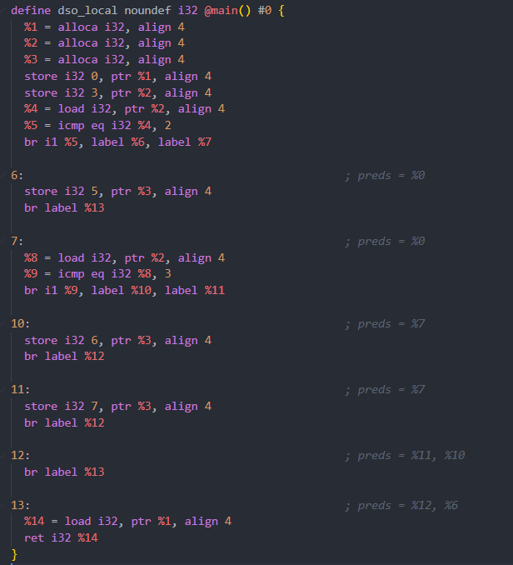
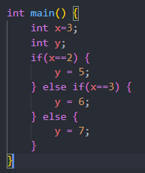
LLVM IR
Example 2 with no optmization :-

Slide 12
LLVM IR
Example 2 with no optmization :-
%5 = icmp eq i32 %4, 2:Compares x == 2. Result is a boolean (i1) stored in %5.
br i1 %5, label %6, label %7:boolean (i1) is true go to lable 6 else go to label 7.

Slide 13
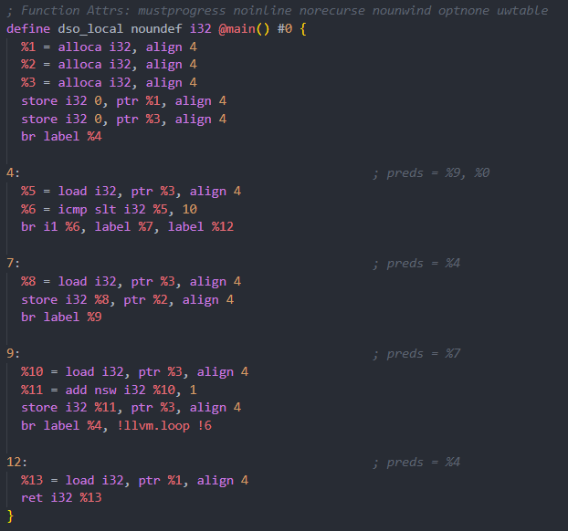
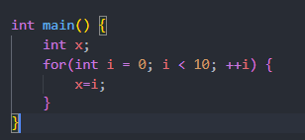
LLVM IR
Example 3 with no optmization :-

Slide 14
LLVM IR
Example 3 with no optmization :-
br label %4, !llvm.loop !6:Marks loop metadata used for optimization ,the IR here with no optimization.

Slide 15
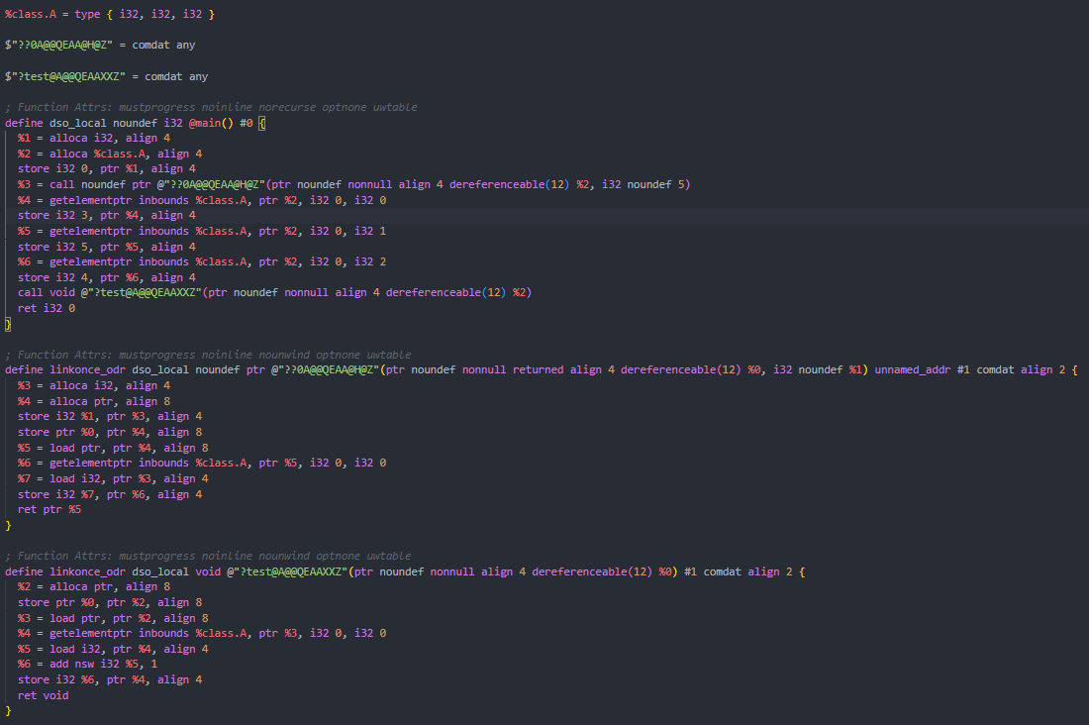
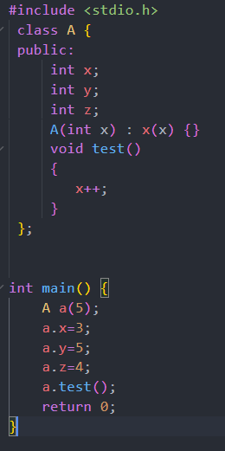
LLVM IR
Example 4 with no optmization :-

Slide 16
LLVM IR
Example 4 with no optmization :-
%class.A = type { i32 }:Defines the class A structure, since A only have one int value then it size is 32 bit.
Note:class with not data member will have size 8 bits not zero.
$"??0A@@QEAA@H@Z" = comdat any , $"?test@A@@QEAAXXZ" = comdat any :short for Common Data used by linkers to allow duplicate definitions of functions or global variables across different object files — but to ensure that only one copy is kept in the final binary.
%2 = alloca %class.A, align 4:Allocates space on the stack for object A.
%3 = call noundef ptr @"??0A@@QEAA@H@Z"(ptr noundef nonnull align 4 dereferenceable(12) %2, i32 noundef 5):passing %2 (allocated object memory) as this, dereferenceable(12) indicates 12 bytes (3 ints) must be accessible.
%4 = getelementptr inbounds %class.A, ptr %2, i32 0, i32 0:return ptr to first member of class A.

Slide 17
LLVM Optimization (opt Tool)
LLVM uses optimization passes to improve IR performance, size, and efficiency.
We have two option of optimization, first to choose optimization level which Automatically apply a predefined sequence of passes, second is to choose specific passes which gives More control and flexibility and Useful for debugging or fine-tuned optimization.
Level | Purpose | Typical Passes
-O0 | No optimization (debug mode) | none (passes skipped)
-O1 | Basic optimizations; fast compile | mem2reg, instcombine, simplifycfg, deadargelim
-O2 | Standard optimization, balanced speed/size | inline, gvn, licm, loop-simplify, loop-unroll, sccp
-O3 | Aggressive optimization for performance | Adds loop-vectorize, slp-vectorizer, higher unrolling
-Os | Size optimization (like O2 but smaller) | O2 passes + globaldce, constmerge, strip-dead-prototypes
-Oz | Maximize size reduction | Further restrict inlining/vectorization beyond Os

Slide 18
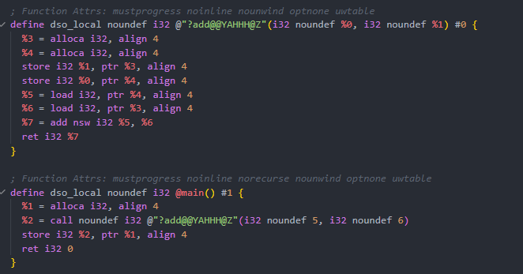
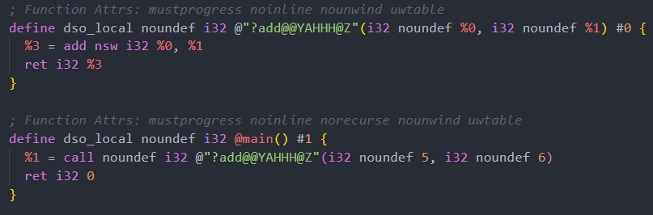
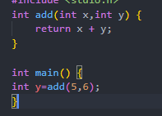
LLVM Optimization (opt Tool)
Mem2reg pass
Purpose: Converts stack-based memory (alloca) into SSA (Static Single Assignment) form.
Command used: opt -S -passes=mem2reg test.ll -o test_mem2reg.ll
Note:-must remove any noopt flag in the generated .ll file for optmization to work.

Slide 19
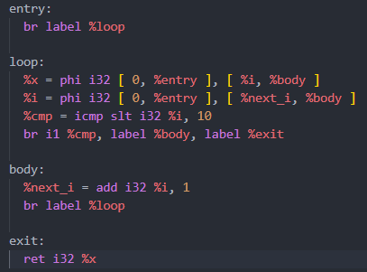
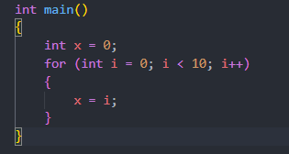
LLVM Optimization (opt Tool)
What is a phi Node?
A phi node is a special instruction in LLVM IR used in Static Single Assignment (SSA) form. It selects a value based on the control flow path taken to arrive at a basic block.
In SSA form, each variable must be assigned exactly once. But in control flow with loops or branches, a variable might come from multiple possible definitions. The phi node resolves that.
Note:-to get IR with meaningful variable name and no noopt flags use this command :-clang -S -emit-llvm -O0 -fno-discard-value-names -Xclang -disable-O0-optnone test.cpp -o test.ll
Example:-

Slide 20
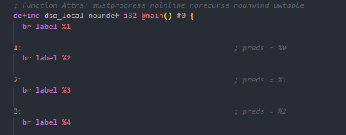
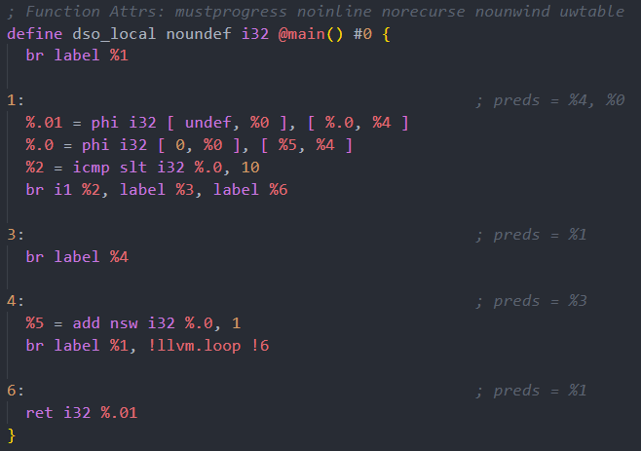
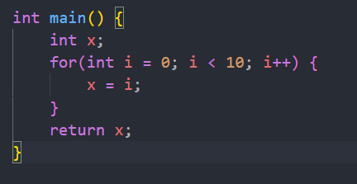
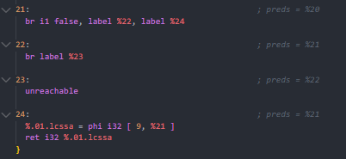
LLVM Optimization (opt Tool)
loop-unroll pass
Purpose: duplicates the body of a loop multiple times to reduce loop overhead and improve performance
Command used: opt -S -passes=mem2reg,loop-unroll test.ll -o test_loop_unrolled.ll
Note:-must use Mem2reg with it to work.

Slide 21
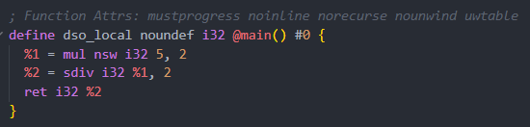
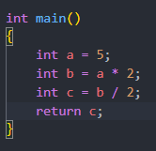

LLVM Optimization (opt Tool)
instcombine pass
Purpose: It simplifies redundant or suboptimal instructions. Think of it as a smart peephole optimizer that combines instructions.
Command used: opt -S -passes=mem2reg,instcombine test.ll -o test_instcombine.ll.

Slide 22
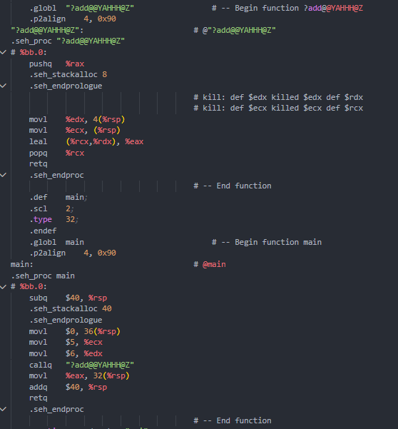
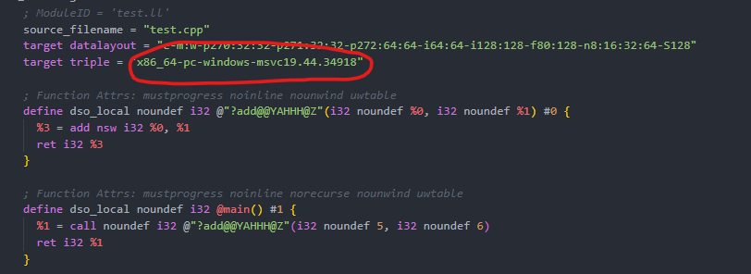
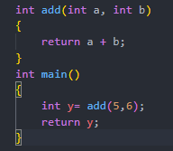
LLVM static compiler(llc)
It converts LLVM IR (.ll) into native assembly for a specific target architecture (e.g., x86, ARM).
Part of the LLVM backend (post-IR, pre-executable).
Command used: llc test.ll -o test.s

Slide 23
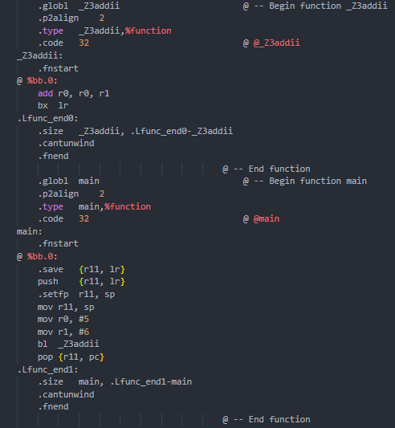
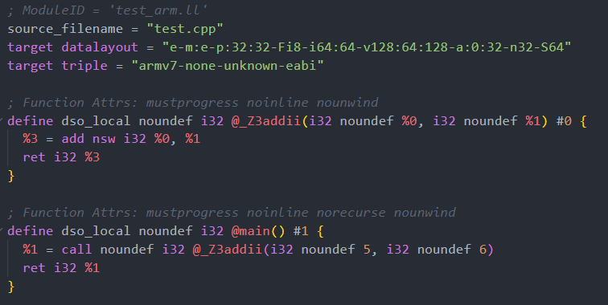
LLVM static compiler(llc)
We need to get IR with some modification is generated by this command:-
clang -target armv7-none-eabi -emit-llvm -S test.cpp -o test_arm.ll
The modification was in target triple and name mangling since MSVC is built for X86_64 ABI so it is not supported in ARM,here ABIs are itanium style mangled.
Then generate assembly by same command:-llc test_arm.ll -o test_arm.s

