Slide 1


Week 5:MLIR Cont.
Iyad Wael-Mohamed Ashraf
17 Aug 2025

Slide 2
Overview of ‘mlir-opt’
mlir-opt is a command-line tool in the LLVM project that's part of the MLIR infrastructure. It is used to:
Parse MLIR (Multi-Level Intermediate Representation) files
Run a series of transformation and analysis passes on them.
Output the transformed MLIR code.
It plays a similar role to opt in traditional LLVM for LLVM IR, but for the MLIR world.
The main role of mlir-opt is to run transformation and analysis passes over MLIR code.
You can think of it as a testing and prototyping tool for:
Trying out different transformation sequencesDebugging passes

Slide 3
Why do we need ‘mlir-opt’
In compiler development, you rarely want to work on raw source code directly. Instead, you run passes:
Analysis passes → gather information (e.g., loop depth, memory dependencies).
Transformation passes → change IR (e.g., inlining, loop fusion, lowering).
mlir-opt provides a sandbox for experimenting with these passes on MLIR files:
You can test how passes change your IR.
You can combine multiple passes in sequence.
You can debug dialect conversions and lowerings.
This makes it extremely useful both for research and for developing new compiler transformations.

Slide 4
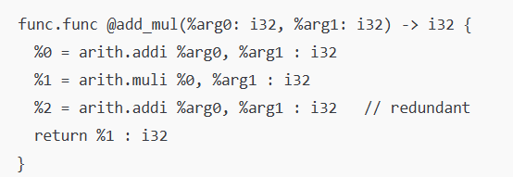
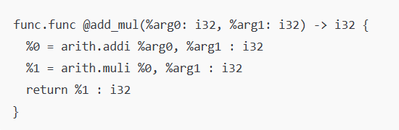
Example Before & After with ‘mlir-opt’

Slide 5
‘mlir-opt’ vs ‘mlir-translate’
There’s a sister tool called mlir-translate, which is used to:
Translate between different input/output formats.
For example: between MLIR and LLVM IR, or from a custom DSL to MLIR .
Use mlir-opt for passes, and mlir-translate for format conversion.

Slide 6
What is ‘mlir-translate’
mlir-translate is a command-line tool that is part of the MLIR infrastructure within LLVM.
Its main job is to convert (translate) between:MLIR and other representations (like LLVM IR, assembly, or custom DSLs)Different dialects or custom formats within the MLIR systemBinary and textual forms of MLIR (though this is less common)
Think of it as the translation engine that connects MLIR to external formats, languages, or compilation targets.

Slide 7
What is it used for?
mlir-translate is commonly used for:
Frontend input translation: Converting source language constructs (from a DSL, say) into MLIR.
Backend output translation: Converting MLIR into LLVM IR, SPIR-V, or other target-specific IRs.
Testing translation layers in compiler toolchains.
Round-tripping between different MLIR formats.

Slide 8
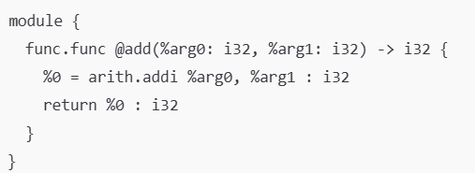
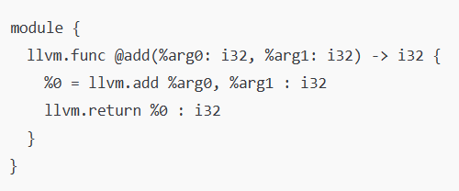
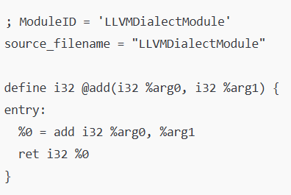
Example on ‘mlir-translate’
Example: Translating MLIR to LLVM IR.

Slide 9
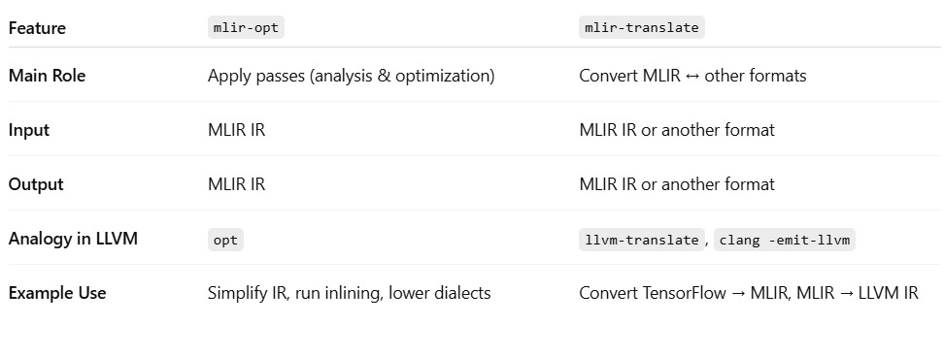
‘mlir-opt’ vs ‘mlir-translate’

Slide 10
What is TableGen?
TableGen is a domain-specific language (DSL) and a code-generation tool used in LLVM and MLIR for:
Defining structured data (like instructions, types, dialects, passes, patterns)
Automatically generating C++ code, boilerplate, and registration logicReducing repetitive manual codingEnabling declarative compiler construction.
TableGen files have the .td extension and are processed by the tblgen tool (in MLIR, that’s mlir-tblgen).

Slide 11
What is the purpose of TableGen?
TableGen is used to generate boilerplate code for MLIR (and LLVM) components in a declarative way.
Instead of manually writing hundreds (or thousands) of lines of repetitive C++ code to define:
Operations
Types
Attributes
Passes
pattern rewrites…
you can write concise, structured descriptions in .td files, and let TableGen auto-generate the necessary C++ code.

Slide 12
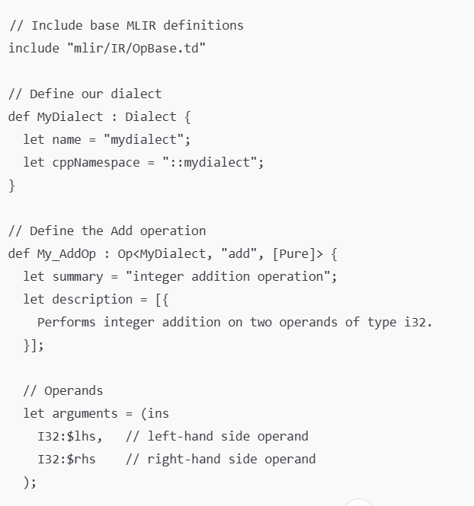
Example on TableGen
Suppose we want to define an add_i32 that add 2 integers:

Slide 13
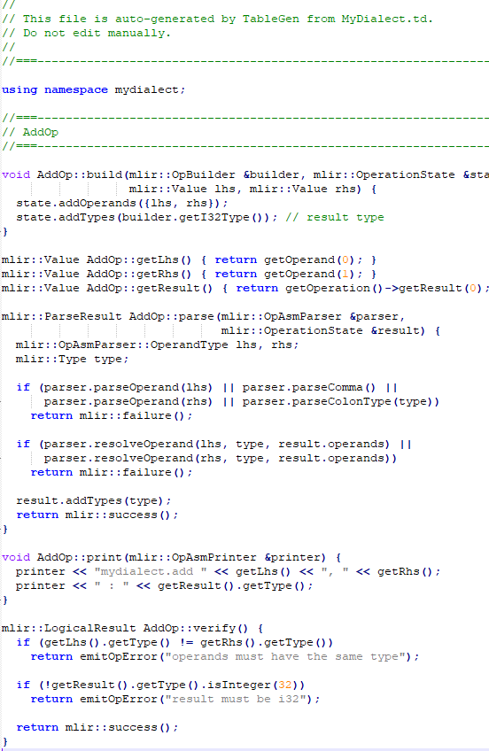
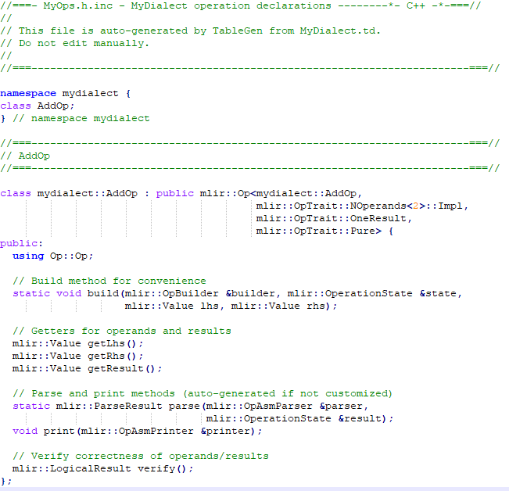
Example on TableGen Cont.

Slide 14
MLIR Syntax Fundamentals
%result = "dialect.operation"(%arg1, %arg2) : (input_type1, input_type2) -> result_type { // Attributes attribute_name = attribute_value : attribute_type // Regions (optional) ^bb0(%bbarg1: type1, %bbarg2: type2): // Block operations }
MLIR uses a textual representation that's similar to LLVM IR but more extensible.
Module: is The top-level container.
func.func: Function operation from the 'func' dialect.
@funcname Function name .
(input1:input1_type, input2:input2_type): Input parameters with types
-> i32: Return type.
attribute_name = attribute_value : attribute_type: variable definition and declration.
^bb0 :basic block.
^ indicates a block label.
bb stands for "basic block"
0 is the block number

Slide 15
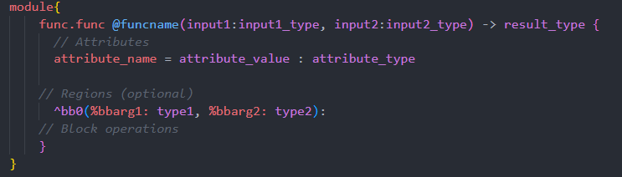
MLIR Syntax Fundamentals Example 1:-
%result = "dialect.operation"(%arg1, %arg2) : (input_type1, input_type2) -> result_type { // Attributes attribute_name = attribute_value : attribute_type // Regions (optional) ^bb0(%bbarg1: type1, %bbarg2: type2): // Block operations }

Slide 16
MLIR Syntax Fundamentals basic block
%result = "dialect.operation"(%arg1, %arg2) : (input_type1, input_type2) -> result_type { // Attributes attribute_name = attribute_value : attribute_type // Regions (optional) ^bb0(%bbarg1: type1, %bbarg2: type2): // Block operations }
A sequence of operations with single entry and single exit.
Have block arguments, Example: ^bb0(%arg: f32) declares a block argument %arg of type f32
Always terminates with a terminator operation (like scf.yield, br,etc.)
Why It's Needed:
Provides a named entry point for control flow.
Enables passing values into the region via block arguments.
Provides a clear starting point for analysis and transformation passes.

Slide 17
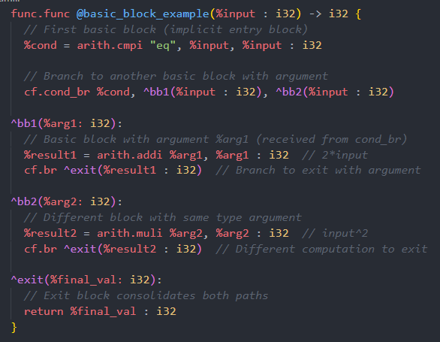
MLIR Syntax Fundamentals Example 2:-

Slide 18
MLIR Syntax Fundamentals Example 2:-
Line 1: Function Definition of single integer as input and integer as output.
Line 2: Integer comparison operation from 'arith' dialect of input with it self which is always true.
Line 3: Conditional branch from 'cf' (control flow) dialect, takes Boolean return from prev compare and choose which label to jump to.
In each block contain whether add or multiply the use Unconditional branch operation from 'cf' (control flow) dialect to jump to exit label.

Slide 19
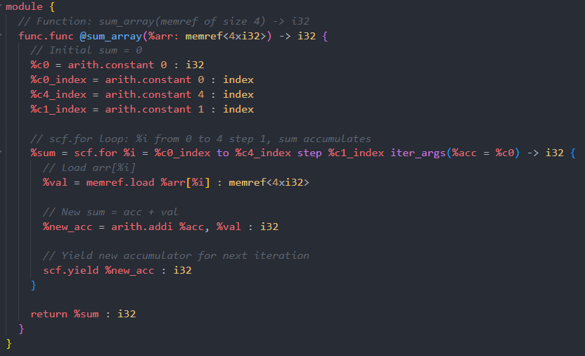
MLIR Syntax Fundamentals Example 3:-

Slide 20
MLIR Syntax Fundamentals Example 3:-
Line 1: Function Definition Takes 1 argument: %arr of type memref<4xi32> (4-element integer array in memory),return integer.
Line 2,3,4,5:4 constants for total sum initial vlaue , start index, end index, step value.
Line 6: %sum = scf.for %i = %c0_index to %c4_index step %c1_index iter_args(%acc = %c0) -> i32
%i: Loop induction variable (from %c0_index to %c4_index)
step %c1_index: Increments by 1 each iteration
iter_args(%acc = %c0): Loop-carried variable initialized to %c0 (sum accumulator)
-> i32: Loop returns an i32 value (final sum)
Line 7:Loads value from memory.
Line 8:Adds current accumulator (%acc) and loaded value (%val).
Line 9:Loop terminator operation, Passes %new_acc to next iteration as the new %acc.
Line 10:Returns the final accumulated sum (%sum) from the function

Slide 21
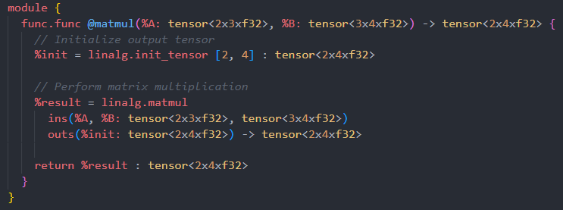
MLIR Syntax Fundamentals Example 4:-

Slide 22
MLIR Syntax Fundamentals Example 4:-
Line 1: Declares a function operation from the 'func' dialect, First input matrix (2 rows × 3 columns), Second input matrix (3 rows × 4 columns), Return type (resulting 2×4 matrix).
Line 2: using Operation from 'linalg' dialect to create an uninitialized tensor (2 rows, 4 columns).
Line 3,4,5: using Operation from 'linalg' dialect to multiply matrix
With 2 input and 1 output matrix.
Line 6:return result matrix.

Slide 23


