Slide 1


Week 4:MLIR
Iyad Wael-Mohamed Ashraf
9 Aug 2025

Slide 2
What is MLIR?
MLIR (Multi-Level Intermediate Representation) is a new compiler infrastructure developed by the LLVM project to extend and modernize how IRs are designed, especially for domain-specific applications like:
Machine learning (TensorFlow, PyTorch)
Graphics (GPU programming)
Hardware description (e.g. FPGA toolchains)
Scientific computing
MLIR is not one IR — it's a framework to build multiple IRs at different abstraction levels that can interoperate and compile efficiently.

Slide 3
Why is MLIR created?
LLVM IR is great, but:
It’s too low-level for many domains (like tensor algebra or neural networks)
Not easy to customize for new languages or accelerators
Hard to represent structured data, like matrices, loops, or pipelines
MLIR was designed to:
Support multiple abstraction levels
Be extensible (you can define your own IR “dialect”)
Unify many different compiler stacks into a common infrastructure

Slide 4
Key concepts in MLIR
1.Dialects:
A dialect is a custom set of operations and types — like your own IR extension.
Examples:
std — general-purpose operations
affine — affine loops and memory access
linalg — linear algebra (tensors, matmuls)
gpu — GPU-targeted ops
tensor, memref — memory types
You can even define your own dialect for your application or hardware.

Slide 5
MLIR Dialects
In MLIR (Multi-Level Intermediate Representation), a dialect is essentially a set of operations, types, and attributes that describe a particular domain or abstraction level.
They allow MLIR to model programs at different levels of abstraction — from very high-level AI ops down to hardware-specific ops — all within the same infrastructure.
MLIR dialects can be high-level (like Tensor computations) or mid-level (like loops and memory accesses), and they can mix in a single module.
High-level dialects represent computations in a very abstract, domain-specific way. For example:Tensor dialects: Represent tensor computations such as matrix multiplication, convolutions, or neural network operations in a way that closely resembles the math or algorithm description, These dialects focus on expressing what computations are done rather than how they are done. They abstract away low-level details like memory layout or control flow.
Mid-Level Dialects represent computations closer to the machine or runtime, capturing details for example Loops, Memory accesses, Control flow and Buffer manipulation.
Mixing Dialects MLIR is designed to be composable. A single MLIR module can contain operations from multiple dialects at different abstraction levels simultaneously.
Low-Level Dialects MLIR also supports low-level dialects that are very close to the hardware and machine code, The most important low-level dialect in MLIR is the llvm dialect.

Slide 6
MLIR Dialects Cont.
func : function-level ops, declarations and returns (func.func, func.return, call).
arith (Common Subexpression Elimination): arithmetic ops and constants (arith.addi, arith.constant, arith.addf).
linalg :linear-algebra ops (matrix multiply/add) with high-level semantics (linalg.generic, linalg.matmul).
memref :memory buffers (memref types, loads/stores); high-level descriptor for multi-D arrays.
Scf:structured control flow (loops, conditionals).
affine:affine maps & loops for polyhedral optimizations.
llvm (LLVM dialect):-low-level ops mapping one-to-one to LLVM IR (llvm.func, llvm.add, llvm.load, llvm.store, llvm.call).

Slide 7
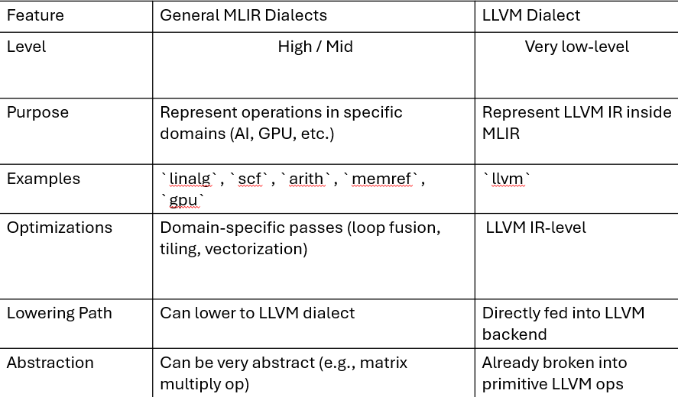
MLIR Dialects Cont.

Slide 8
Key concepts in MLIR Cont.
2.Multi-Level Abstraction:
You can represent the same computation at:
• High-level (e.g. matrix multiply as linalg.matmul)
• Mid-level (loops, tensors)
• Low-level (memory access, branches, loads)
Each level can be optimized separately and progressively lowered into LLVM IR or machine code.

Slide 9
Key concepts in MLIR Cont.
3.Conversion and Lowering:
conversion and lowering in MLIR are basically about translating your program’s IR from one form to another, usually step-by-step from high-level to low-level until you reach machine code.
You often start with high-level MLIR in a domain-specific dialect
Example: linalg for tensor ops, or your own custom dialect).
High-level Dialect → Mid-level Dialect → Low-level Dialect → LLVM Dialect → LLVM IR → Machine Code
This process uses conversion passes in MLIR.

Slide 10
Lowering in MLIR
Lowering is a specific kind of conversion where you move from a higher abstraction level to a lower one.
Usually happens in stages:
High-level dialects → loop-based dialects (e.g., linalg → scf or affine)
Loop-based dialects → std or arith dialect
std/arith → llvm dialect
LLVM dialect → LLVM IR → Machine Code
Staged lowering keeps each step simple and modular — you don’t jump from linalg directly to llvm in one go.

Slide 11
Why is it Flexible?
You can stop lowering at different stages depending on your target:
GPU backend? Lower to a GPU dialect instead of LLVM.
Custom accelerator? Lower to your own hardware-specific dialect.
This modular approach is one of MLIR’s main strengths — you don’t hardcode one “path” to machine code.

Slide 12
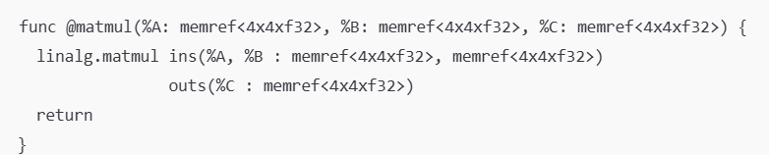
MLIR VS LLVM IR
mlir
Example: Matrix Multiplication in a Machine Learning Framework
MLIR Approach:
You can directly represent the matmul as a single operation with tensor semantics:
The operation knows it’s a matrix multiplication — you can apply high-level optimizations like tiling, vectorization, and fusion before lowering.

Slide 13
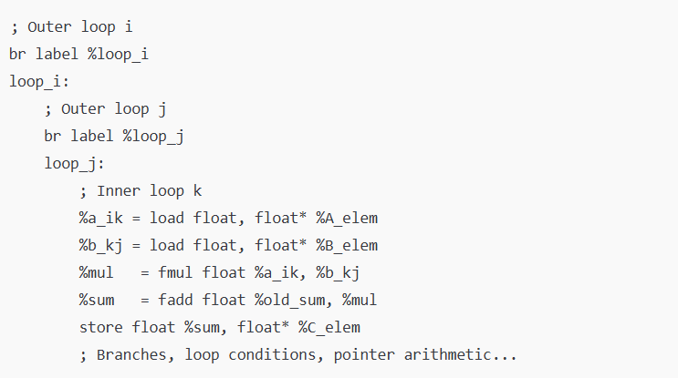
MLIR VS LLVM IR Cont.
LLVM IR Approach:
You must represent the algorithm immediately as low-level scalar instructions with explicit loops:
There’s no concept of “matrix multiply” anymore — just loads, stores, and scalar arithmetic.
To optimize, you must recognize the pattern of nested loops yourself (hard and error-prone).

Slide 14
MLIR Passes
A pass in MLIR is just like in LLVM — it’s a transformation or analysis that runs over some part of your IR.
Transformation pass — modifies the IR (e.g., optimization, lowering, dialect conversion).
Analysis pass — inspects the IR and provides information to other passes (e.g., loop bounds, alias analysis).
The big difference is:
In MLIR, passes can run at multiple abstraction levels and on different IR scopes:
Module-level
Function-level
Region/Block-level
Operation-level
In LLVM, passes mainly run at module, function, or loop scope — but only on low-level IR.

Slide 15
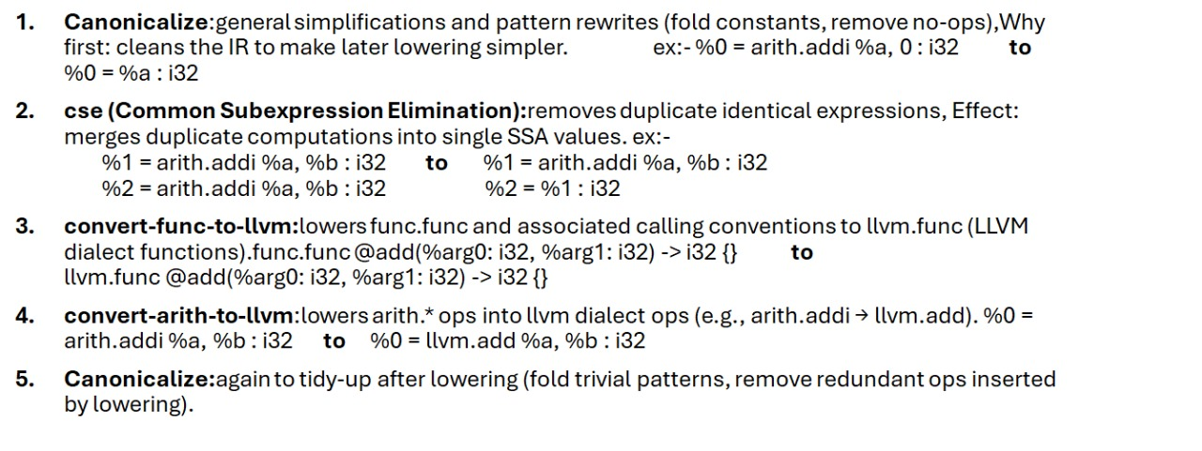
MLIR Passes Cont.

Slide 16
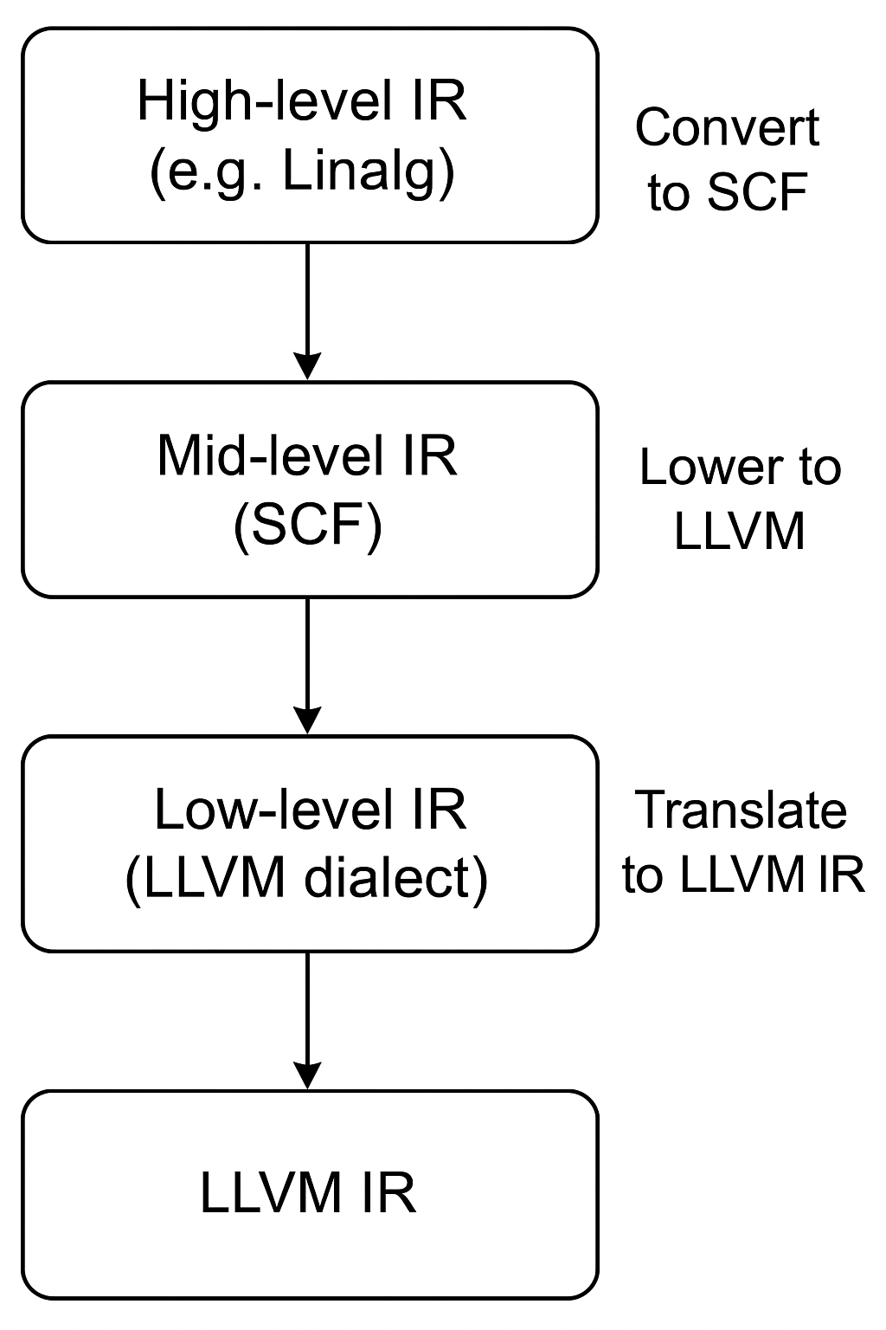
Why MLIR Passes are Powerful
They can run at any abstraction level (tensor ops, loops, LLVM ops).
They can be dialect-specific (optimize only your custom ops).
They can be chained in pipelines for stepwise lowering.
They integrate with pattern rewriters for easy, rule-based transformations.

Slide 17
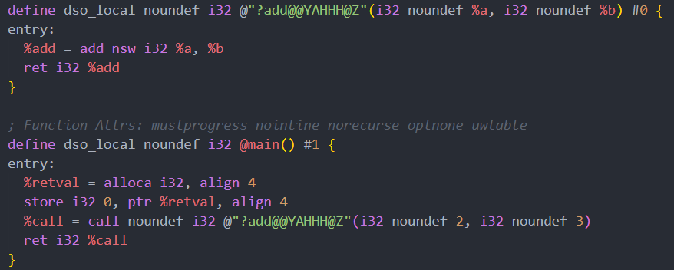
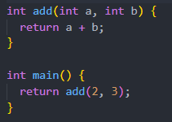

Example 1:-

Slide 18
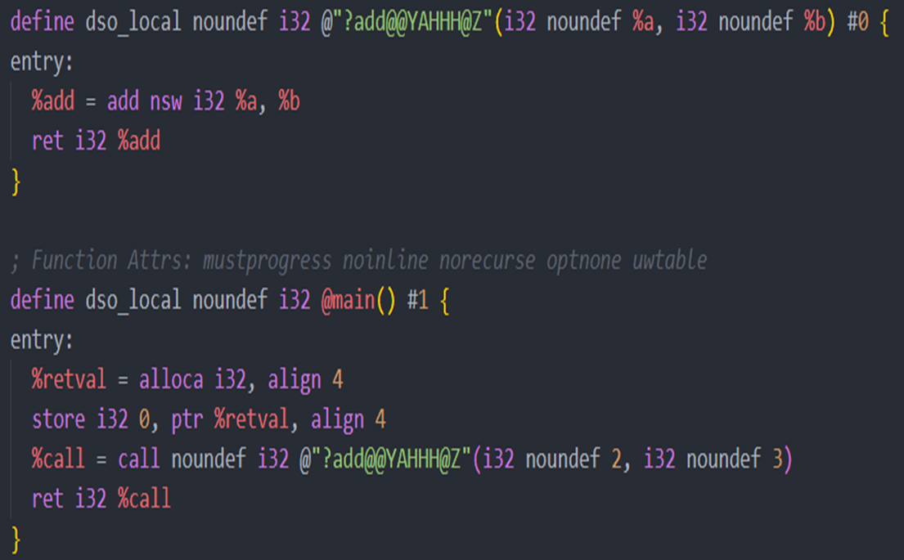
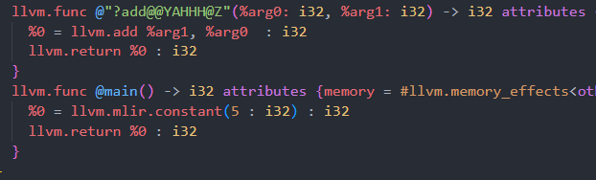
Example 1:-

Slide 19
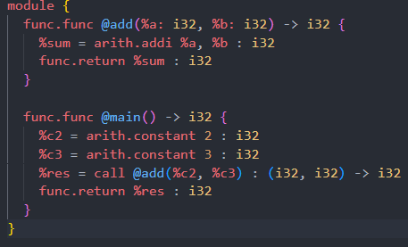
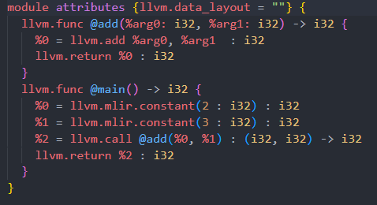
Example 2:-

Slide 20
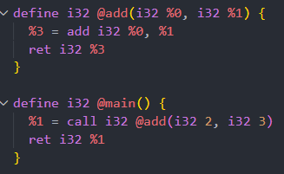
Example 2:-

Slide 21


