Slide 1


Next Generation Sequencing
Bioinformatics Course 2021
Module 6 – Pathogen variant calling
Session 1: Alignment to reference

Slide 2
Detection of variants (Variant calling)
Choose a suitable reference
Alignment to reference (bwa)
Identify all variants (raw SNPs)
Filter the variants (SNPs)

Slide 3
Selecting suitable reference
Best source: NCBI reference database or prior published studies
Complete genome sequence available
NCBI has versions : select the latest
Genome annotation
From the same species or close relative
Present case : M. tuberculosis H37Rv (NC_000962.3)
reference
Mapped reads

Slide 4
Step1: Alignment to reference
Index the reference (bwa index)
Align the reads (bwa mem)
Convert sam to bam (bwa mem)
Sort the bam file (bwa sort)
Mark the duplicates (picard)
Index the sorted file (bwa index)

Slide 5
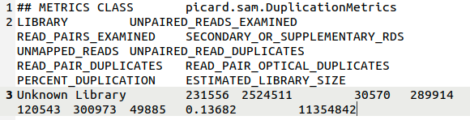
Duplicates
1) picard MarkDuplicates I=sorted.bam O=markdup.bam M=metrics.txt
2) grep –A 2 “^## METRICS” metrics.txt

Slide 6
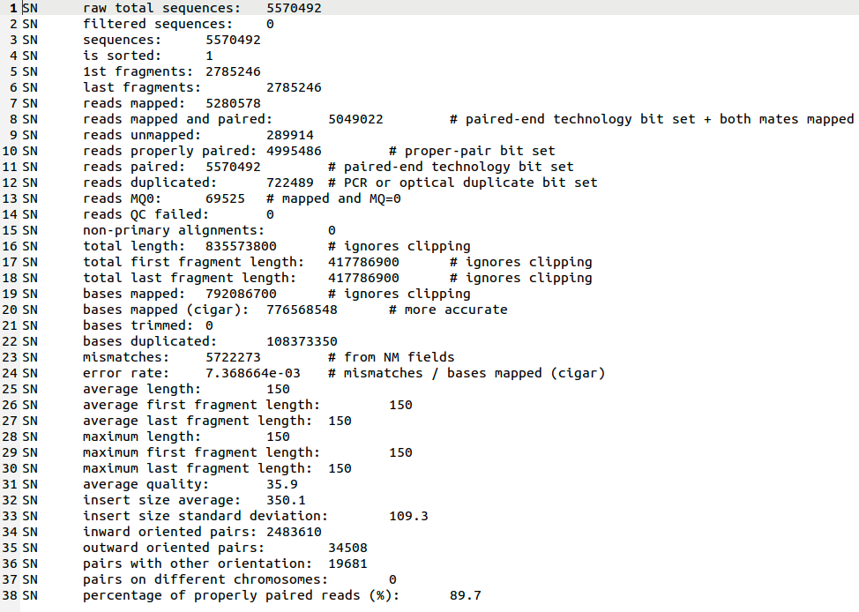
Mapping statistics
1) samtools stats in.bam>bamstat.txt
2) grep “^SN” bamstats.txt >stats.txt

Slide 7
Thank you

