Slide 1



Next Generation Sequencing
Bioinformatics Course 2021
Module 6 – Pathogen variant calling
NGS Bioinformatics Course Africa 2021
Trainer name

Slide 2

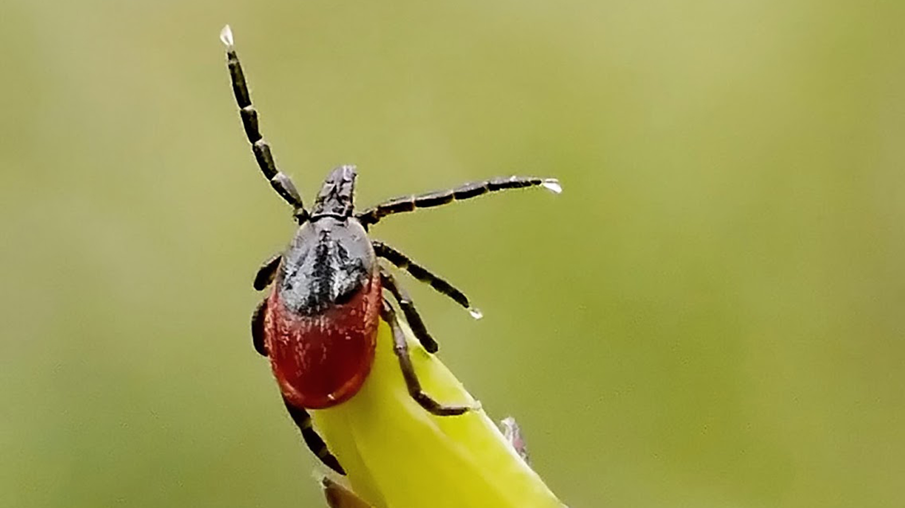


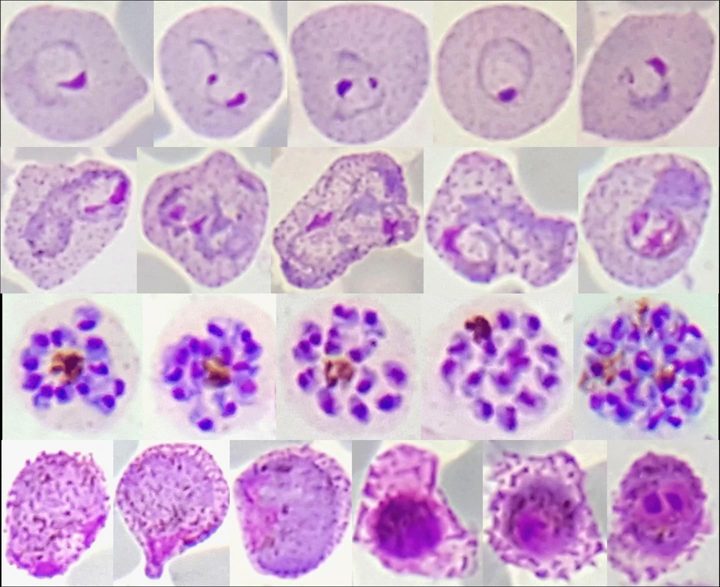
Pathogens
Viruses
SARS-Covid-2
Bird Flu
Swine Flu
Yellow fever
Lime disease
Arthropods
Bacteria
Pneumonia
Tuberculosis
Pathogens
Fungi
Parasites
Aspergillosis
Candidiasis
Malaria
Filariasis
Next Generation Sequencing Bioinformatics
Trainer Name: Narender Kumar

Slide 3
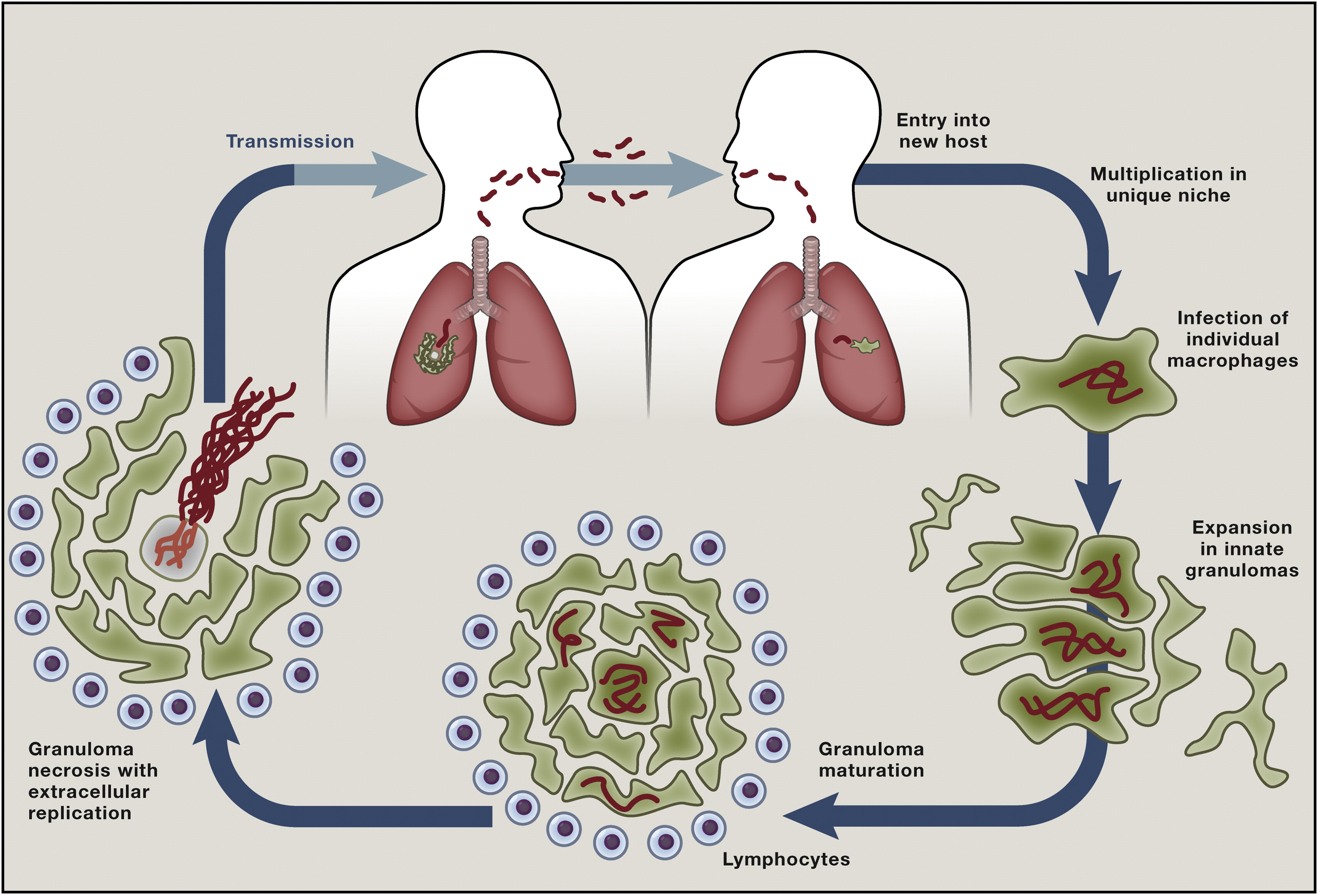
Mycobacterium tuberculosis
Cause Tuberculosis in humans
Primary source of transmission through aerosols produced during cough
Diagnosis involves microscopy, GeneXpert
Culturing takes weeks to months
Phenotypic DST labour and time intensive
Rapid methods for detecting resistance needed : WGS
Next Generation Sequencing Bioinformatics
Trainer Name: Narender Kumar

Slide 4
Question: Investigating resistance in M. tuberculosis
What we know
4 isolates from patients with Tuberculosis in a region
The rapid tests (GeneXpert) have revealed resistance to rifampicin
WGS performed for all 4 isolates
Isolate | Drug | Resistance
MD001 | Rifampicin | Resistant
MD002 | Rifampicin | Resistant
MD012 | Rifampicin | Resistant
MD024 | Rifampicin | Sensitive
Questions we would investigate
Detect genetic variants for resistance
resistance to other anti-Tb drugs
Are these related isolates (pairwise SNP difference)
Understand their phylogenetic relationship
Next Generation Sequencing Bioinformatics
Trainer Name: Narender Kumar

Slide 5
Resistance mechanisms: M. tuberculosis
Acquired genetic mutations confers resistance
Drug | Gene | Mutations
Rifampicin | rpoB | S450X, D435X
Streptomycin | rpsL | K43R
Isoniazid | katG | S315T
Fluoroquinolone | gyrA | D94X
Next Generation Sequencing Bioinformatics
Trainer Name: Narender Kumar

Slide 6
Contents
Session1: Alignment to reference
Session2: Variant calling and filtering
Session3: Inferring genetic relatedness
Session4: Summary of all the results
Next Generation Sequencing Bioinformatics
Trainer Name: Narender Kumar

Slide 7
Thank you
Next Generation Sequencing Bioinformatics
Trainer Name: Narender Kumar

