Slide 1


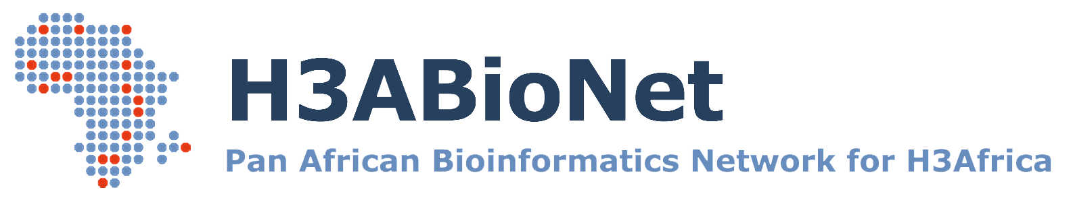
Next Generation Sequencing
Bioinformatics Course 2021
Pathogen Variant Calling
Variant calling
NGS Bioinformatics Course Africa 2021
Jon Ambler

Slide 2
Overview
Read QC (Trimming, adapter removal)
Read alignment
Variant calling
Alignment QC (Multi-mapping sequences, coverage cutoffs)
Filtering variants
Sample sequence (fastq)
Filtered sample sequence (fastq)
Reference genome (fasta)
Alignment format (SAM BAM)
Filtered Variants (VCF)
Next Generation Sequencing Bioinformatics
Trainer Name: Jon Ambler

Slide 3
Overview
Question: Investigating resistance in M. tuberculosis
Next steps:
Where do errors come from?
How are variants called
Variant filtering
Investigate VCF files
Next Generation Sequencing Bioinformatics
Trainer Name: Jon Ambler

Slide 4
Overview
What does variant calling do?
Variant calling identifies small differences (variants) between a sample and a reference
Resolution dependent on the read length & algorithm
Most tools are limited to detecting events shorter than the length of a short-read sequencing alignment.
SNPs (single-nucleotide polymorphisms), Indels (insertions and deletions), MNPs (multi-nucleotide polymorphisms)
What does it not do?
Identification of large structural events
Chromosomal rearrangements, large deletions, gene duplications
Often variants are incorrectly called at structural breakpoints
Next Generation Sequencing Bioinformatics
Trainer Name: Jon Ambler
Notes:
If a gene is missing in the sample, no variants will be called. If your research question if to look for reasons why a pathway is not working, variant calling will miss this.

Slide 5
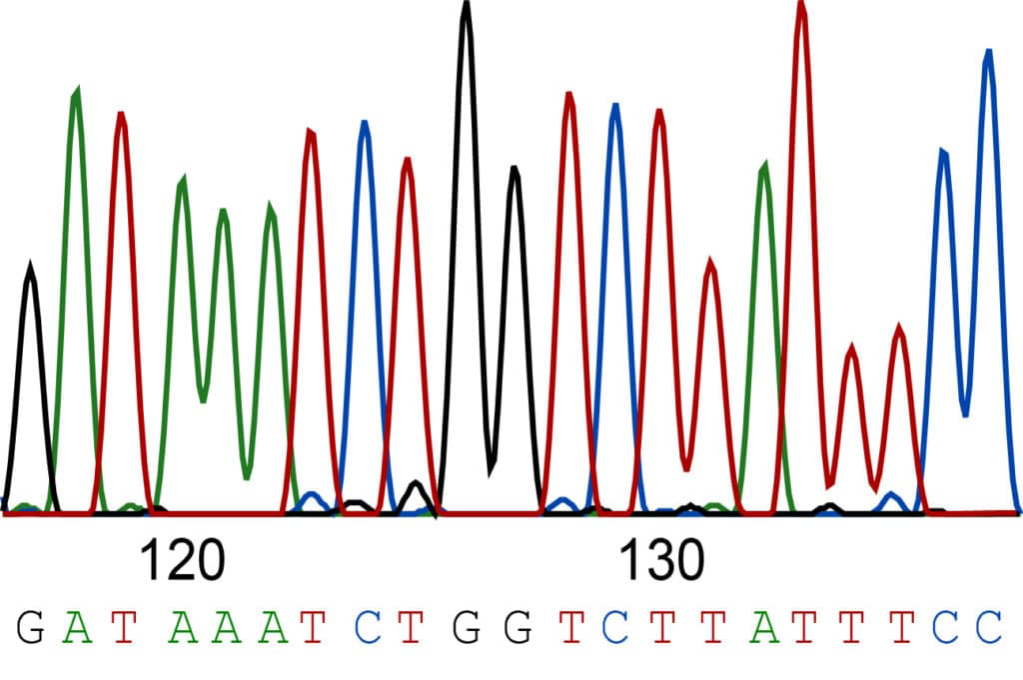
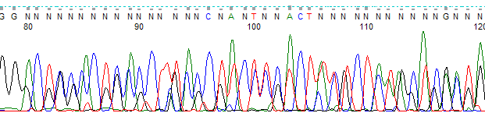
QC - Base calling errors
Where do errors come from?
Uncertainty from the base call
Normally quality falls off towards the end of the read
Low quality, wrong base
PCR errors
Errors early in the PCR reaction
Bridge PCR (Illumina / Solexa solid phase amplification) or emulsion PCR
High quality, wrong base
PCR vs PCR free sequencing
Nanopore sequencing = no PCR
Platform specific error profiles
Next Generation Sequencing Bioinformatics
Trainer Name: Jon Ambler
Notes:
If a gene is missing in the sample, no variants will be called. If your research question if to look for reasons why a pathway is not working, variant calling will miss this.

Slide 6
Variant calling
Goal:
Given an alignment (bam), identify positions where reads support an alternate allele at a position compared to the reference sequence.
Tools:
Freebayes
SAMtools mpileup / bcftools
GATK
Next Generation Sequencing Bioinformatics
Trainer Name: Jon Ambler
Notes:
Filtering trims this down

Slide 7
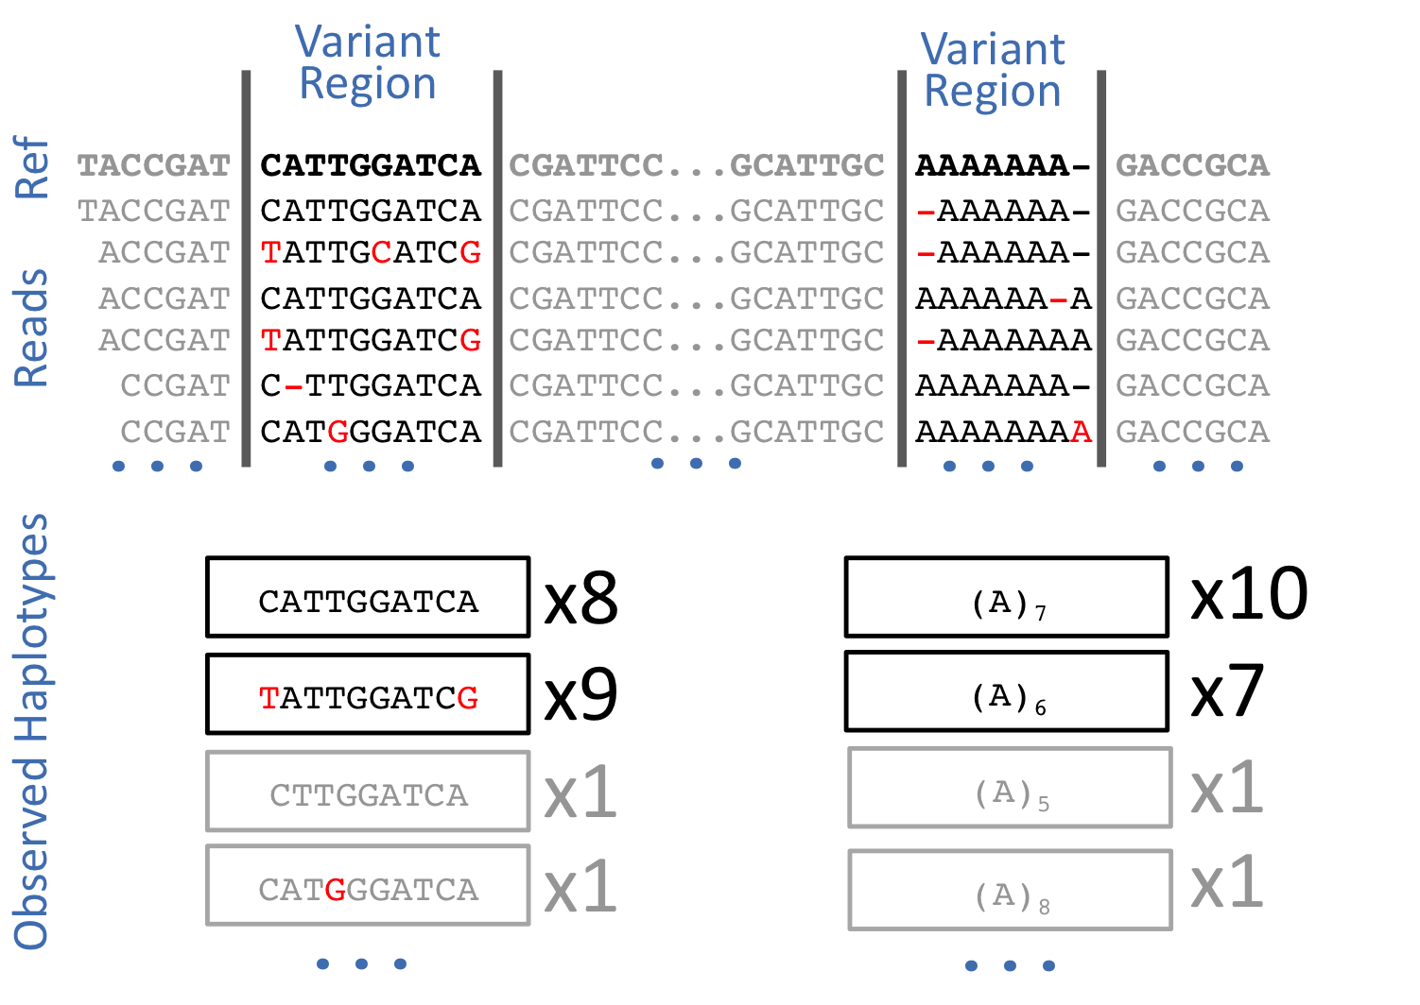
Variant calling
Freebayes
Uses a Bayesian approach to find variants
GATK
Built for human genomes
Widely used, constantly improved
SAMtools mpileup
bcftools mpileup generates genotype likelihoods
bcftools call makes the calls
How to choose
Look at what other researchers are using for the organism
Use what you have support for / your team has experience with (but stay up to date)
Read papers to stay up to date
Source: https://github.com/freebayes/freebayes
Term definition: A haplotype is a group of genes within an organism that was inherited together from a single parent.
Next Generation Sequencing Bioinformatics
Trainer Name: Jon Ambler
Notes:
The newest is not always the best, problems may just not yet have been found.
Better versions will always come out.

Slide 8
QC - Variant filtering
What can you filter on?
Depth, ploidy, quality
Depth
Why can high coverage be bad?
Could indicate a region with a lot of multi-mapping reads from a gene duplication
Ploidy
In haploid organisms, things are simpler
Many tools built for diploid, still output genotype information (A/A or A/C or C/C)
Quality
QUAL column: phred-scaled probability the ALT is wrong
GQ (Genotype quality) in the format column. Defined as -10log_10p(genotype call is wrong)
Examples:
1 / 1 000 chance the genotype call is wrong
-10log_10(0.001) = 30
GQ = 12
10 ^ (-12 / 10) = Probability of 0.063095 that the call is incorrect
Next Generation Sequencing Bioinformatics
Trainer Name: Jon Ambler
Notes:
If a gene is missing in the sample, no variants will be called. If your research question if to look for reasons why a pathway is not working, variant calling will miss this.

Slide 9
QC - Variant filtering
Challenges
Duplicate genes
Sequenced genome had two copies of a region
Region appears only once in the reference genome
Missing genes
If a gene is missing in a sample but present in the reference, no variants will be called.
Closely related reference genome NB
Next Generation Sequencing Bioinformatics
Trainer Name: Jon Ambler

Slide 10
QC - Variant filtering
Tools
gatk VariantFiltration
vcftools
bcftools filter / view
bcftools query
Useful to test filtering and report general quality
A useful cheat sheet for BCF:
https://gist.github.com/elowy01/93922762e131d7abd3c7e8e166a74a0b
By: Ernesto Lowy
Next Generation Sequencing Bioinformatics
Trainer Name: Jon Ambler

Slide 11
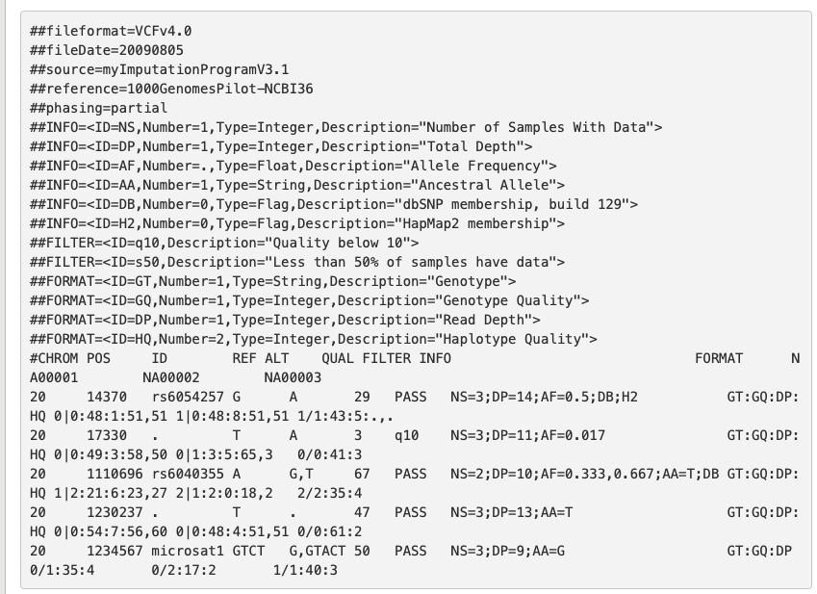
QC - Anatomy of a VCF file
Mapping of info in the Meta-information lines
Source: https://www.internationalgenome.org/wiki/Analysis/vcf4.0/
Next Generation Sequencing Bioinformatics
Trainer Name: Jon Ambler
Notes:
Go through examples of filtering and logic

Slide 12
QC - Anatomy of a VCF file
Mapping of info in the Meta-information lines
Source: https://www.internationalgenome.org/wiki/Analysis/vcf4.0/
Next Generation Sequencing Bioinformatics
Trainer Name: Jon Ambler
Notes:
Go through examples of filtering and logic

Slide 13
QC - Anatomy of a VCF file
Mapping of info in the Meta-information lines
Source: https://www.internationalgenome.org/wiki/Analysis/vcf4.0/
Next Generation Sequencing Bioinformatics
Trainer Name: Jon Ambler
Notes:
Go through examples of filtering and logic

Slide 14
QC - Anatomy of a VCF file
Mapping of info in the Meta-information lines
Source: https://www.internationalgenome.org/wiki/Analysis/vcf4.0/
Next Generation Sequencing Bioinformatics
Trainer Name: Jon Ambler
Notes:
Go through examples of filtering and logic

Slide 15
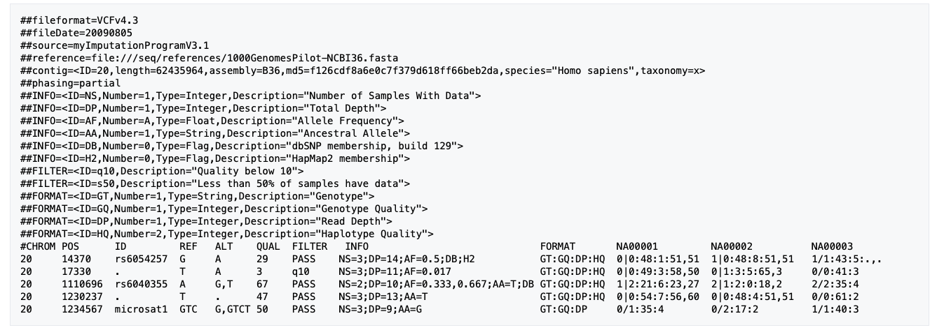
QC - Anatomy of a VCF file
Multiple samples in the same VCF
Source: https://www.internationalgenome.org/wiki/Analysis/vcf4.0/
Next Generation Sequencing Bioinformatics
Trainer Name: Jon Ambler
Notes:
Go through examples of filtering and logic

Slide 16
QC - Variant filtering
bcftools filter -i 'type="snp" && QUAL>=50 && FORMAT/DP>5 && MQ>=30' -g10 -G10 MD001_variants.vcf -o MD001_SNPs_filtered_try1.vcf
QUAL = Base quality score column
DP = Read depth
MQ = Mapping quality
Next Generation Sequencing Bioinformatics
Trainer Name: Jon Ambler

Slide 17
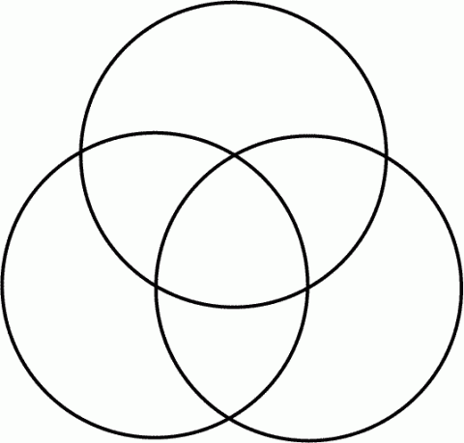
Identifying mutations of interest
Variant calling is only a part of the comparison process.
What are the mutation of interest?
Mutations found only in the case samples
Missing mutations not covered
Sample 2
Sample 5
4
3
Sample 1
6
1
Sample 4
3
6
77
80
2
3
1
5
7
2
Sample 3
Sample 6
Case
Control
Next Generation Sequencing Bioinformatics
Trainer Name: Jon Ambler

Slide 18
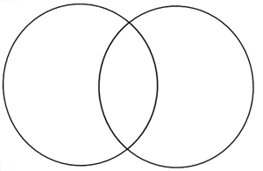
Identifying mutations of interest
Variant calling is only a part of the comparison process.
What are the mutation of interest?
Mutations found only in the case samples
What about missed mutations due to uneven coverage?
Sample 2
Case
Control
Sample 5
4
3
Sample 1
6
1
70
7
73
Sample 4
3
6
77
80
2
3
1
5
7
2
Sample 3
Sample 6
Case
Control
Next Generation Sequencing Bioinformatics
Trainer Name: Jon Ambler

