Slide 1


Next Generation Sequencing
Bioinformatics Course 2021
Pathogen Variant Calling
Variant annotation

Slide 2
Overview
Investigating resistance in Mycobacterium tuberculosis
What mutations are causing the resistance phenotype?
Using SnpEff
Using databases
Interpreting the output
Filtering based on your research goals

Slide 3
SnpEff
Provides information on the effects of variants
Within gene
Mutation effect
Silent, missense, nonsense
Up / downstream effects
Relevant for regulation (TF binding sites)

Slide 4
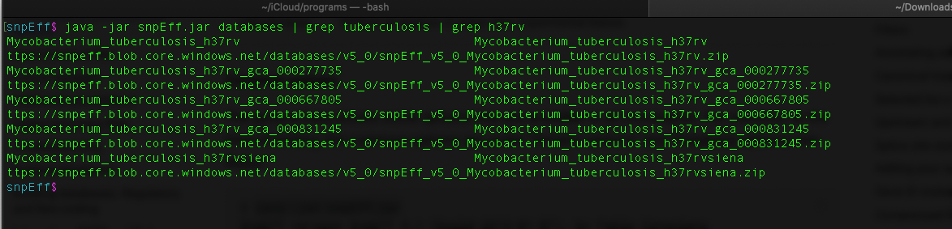
SnpEff
Using existing databases
Need to use the same assembly that matches the annotation
Find using grep & SnpEff database command
Notes:
Keeping the same annotation and reference all through the process is NB!!

Slide 5
SnpEff
Building your own database
Use custom annotations
Useful when assembling genomes
Annotations not found in the database
From the creators of SnpEff:
“Most people do NOT need to build a database, and can safely use a pre-built one. So unless you are working with an rare genome you most likely don't need to do it either.”

Slide 6
SnpEff
How?
Create folder in SnpEff directory for the genome (for example newBacGenome)
Move the fasta reference into the new folder and rename it “sequences.fa”
Move annotation file (GFF) to the folder and rename it “genes.gff”
Add "newBacGenome.genome: newBacGenome" to the bottom of the snpEff.config file where “newBacGenome” is the folder name
https://pcingola.github.io/SnpEff/se_buildingdb/

Slide 7
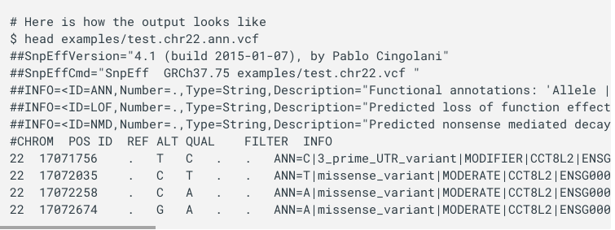
SnpEff
Output of snpEff annotation:

Slide 8
SnpEff
Output vcf ANN entry:
ANN=T|missense_variant|MODERATE|CCT8L2|ENSG00000198445|transcript|ENST00000359963|protein_coding|1/1|c.1406G>A|p.Gly469Glu|1666/2034|1406/1674|469/557||,T|downstream_gene_variant|MODIFIER|FABP5P11|ENSG00000240122|transcript|ENST00000430910|processed_pseudogene||n.*397G>A|||||3944|
Filter by:
cat sample_filtered_annotated.vcf | grep HIGH
Count by:
cat sample_filtered_annotated.vcf | grep start_lost | wc -l
More info on format here:
https://pcingola.github.io/SnpEff/se_inputoutput/

Slide 9
SnpEff
Filtering:
Effect of mutation
High, moderate, low
Type of mutation
Indel, frameshift_variant, missense_variant
Genes of interest
Search by gene name to find all related variants
Includes upstream / downstream

Slide 10
SnpEff
Lists of resistance genes for different microbes
https://bitbucket.org/genomicepidemiology/pointfinder_db/src/master/

