Slide 1


Portable Wireless
Pulse Oximeter
Remote Health Monitoring System
Faculty of Engineering • Damanhour University • Communications & Electronics Dept.

Slide 2
Team Members
Hossam Rabie Alwani
Abd El-Rahman Sabry Kamel
Kareem Essam El-Sayed
1
2
3
ID: 22170160
ID: 23170153
ID: 22170191
Mohamed Ashraf Mohamed Haddad
Mohamed Khaled Mohamed
Mohamed Sha'ban El-Gamal
4
5
6
ID: 22170193
ID: 22170195
ID: 22170197
Mohamed Kareem El-Sharqawy
Mohamed Mohamed Ibrahim
Mohamed Mahmoud Shehata
7
8
9
ID: 22170200
ID: 22170201
ID: 22170202

Slide 3
Table of Contents
01 Problem Statement
06 Components & Budget
02 Solution Idea
07 Challenges
03 Electronic Circuit Design
08 Project Demo Video
04 Circuit Simulation
09 Future Work
05 PCB Design

Slide 4
Problem Statement
⚠ Limited Access to Continuous Monitoring
🏥 High Cost of Clinical Equipment
Patients in remote areas or home settings lack access to continuous real-time SpO2 and heart rate monitoring, leading to delayed diagnosis of critical conditions like hypoxemia.
Hospital-grade pulse oximeters are expensive and not portable. There is no affordable, integrated IoT solution that connects patients directly to healthcare providers.
📡 No Remote Doctor Visibility
👤 No Role-Based Health Platform
Current consumer devices display data locally only. Doctors have no real-time access to patient readings, making remote health management practically impossible.
Existing systems lack structured multi-role platforms (Patient, Doctor, Admin) needed for organized medical monitoring, alerts, and data management.

Slide 5
Solution Idea
1
2
3
4
Hardware Device
Data Transmission
Web Platform
User Roles
NodeMCU ESP8266
MAX30102 Sensor
OLED Display
Battery Powered
WiFi / Cloud
MQTT / HTTP
Real-time Upload
Secure Channel
FastAPI Backend
Real-time Dashboard
Role-Based Access
Alert System
Patient Portal
Doctor Dashboard
Admin Panel
Data Analytics
End-to-end remote health monitoring: from sensor to doctor screen

Slide 6
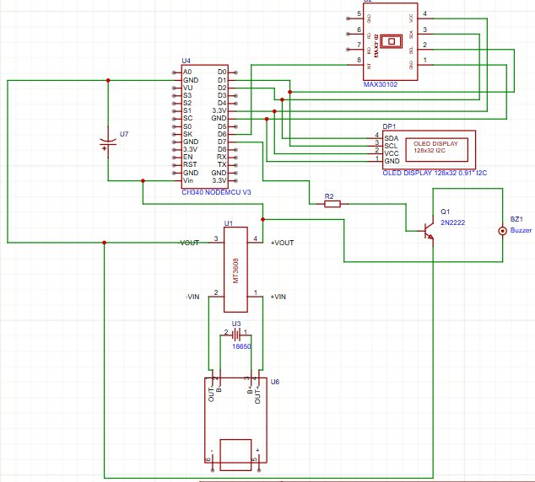
Electronic Circuit Design
Key Components
NodeMCU ESP8266 (CH340)
MAX30102 SpO2 Sensor
SSD1306 OLED 128×32
MT3608 Boost Converter
TP4056 Charging Module
18650 Li-ion Battery
2N2222 Transistor
Piezo Buzzer (BZ1)

Slide 7
Circuit Simulation
[Insert Simulation Screenshot Here]
Wokwi / Proteus Simulation
Simulation validates I2C communication, MAX30102 readings, OLED output, and power stability before PCB fabrication.

Slide 8
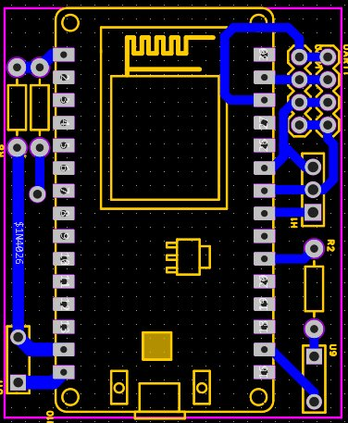
PCB Design & Assembly
PCB Layout
Designed in EasyEDA with optimized component placement for minimal noise and compact form factor.
Power Path
TP4056 → MT3608 boost → 5V rail for NodeMCU. Decoupling caps on all IC power pins.
I2C Bus
4.7kΩ pull-ups on SDA/SCL shared between MAX30102 and SSD1306 OLED.
Form Factor
Designed for compact 18650 or LiPo battery enclosure with charging indicator.

Slide 9
Components & Budget
Component | Qty | Unit Price (EGP) | Total (EGP)
NodeMCU ESP8266 (CH340) | 1 | 85 | 85
MAX30102 SpO2/HR Sensor | 1 | 120 | 120
SSD1306 OLED 128×32 I2C | 1 | 60 | 60
MT3608 Boost Converter | 1 | 15 | 15
TP4056 Charging Module | 1 | 12 | 12
18650 Li-ion Battery | 1 | 45 | 45
PCB Fabrication | 1 | 150 | 150
Resistors, Capacitors, etc. | — | 20 | 20
Buzzer + Transistor | 1 | 10 | 10
Enclosure / Housing | 1 | 40 | 40
TOTAL BUDGET |  |  | 557 EGP

Slide 10
Challenges Faced
I2C Bus Conflicts
Power Rail Instability
01
Both MAX30102 and SSD1306 share the I2C bus. Missing pull-up resistors (4.7kΩ on SDA/SCL) caused both devices to be unresponsive on first PCB bring-up.
02
The MT3608 boost converter output had high ripple without adequate decoupling caps, causing the NodeMCU to reset unexpectedly during sensor reads.
SpO2 Accuracy Calibration
WiFi Connectivity in Low Signal
03
The MAX30102 AC/DC ratio algorithm required fine-tuning of the R-value lookup table to achieve readings within ±2% of clinical reference devices.
04
ESP8266 struggled to maintain stable MQTT connection in weak WiFi environments. Added reconnection logic and exponential backoff.
PCB Routing & Noise
Battery Life Optimization
05
Analog sensor traces near switching power supply traces introduced noise. Resolved by proper ground plane partitioning and shorter trace lengths.
06
Continuous WiFi transmission drained the 18650 in ~3 hours. Implemented deep sleep intervals and buffered data uploads to extend battery life.

Slide 11
Project Demo
▶
[ Insert Video Here ]
Demo Duration: ≤ 1 minute • Shows live SpO2 & BPM readings transmitted to web dashboard

Slide 12
Future Work
🤖 AI-Powered Health Alerts
📱 Mobile Application
🌐 Multi-Sensor Expansion
Integrate a machine learning model to detect anomalies in SpO2/BPM trends and issue predictive health alerts before critical thresholds are reached.
Develop a cross-platform mobile app (React Native) for patients and doctors to receive push notifications and view historical health trends on the go.
Add ECG, temperature, and blood pressure sensors to evolve the device into a comprehensive multi-parameter portable health monitor.
☁ Cloud & Telemedicine Integration
🔋 Advanced Power Management
🏭 3D-Printed Enclosure
Connect the platform to telemedicine services and EHR systems (e.g., HL7 FHIR) enabling seamless data exchange with hospitals and clinics.
Implement adaptive deep sleep and solar charging options to extend battery life to 48+ hours for continuous patient monitoring.
Design and fabricate a compact medical-grade 3D-printed enclosure with ergonomic finger clip and USB-C charging port.

Slide 13
Thank You
Portable Wireless Pulse Oximeter
Faculty of Engineering • Damanhour University
Questions & Discussion

