Slide 1
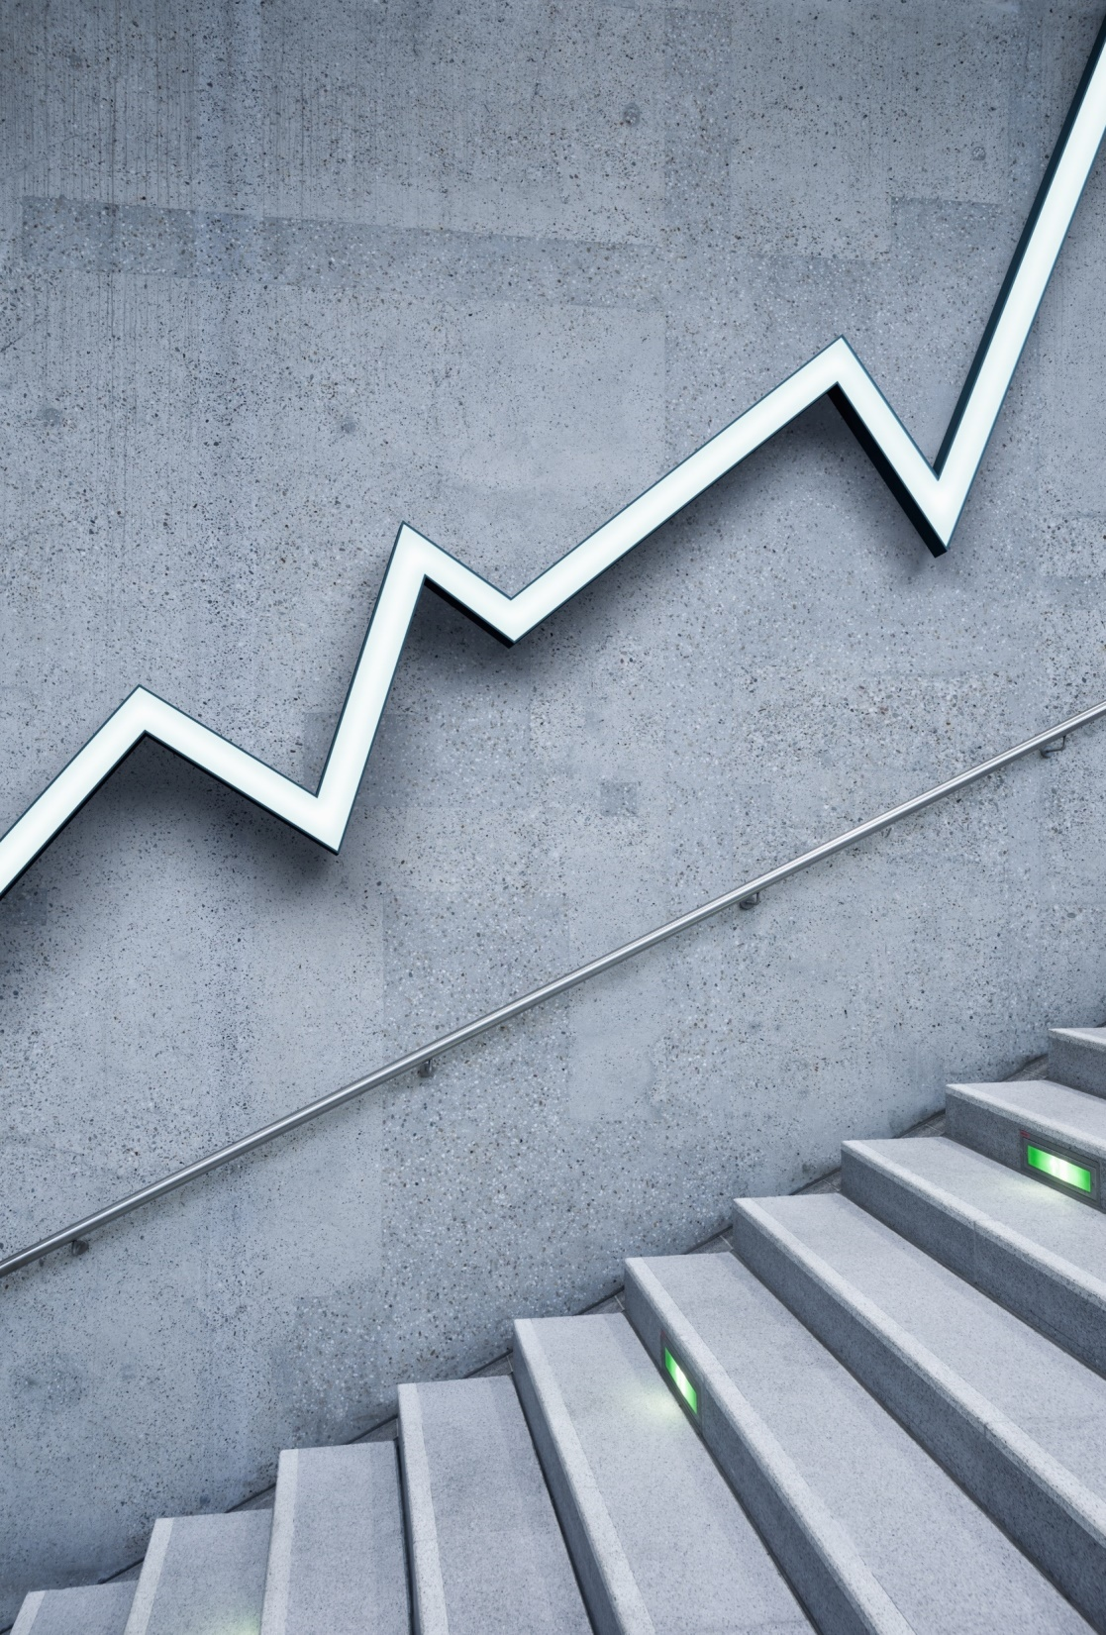
LITECOIN
Present By:
Balasankar.s(2019202005)
Mohamed azarudeen.s(2019202031)

Slide 2
What is Litecoin?
  As with the passage of time cryptocurrency is being embraced by the world, individuals are now searching for better investment options in these digital currencies.
  After seeing the investment scope in Ethereum and Bitcoin, they are now looking forward to Litecoin.
  As all the cryptocurrencies work on the technology of Blockchain, so does Litecoin too.
  The blockchain is a technology which is helpful in maintaining open records or blocks between seller and buyer of cryptocurrency.

Slide 3
What is Litecoin?
  Before understanding what Litecoin is, let us first see about its founder.
  The man behind the Litecoin digital currency is Charlie Lee who worked previously with Google group.
  Litecoin was released on GitHub on 7th October 2011 and it went live on 13th October 2011.
  Technically Litecoin if compared with Bitcoin is a bit different, as hashing algorithm “scrypt” is used instead of “SHA-256” and little modification with GUI makes you experience a fast and better digital currency.

Slide 4
What is Litecoin?
  Litecoin is a currency which has its complete base on peer to peer and It’s been widely accepted in the economy since its release.
  As with other cryptocurrencies, litecoin also doesn’t require any intermediate body like a bank for making and receiving payments.
  Let us now understand the buying options available in the market for this coin.

Slide 5
How can you buy Litecoin?
  If you want to possess litecoins then cryptocurrency mining is one of the options.
  If mining doesn’t suit you then buying them is the other option of procuring them.
  Litecoin cannot be directly bought in fiat currency, rather needs to be exchanged against Bitcoins or maybe some other cryptocurrency.
  This trade of litecoin can be done on the platform called exchange.

Slide 6
How can you buy Litecoin?
  There exist a lot of exchanges on which cryptocurrencies can be traded.
  However, there are some options or exchanges which now allow buying Litecoin against US dollars.
  When a person wishes to initiate an exchange of cryptocurrencies, then arise the need to maintain them in a secure place which is called the wallet.
  As we need a wallet to keep our fiat money safe similarly, cryptocurrencies are kept in wallets.

Slide 7
What is Litecoin Wallet?
  Digital wallets are the platform where Litecoins are stored with security and safety like all other cryptocurrency wallets.
  These wallets can be easily stored on your iPhones or Android phones or maybe on a computer with the help of software.
  There is one more way of securing the litecoin, although it’s an outdated as well as a complex method of storing coins.
  This method involves the creation of a paper wallet.
  Here we need to generate and take a printout of the private-key.

Slide 8
What is Litecoin Wallet?
  Every individual wallet has this private-key which further helps in receiving and sending litecoins.
  As internet can be hacked but hardcopy cannot be, thus this offline method can be considered more secure.
  There are more than a ton of wallets where you can store these coins.
  There are 4 types of wallets to store them:

Slide 9
Litecoin Wallets:
Paper Wallet: these wallets are considered to be the safest option to store the coins. The ultimate reason is that the user has complete control over this printed version.
1. They are cold storage i.e. offline storage
2. Private Key and public key are printed in form of QR code.
3. There isn’t any need to be afraid of hackers.

Slide 10
Litecoin Wallets:
Mobile Wallet: an application needs to be downloaded on Android or iPhone to use this wallet.
Hardware Wallet: these are physical devices meant for the currency storage purpose.
1. It can be in the form of a USB Stick.
2. Ledger Nano S and Trezor are the two hardware wallets which can be utilized to store Litecoins.

Slide 11
Litecoin Wallets:
Desktop Wallet: the device required to use this wallet is a computer
1. You need one system, laptop or desktop.
2. The software has to be downloaded.
3. The wallet has to be accessed on that particular system where software has been installed.
4. Although it is a safe platform but can at times become difficult to access as the same computer would be required while transacting.

Slide 12
What is the difference between Bitcoin & Litecoin?
  Bitcoin, as was the first cryptocurrency which came into existence ever after its creation in the year 2009.
  It has set certain benchmark and performance standards, and in order to analyze the performance of any other currency, the older currency needs to be compared.
  Thus to really understand how Litecoin is doing in financial market we need to compare it with Bitcoin.
  It is also said for Litecoin that, it is considered to be a clone of Bitcoin.

Slide 13
What is the difference between Bitcoin & Litecoin?
  Although both the terminologies Litecoin and Bitcoin belong to the same class i.e. Cryptocurrency, but there are several differences between the two.
  If we observe from the surface then both of them are similar and share several common aspects.
  Let us try to analyze the difference between them.

Slide 14
What is the difference between Bitcoin & Litecoin?
  Fast Mining:
    On technical grounds, Litecoin aims to process every block at every 2.5 minutes whereas Bitcoin has its time as 10 minutes, which makes Litecoin transactions faster than that of the Bitcoin.
  Date of creation:
    Bitcoin was created two years before the creation of Litecoin, i.e. on 3rd January 2009 Bitcoin was created and Litecoin was created on 7th October 2011.
  The difference of Algorithm:
    Litecoin uses the proof of work algorithm scrypt whereas Bitcoin uses SHA-256 technology.

Slide 15
What is the difference between Bitcoin & Litecoin?
    Mining Aspect:
      FPGA and ASIC devices are used for mining litecoin due to its “scrypt” algorithm technology which is complicated as well as expensive to mine.
    Coins to be released:
      Number of bitcoins to be released is 21 million whereas litecoin is 84 million to be released.
    Gold v/s Silver:
      Bitcoin and Litecoin can be compared with Gold and Silver in the real world.
      The worth of both can be respectively similar.

Slide 16
What are the features of Litecoin?
  There are 4 Unique Features of Litecoin which give immense strength to its basic concept. These features are enlisted below:
                • Speed,
                • Liquidity,
                • Equality,
                • Fast Technology.
  All the above-mentioned features of Litecoin take it ahead of Bitcoin.

Slide 17
What are the features of Litecoin?
  In terms of technology, litecoin is working on testing and implementing concept which is faster than Bitcoin.
  Liquidity of 84 million coins in comparison to 21 million Bitcoins brings more satisfaction on the face of miners and investors having faith in litecoin.
  At the Initial stages, Charlie lee faced failure because he was involved in the reviving team of Fairbix blocks but unfortunately it was not revived and he launched Litecoin cryptocurrency.

Slide 18
How to earn Litecoin?
  There are platforms available on the internet, various websites where you just need to visit and do what you already know to do.
  You don’t need to do something new or even technical.
  You just need to enter into some engaging activities on the internet and you can grab some litecoins as a reward without mining them or even exchanging them

Slide 19
How to earn Litecoin?
There are certain tasks that you can accomplish to earn Litecoin which are:
  Watching ads: there are some video ads watching which could help you earn Litecoins. These ads can be viewed on a cell phone or computers as well.
  Playing games: Free Litecoins can also be earned just by downloading a game on your mobile phone and playing it.
  Doing surveys: there are some surveys which are sponsored and needs to be done daily (at times), which can help you earn Litecoins.
  Refer a friend: this invitation to other friends can help you earn, as they would earn so would you along with them.

Slide 20
THANK YOU…

