Slide 1
Easy CQRS with ASP.NET Core & MediatR
Ryan Foote - Lead Developer, Dayton Freight Lines, Dayton, OH

Slide 2


Background
Lead Developer, Cloud Development Team, Dayton Freight Lines
Leveraging Microsoft Azure
Software Development for 15 years
Specializing in web application and database development and design
First time speaker, first time at CodeMash

Slide 3
Dayton Freight Lines, Inc.
Regional LTL freight carrier
Approx. 6000 employees
13 States
Over 50 service centers
LTL …think UPS with skids
HQ in Dayton, OH
$500 million annually
Notes:
Focus on what makes me different than other speakers
Technology investment
In-house development
Focus on developer advocacy
Development community involvement
Really want people to know that we are a technology company too

Slide 4
Why Am I Here?
Larger Applications
Our organization needed to know the next steps
Need more “Enterprise” approach. But how?
MediatR! Woo!
Developers need to know
What it means
How it works
Why it’s good

Slide 5
We have problems…
Applications becoming large and have very long life spans. Maintenance is a big issue.
Making modifications and debugging difficult
Difficulty in testing
Bloated controllers leading to bloated service layers
Difficulty in team development
How do I segment my work?
Merge difficulties

Slide 6
How do we solve these problems?
How do we get more “Enterprise”?

Slide 7
CQRS
Command Query Responsibility Segregation

Slide 8
CQRS
Awesome!
What does that mean?

Slide 9
CQRS
Development pattern
Main Idea: Segregate read and write operations
Keep reads and writes separate
Can be more complex
Data store agnostic
Do not know or care about data persistence
Read and writes can be shaped different on the same entity
Ex. Sometimes fields are required, sometimes not
Ex. Different queries against the same underlying entity

Slide 10
CQRS
To get a better understanding, let’s talk CRUD…
Create, read, update, delete
All create, read, update, delete operations are against the same representation of an entity
What if you’re only updating one field?
Have to ensure the rest of the entity is updated correctly regardless if the additional fields are being updated.

Slide 11
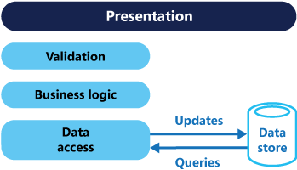
CRUD Applications
Works well with limited validation and business logic
DTOs representing certain data are retrieved from the database and displayed to the user
User updates the data and sends it back
Notes:
Main idea: because the logic applies to everything, every time. Limit what happens
Main idea: load data from database and put in DTO
Main idea: user changes what they want, sends ALL back

Slide 12
CRUD Applications
The same logic and validation is applied to the DTO regardless of what’s being created/updated
Can cause database concurrency issues when multiple users are accessing data in parallel
Any of this sound familiar? Basically every app I’ve ever written in some form
Notes:
Main idea: if you’re updating one or MANY fields, the same logic applies
Main idea: what if one user is working on one set of fields, and another person, another set of fields, if you have to update ALL the fields EVERY time, then you’re likely to have issues

Slide 13
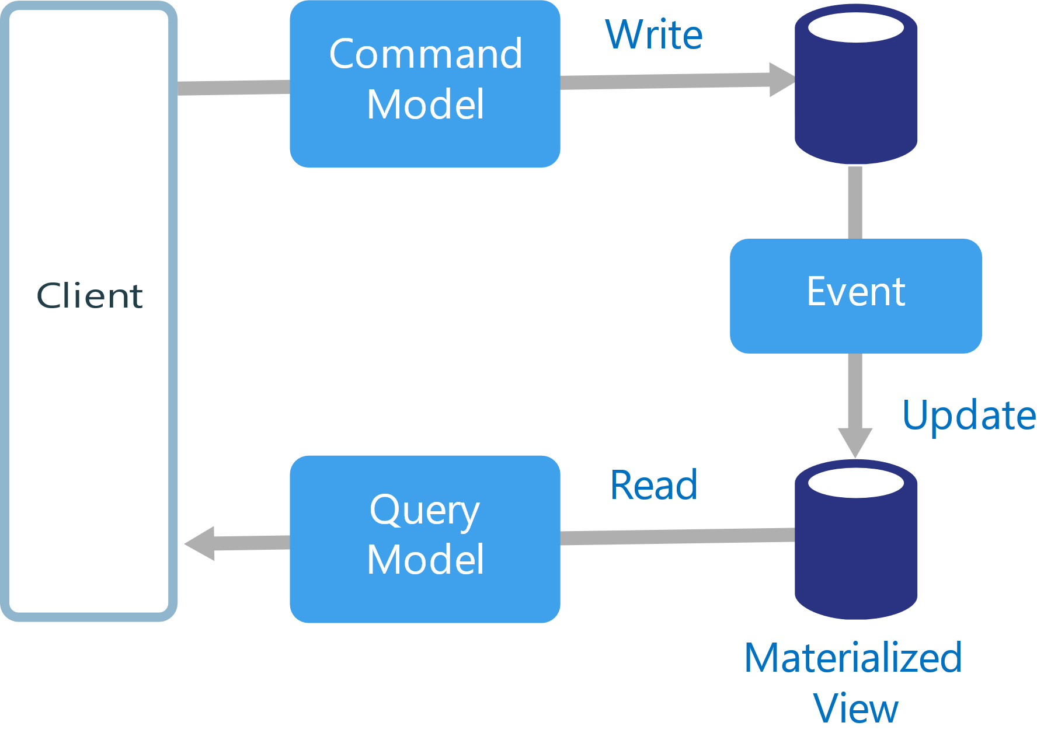
CQRS
Separate interfaces for reads and writes
Allows many different models for different reads and writes
Simpler individual components and in a way, overall design
Allows flexibility with data stores
Can have separate read-only copies
Can separate read vs. write data stores
Can be traditional
Distributed applications can leverage messaging for communicating updates via events and commands
Notes:
Smaller pieces
Easier to maintain
Easier to test

Slide 14
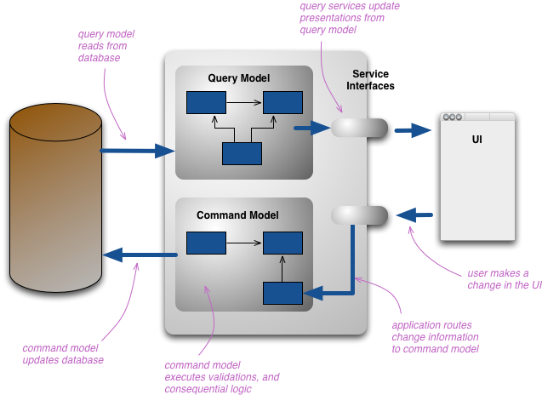
CQRS
Notes:
Command model executes validations and logic AGAINST THAT COMMAND SPECIFICALLY
Not general entire entity-based logic
Command model updates the database with info IN THAT COMMAND SPECIFICALLY
Not the ENTIRE entity

Slide 15
CQRS
Implementation Considerations
Separating / dividing read and write data stores
Increases complexity
Makes it difficult to ensure data consistency across stores
Event Sourcing
Common in distributed applications
Using events to “tell the tale” of your updates in your update model
Start small
Notes:
Emphasize the fact that the point here is to not scare anyone away and that it is possible to start small and begin to get an understanding
Event Sourcing
Append only
System of record
Can be used to materialize domain objects
Eliminates need to synchronize the data model and business domain
Audit trails and history
Transactional consistency

Slide 16

CQRS
Smileys
Can minimize conflicts by creating increasingly granular commands
Even on the same type (entity/model/whatever)
Make ever more specific commands
Plays nicely with Domain Driven Design
Already conceptualizing the objects for the domain, CQRS goes further and separates by operation.
Write model has full command processing stack for each group of objects (aggregates)
Validation, business logic
Read model has no logic
Simply retrieves a DTO and projects it to a new view model
Notes:
Think about telling origin story of “smileys”
Retrospective: smileys, frownies, changies
#3 = not validating or executing logic for the entire entity every time. Each stack is specific to that command,
#4, talk about simple, specific queries and query objects

Slide 17
CQRS
More smileys
Allows tuning of read performance
More for distributed systems
More instances for reads, vs. few or one for writes
Segment work for devs per model, per command/query
Supports evolution of model over time
Business logic and validation requirements changing
Great for heterogeneous systems integration
Interruptions or failures of one system, won’t affect the other
Notes:
Talk about splitting reads/writes into separate applications
Communicate w/ queues, mention service bus
w/ queue processor that runs in it’s own instance
Be sure to talk about our team development evolution
Give CQRS journey ticketing application example
OPTIMISTIC LOCKING

Slide 18
Goals
Now we know CQRS, what are our goals here today?

Slide 19
Goals
Start
…realizing benefits of CQRS
Jump
…headfirst into CQRS with MediatR
Understand
Understand the benefits of the architecture that MediatR makes easy

Slide 20
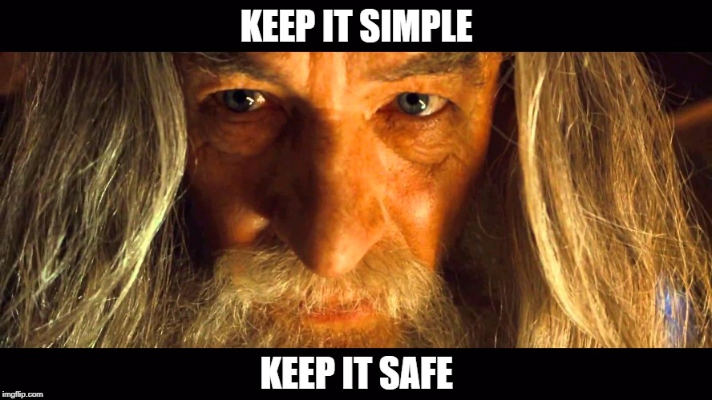

Slide 21
MediatR
Open-source C# library, written by Jimmy Bogard
Mediator implementation for sending and handling messages
https://github.com/jbogard/MediatR

Slide 22
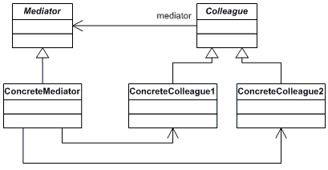
Mediator Pattern
Gang of Four
Behavioral
How objects communicate
Communication between objects via mediator implementation

Slide 23
MediatR - Requests
Requests
Implementations of commands and queries (the C’s and Q’s)
Encapsulates necessary properties for fulfilling a command or query.
IRequest
When request doesn’t require a response.
IRequest<out TResponse>
Type parameter indicates the corresponding response type

Slide 24
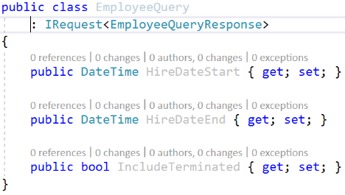
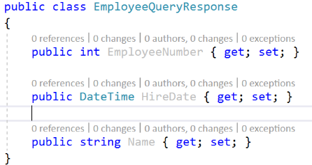
Example Query
Example Request
Example Response

Slide 25
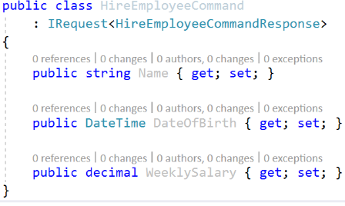
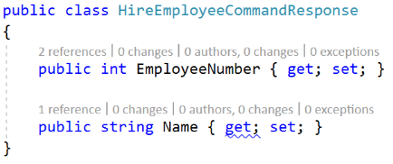
Example Command
Example Request
Example Response

Slide 26
MediatR - Responses
No fancy interface, just POCO (plain old CLR object)
Contains properties relevant to fulfilling the command or query
Can use Unit or Unit.Task if you need void response type

Slide 27
MediatR – Request Handlers
Command / query processor for a specific request and response type.
…not much else to say

Slide 28
Request Handlers
IRequestHandler<TRequest>
Handles command/query that does not require a response.
IRequestHandler<in TRequest, TResponse>
Handles command/query that DOES require a response.
MediatR 4.0 consolidated all handler types into one type
The previously known ICancellableAsyncRequestHandler is now the default
New helper base classes
RequestHandler - for synchronous actions
AsyncRequestHandler - for async actions that ignore the cancellation token

Slide 29
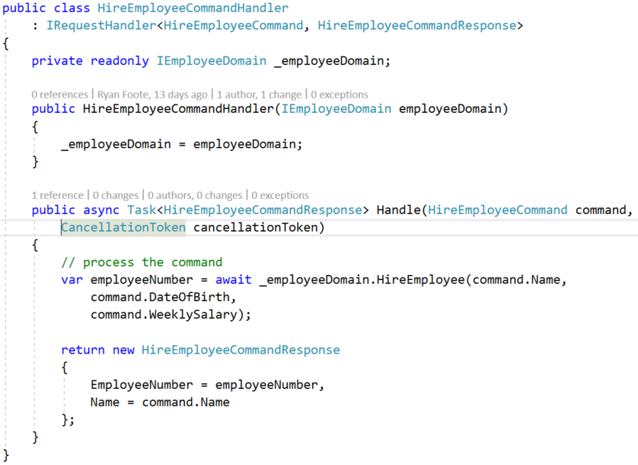
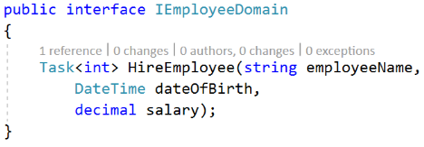
Example Request Handler

Slide 30
MediatR - Notifications
INotification
One-way
Use on POCO classes to denote a notification wrapper
Contains all properties needed to process the notification
All the information interested parties might care about.
Think event
Ex. An employee was hired, so let’s notify everyone interested

Slide 31
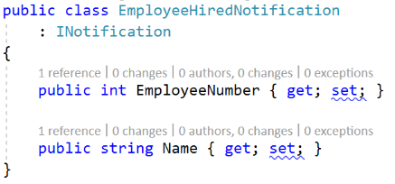
Example Notification

Slide 32
MediatR – Notification Handlers
INotificationHandler<in TNotifiction>
Handles a notification of type TNotification
Can have multiple handlers for a given notification type
Allows decoupling of processing from main application
Replaces the previously known ICancellableNotificationRequestHandler
NotificationHandler / AsyncNotificationHandler
Default implementations of notification handlers
Derive and override
Notes:
Notification processing of the same notification may be unrelated
Ex. If you need to send emails and maybe log that something happened.

Slide 33
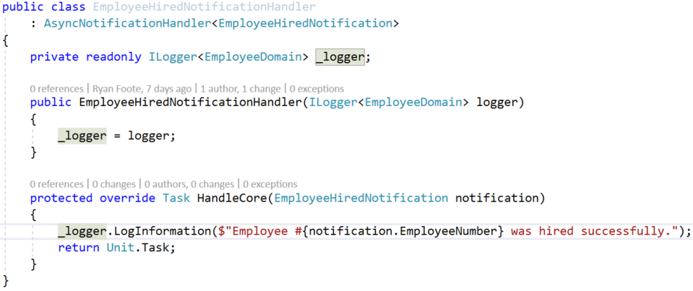
Example Notification Handler
Notes:
Kind of lame, but point is to show how to publish events

Slide 34
MediatR - Mediator
Dispatches requests (commands / queries) and notifications (events)
.Send() for requests
Accepts arguments of type TRequest
.Publish() for notifications
Accepts arguments of type INotification

Slide 35
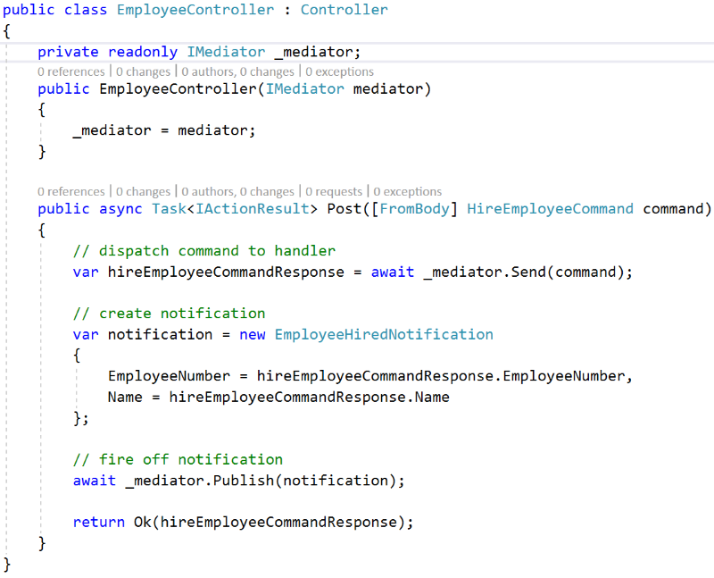

Slide 36
MediatR – Pipeline Behaviors
Build your own pipeline
IPipelineBehavior<TRequest, TResponse>
Great for chaining validation, logging

Slide 37
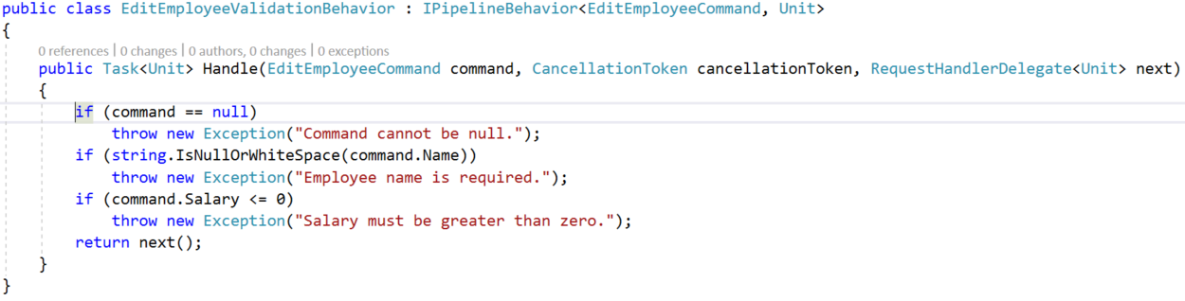
MediatR – Pipeline Behaviors

Slide 38
MediatR Setup
DI container registrations
ASP.NET Core
MediatR.Extensions.Microsoft.DependencyInjection Nuget package
IServiceCollection.AddMediatR(Assembly)
All handlers
Any other DI container
Mediator
Factory delegates
SingleInstanceFactory
MultiInstanceFactory
All handlers
Your stuff

Slide 39
Demos
To the code!!!

Slide 40
Links and References
CQRS Pattern
CQRS
Event Sourcing
CQRS with MediatR and AutoMapper
MediatR with ASP.NET Core
Non-Trivial MediatR Usage
Fat Controller CQRS Diet
MediatR Repo
MediatR 4.0
Design Patterns
My blog
My GitHub
Email

