Slide 1
Neural Machine Translation

Slide 2
Definition
Using Neural Networks to translate text from a human language to another.

Slide 3
Transformers

Slide 4
Attention
Mapping a query and a set of key-value pairs to an output.
The output is computed as a weighted sum of the values.
the weight assigned to each value is computed by a compatibility function of the query with the corresponding key.
$$Attention(Q,K,V)=softmax(\frac{QK^{T}}{\sqrt{d_{k}}}V)$$

Slide 5
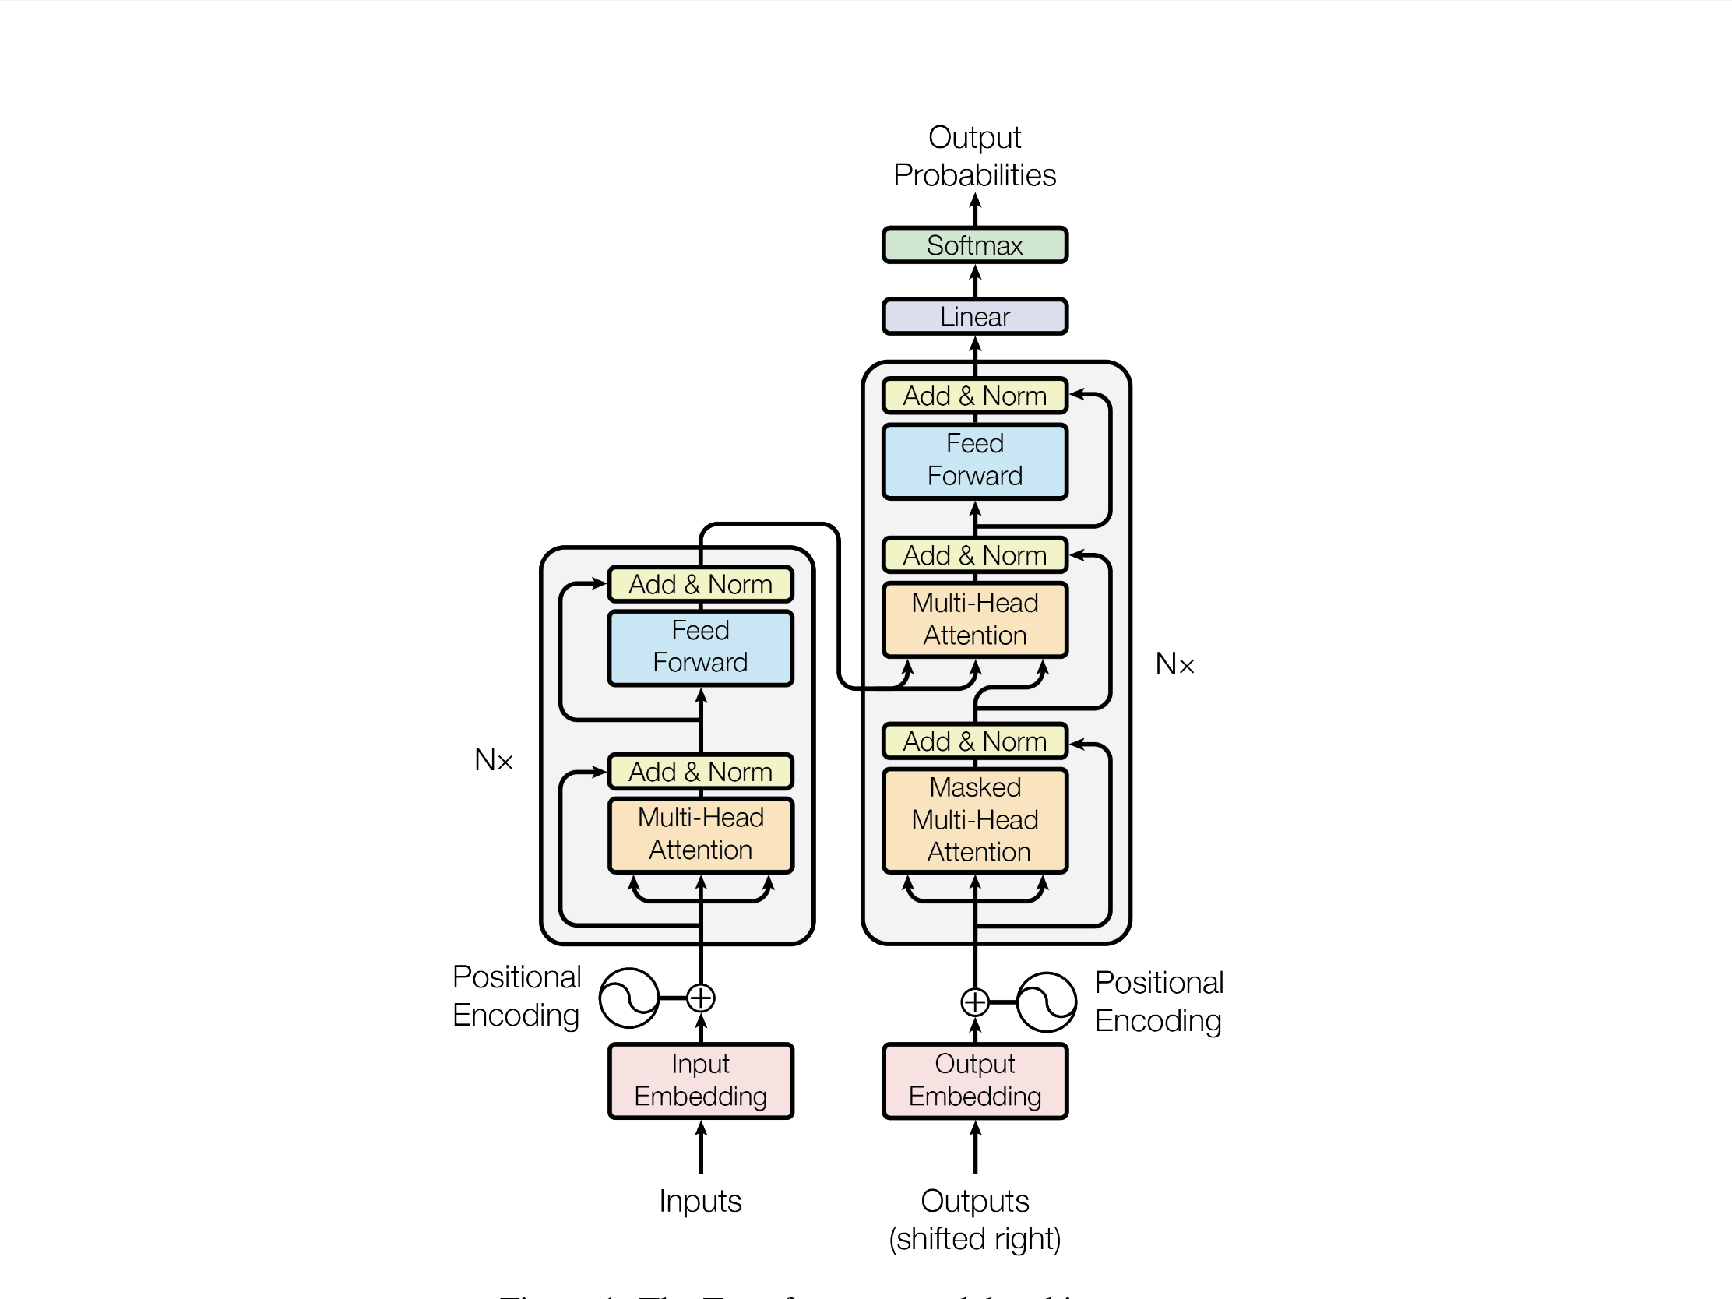
Model Architecture

Slide 6
Multi-head self attention mechanism,
Use H attention functions instead of 1.
$$Multihead(Q,K,V)=contact(head_{1},...,head_{h})W^{O}wherehead_{i}=attention(QW_{i}^{Q},KW_{i}^{K},VW_{i}^{V})$$

Slide 7
Application of multi-head self-attention mechanism ???
In "Encoder-Decoder attention" layers, the queries come from the previous decoder layer, and the memory keys and values come from the output of the encoder. This allows every position in the decoder to attend over all positions in the input sequence. This mimics the typical encoder-decoder attention mechanisms in sequence-to-sequence models.
The encoder contains self-attention layers. In a self-attention layer, all of the keys, values and queries come from the same place, in this case, the output of the previous layer in the encoder. Each position in the encoder can attend to all positions in the previous layer of the encoder.
Similarly, self-attention layers in the decoder allow each position in the decoder to attend to all positions in the decoder up to and including the position. We need to prevent leftward information flow in the decoder to preserve the auto-regressive property. We implement this inside of scaled Dot-Product attention by masking out (setting to $-\infty$) all values in the input of the softmax which correspond to illegal connection. See figure \ref{fig:scaled-dot-product-attention}. %figure 2 in transformer

Slide 8
Position-wise fully connected feed forward network
Position-wise fully connected feed forward network
2 linear transformations with ReLU in between$FFN(x)=max(0,xW_{1}+b_{1})+W_{2}+b_{2}$

Slide 9
Embeddings and Softmax
Similar to other sequence transduction models, this model uses learned embeddings to convert the input tokens and output tokens to vectors of dimension $D_{model}$. We also use the usual learned linear transformation and softmax function to convert the decoder output to predicted next-token probabilities. In this model, the same weight matrix is shared between the two embedding layers and the pre-softmax linear transformation,. In the embedding layers,we multiply those weight by $\sqrt{d_{model}}$.

Slide 10
Positional Encoding
Because what we have learned till now doesn’t reserve position of input token, we use positional encoding to provide it.$PE_{(POS,2i)}=sin(POS/{10000}^{2i/d_{model}})$

Slide 11
Language Modeling

Slide 12
Bidirectional Encoder Representations From Transformers (BERT)
Technique for NLP pre-training

Slide 13
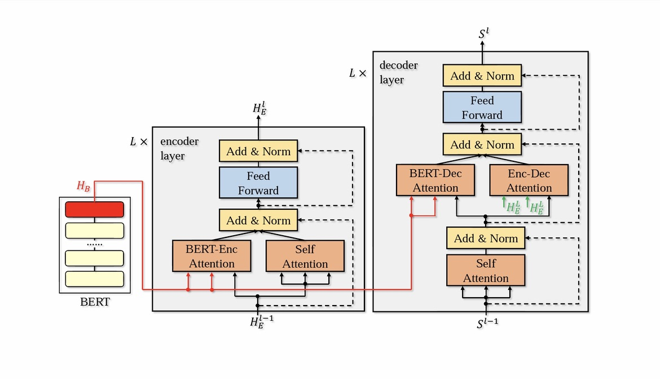
BERT-fused Model
BERT+Transformer+…

Slide 14
Step 1
For input x, BERT makes representation HB
$$H_{B}=BERT(x)$$

Slide 15
Step 2
$$\overset{˜}{h_{i}^{l}}=\frac{1}{2}(attn_{S}(h_{i}^{l-1},H_{E}^{l-1},H_{E}^{l-1})+attn_{B}(h_{i}^{l-1},H_{B},H_{B})),∀i∈[l_{x}]$$
$$Theoutputofthel-thlayerinencoder:H_{E}^{l}=(FFN(\overset{˜}{h_{1}^{l}}),...,FFN(\overset{˜}{h_{l_{x}}^{l}})$$

Slide 16
Step 3
$$\overset{̂}{S_{t}^{l}}=attn_{s}(S_{t}^{l-1},S_{<t-1}^{l-1},S_{<t-1}^{l-1});$$
$$\overset{˜}{S_{t}^{l}}=\frac{1}{2}(attn_{B}(\overset{̂}{S_{t}^{l}},H_{B},H_{B})+attn_{E}(\overset{̂}{S_{t}^{l}},H_{E}^{L},H_{E}^{l}))S_{t}^{l}=FFN(\overset{˜}{S_{t}^{l}}$$
Then apply softmax to get probabilities for each word in set of tokens:
$$\overset{̂}{y_{t}}=\frac{e^{S_{t}^{L}}}{\sum_{j=1}^{T}{e^{S_{j}}}}$$

Slide 17
Our NMT model
BERT Base (cased & multilingual uncased)
0 encoder layers
6 decoder layers

Slide 18
Measuring performance of NMT system
Label smoothing cross entropy(training)
Sacrebleu (testing the model)

Slide 19
Label Smooth Cross Entropy
$$L=-\overset{n}{\underset{i=1}{∑}}[(1-ϵ)H_{i}(p,q_{θ})+ϵH_{i}(U,Q_{θ})]$$

