Slide 1


Session_2
Eng-Adham Khaled

Slide 2



Slide 3

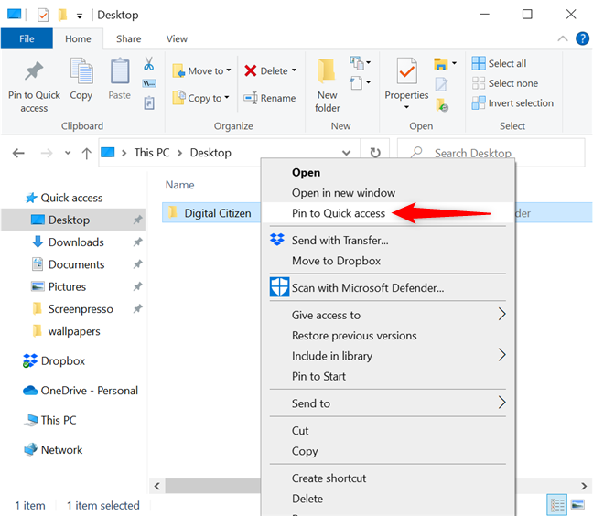
Basics of computer
Click right in icon

Slide 4
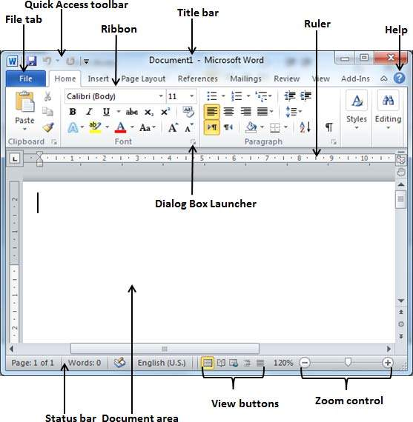
word-Screen layout

Slide 5
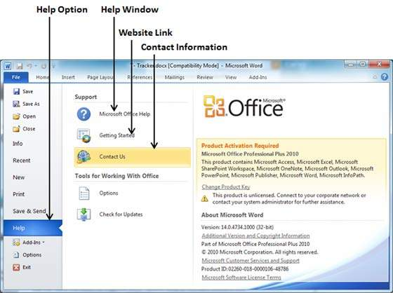
word-help

Slide 6
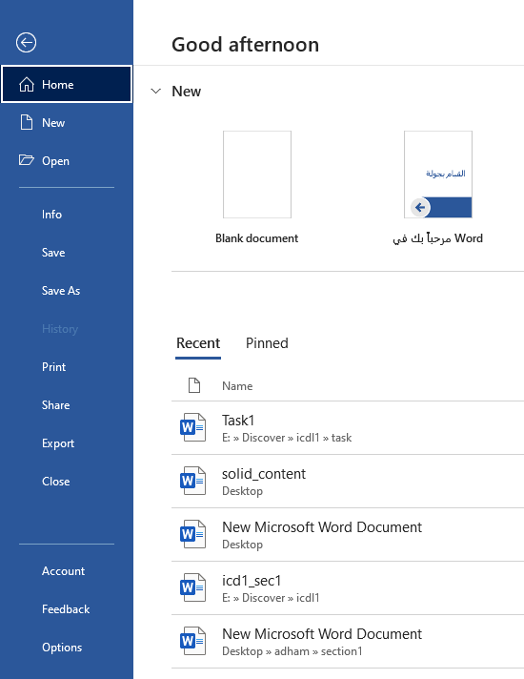
Working with document
From file tab:
Create document word
Information about document.
Open existing document word.
Save document .
Save as document.
Print document .
Share
Export
Close

Slide 7
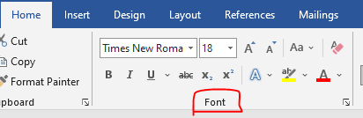
Format text
From tab Home:
Font type
Font size
Change case
Bold
Italic
Underline
Strikethrough
Subscript ----superscript
Text effect and typography
Text highlight color
Font color

Slide 8

How to remove all text format ?

Slide 9
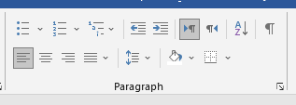
Formatting paragraph
Form tab home :
Bullets
Numbering
Level(decrease- increase)
Text direction
Justify
Line and paragraph spacing
Shading
border
Sort

Slide 10
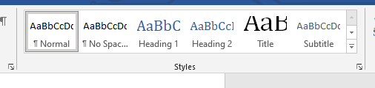
Styles

Slide 11
How to create own style?

Slide 12
How to seach in text word?
Using find

Slide 13


