Slide 1


Session_4
By Eng-Adham Khaled

Slide 2


Slide 3

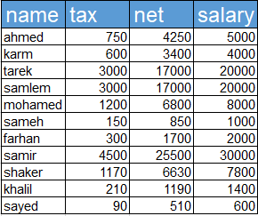
quiz
Create the next table:

Slide 4
project
Make a report about Ahmed Zewail.

Slide 5
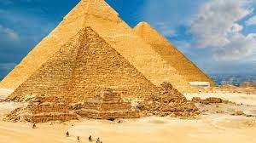
Task
Make a report about pyramids

Slide 6


