Slide 1
Using XGBoost and Random Forest to Reduce Scania Truck Maintenance Cost
Machine Learning (IA651 Final Project)
IA650D1_U20
Submitted by:
Mohamed Elwakdy
Jeenat Maitry

Slide 2

Outline
Introduction
Dataset
XGBoost Classifier
Random Forest Classifier
Conclusion

Slide 3
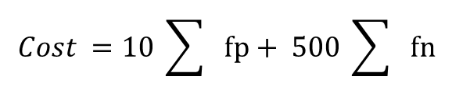
Objectives
Building a predictive model has the ability to predict and minimize the cost of failures.
Using the XGBoost classifier and Random Forest Classifier to see if we get a high classification accuracy and minimize the cost of failures.
Changing the cut-off threshold to get a maximum business objective where highest F1-score is the maximum.
$$Cost =10 \sum{fp}+ 500 \sum{fn}$$

Slide 4
Training and Test Dataset
Training Dataset
Test Dataset
60,000 examples (observations) in total:
59,000 belong to the negative class
1,000 positive classes
16,000 examples (observations) in total:
15,625 belong to the negative class
375 positive classes

Slide 5
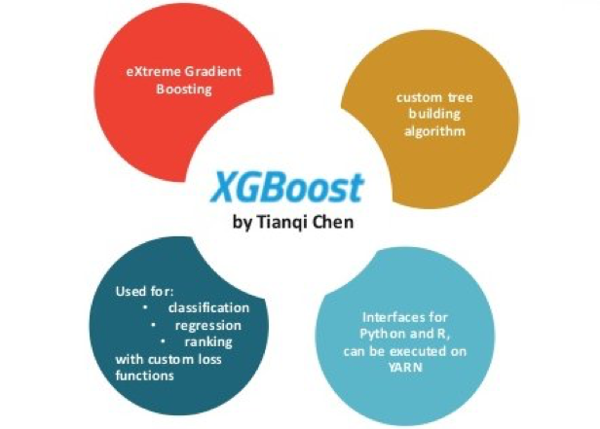
XGBoost Classifier
XGBoost is an optimized distributed gradient boosting library.
XGBoost has the ability in prediction problems involving unstructured data (images, text, etc.)
XGBoost applications
Deal with missing values

Slide 6
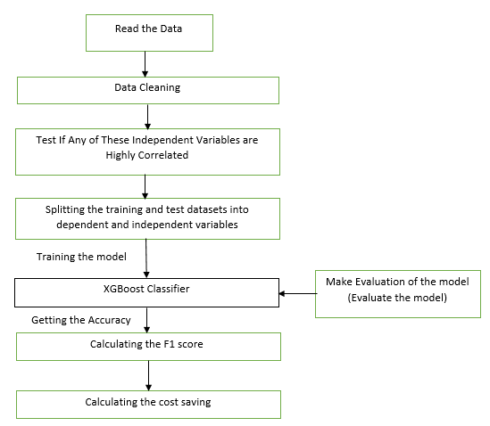
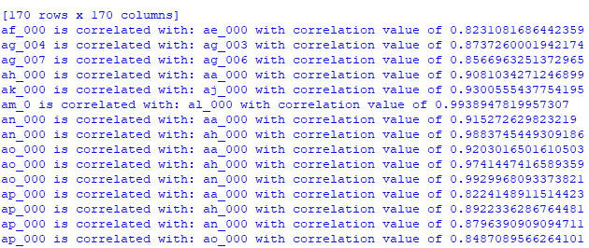
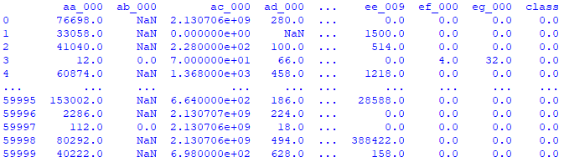
XGBoost Classifier/ Reading and Cleaning Dataset
Read the datasets
Data Cleaning
Test Correlation between variables

Slide 7
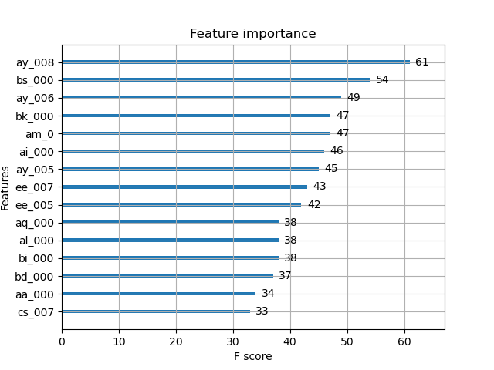
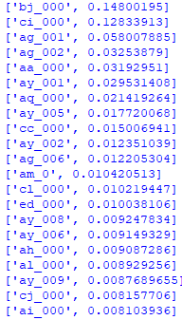
Test the Correlation / Getting the Maximum F1-Score
Splitting Training and Test Datasets
Check the most important variables
Check most important variables based on the Fitted Tree

Slide 8
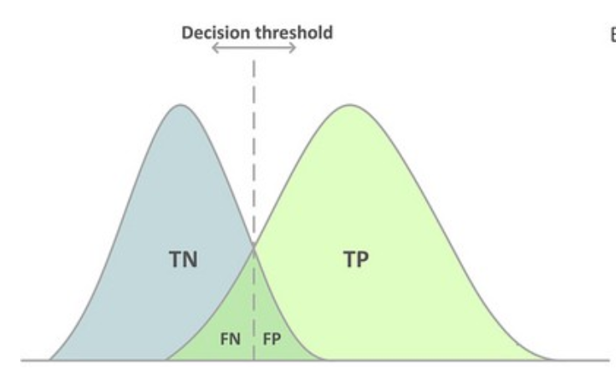
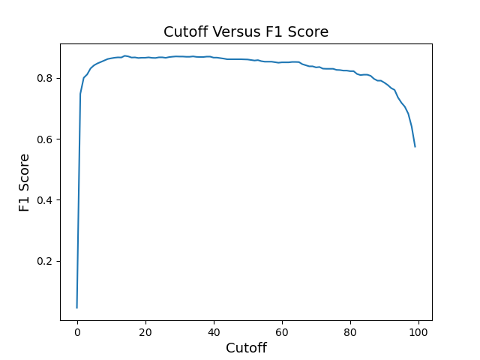
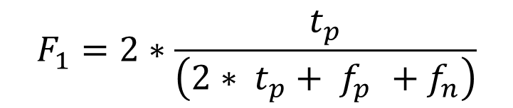
Test the Correlation / Getting the Maximum F1-Score
Change the cut-off threshold and get the threshold value where we maximize the business objective.
The cut-off value has the range from 0 to 1.
The maximum F1-score we get is 0.87 with cut off : 0.14.
$$F_{1}=2∗\frac{t_{p}}{\left(2∗ t_{p}+ f_{p }+f_{n}\right)}$$

Slide 9
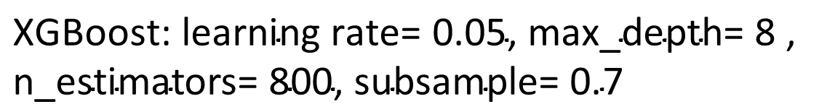
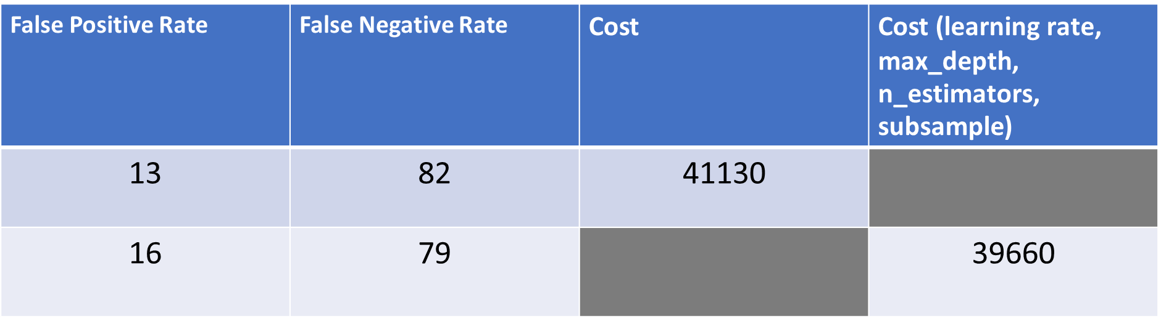
Calculating The Cost Saving / XGBoost Classifier
False Positive Rate | False Negative Rate | Cost | Cost ($\text{learning} \text{rat}\text{e}\text{,} \text{max}\text{_}\text{depth}\text{, }\text{n}\text{_}\text{estimators}\text{, }\text{subsample}$)
13 | 82 | 41130
16 | 79 |  | 39660
$$\text{XGBoost}\text{: }\text{learning} \text{rate}\text{= 0.05, }\text{max}\text{_}\text{depth}\text{= 8 , }\text{n}\text{_}\text{estimators}\text{= 800, }\text{subsample}\text{= 0.7}$$
$$\text{C}\text{ost}\text{ = 10∗}\text{False} \text{Positive} \text{Rate}\text{ + 500 ∗ }\text{False} \text{Negative} \text{Rate}$$

Slide 10
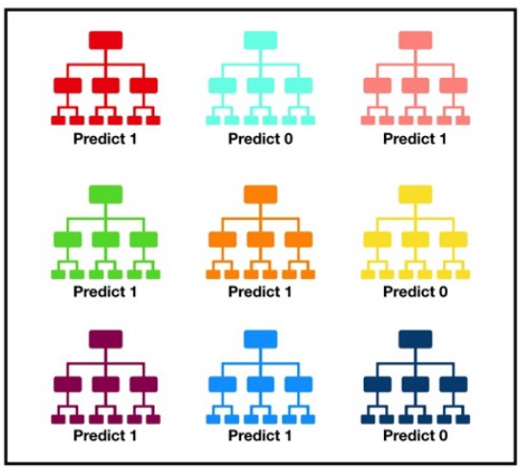
Random Forest Classifier
A random forest is a meta estimator that fits a number of decision tree classifiers
We used the Random Forest Classifier for prediction of two classes “1” and “0” in two cases: dropping out "missing values“ and without dropping out "missing values“ .
Calculating the classification accuracy for both cases above.

Slide 11
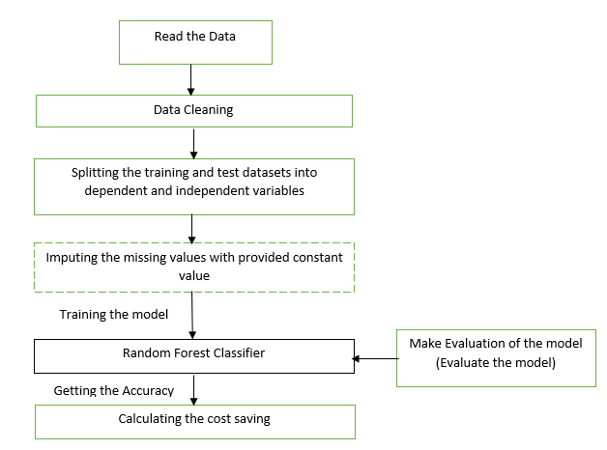
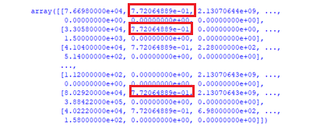
Random Forest Classifier
Read the datasets
Data Cleaning
Splitting Training and Test Datasets.
Imputing the missing values
Data Cleaning
Number of Observations (Examples)/ | Before | After
Training data | 60,000 | 591
Test data | 16,000 | 165

Slide 12
Random Forest Classifier
Cases | hyperparameters (n_jobs=-1, random_state=0) | Bagging technique , hyperparameters (n_estimators = 10,n_jobs=-1,random_state=0) | Bagging technique, hyperparameters (n_estimators = 20,n_jobs=-1,random_state=0) | Bagging technique, hyperparameters (n_estimators = 40,n_jobs=-1,random_state=0)
Case 1 (Accuracy %) | 95.76 | 96.36 | 96.97 | 95.76
Case 2 (Accuracy %) | 99.27 | 99.11 | 99.16 | 99.23

Slide 13
Random Forest Classifier
Cases | RandomForestClassifier (n_jobs=-1, oob_score= True, random_state=0), set_rf_samples (100, 200 or 300) | RandomForestClassifier (n_estimators = 40, n_jobs=-1, oob_score=True,random_state=0), set_rf_samples (100, 200 or 300) | RandomForestClassifier (n_jobs=-1, oob_score= True, random_state=0), set_rf_samples (10000) | RandomForestClassifier (n_estimators = 40, n_jobs=-1, oob_score=True,random_state=0), set_rf_samples (10000)
Case 1 (Accuracy %) | 95.75 | 95.75
Case 2 (Accuracy %) |  |  | 99.27 | 99.23

Slide 14
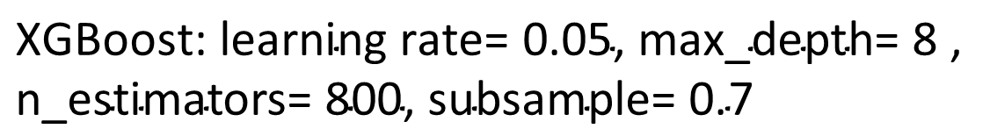
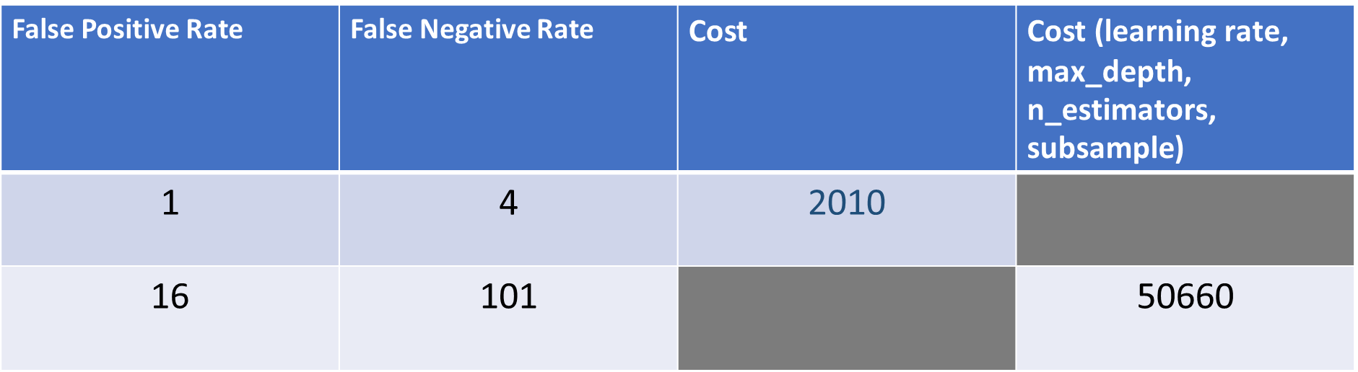
Random Forest Classifier / Cost Saving
False Positive Rate | False Negative Rate | Cost | Cost ($\text{learning} \text{rat}\text{e}\text{,} \text{max}\text{_}\text{depth}\text{, }\text{n}\text{_}\text{estimators}\text{, }\text{subsample}$)
1 | 4 | 2010
16 | 101 |  | 50660
$$\text{XGBoost}\text{: }\text{learning} \text{rate}\text{= 0.05, }\text{max}\text{_}\text{depth}\text{= 8 , }\text{n}\text{_}\text{estimators}\text{= 800, }\text{subsample}\text{= 0.7}$$
$$\text{C}\text{ost}\text{ = 10∗}\text{False} \text{Positive} \text{Rate}\text{ + 500 ∗ }\text{False} \text{Negative} \text{Rate}$$

Slide 15
Conclusion
Increase in the number of estimators doesn’t make that much of an effect on classification accuracy.
The size of the dataset makes an effect on increasing or decreasing the classification accuracy and cost saving.
The increase of classification accuracy doesn’t mean the decrease in the cost saving because the calculation of the cost saving depends on the two main parameters: "False Positive Rate" and "False Negative Rate“.
We think that we may get a low cost saving if we just reduce the size of the dataset even if this dataset includes missing values.
Thank you very much !

