Slide 1


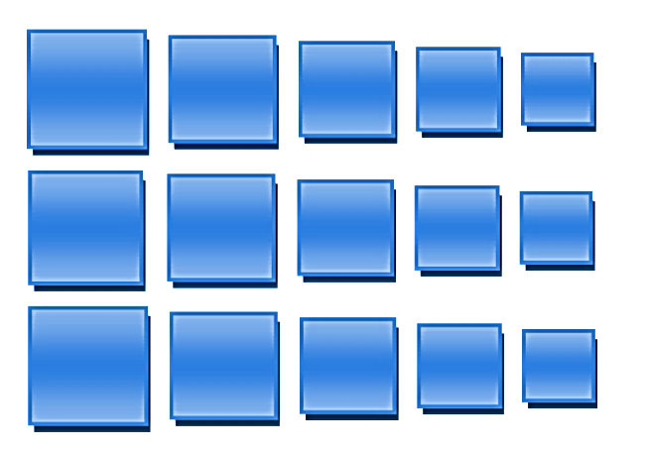
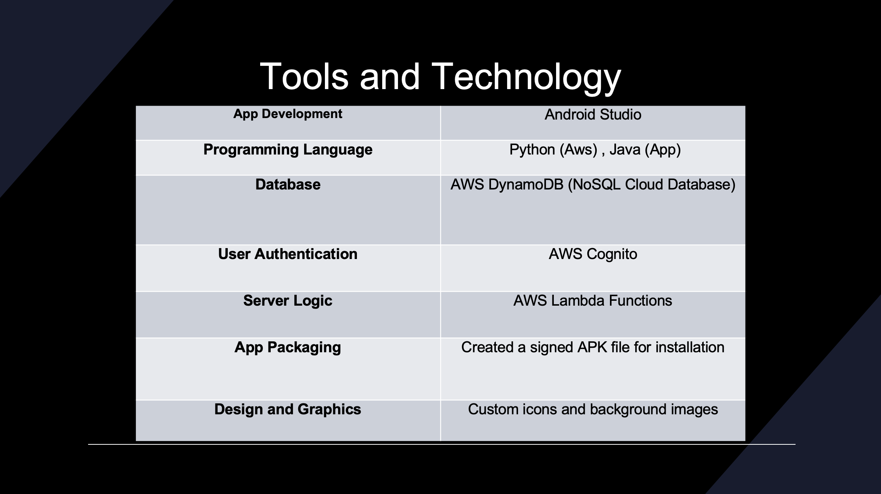
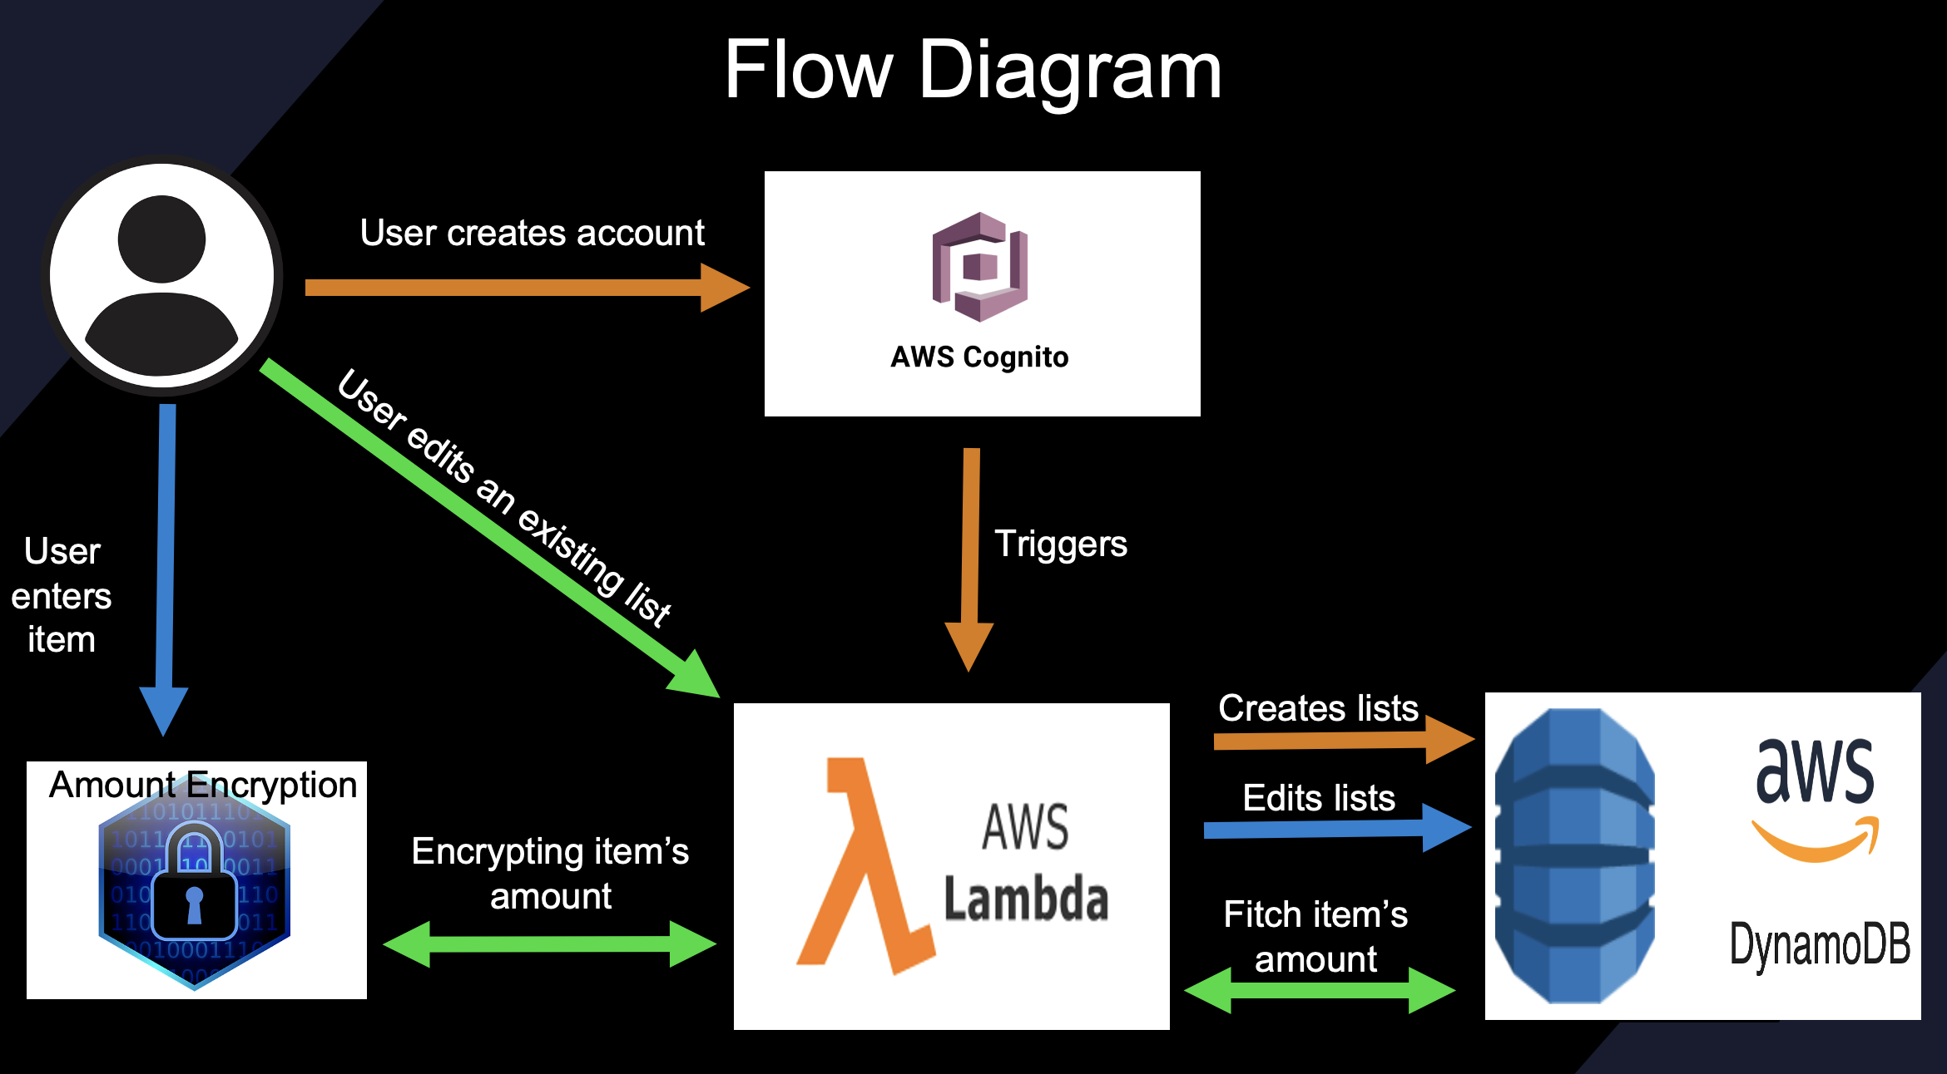
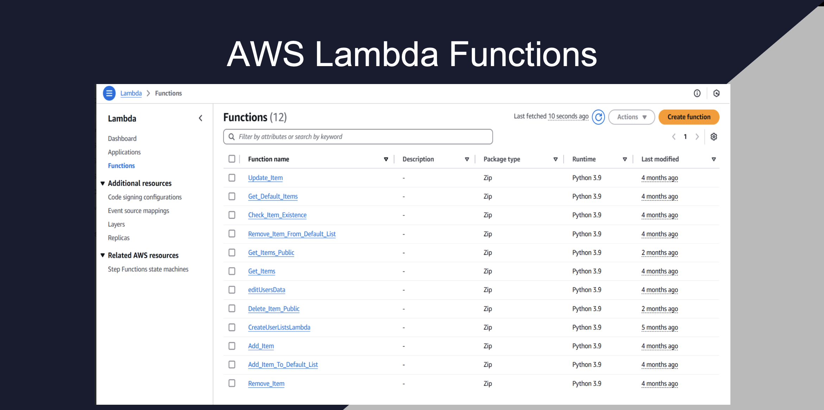

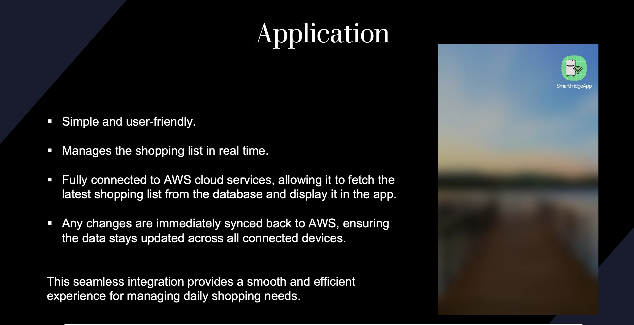
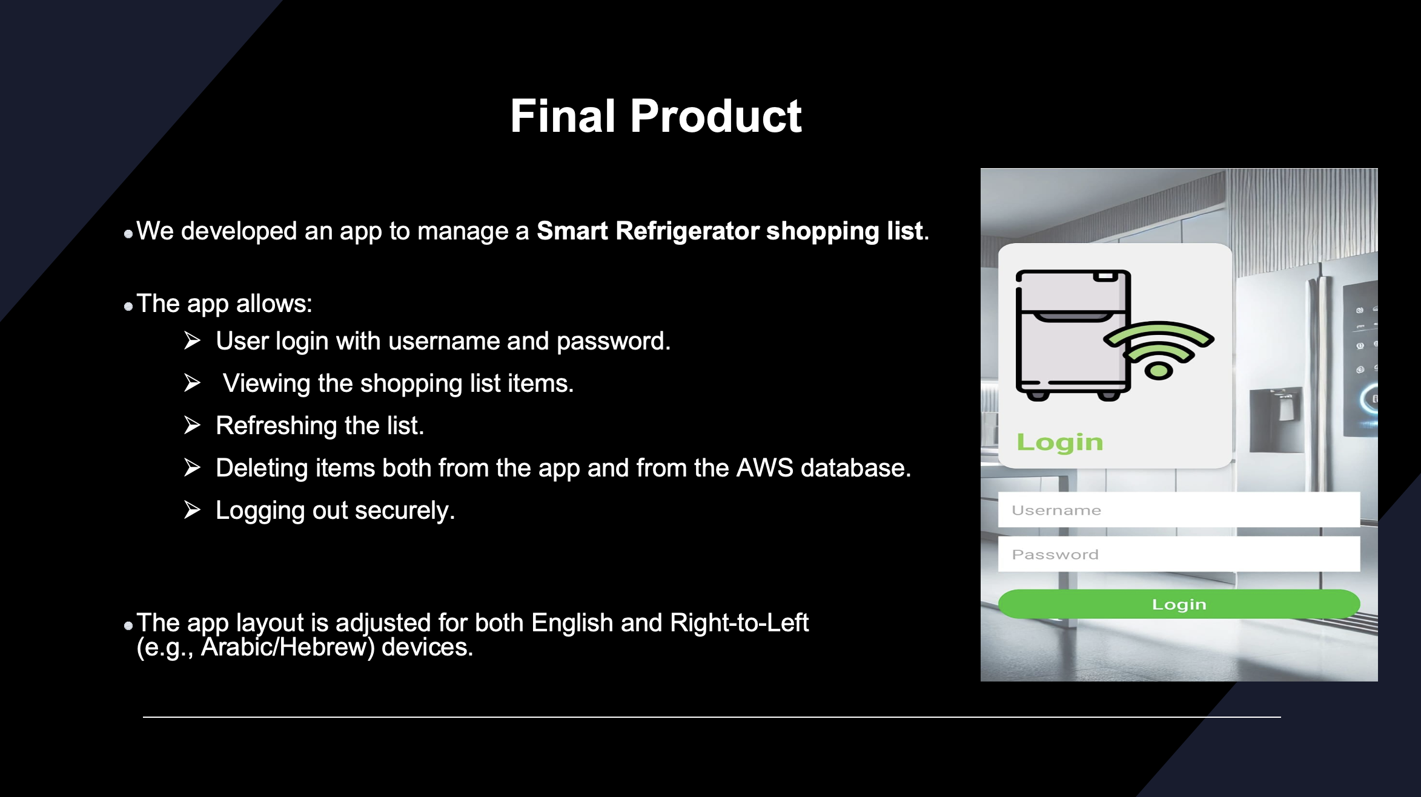
The Andrew & Erna Viterbi Faculty of
Electrical Engineering
Electronics
Computers
Communications
Smart Refrigerator Using AI - Part B
Supervisor: Mony Orbach
Students: Raghad Badarny, Mohammed Ghanayem

