Slide 1
Eng. Mohamed Hamdy
Mastering Embedded System Online Diploma www.learn-in-depth.com
Second Term (unit6Lesson3) – system clock configuration on stm32f103c
My Profile: https://www.learn-in-depth-store.com/profile/mohamedhamdy-m-h-m-a/profile
GitHub repo: https://github.com/Mohamed-Hamdy-MA/Mastering_Embedded_System.git

Slide 2
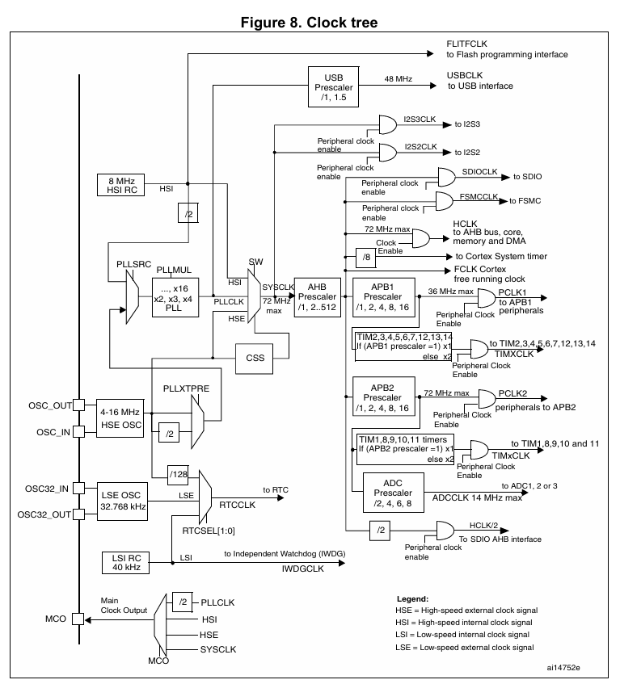

Slide 3
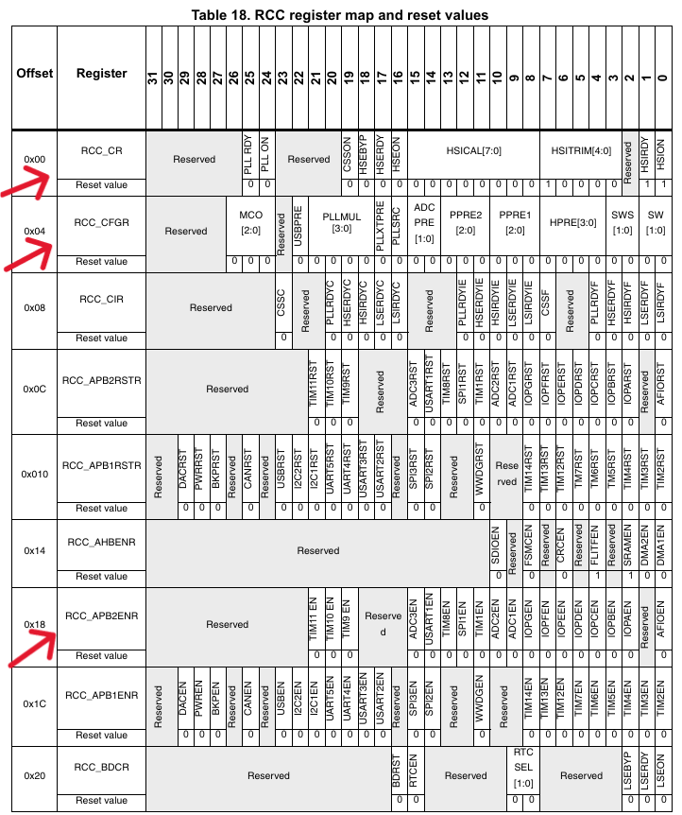

Slide 4
Screenshots

Slide 5
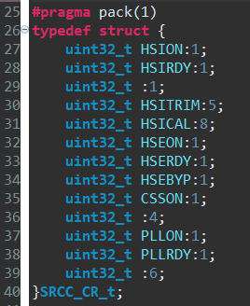
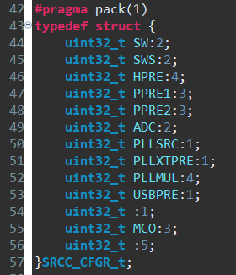
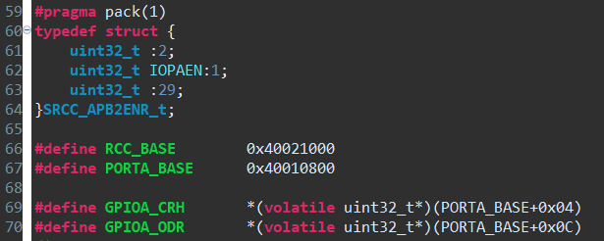

Slide 6
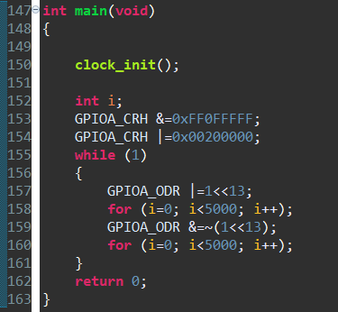

Slide 7
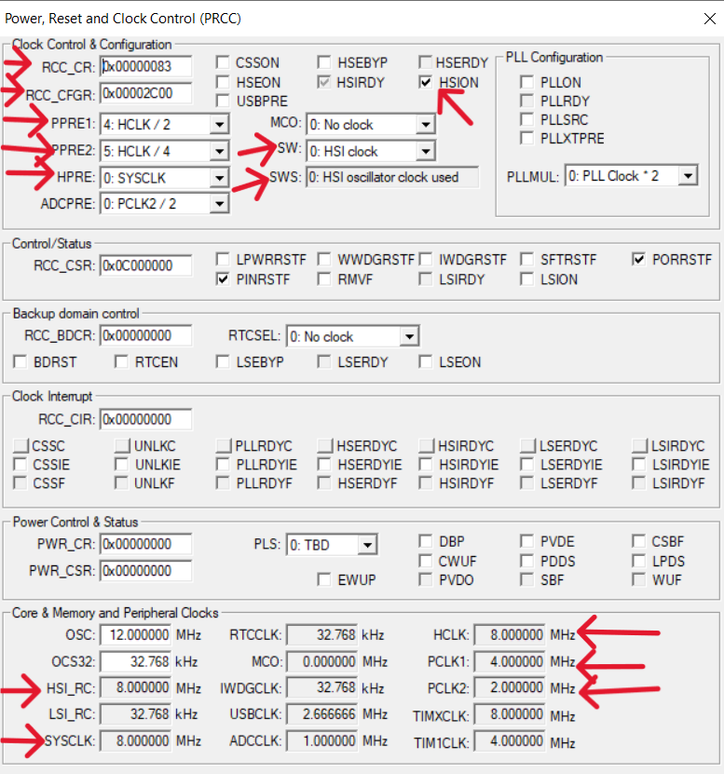
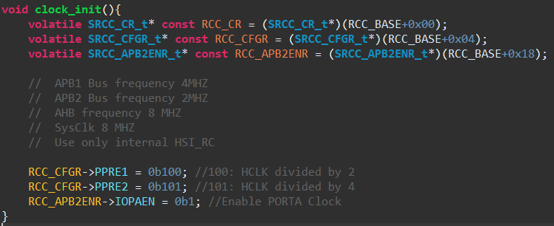

Slide 8
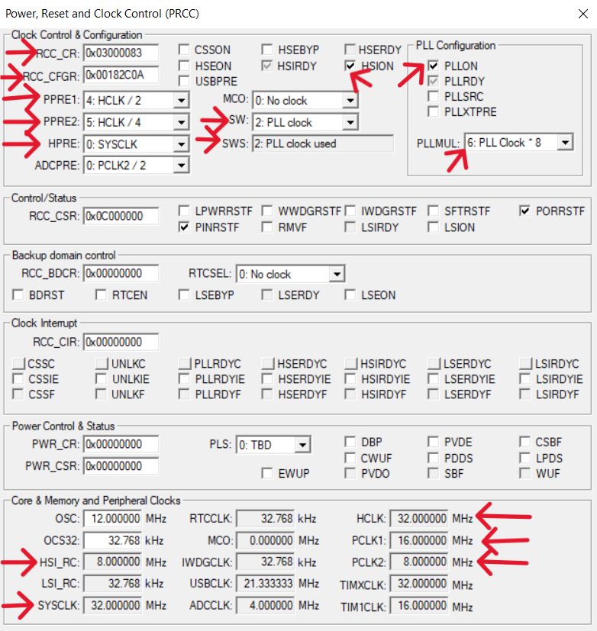
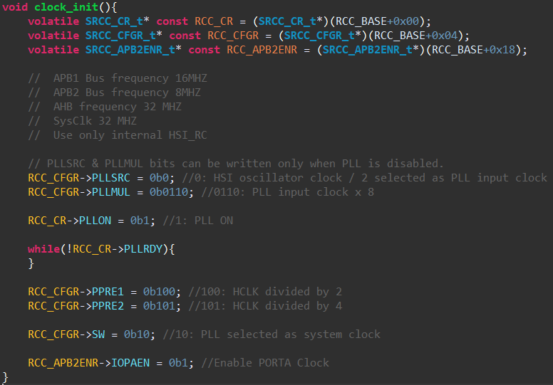

Slide 9
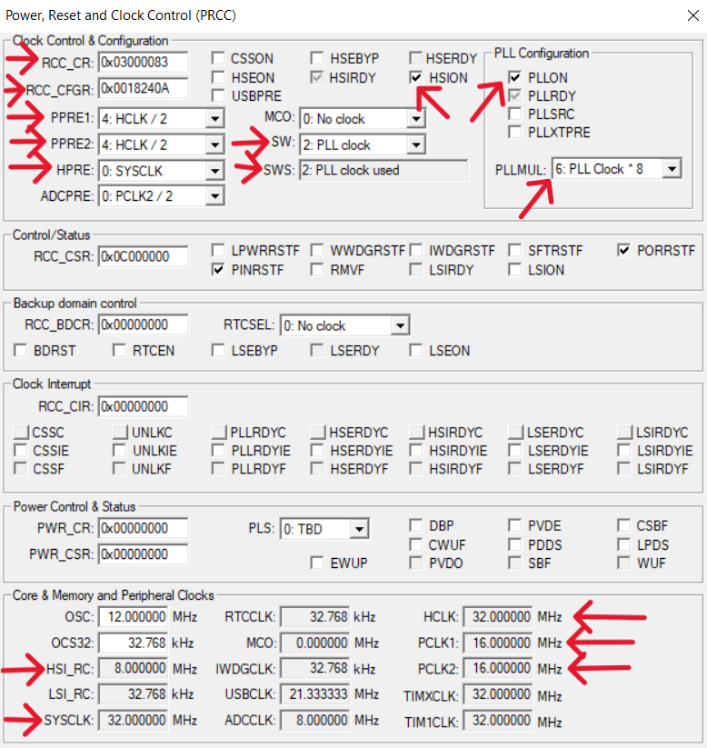
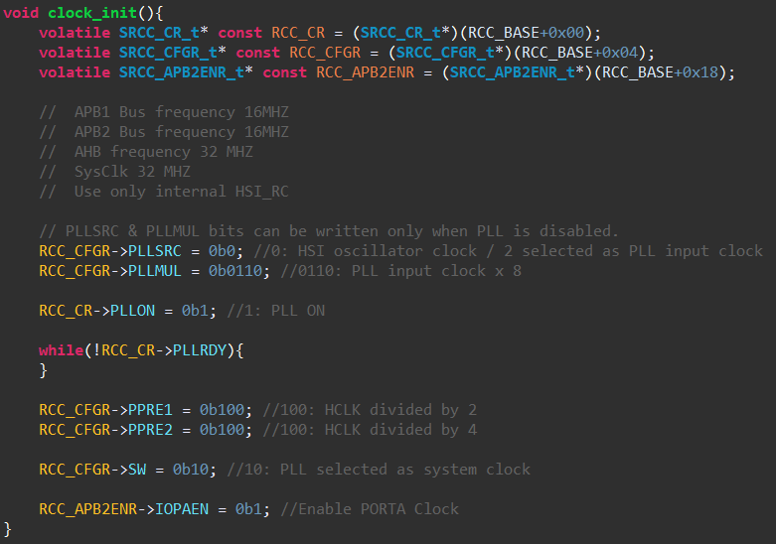

Slide 10
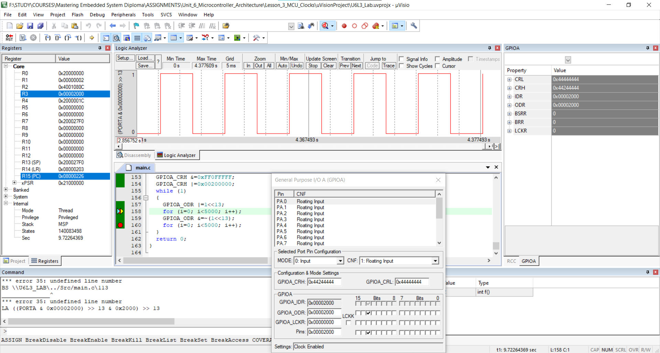

Slide 11
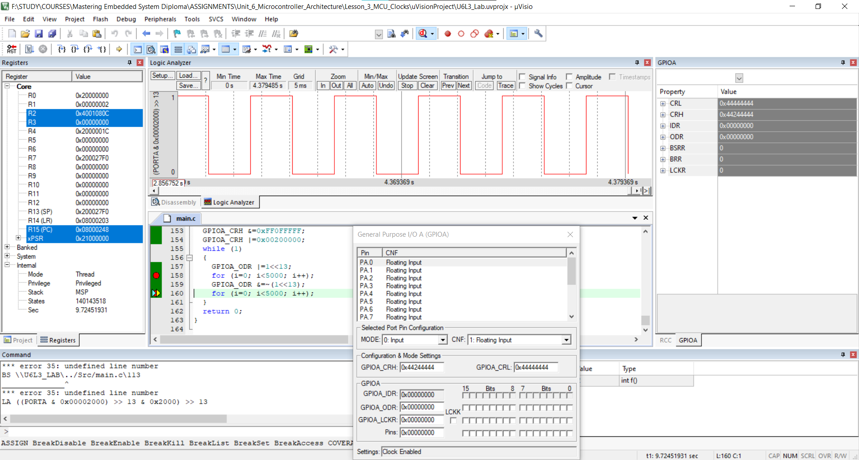

Slide 12
THANK YOU
Mohamed Hamdy
Mohamedhamdy.m.h.m.a@gmail.com

