Slide 1
Eng. Mohamed Hamdy
Mastering Embedded System Online Diploma www.learn-in-depth.com
First Term (Final Project 1) – Pressure Detection System
My Profile: https://www.learn-in-depth-store.com/profile/mohamedhamdy-m-h-m-a/profile
GitHub repo: https://github.com/Mohamed-Hamdy-MA/Mastering_Embedded_System.git

Slide 2
Agenda
1.Project objective
2.Project idea
3.System architecture
4.Implementation
5.Simulation
6.Binary utilities

Slide 3
1.Project objective
The project covers topics including:
  Embedded C.
  Bare-metal software build process.
  Arm-none-eabi toolchain
  Startup.
  Linker script.
  Make File.
  System architecture using UML.

Slide 4
2.Project Idea
A “client” expects you to deliver the software of the following system:
  A pressure detection system informs the crew of a cabin with alarm when the pressure exceeds 15 bars in the cabin.
  The alarm duration equals 60 seconds.

Slide 5
3.System architecture
  3.1.Case Study
  3.2.Method.
  3.3.Requirements.
    Requirements Diagram
  3.4.Space Exploration
  3.5.System Analysis
    Use Case Diagram.
    Activity Diagram.
    Sequence Diagram.
  3.6.System Design
    Block Diagram
    State machine Design

Slide 6
3.1.Case Study
Pressure Detection System Assumptions:
  The controller set up and shutdown procedures are not modeled.
  The controller maintenance is not modeled.
  The pressure sensor never fails.
  The alarm never fails.
  The controller never faces power cut.

Slide 7
3.2.Method
The SW development can follow one of these life cycle:
  Waterfall
  V-model
  Agile
  Rapid Application Development(RAD)
  Spiral

Slide 8
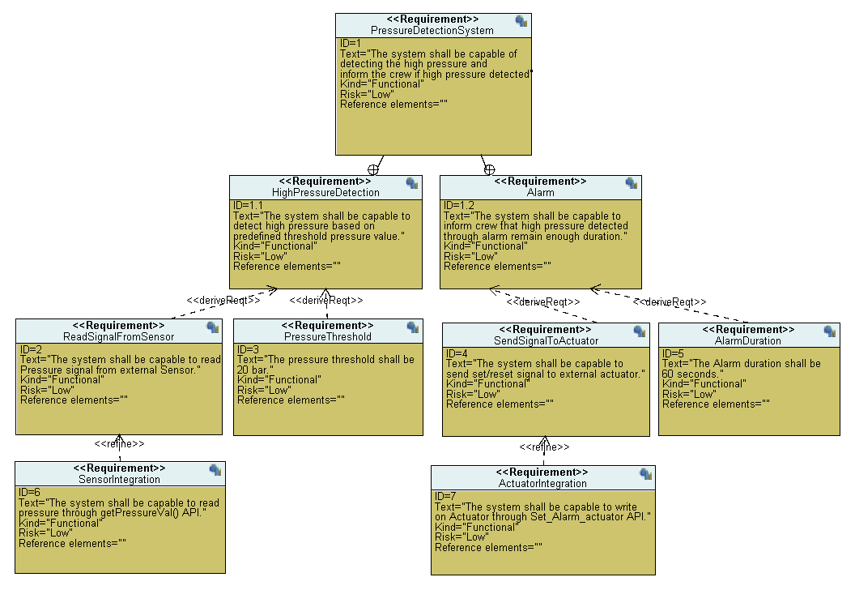
3.3.Requirements
3.3.1.Requirements Diagram

Slide 9
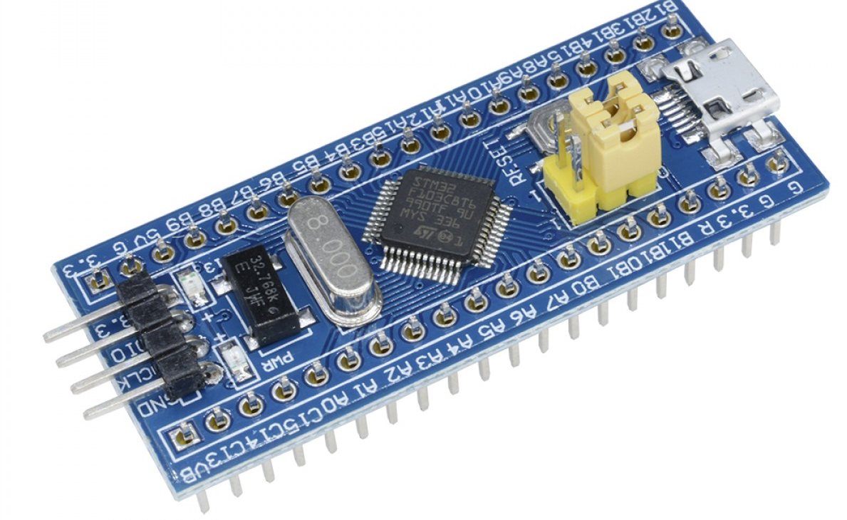
3.4.Space Exploration
The development will be implemented using STM32 board with ARM-CORTEX-M3 core.

Slide 10
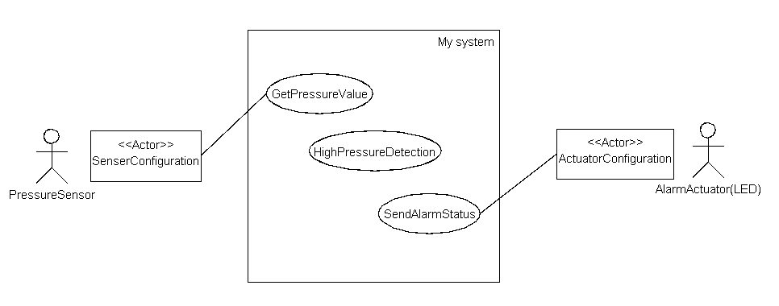
3.5.System Analysis
3.5.1.Use Case diagram

Slide 11
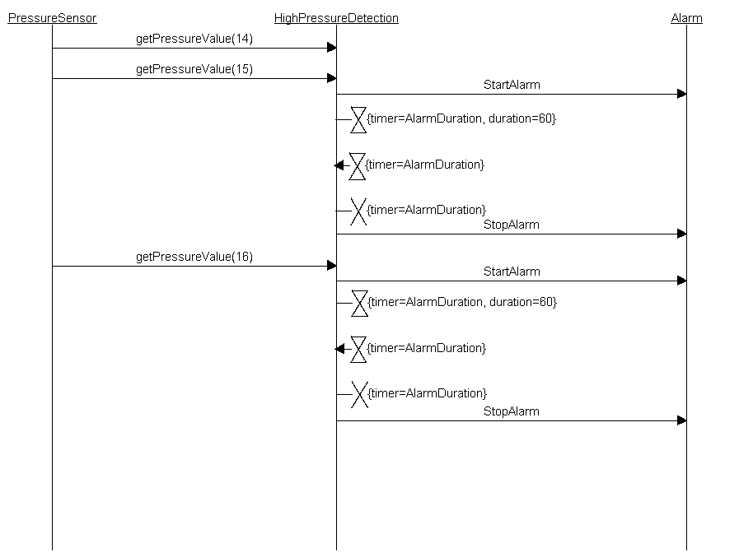
3.5.System Analysis
3.5.2.sequence diagram

Slide 12
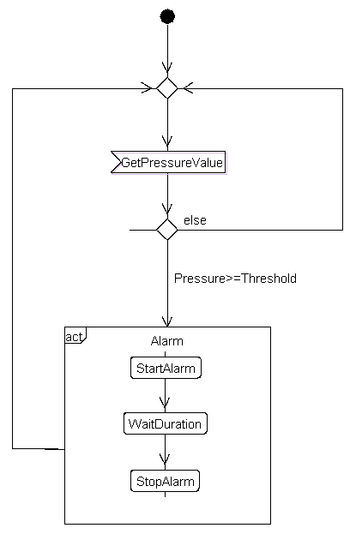
3.5.System Analysis
3.5.3.Activity diagram

Slide 13
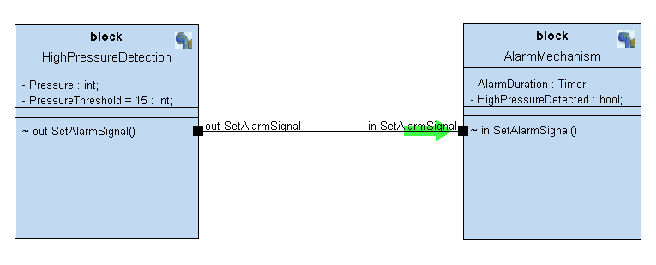
3.6.System Design
3.6.1.Block diagram

Slide 14
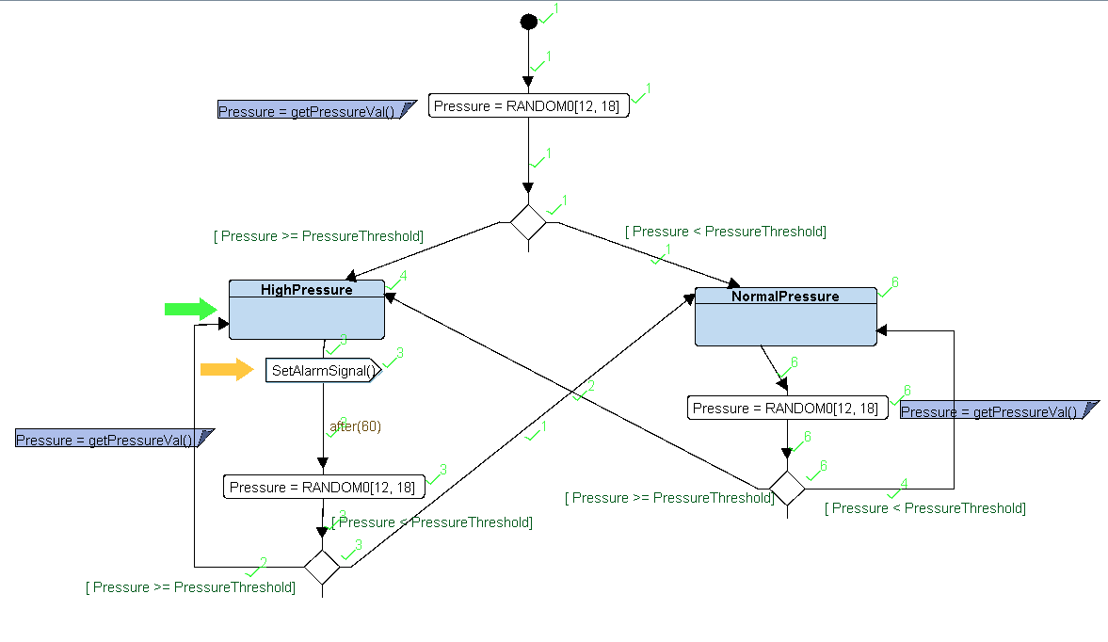
3.6.System Design
3.6.2.High pressure Detection state-machine

Slide 15
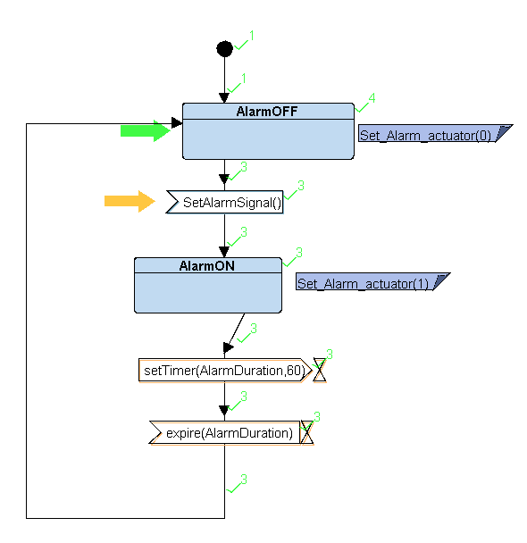
3.6.System Design
3.6.3.alarm mechanism state-machine

Slide 16
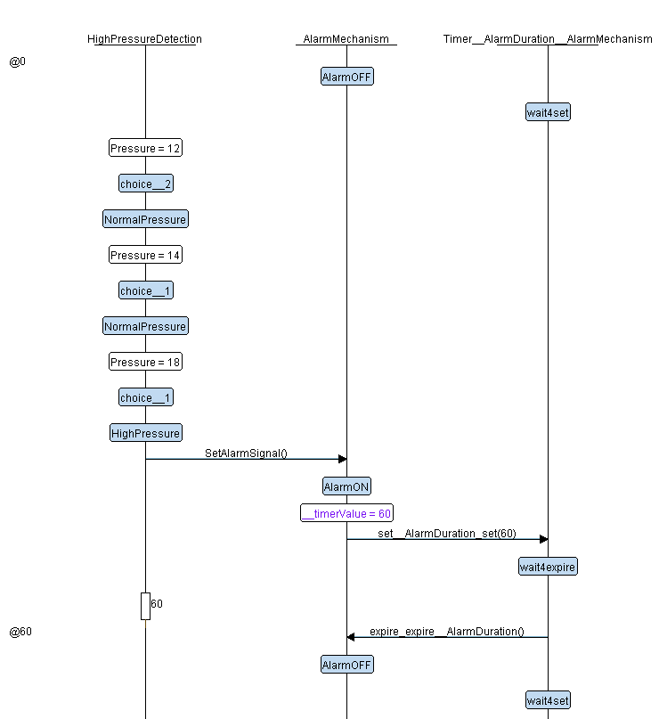
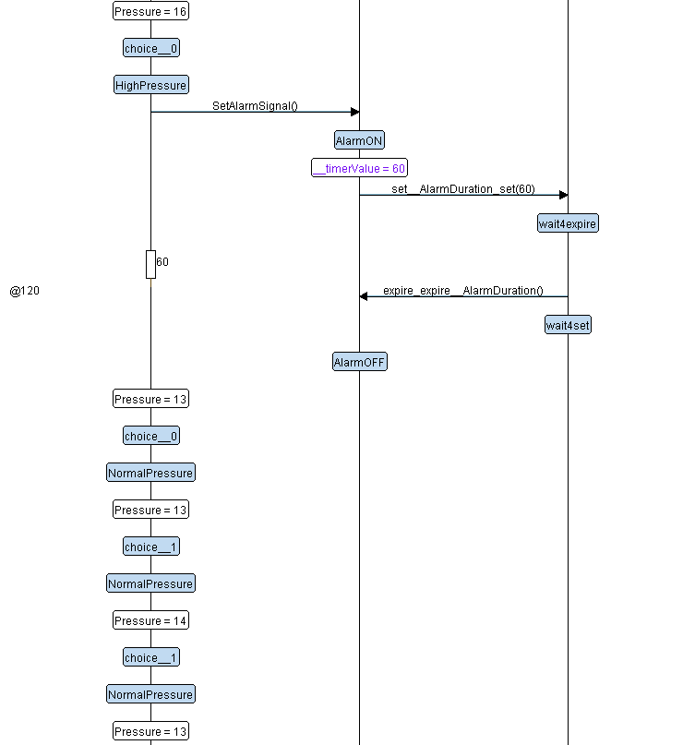
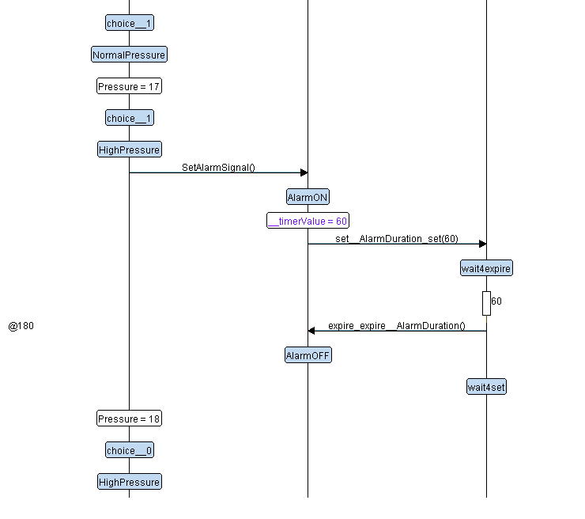
3.6.System Design
3.6.4.Simulation trace

Slide 17
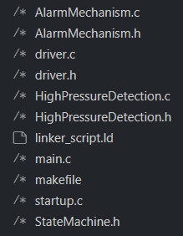
4.implementation
The code is available on GitHub Repo: https://github.com/Mohamed-Hamdy-MA/Mastering_Embedded_System.git

Slide 18
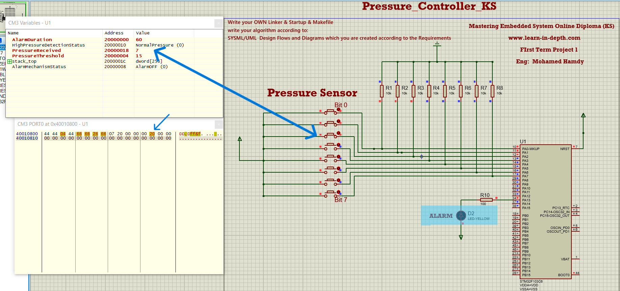
5.simulation
normal pressure Detected

Slide 19

5.simulation
High pressure Detected

Slide 20
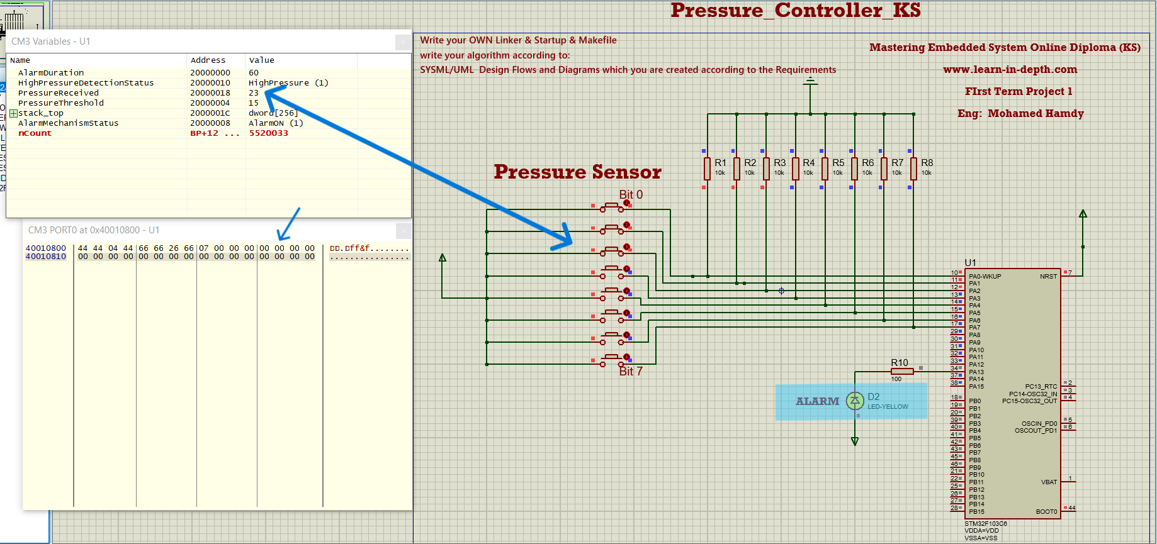
5.simulation
ALARM MECHANISM

Slide 21
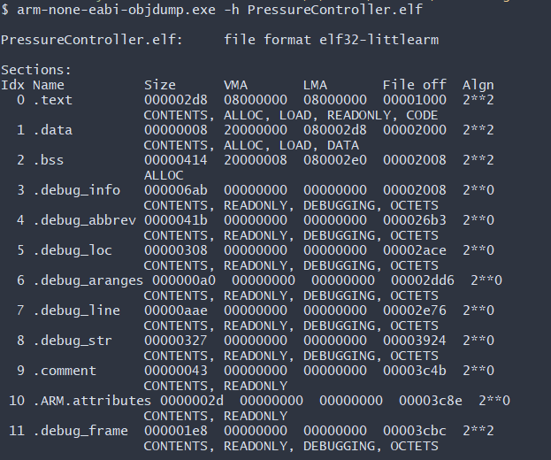
6.BINARY UTILITIES
6.1.HEADERS

Slide 22
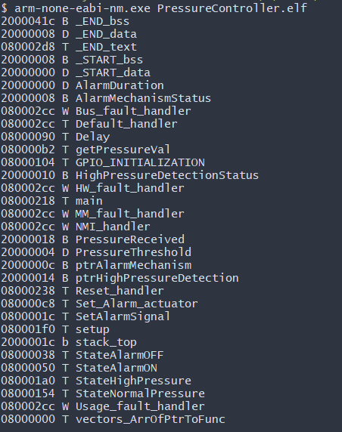
6.BINARY UTILITIES
6.2.SYMBOLS

Slide 23
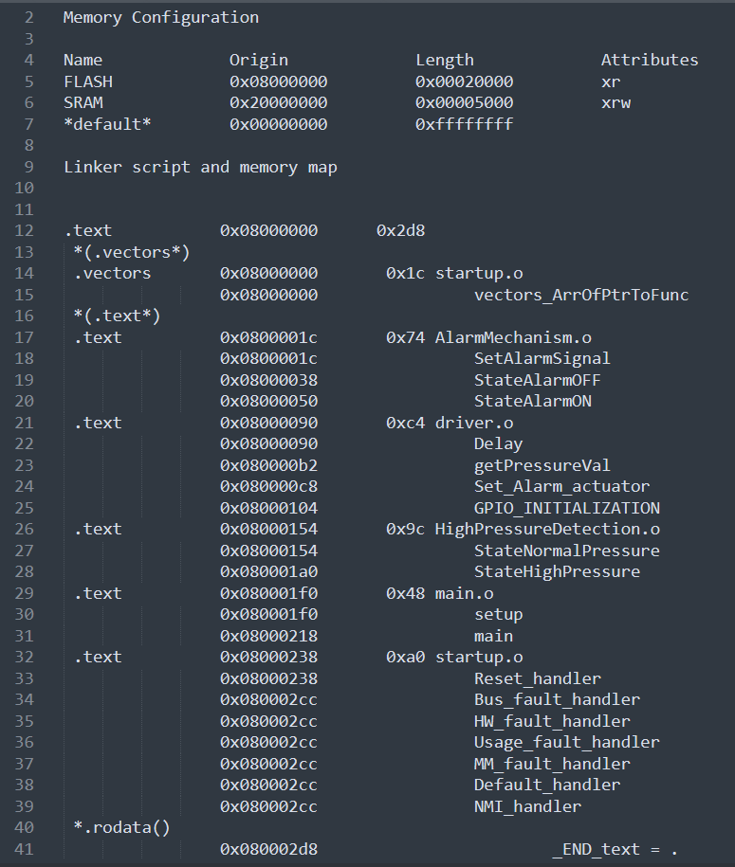
6.BINARY UTILITIES
6.3.MAP FILE

Slide 24
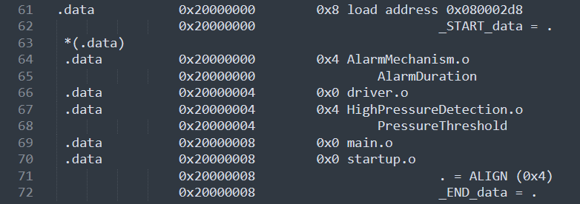
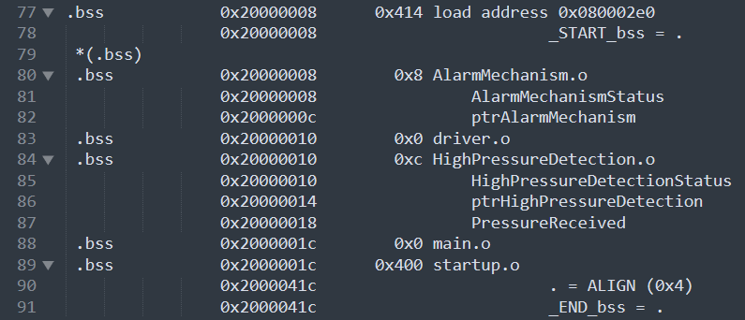

Slide 25

6.BINARY UTILITIES
6.4.size

Slide 26
THANK YOU
Mohamed Hamdy
Mohamedhamdy.m.h.m.a@gmail.com

