Slide 1
Eng. Mohamed Hamdy
Mastering Embedded System Online Diploma www.learn-in-depth.com
First Term (Final Project 2) – students management System
My Profile: https://www.learn-in-depth-store.com/profile/mohamedhamdy-m-h-m-a/profile
GitHub repo: https://github.com/Mohamed-Hamdy-MA/Mastering_Embedded_System.git

Slide 2
Agenda
1.Project objective
2.Project idea
3.Implementation
4.Run-Time Screenshots

Slide 3
1.Project objective
The project covers topics including:
  C Programming.
  Data structures.

Slide 4
2.Project Idea
Expected to deliver software of the following system:
  A students management system is designed around queue data structure, ensuring orderly and efficient processing of student data.
  The system provides a range of operations including adding, deleting, searching, and viewing student records.
  The system includes functionality to save and load student data from a text file, ensuring that data is preserved between sessions.

Slide 5
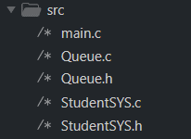

3.implementation
The code is available on GitHub Repo: https://github.com/Mohamed-Hamdy-MA/Mastering_Embedded_System.git

Slide 6
4. Run-Time Screenshots

Slide 7
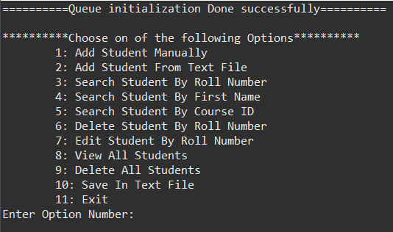
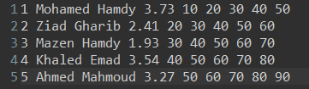


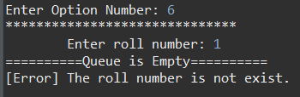


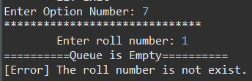



Slide 8
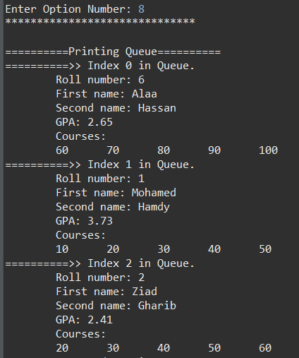
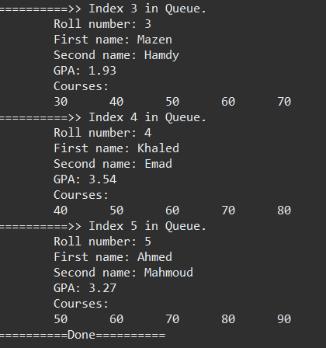

Slide 9
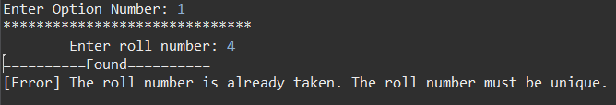


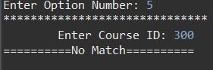
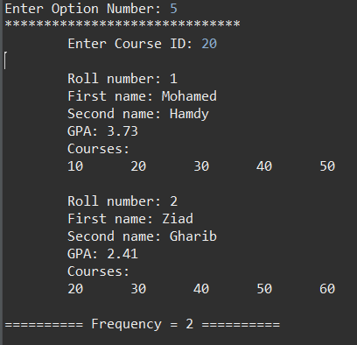
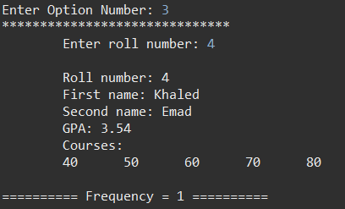
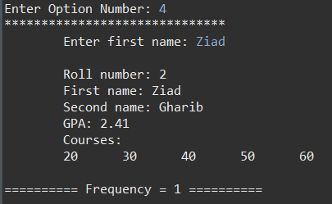

Slide 10
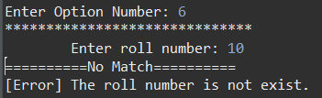
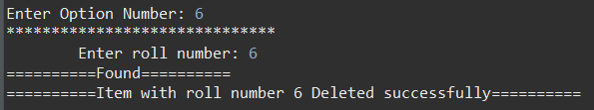
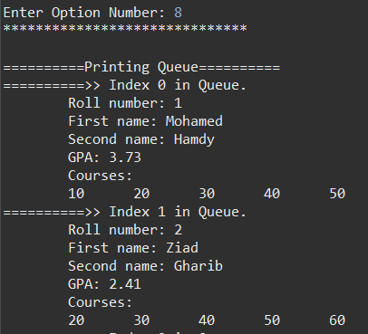
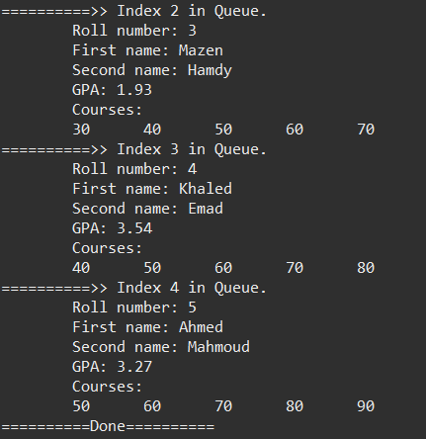

Slide 11
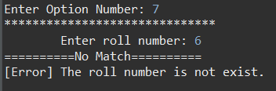
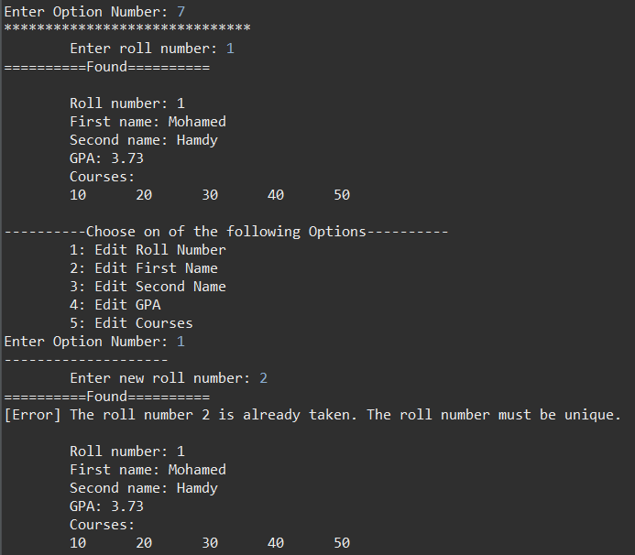

Slide 12
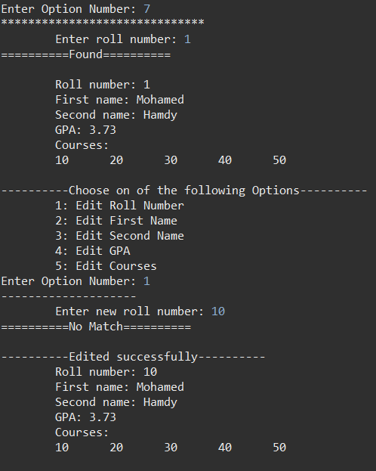
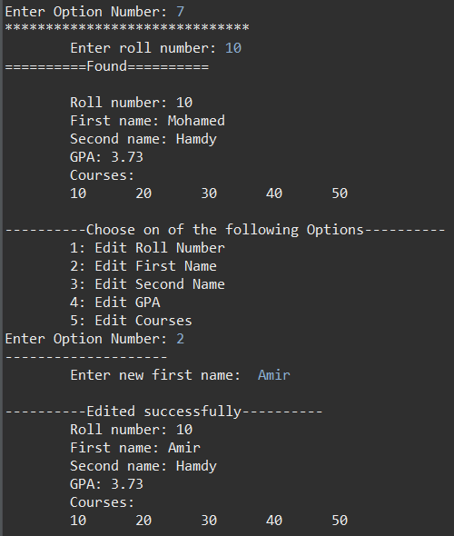

Slide 13
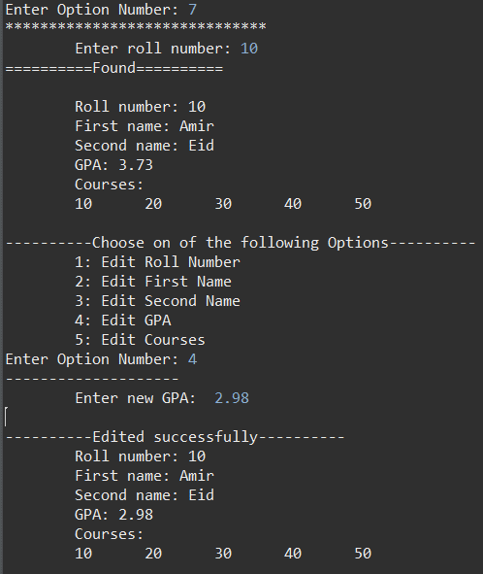
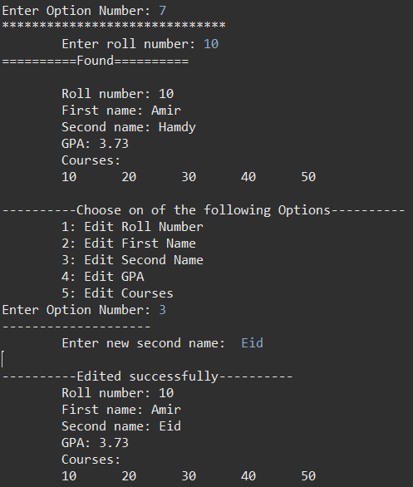

Slide 14
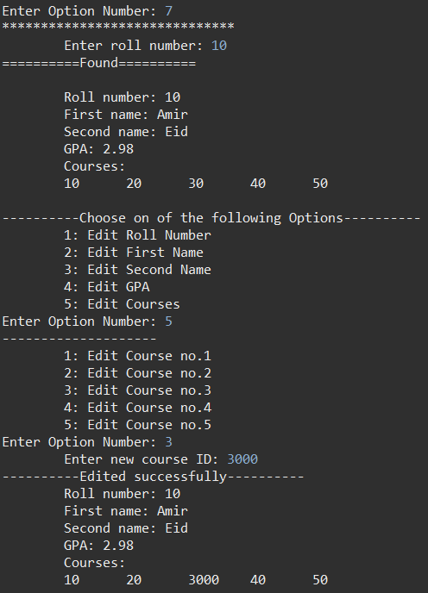

Slide 15
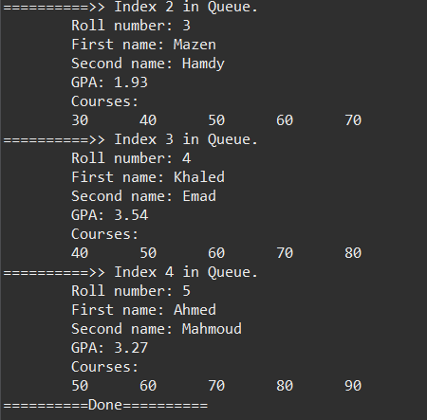
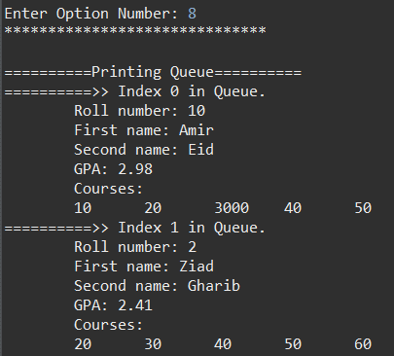

Slide 16

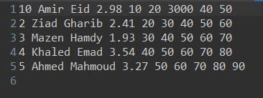

Slide 17




Slide 18
THANK YOU
Mohamed Hamdy
Mohamedhamdy.m.h.m.a@gmail.com

