Slide 1

Internship Summary
Mohamed Hatem Dawood

Slide 2
Internship Content
Course Content
Python Basics
NumPy Library
Pandas Library
Matplotlib Library
Librosa Library
Project

Slide 3

Course content
The full content is available in the training Word file

Slide 4

Project (Sales Data Analysis Project)
Data overview
Let's start by getting an overview of the dataset.
Dataset Details
Dataset: sales_data Number of Rows: [100] Number of Columns: [5]

Slide 5
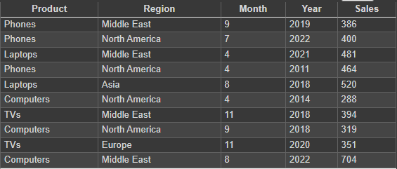
sample data

Slide 6

Dataset Insights
During our analysis, we focused on understanding:
Sales distribution across products and regions.
Seasonal sales patterns.
Top-selling products and regions.
Data visualization

Slide 7
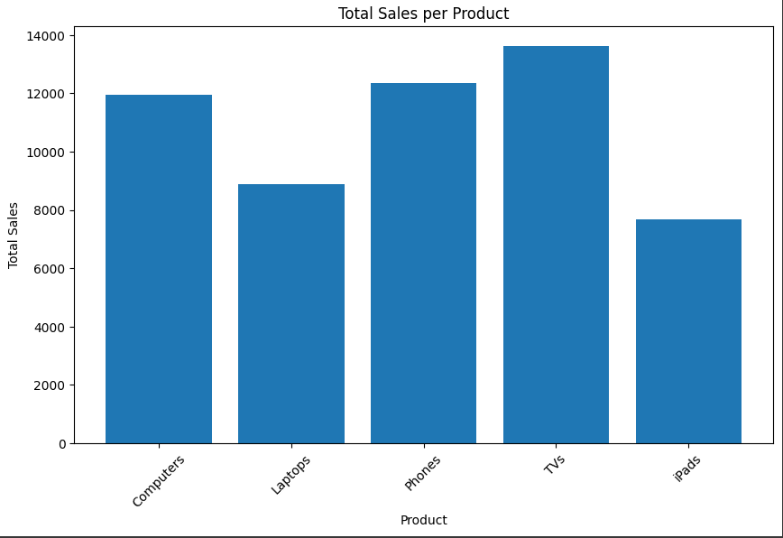
Sample output

Slide 8
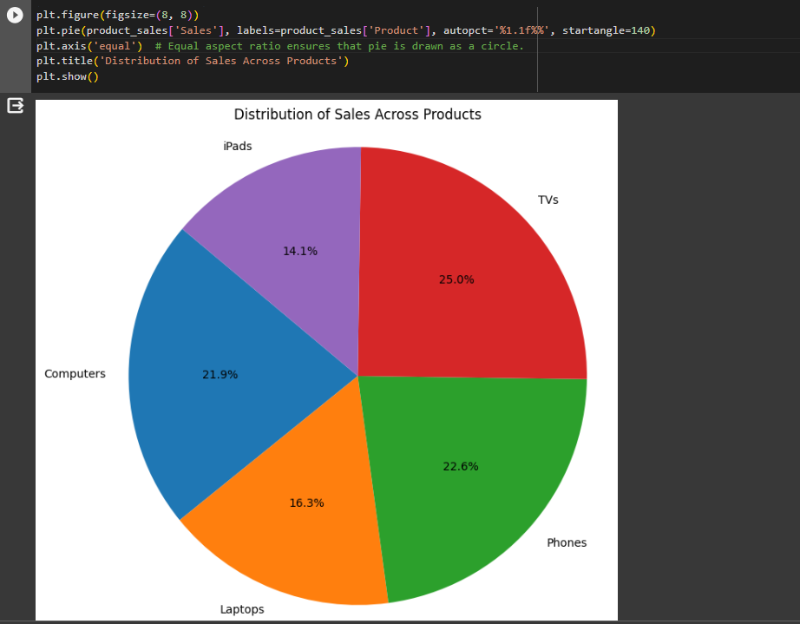
Sample output

Slide 9

Source code: https://colab.research.google.com/drive/1FF8b9llUpbLXnCGO6hlNUUKmg8bUzKcw
Thank you

