Slide 1
ACADEMIC MINI PROJECT • 2026 – 2027
SmartSelections &
Performance Analyser
Using Intelligent Keyword Search
“ Select the right student for the right opportunity. ”
PRESENTED BY • TEAM GRYFFINDOR
Department of AI & DS | Academic Year 2026-2027

Slide 2
Meet The Team
We are Gryffindor — a team driven by curiosity, courage, and code.
Our mission is to build intelligent systems that empower educators
to recognise potential and unlock opportunities for every student.
01
02
04
Mohamed Irban S
Jitendra VK
Team Lead
Designer
Team Gryffindor • SmartSelection & Performance Analyser
2 / 7

Slide 3
Problem & Proposed Solution
Why educational institutions need a smarter way to choose.
THE PROBLEM
OUR SOLUTION
Manual Student Selection is Slow
Intelligent Keyword-Based Engine
● Teachers manually scan hundreds of student records.
● Tracking skills, certifications & history is tedious.
● No centralised academic performance view.
● Risk of overlooking the most eligible candidates.
● Repeated effort for every event, drive or scholarship.
✓ Centralised digital profile of every student.
✓ Natural-language queries instead of menu filtering.
✓ Automatic performance classification & analytics.
✓ Smart matching of students to events .
✓ Faster, fairer, data-driven decisions.
Team Gryffindor • SmartSelection & Performance Analyser
3 / 7

Slide 4
Objectives & Core Modules
What we set out to build and how it is structured.
KEY OBJECTIVES
01
Maintain complete digital student profiles
02
Analyse academic performance automatically
03
Enable keyword-based intelligent search
04
Recommend the right student for the right event
THREE CORE MODULES
MODULE 01
MODULE 02
MODULE 03
Student Database
Management
Academic Performance
Analytics
Intelligent Keyword
Search Engine
▸ Add / Update / Delete records
▸ View student details
▸ Manage skills, fees, certifications
▸ Average marks calculation
▸ Pass / Fail rate analysis
▸ Categorise: Poor • Average
▸ Natural-language queries
▸ Tokenization & keyword extraction
▸ Smart recommendation output
Team Gryffindor • SmartSelection & Performance Analyser
4 / 7

Slide 5
System Workflow & Architecture
From a teacher's query to a ranked list of recommended students.
1
2
3
4
5
6
Query
Input
Text
Processing
Keyword
Extraction
Database
Search
Performance
Analysis
Recommended
Students
Teacher types a
natural query
Cleaning &
tokenisation
Identify
important terms
Lookup matching
student records
Rank by skills,
marks, history
Display the best
candidates
EXAMPLE QUERY
ARCHITECTURE STACK
“ Recommend students for
the Smart India Hackathon ”
User Interface
Teacher / Admin Login
Processing Layer
Text + Keyword Engine
→ Keywords: hackathon, recommend, students
→ Filters: Python, ML, AI cert., avg > 80%
→ Output: Ranked list of eligible students
Recommendation
Ranking & Matching Logic
Data Layer
Student Database (SQLite / MySQL)
Team Gryffindor • SmartSelection & Performance Analyser
5 / 7

Slide 6
Real Hackathons & Symposiums
How our system maps real opportunities to the right students.
Smart India Hackathon
R1 CodeFiesta
Hackadroit
Ministry of Education, GoI
National Level Hackathon
IEEE Student Branch • PEC
36-hour nationwide innovation challenge across AI, healthcare,
agriculture, smart cities and cyber security.
Cybersecurity, blockchain & open innovation tracks in a
36-hour intensive coding marathon.
Flagship 24-hour software hackathon under Techadroit
for robotics, software & gaming.
Python
Machine Learning
Teamwork
Cyber Security
Blockchain
Full-Stack
Software Dev
Robotics
Gaming
Argonyx Hackathon
FESTX '23
Coding Contests &
Paper Presentations
IEEE • Pitch + Build
Sri Sairam Engineering College
Symposium Track
Healthcare, sustainability, FinTech & social impact prototypes
presented to founders & industry experts.
National-level technical symposium with hackathon, coding,
debugging, project expo and startup pitch.
DSA, algorithmic challenges, research papers and
technical poster presentations.
Product Dev
Pitching
Innovation
Coding
Project Expo
Startup Pitch
DSA
Research
Communication
Team Gryffindor • SmartSelection & Performance Analyser
6 / 7

Slide 7
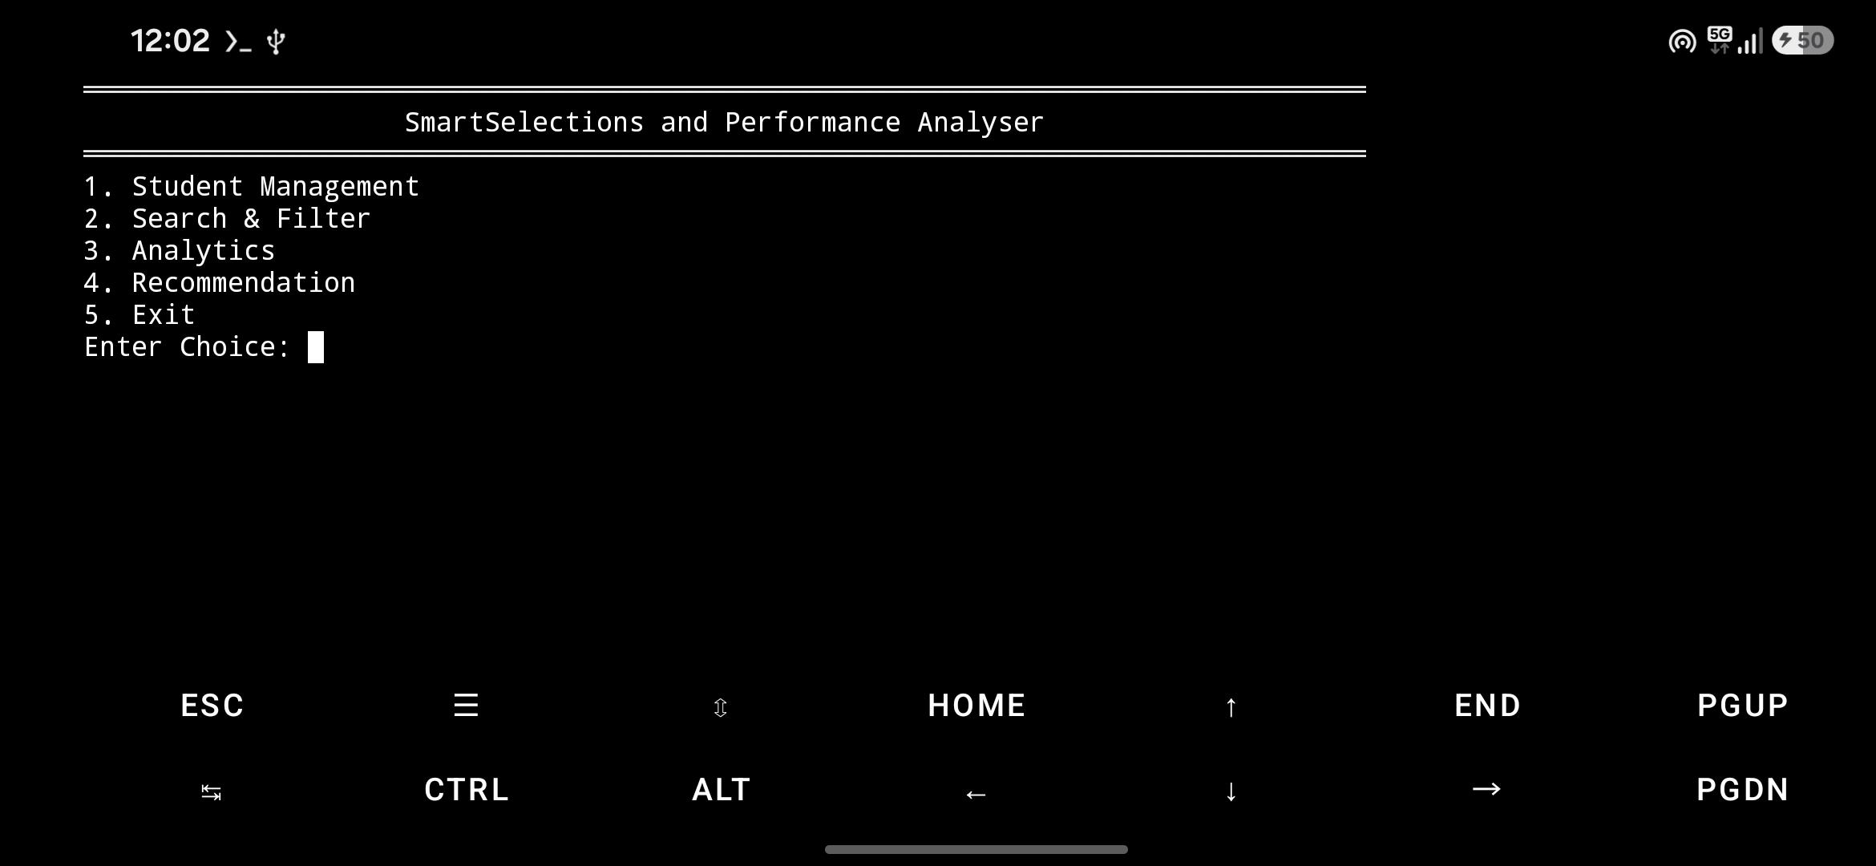
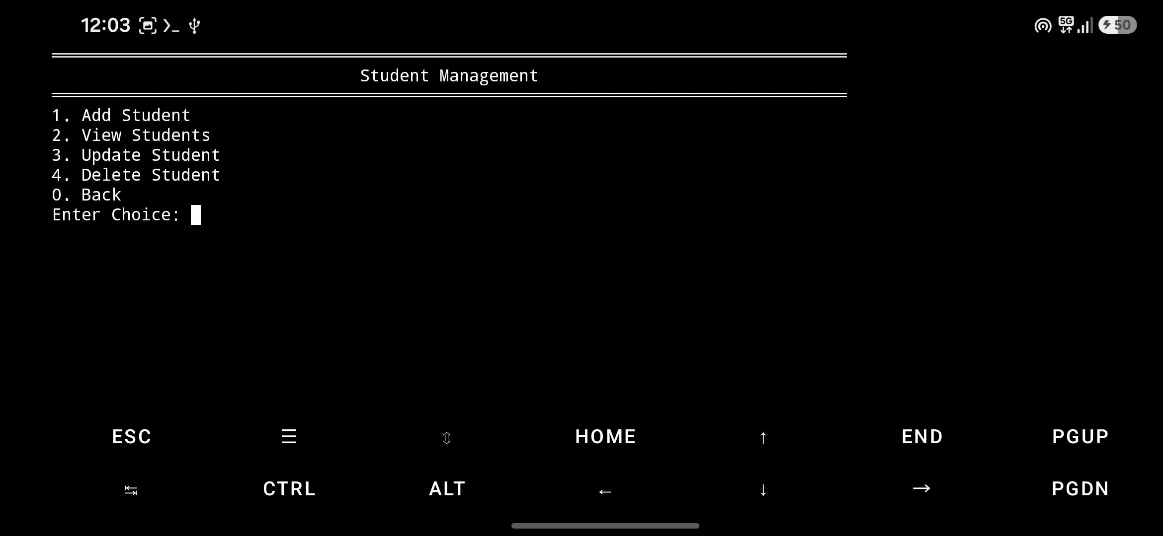
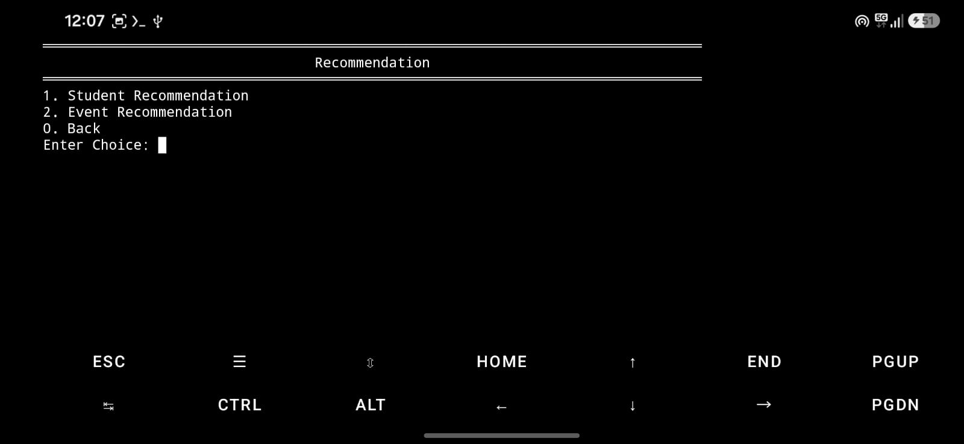
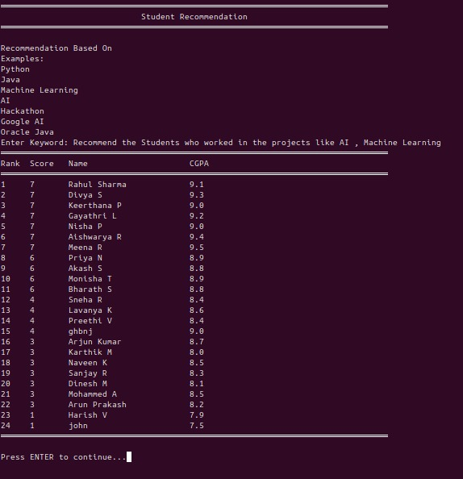
OUTPUT:
MAIN MENU
Student Management
Recommendation
Keyword Selection

Slide 8
Future Scope & Conclusion
Where this system is heading — and the impact it leaves.
FUTURE ENHANCEMENTS
AI Recommendation Engine
Voice-Based Search
CONCLUSION
1
2
ML models that predict the
best-fit students automatically.
Hands-free queries via
speech recognition.
Right Student. Right Opportunity.
Our Student Recommendation & Selection
System turns scattered student records into
actionable insights.
By blending performance analytics with
intelligent keyword search, we help institutions
save time, reduce bias, and make data-driven
decisions for every event, scholarship, and
placement opportunity.
3
Web & Mobile Dashboard
4
Placement Prediction
Anywhere access for teachers,
HODs and placement officers.
Predict placement readiness
from historical data.
5
Cloud Database
6
Chatbot Interface
Scalable, secure storage
for institution-wide deployment.
Conversational assistant
for faster interaction.
Thank You
— Team Gryffindor —
Team Gryffindor • SmartSelection & Performance Analyser
7 / 7

