Slide 1
Bluestock Mutual Fund Analytics Capstone Project
Prepared By:Mohamed Ismail M
• Technologies: Python, Pandas, NumPy, Matplotlib, Power BI
• Project Domains: Financial Analytics, Risk Assessment, Investor Analytics, Business Intelligence

Slide 2
Problem Statement & Objectives
Large mutual fund datasets are difficult to analyze manually
• Evaluate performance and risk
• Analyze investor behaviour
• Build interactive dashboard

Slide 3
Data Sources
Fund Performance Data
• NAV History
• Benchmark Data
• Investor Transactions
• Portfolio Holdings

Slide 4
Project Architecture
Raw Mutual Fund Data
↓
ETL & Data Cleaning
↓
Feature Engineering
↓
EDA & Performance Analysis
↓
Risk Analytics
↓
Power BI Dashboard
↓
Business Insights

Slide 5
EDA Highlights – Industry Analysis
AUM Growth Analysis
• Fund House Comparison
• Category Distribution
• Increasing SIP Participation

Slide 6
EDA Highlights – Investor Analysis
State-wise Investments
• Age Group Analysis
• Transaction Trends
• Investor Behaviour Insights

Slide 7
Performance Metrics
CAGR
• Sharpe Ratio
• Sortino Ratio
• Alpha & Beta
• Fund Scorecard

Slide 8
Advanced Analytics & Risk Metrics
VaR & CVaR
• Rolling Sharpe Ratio
• Cohort Analysis
• SIP Continuity
• Sector HHI

Slide 9
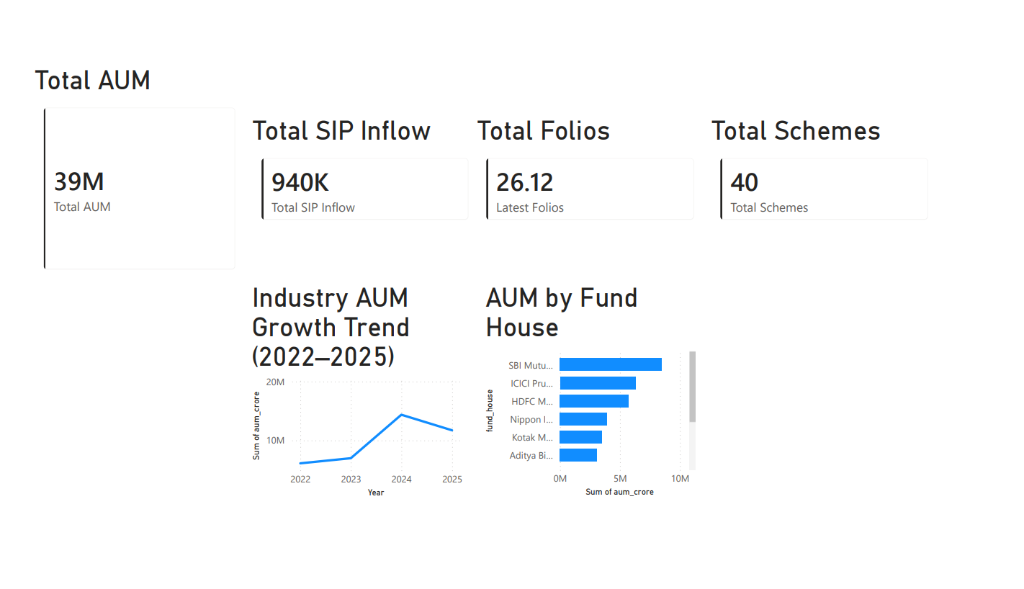
Dashboard Overview
Industry Overview Dashboard
• AUM KPIs
• SIP Inflows
• Fund House Analytics

Slide 10
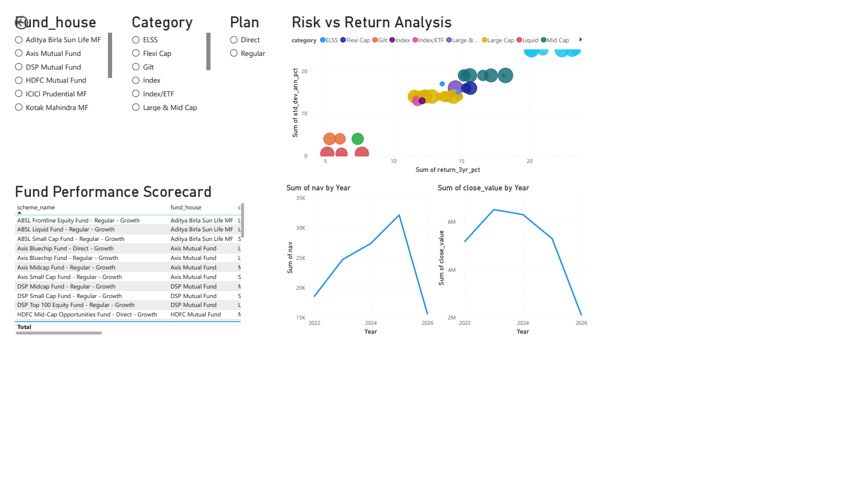
Dashboard Analytics
Risk vs Return Analysis
• Investor Analytics
• SIP Trends
• Market Comparison

Slide 11
Key Findings
Industry growth remained strong
• Equity funds generated strong returns
• Risk-adjusted performance varied
• SIPs remained a major growth driver

Slide 12
Thank You
Bluestock Mutual Fund Analytics Capstone Project
Prepared By: Mohamed Ismail M
Questions & Discussion

