Slide 1
Loan Approval
Analytics Dashboard
End-to-End Data Analysis & Science Project
Python • EDA
Data Cleaning
Machine Learning
Power BI
Data Analysis | Visualization | Predictive Modeling

Slide 2
Project Overview
🎯 Objective
🔄 Project Workflow
Predict whether a loan application will be approved or rejected — and understand the factors driving that decision.
01
Data Collection
614 records, 13 features
02
EDA & Cleaning
📊 Dataset Snapshot
Python — handle missing values
03
Feature Engineering
614
13
68.7%
Encode + transform variables
Loan Applications
Features
Approval Rate
04
ML Modeling
SVM + 6 algorithms tested
05
Power BI Dashboard
Interactive visual insights

Slide 3
Exploratory Data Analysis & Cleaning
Python (Pandas · Seaborn · Scikit-learn)
Key Statistics from Dataset
$5,403
$145.8K
360 months
84.2%
Avg Applicant Income
Avg Loan Amount
Median Loan Term
Good Credit Ratio
🔍 Missing Values — Handling
⚙️ Feature Engineering
Categorical columns → filled with Mode LoanAmount → filled with Median Duplicates → None found ✓
Label Encoding applied to: Gender, Married, Self_Employed
Property_Area, Education
Dependents: '3+' → 4
Loan_Status: Y→1, N→0

Slide 4
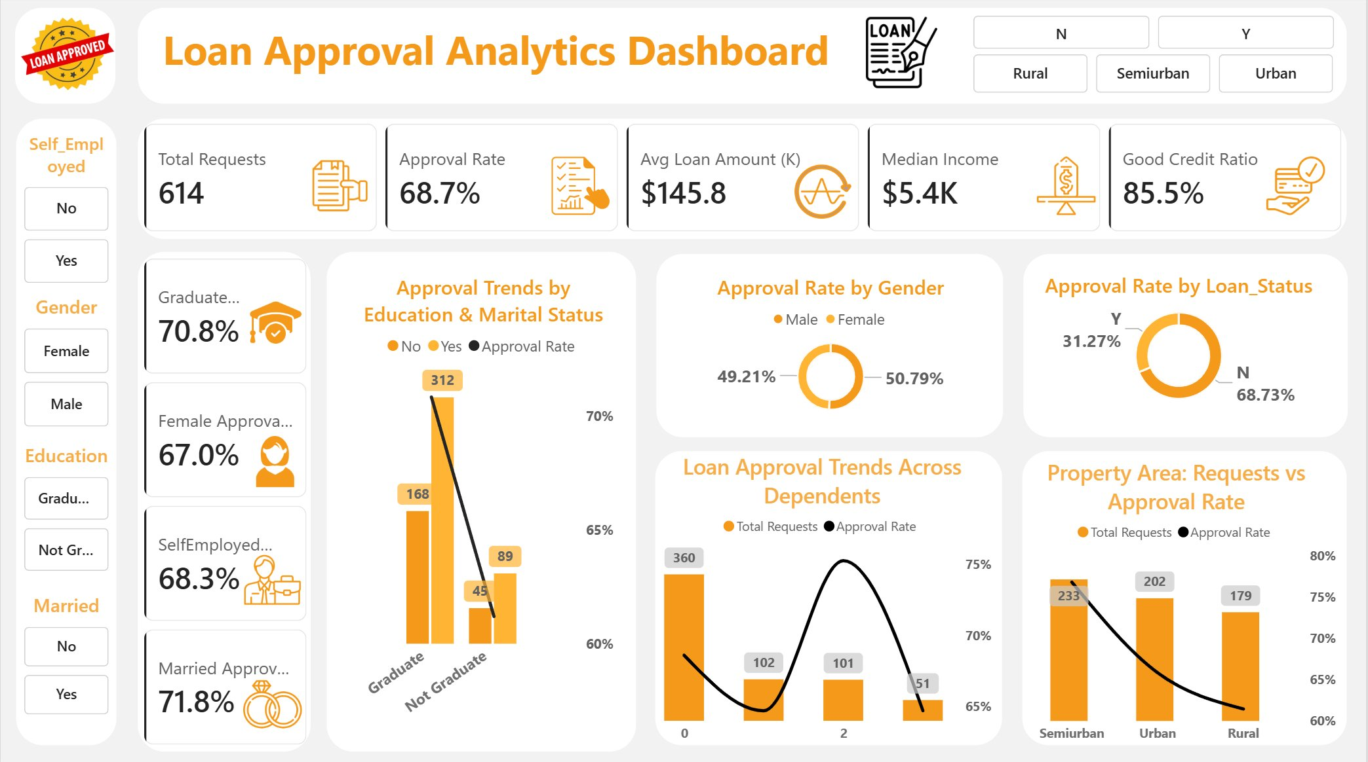
Interactive Power BI Dashboard
614 Total Requests
68.7% Approval Rate
$145.8K Avg Loan
85.5% Good Credit Ratio

Slide 5
Key Insights from the Dashboard
💳 Credit History is King
🎓 Education Matters
🏘️ Semiurban Leads
85.5% of applicants with good credit were approved — the single strongest predictor of loan approval.
Graduates had a 70.8% approval rate vs lower rates for non-graduates, especially when married.
Semiurban areas had the highest request volume (233) AND the best approval rates among all property areas.
👨‍👩‍👧 Dependents Impact
⚖️ Gender Parity
💰 Income vs Loan Size
Applicants with 0 dependents made up 360 requests. Approval rate peaks at 1-2 dependents and drops at 3+.
Male (49.21%) vs Female (50.79%) — nearly equal distribution, but married applicants had 71.8% approval.
Median income $5.4K with avg loan $145.8K — most applicants are taking loans within reasonable income range.

Slide 6
Machine Learning Model
🤖 Chosen Model
📊 Models Comparison
Support Vector Machine (SVM)
Kernel: Linear
Train / Test Split
Training Set
90%
552 samples
Test Set
10%
62 samples
Final Accuracy
80%

Slide 7
Conclusions & Takeaways
01
Credit History Dominates
02
80% Model Accuracy
The most predictive feature — applicants with good credit history are approved at dramatically higher rates.
SVM with Linear Kernel achieved 80% accuracy on unseen test data — competitive with Logistic Regression and Naive Bayes.
03
Demographics Matter
04
Power BI for Business Value
Education level, marital status, and property area all significantly influence loan approval decisions.
Interactive dashboard enables non-technical stakeholders to explore approval trends by gender, area, and more.
Thank You
Mohamed Nofal Linked in Github

