Slide 1
Welcome to our presentation

Slide 2



SUBMITED BY
AbdiQadir Jaylani
Hamze Shacban
MohamedNur Abshir
Roll: 07
Roll: 02
Roll: 29

Slide 3

Submitted to
Asst. Prof. Md. Habibullah Belali

Slide 4
Topics
RPC OPERATIONS
ASYNCHRONOUS RPC
DEFERRED SYNCHRONOUS

Slide 5
RPC OPERATION
RPC is Remote Procedure Call that used to call other processes on the remote systems like a local system.

Slide 6
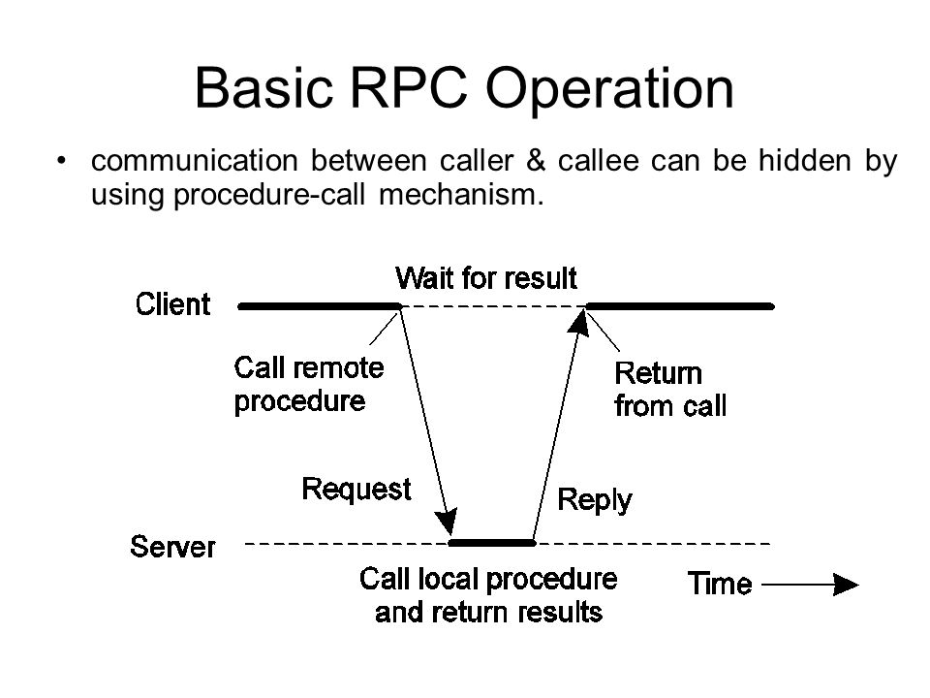

Slide 7
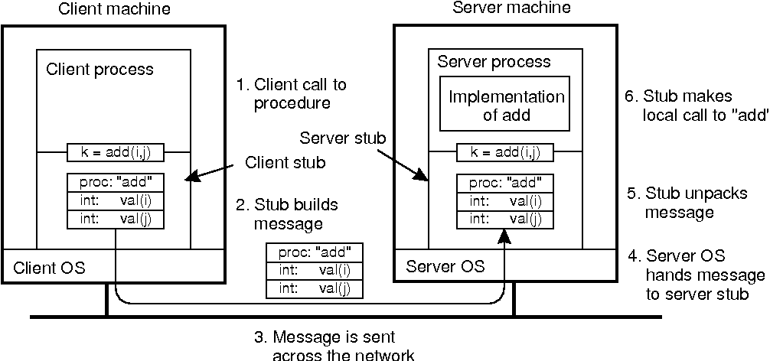
The steps involved in a doing a remote computation through RPC.

Slide 8
a remote procedure call occurs in the following steps:
1. The client procedure calls the client stub in the normal way.
2. The client stub builds a message and calls the local operating system.
3. The client's OS sends the message to the remote OS.
4. The remote OS gives the message to the server stub.
5. The server stub unpacks lhe parameLers and calls the server.
6. The server does the work and returns the result to the stub.

Slide 9
Asynchronous rpc

Slide 10
asynchronous
Asynchronous Rpc is the updated one Comparing to the traditional or normal Rpc

Slide 11
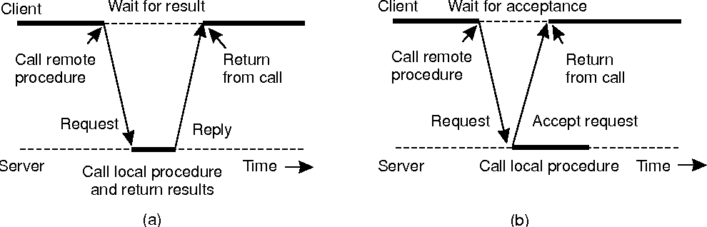
The interaction between client and server in a traditional RPC.
The interaction using asynckonous RPC'

Slide 12
Deferred synchronous rpc

Slide 13
Deferred synchronous rpc
Combining two asynchronous RPCs is referred to as a deferred synchronous RPC

Slide 14
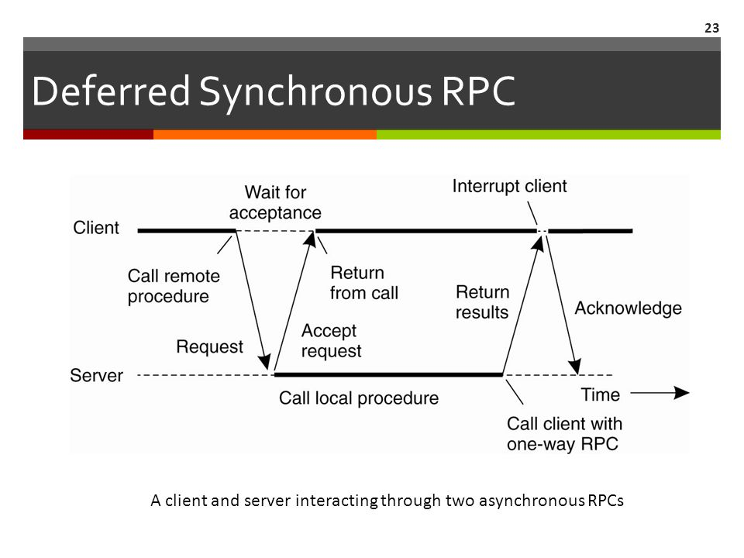

Slide 15

THANK YOU All
For Listening Our Presentation

