Slide 1
Cyberstalking
@#&!*
EW
YOU CAN'T

Slide 2
OUR TEAM
Gharbi Dina
Gassouma Samia
Kaabi Nawel
Allani Nour
Ousleti Abir
Jemali Mohamed

Slide 3
TABLE OF CONTENTS
01
02
03
INTRODUCTION
CYBERSTALKING
Data reporting
04
05
06
Survey Reporting
ACTION PLAN
CONCLUSIONS
Team logo and slogan
Definition cyberbullying
History of cyberbullying
n
Definition of Cyberstalking
Difference between cyberstalking and online Harrasment

Slide 4
01
INTRODUCTION
@#&!*
YOU CAN'T

Slide 5

Be unique, hit delete, and smile

Slide 6

A PICTURE IS WORTH A THOUSAND WORDS

Slide 7
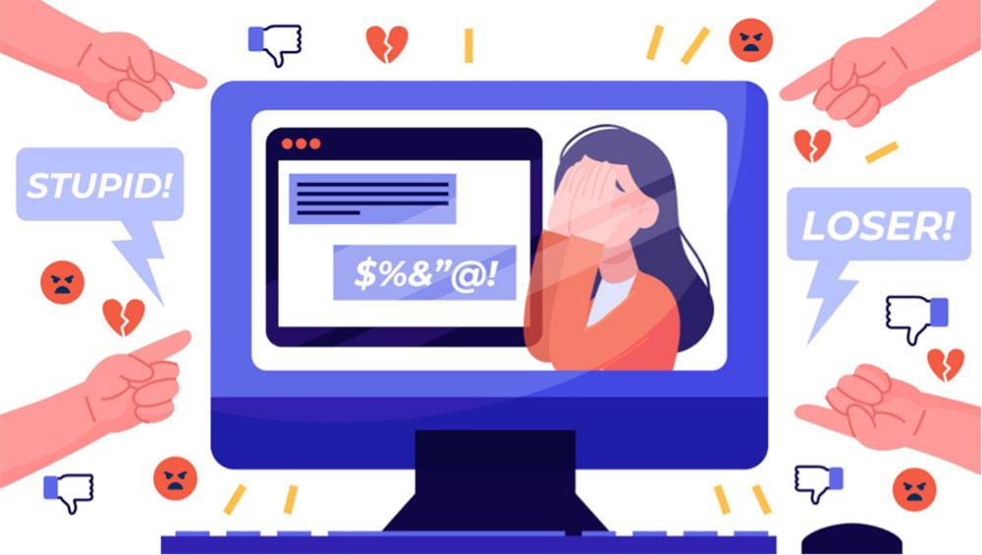

Cyberbullying
Cyberbullying is when someone uses the internet to be mean to a child or young person so they feel bad or upset

Slide 8
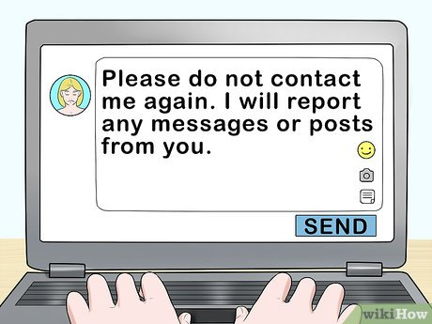
History of cyberbullying :
Traditional bullying forced its way onto the web in the 1990s with the advent of affordable personal computers. Since then, classmates (and even strangers) have subjected children and teens to cyberbullying in public chatrooms or on private messaging platforms. The web’s anonymity provided the perfect cover for a user to harass or intimidate others without many repercussions.

Slide 9
02
CYBERSTALKING
@#&!*
is a dangerous form of cyberbullying in which attackers harass victims through online communications like email or social media it also refers to adults using the internet to contact and meet young people for abusive purposes.
YOU CAN'T

Slide 10
DIFFERENCE BETWEEN CYBERBULLYING AND ONLINE HARRASSMENT
In law, a distinction is often drawn between the two: according to the National Conference of State Legislatures, online harassment is typically defined as “not involving a credible threat”, whereas threat is present in cyberstalking.

Slide 11
03
DATA REPORTING

Slide 12
How Often Does Cyberstalking Occur?
The Pew Research Center identified that 7% of Americans have been stalked online. Young people under the age of thirty, and particularly women between the ages of 18-24, seemed vulnerable to the most “severe” forms, including physical threats and sexual harassment.

Slide 13
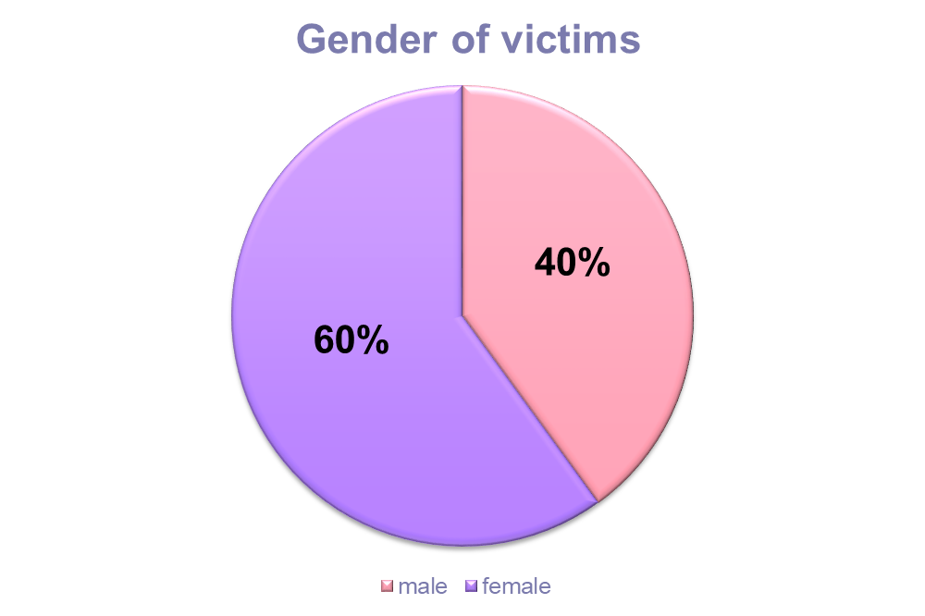
Notes:
In 2019, the prevalence of stalking was higher among females (60%) than males (40%)

Slide 14
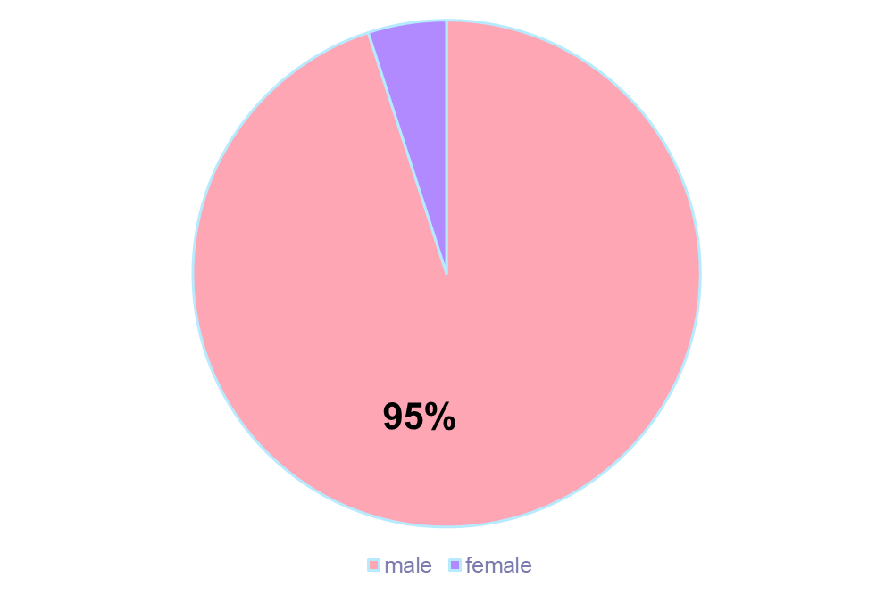
Gender of Pursuer
200,000 people are real stalkers in America, approximately 1 in 1250 persons. 95% of stalkers are men

Slide 15
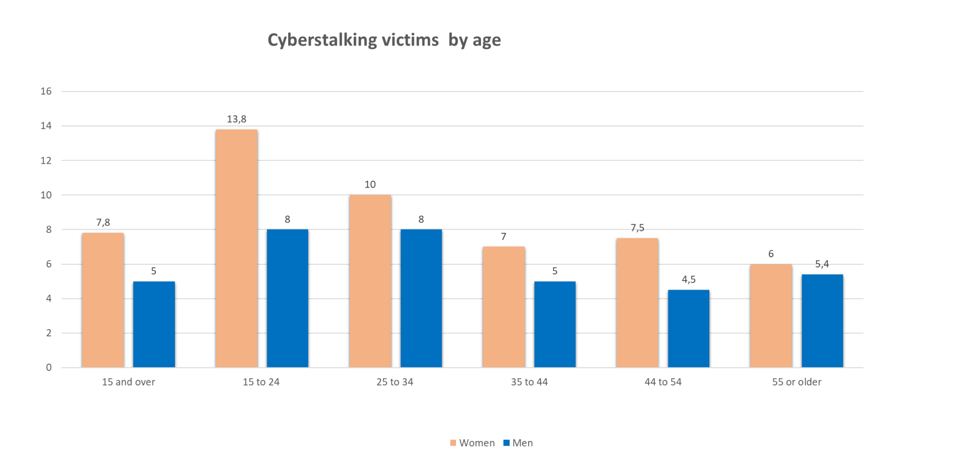
Notes:
Persons aged 20 to 24 (2.0%) were stalked more often than persons in age groups over 35.

Slide 16
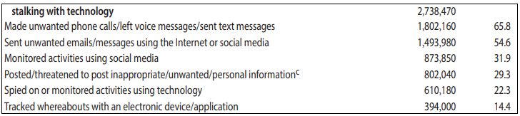
Cyberstalking victims by type of staking behavior
Notes:
and about 65.8% of cyberstalkes victims received unwanted emails or messages using the Internet or social media. Approximately 54.6% were monitored using social media or had unwanted information posted about them on the Internet. About22.3% of all persons were spied on using technologies or had their whereabouts tracked with an electronic device or application.

Slide 17
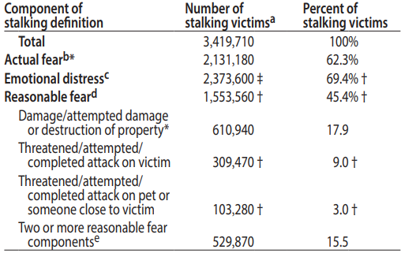
Effect of cyberstalking
Notes:
Of the 3.4 million stalking victims in 2019, more than 2.1 million (62%) experienced fear and 2.4 million (69%) experienced substantial emotional distress (table 10). About 1.6 million (45%) victims had an experience that would, by definition, cause a reasonable person to experience fear, including property damage or an attack.

Slide 18
04
SURVEY REPORTING
DISGUSTING
@#&!*

Slide 19
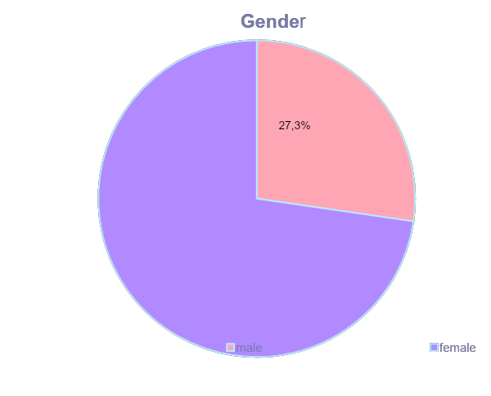
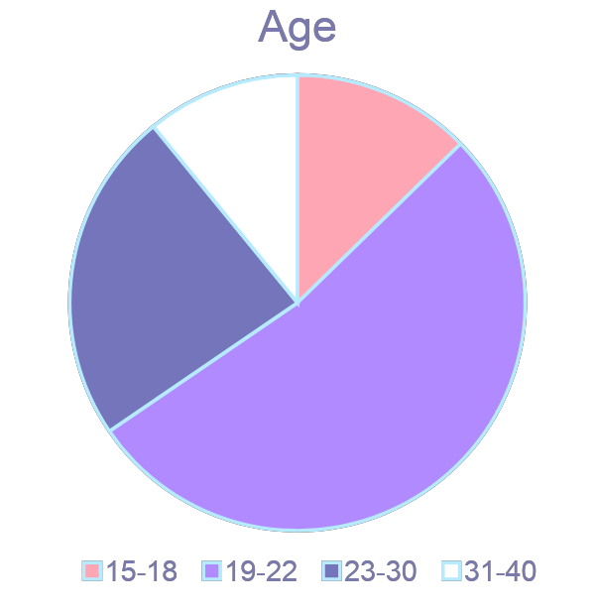
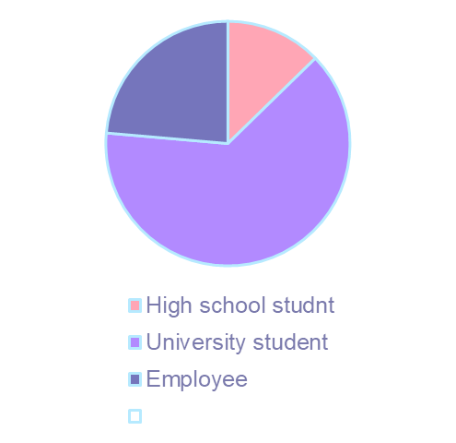
10,9%
12,7%
12.7%
23.6%
23,6%
72,7%
52,7%
63.6%

Slide 20
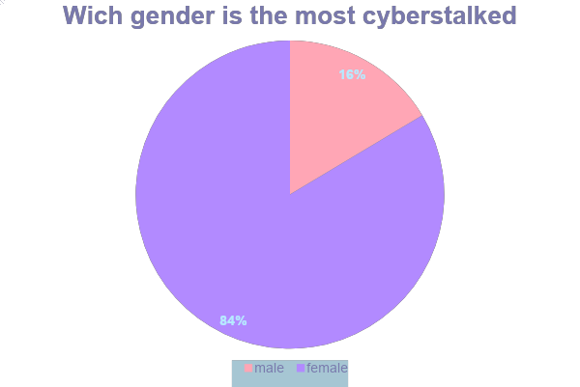

Slide 21
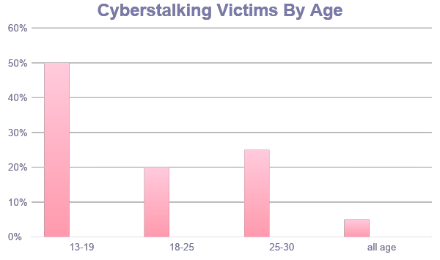

Slide 22
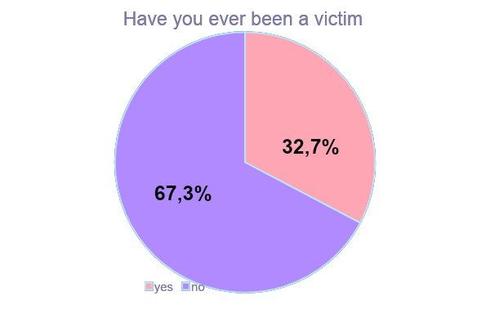
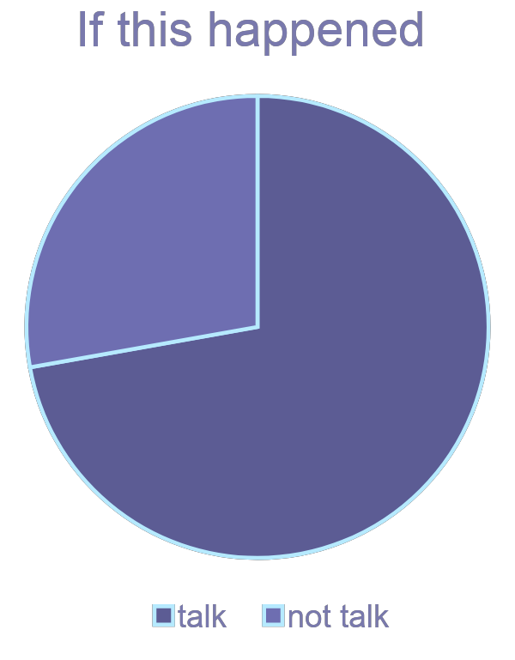
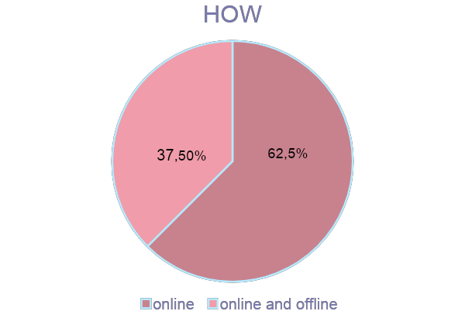
27,8%
72,2%

Slide 23
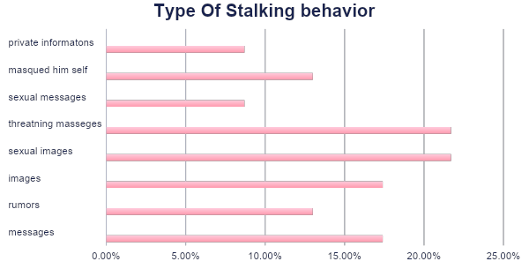

Slide 24

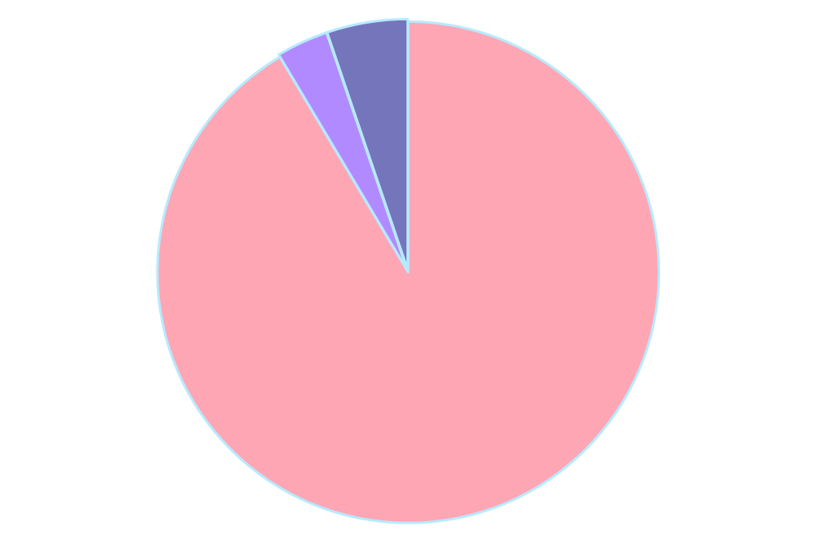










Slide 25
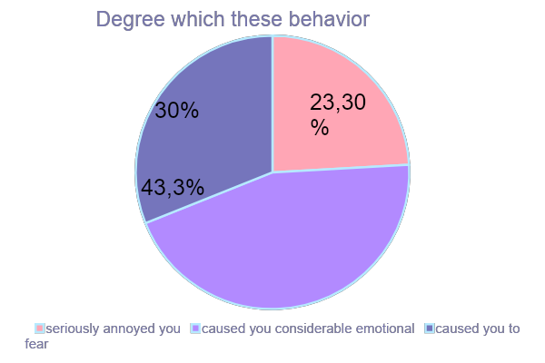

Slide 26
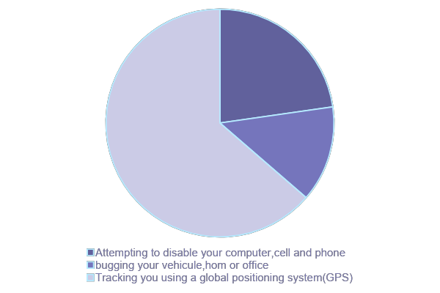
How other one harres you
30%
50%
20%

Slide 27
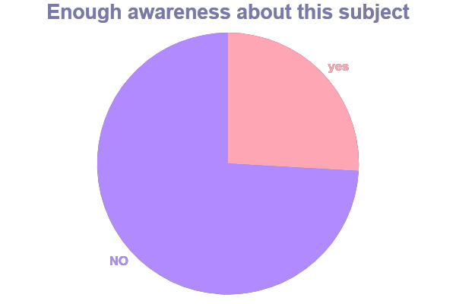
25,9%
74,1%

Slide 28
05
ACTION PLAN
DISGUSTING
YOU CAN'T

Slide 29
Posters
-Distribute the posters which contains information to educate the public about cyberstalking.
In this posters we must confirm the role of parents which represented in:
*Supporting their children if they are victims of cyberstalking ,telling them it was not their fault and keeping a copy or screenshot of the bully’s comments and messages.
In addition, parents can monitor their children on social media through programs and apps, as they can alert parents to any inappropriate language or photos.
*Develop family laws that can reduce the occurrence of cyberstalking , such as not talking to unknown people and activate their social media settings.

Slide 30
Awareness-raising spot
-Filming a short video about community awareness .
This video includes an awareness paragraph about cyberstalking which we encourage parents to control their children also all people must create strong,unique password for all online accounts.
People should only visit safe sites that adopt and follow an anti-harassment policy.

Slide 31
Interview with an expert
-Arrange an interview with a psychologist where we will discuss victim’s situation and feelings and Arrange an interview with a psychologist where we will discuss their situation and feelings and advise us on how to deal with them.

Slide 32
06
CONCLUSIONS
@#&!*

Slide 33
Cyberstalking is proved to be a grave offence. It has very far-reaching impact on the mental and physical health of the victim.
Many countries have legislation on this subject while in others it is still debated.
Cyberstalking is a punishable offence and should always be reported.
It is important to conduct further and continue research on cyberstalking to help law enforcement and victim service providers build prevention strategies.

Slide 34
ALTERNATIVE RESOURCES
https://bjs.ojp.gov/content/pub/pdf/sv19.pdf
STOP BULLYING

Slide 35
THANKS!
Please keep this slide for attribution
STOP BULLYING

