Slide 1

FEDERAL REPUBLIC OF SOMALIA • MINISTRY OF FOREIGN AFFAIRS
Somali Global Citizen Support
& Digital Consular Services Platform
Modernising consular services for Somali citizens worldwide
Presented to the Ministry of Foreign Affairs
Federal Republic of Somalia
Notes:
Good morning/afternoon, Honourable Minister, Deputy Ministers, Directors General, Ambassadors and Consuls. Today I will present a digital platform built to modernise how the Ministry of Foreign Affairs serves Somali citizens abroad — from finding their nearest mission, to booking appointments, tracking complaints, and receiving emergency assistance. Every screen you will see is a working part of the system, not a mock-up. The goal is a more transparent, responsive, and citizen-centred consular service.

Slide 2
THE CHALLENGE
Serving citizens across the world is hard today
Somali citizens abroad often face avoidable barriers when they need consular help the most.
!
!
!
Long-distance travel
Appointment difficulties
Emergency assistance
Citizens travel hundreds of kilometres to a mission without knowing hours, services, or requirements.
No simple way to see availability or reserve a time; queues and repeat visits are common.
In a crisis — detention, lost passport, medical — there is no fast, structured channel to the mission.
!
!
!
Communication gaps
Document processing
Limited transparency
Citizens cannot see the status of their request, and follow-up depends on phone calls and email.
Travelling without the right documents leads to rejected visits, extra cost, and delay.
Neither citizens nor the Ministry have a clear, shared view of service quality and response times.
Somali MFA — Digital Consular Services Platform
2
Notes:
Before showing the solution, it helps to name the problem. A Somali citizen in London, Nairobi or Istanbul who needs a passport renewed, a document authenticated, or urgent help in an emergency faces six recurring barriers: the distance to a mission, difficulty getting an appointment, no fast emergency channel, no visibility of their case, uncertainty about required documents, and — for the Ministry — limited transparency into service quality. These are exactly the gaps the platform is designed to close.

Slide 3
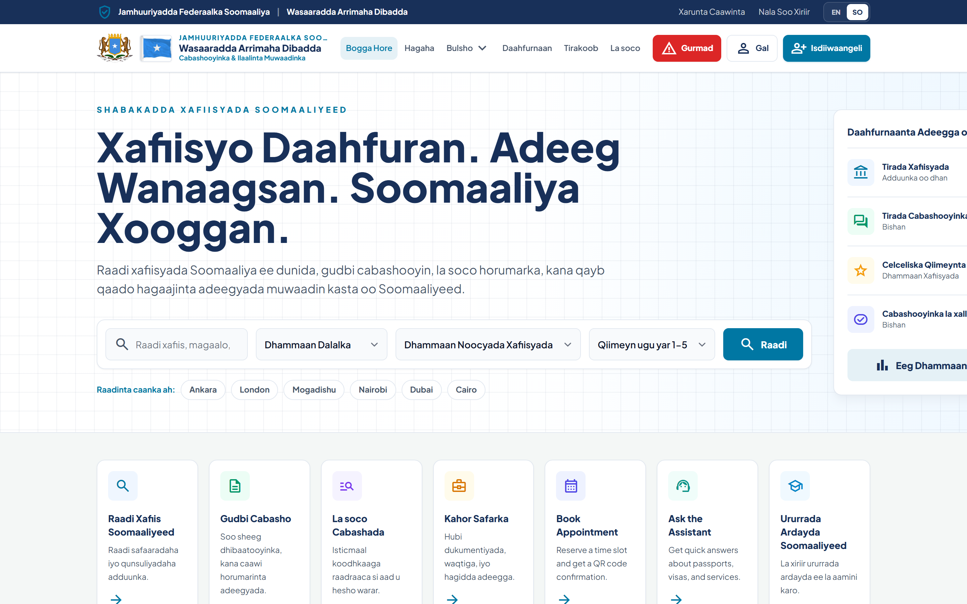
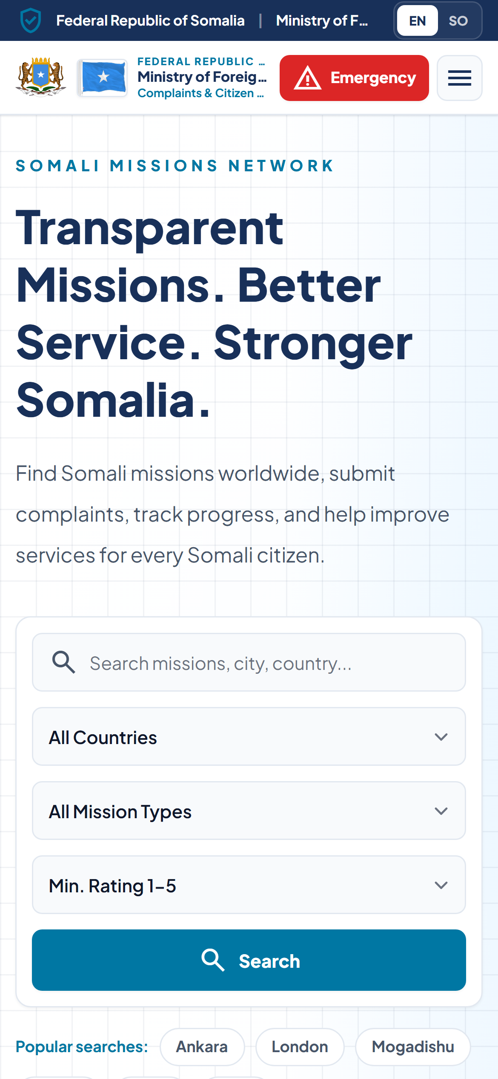
PROJECT VISION
A modern, transparent, citizen-centred consular service
1
2
3
4
Modern
Transparent
Citizen-centred
Connected
Digital-first services citizens can reach from anywhere, on any device.
Open service statistics and case status that build public trust.
Designed around real citizen journeys — in English and Somali.
One national network linking every mission, the Ministry, and communities.
Built in for every citizen
Full English & Somali language support and a fully mobile-responsive interface — so the service works on a phone, in the citizen’s own language.
Somali MFA — Digital Consular Services Platform
3
Notes:
Our vision rests on four principles. Modern: services are digital-first and reachable from anywhere. Transparent: service statistics and case status are open, which builds public trust. Citizen-centred: the system is designed around real journeys and is fully bilingual — English and Somali. Connected: it is one national network linking every mission, the Ministry, and verified community organisations. As you can see at the bottom, the interface is fully translated into Somali and works on mobile phones, which is how most citizens abroad will access it.

Slide 4
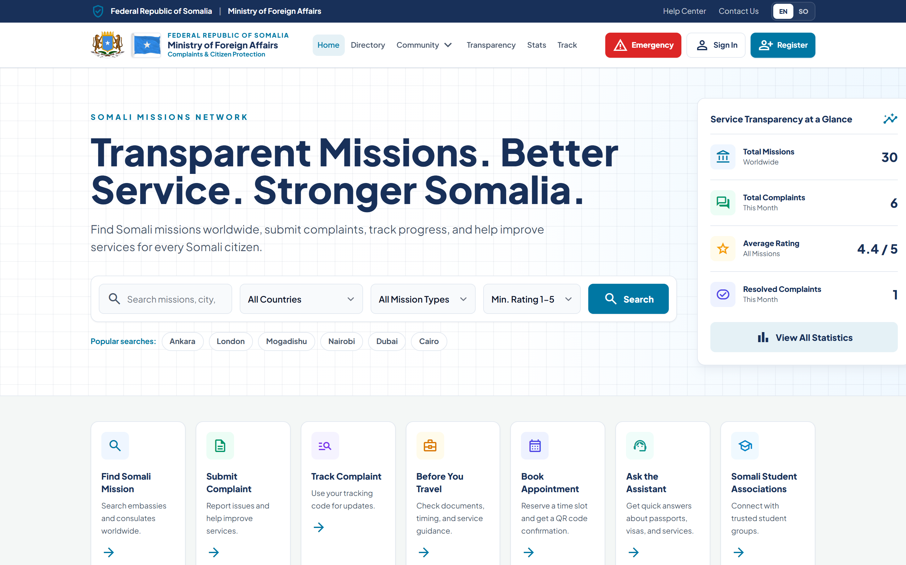
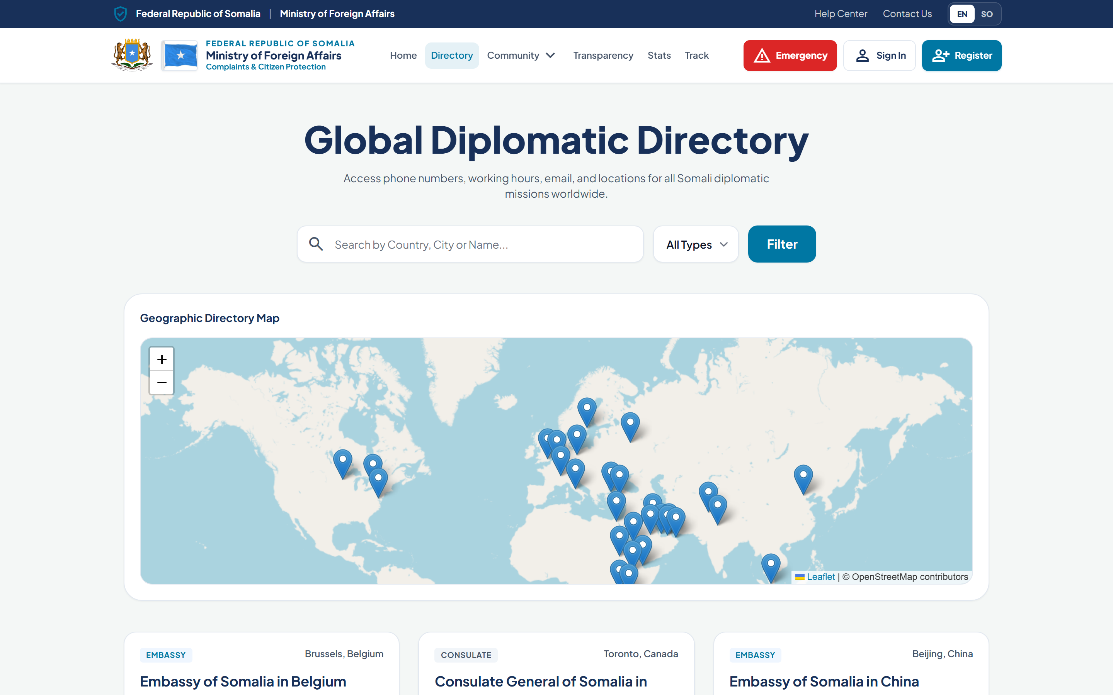
PLATFORM OVERVIEW
One platform, many services
A single, official gateway that brings the Ministry’s consular services together in one place.
Worldwide mission directory with map & search
Appointment booking with required-document checklists
Complaint submission and public case tracking
Emergency assistance channel with priority handling
Verified community organisations & consular events
Ministry oversight, analytics and public transparency
Somali MFA — Digital Consular Services Platform
4
Notes:
This is the platform’s public home. It is a single official gateway that unifies the Ministry’s consular services: a worldwide mission directory with a live map and search; appointment booking with document checklists; complaint submission and public tracking; an emergency channel; verified community organisations and events; and Ministry oversight with public transparency. The lower image shows the interactive global directory — a citizen anywhere can find their nearest mission and its services in seconds.

Slide 5
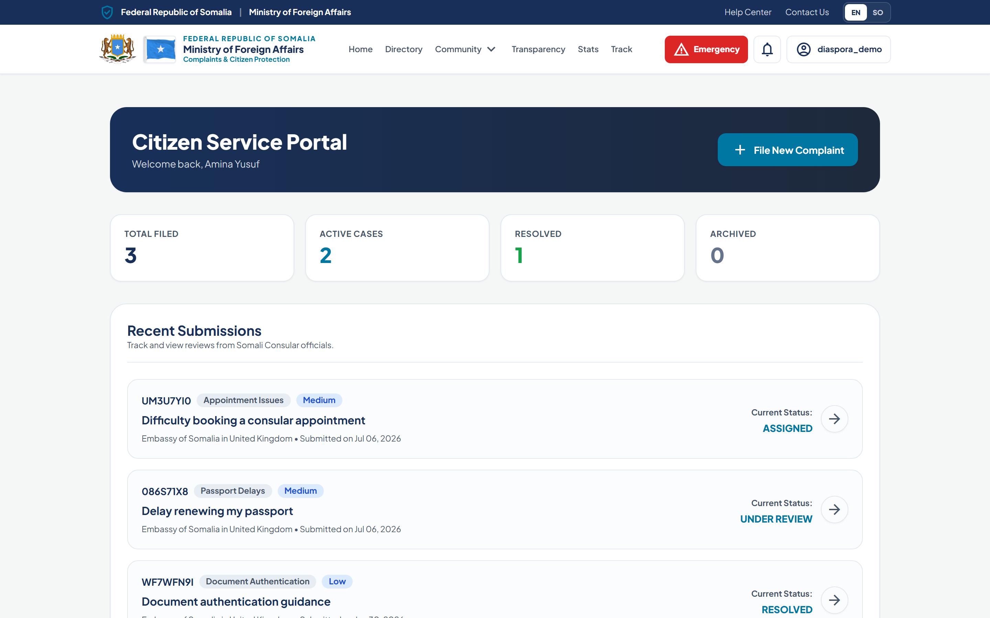
CITIZEN DASHBOARD
Every citizen’s cases in one place
After registering, citizens get a personal, secure dashboard for all their consular requests.
Clear totals: filed, active, resolved, archived
Every complaint with its live status and tracking code
File a new complaint or request in one click
Private — each citizen sees only their own cases
Somali MFA — Digital Consular Services Platform
5
Notes:
Once a citizen registers and verifies their email, they land on this personal dashboard. It summarises everything they have filed — total, active, resolved and archived — and lists each case with its live status and unique tracking code. They can file a new request in one click. Importantly, access is strictly private: a citizen sees only their own cases, enforced by the system’s role-based permissions.

Slide 6
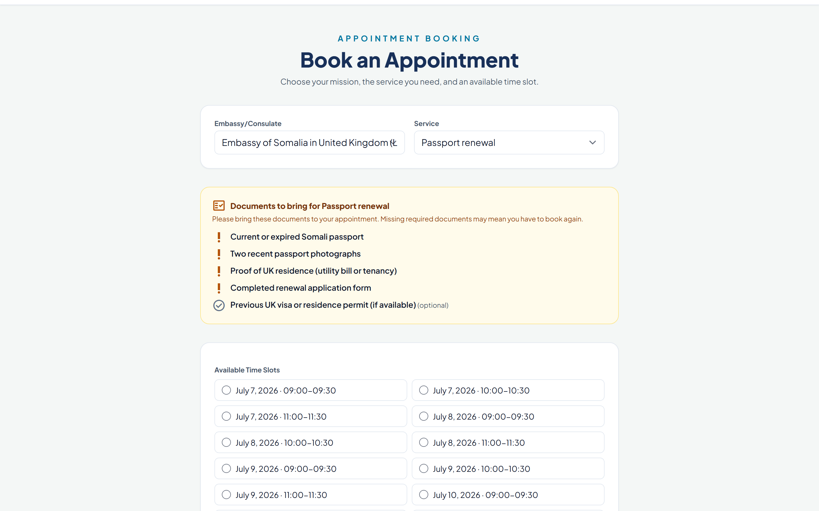
APPOINTMENT SYSTEM
Book the right service, prepared
Citizens choose a mission and service, see real available time slots, and know exactly what to bring.
Select country, mission, service and time slot
Required documents shown before booking
Each mission has its own calendar of slots
No double-booking; full slots move to a waitlist
QR-coded confirmation for the visit
Somali MFA — Digital Consular Services Platform
6
Notes:
Appointments are a core service. The citizen selects a mission and the service they need, and the system shows the real available time slots for that mission’s own calendar. Crucially, before they book, the required documents are listed — so they never travel unprepared and get turned away. The system prevents double-booking: if a slot is full, the citizen is automatically placed on a waitlist. Each confirmed appointment carries a QR code for check-in.

Slide 7
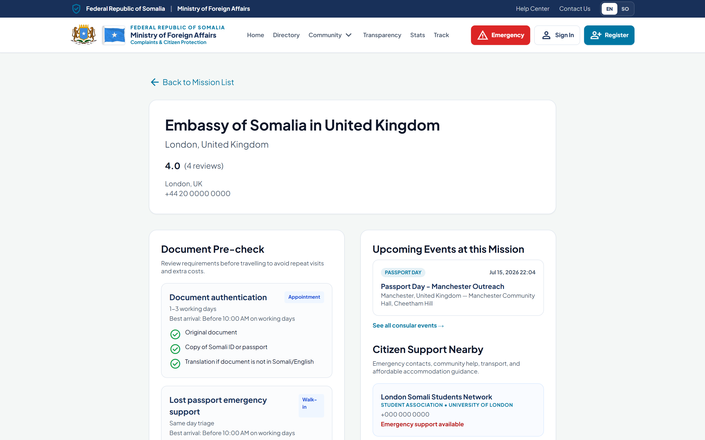
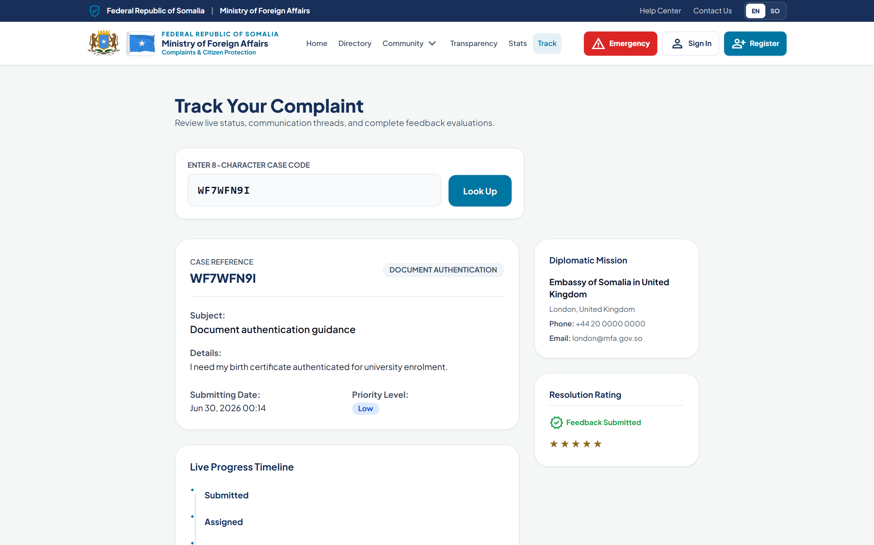
COMPLAINT MANAGEMENT
A transparent complaint workflow
Citizens raise issues and follow them from submission to resolution — with an official response.
Submit by category, with evidence and optional anonymity
Receive a secure 8-character tracking code
Follow a live status timeline to resolution
Read the mission’s official public response
Rate the resolution to inform service quality
Somali MFA — Digital Consular Services Platform
7
Notes:
Complaints follow a transparent workflow. A citizen submits by category, can attach evidence, and may submit anonymously. They receive a secure eight-character tracking code and can follow a live status timeline — submitted, assigned, under review, resolved — shown on the right. When the mission responds, the official public response appears on the tracking page, and the citizen can rate the resolution, which feeds the Ministry’s service-quality metrics.

Slide 8
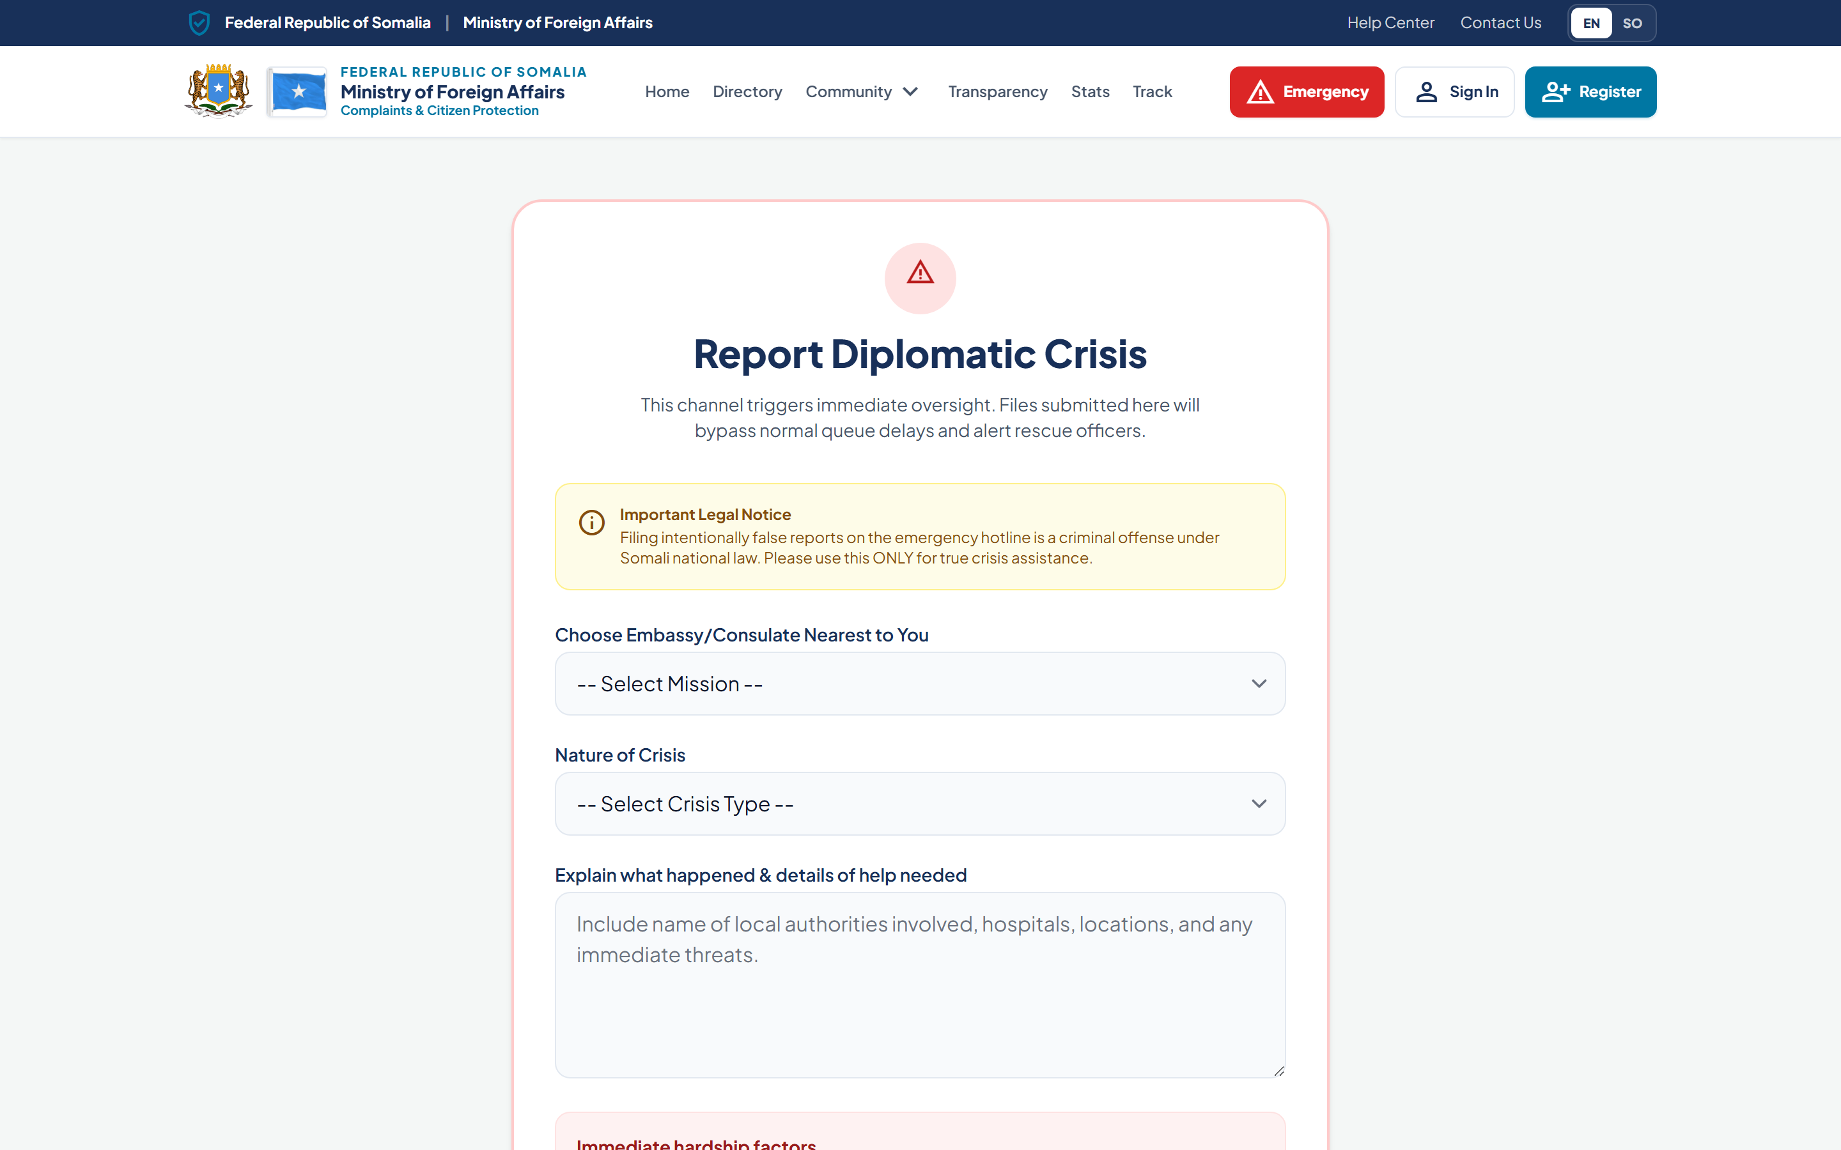
EMERGENCY ASSISTANCE
A fast, prioritised channel for crises
A prominent emergency channel routes urgent cases straight to mission and Ministry attention.
Typed crises: medical, detention, trafficking, lost passport, and more
Server-validated intake so no critical detail is missed
Automatically flagged CRITICAL priority
Pinned at the top of staff and Ministry dashboards
Hardship factors captured for faster triage
Somali MFA — Digital Consular Services Platform
8
Notes:
In an emergency, speed matters. The platform has a prominent emergency channel with clearly typed crisis categories — medical, arrest or detention, human trafficking, lost passport, domestic violence and more. The intake is validated so critical details are never missed, and every emergency is automatically flagged as CRITICAL priority. As we will see on the dashboards, these cases are pinned at the top of both mission and Ministry screens so they are actioned before routine work.

Slide 9
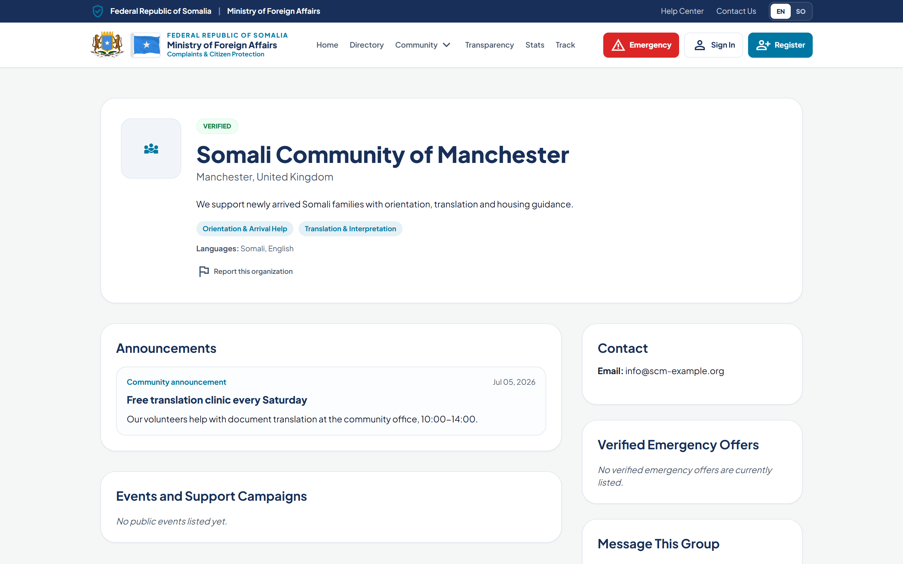
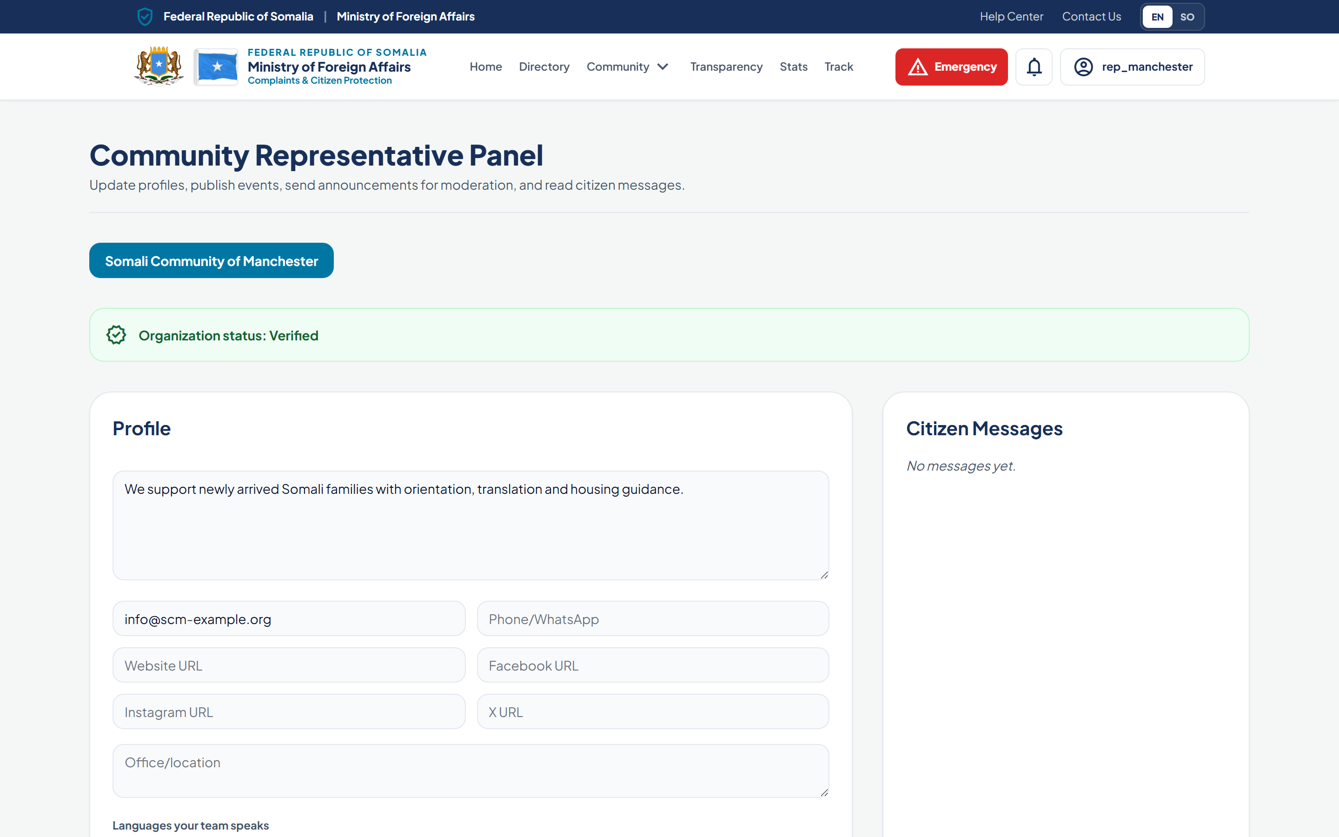
COMMUNITY ORGANISATIONS
Verified community support, officially recognised
Somali student associations and community groups register, are verified, and connect citizens to help.
Student associations, community groups and volunteers
Self-registration with a verified / pending status
Only Ministry-verified organisations appear publicly
Profiles show services, languages and emergency support
Organisations manage their own profile, events and messages
Somali MFA — Digital Consular Services Platform
9
Notes:
Beyond the missions themselves, a strong diaspora support network already exists — student associations, community groups, volunteers who offer translation, accommodation and legal guidance. The platform lets these organisations register themselves and be officially verified by the Ministry. Only verified organisations appear to the public. Each manages its own profile, announcements and events through the self-service panel on the right, while the Ministry retains full oversight and moderation.

Slide 10
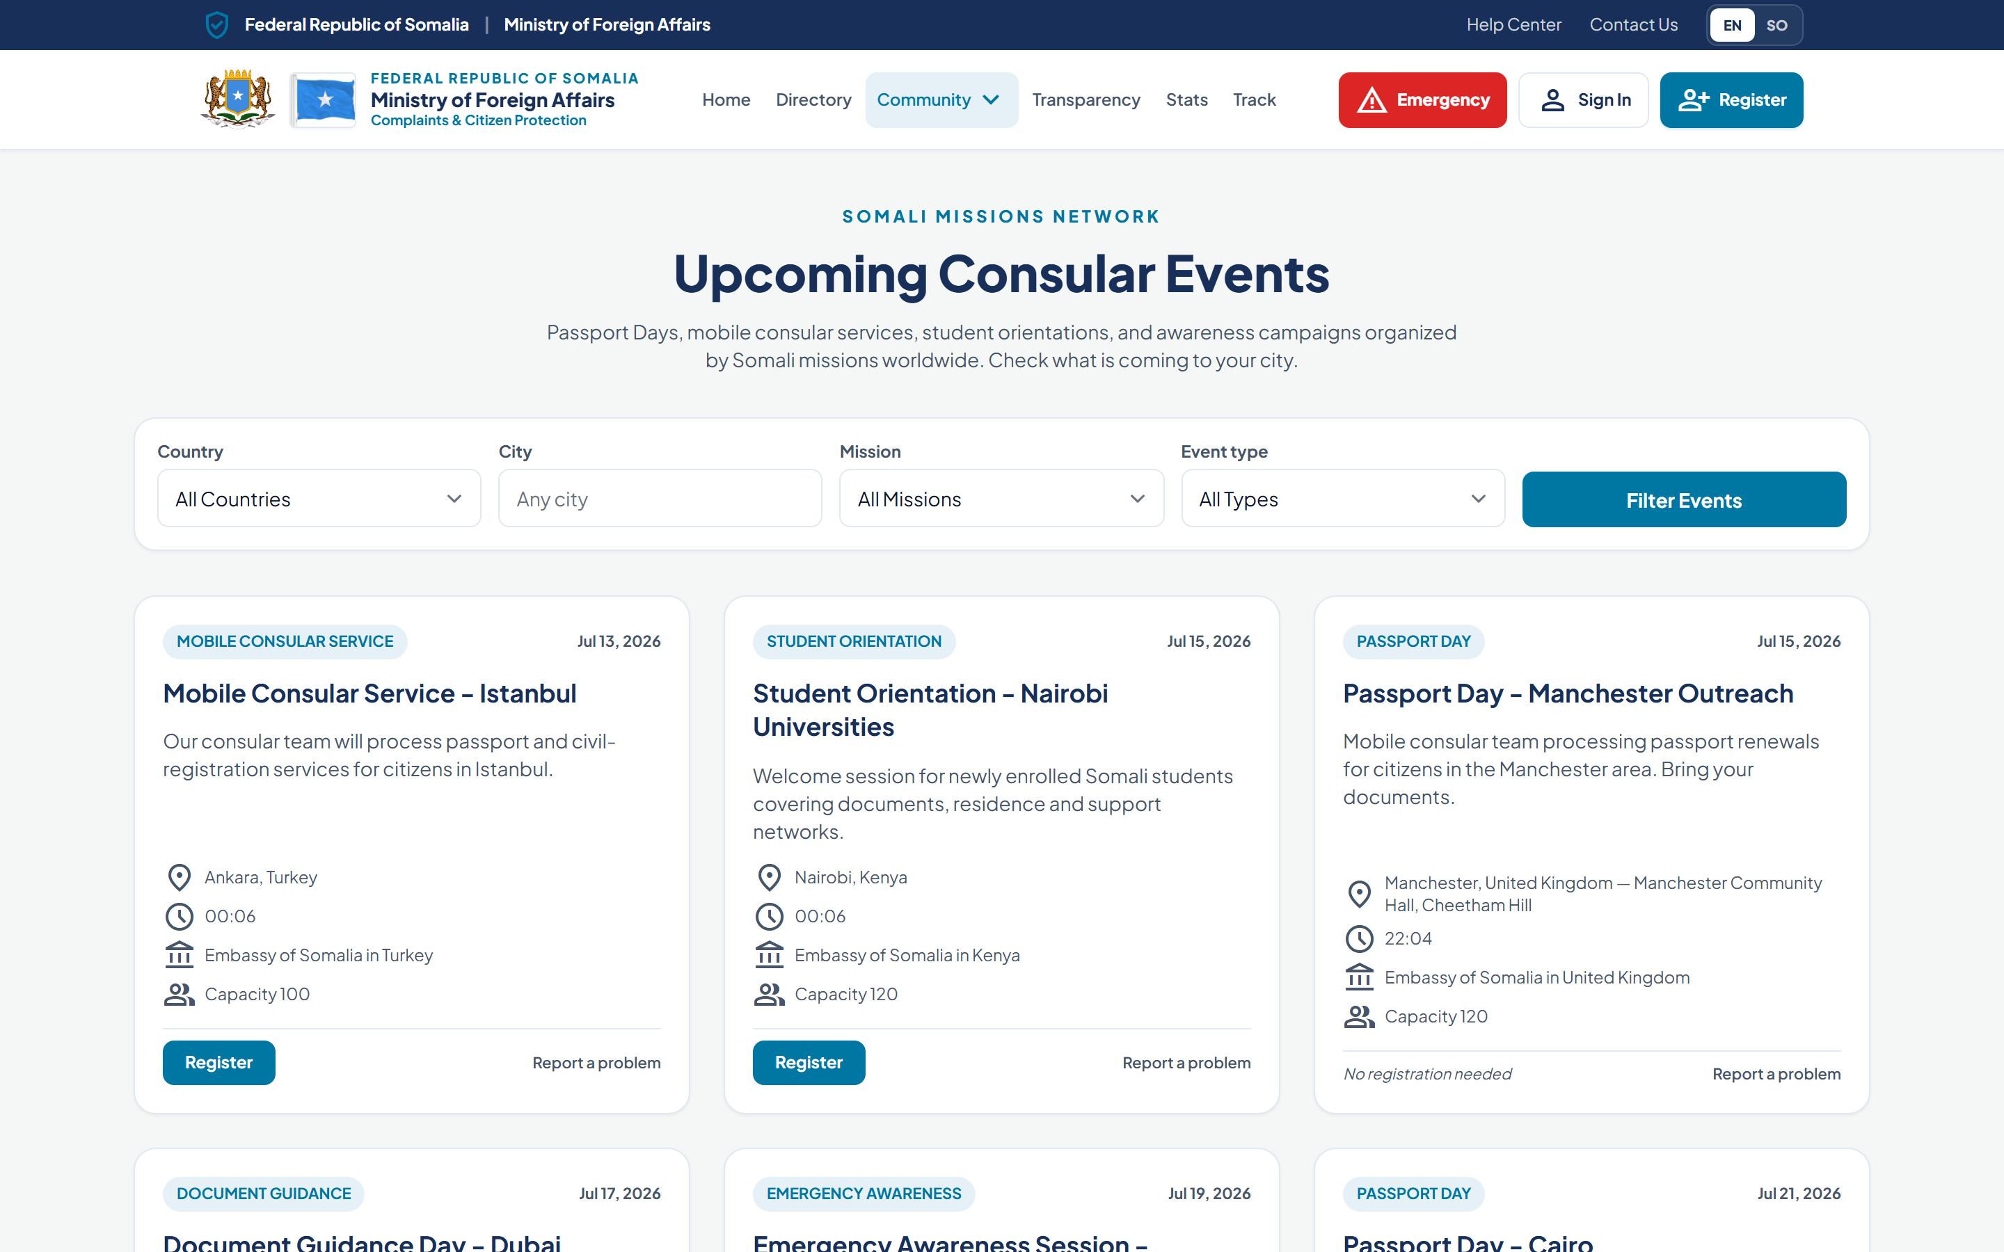
COMMUNITY & CONSULAR EVENTS
Bringing services closer to citizens
Missions publish Passport Days, mobile consular services and awareness sessions citizens can find and join.
Passport Days and mobile consular services
Student orientations and document-guidance sessions
Emergency-awareness and community meetings
Filter upcoming events by country, city and mission
Registration links and capacity shown up front
Somali MFA — Digital Consular Services Platform
10
Notes:
The platform also promotes public engagement. Missions and the Ministry publish consular events — Passport Days, mobile consular services that travel to where citizens are, student orientations, document guidance and emergency-awareness sessions. Citizens can filter upcoming events by country, city and mission, see capacity, and register. This brings services physically closer to communities and strengthens the relationship between citizens and their missions.

Slide 11
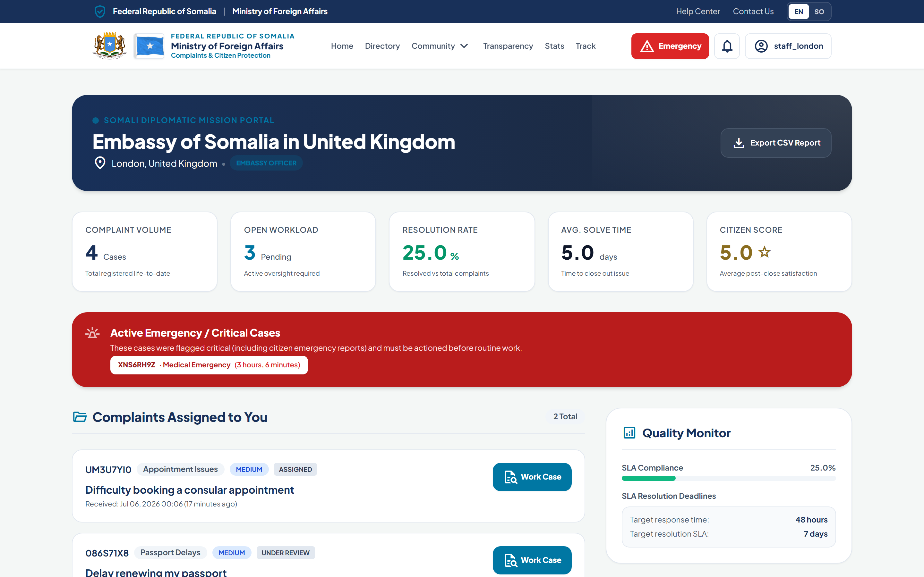
EMBASSY DASHBOARD
Everything a mission needs to serve and respond
Embassy officers and managers get a scoped workspace for their own mission’s cases and performance.
Active emergency / critical cases pinned at the top
Live metrics: volume, resolution rate, response time, satisfaction
Case assignment and status management
SLA targets and response deadlines in view
Staff see only their own mission’s data
Somali MFA — Digital Consular Services Platform
11
Notes:
This is the embassy staff workspace. The first thing an officer sees is the red band of active emergency and critical cases, which must be handled before routine work. Above the case list are live performance metrics — volume, resolution rate, average response time and citizen satisfaction — alongside SLA targets. Managers can assign cases to officers and manage status. Access is mission-scoped: staff see only the cases and data for their own mission, never another’s.

Slide 12
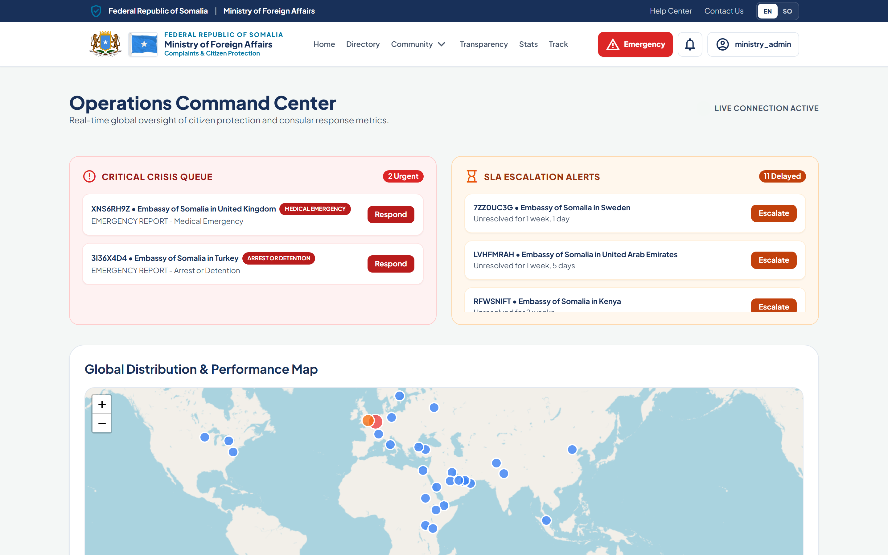
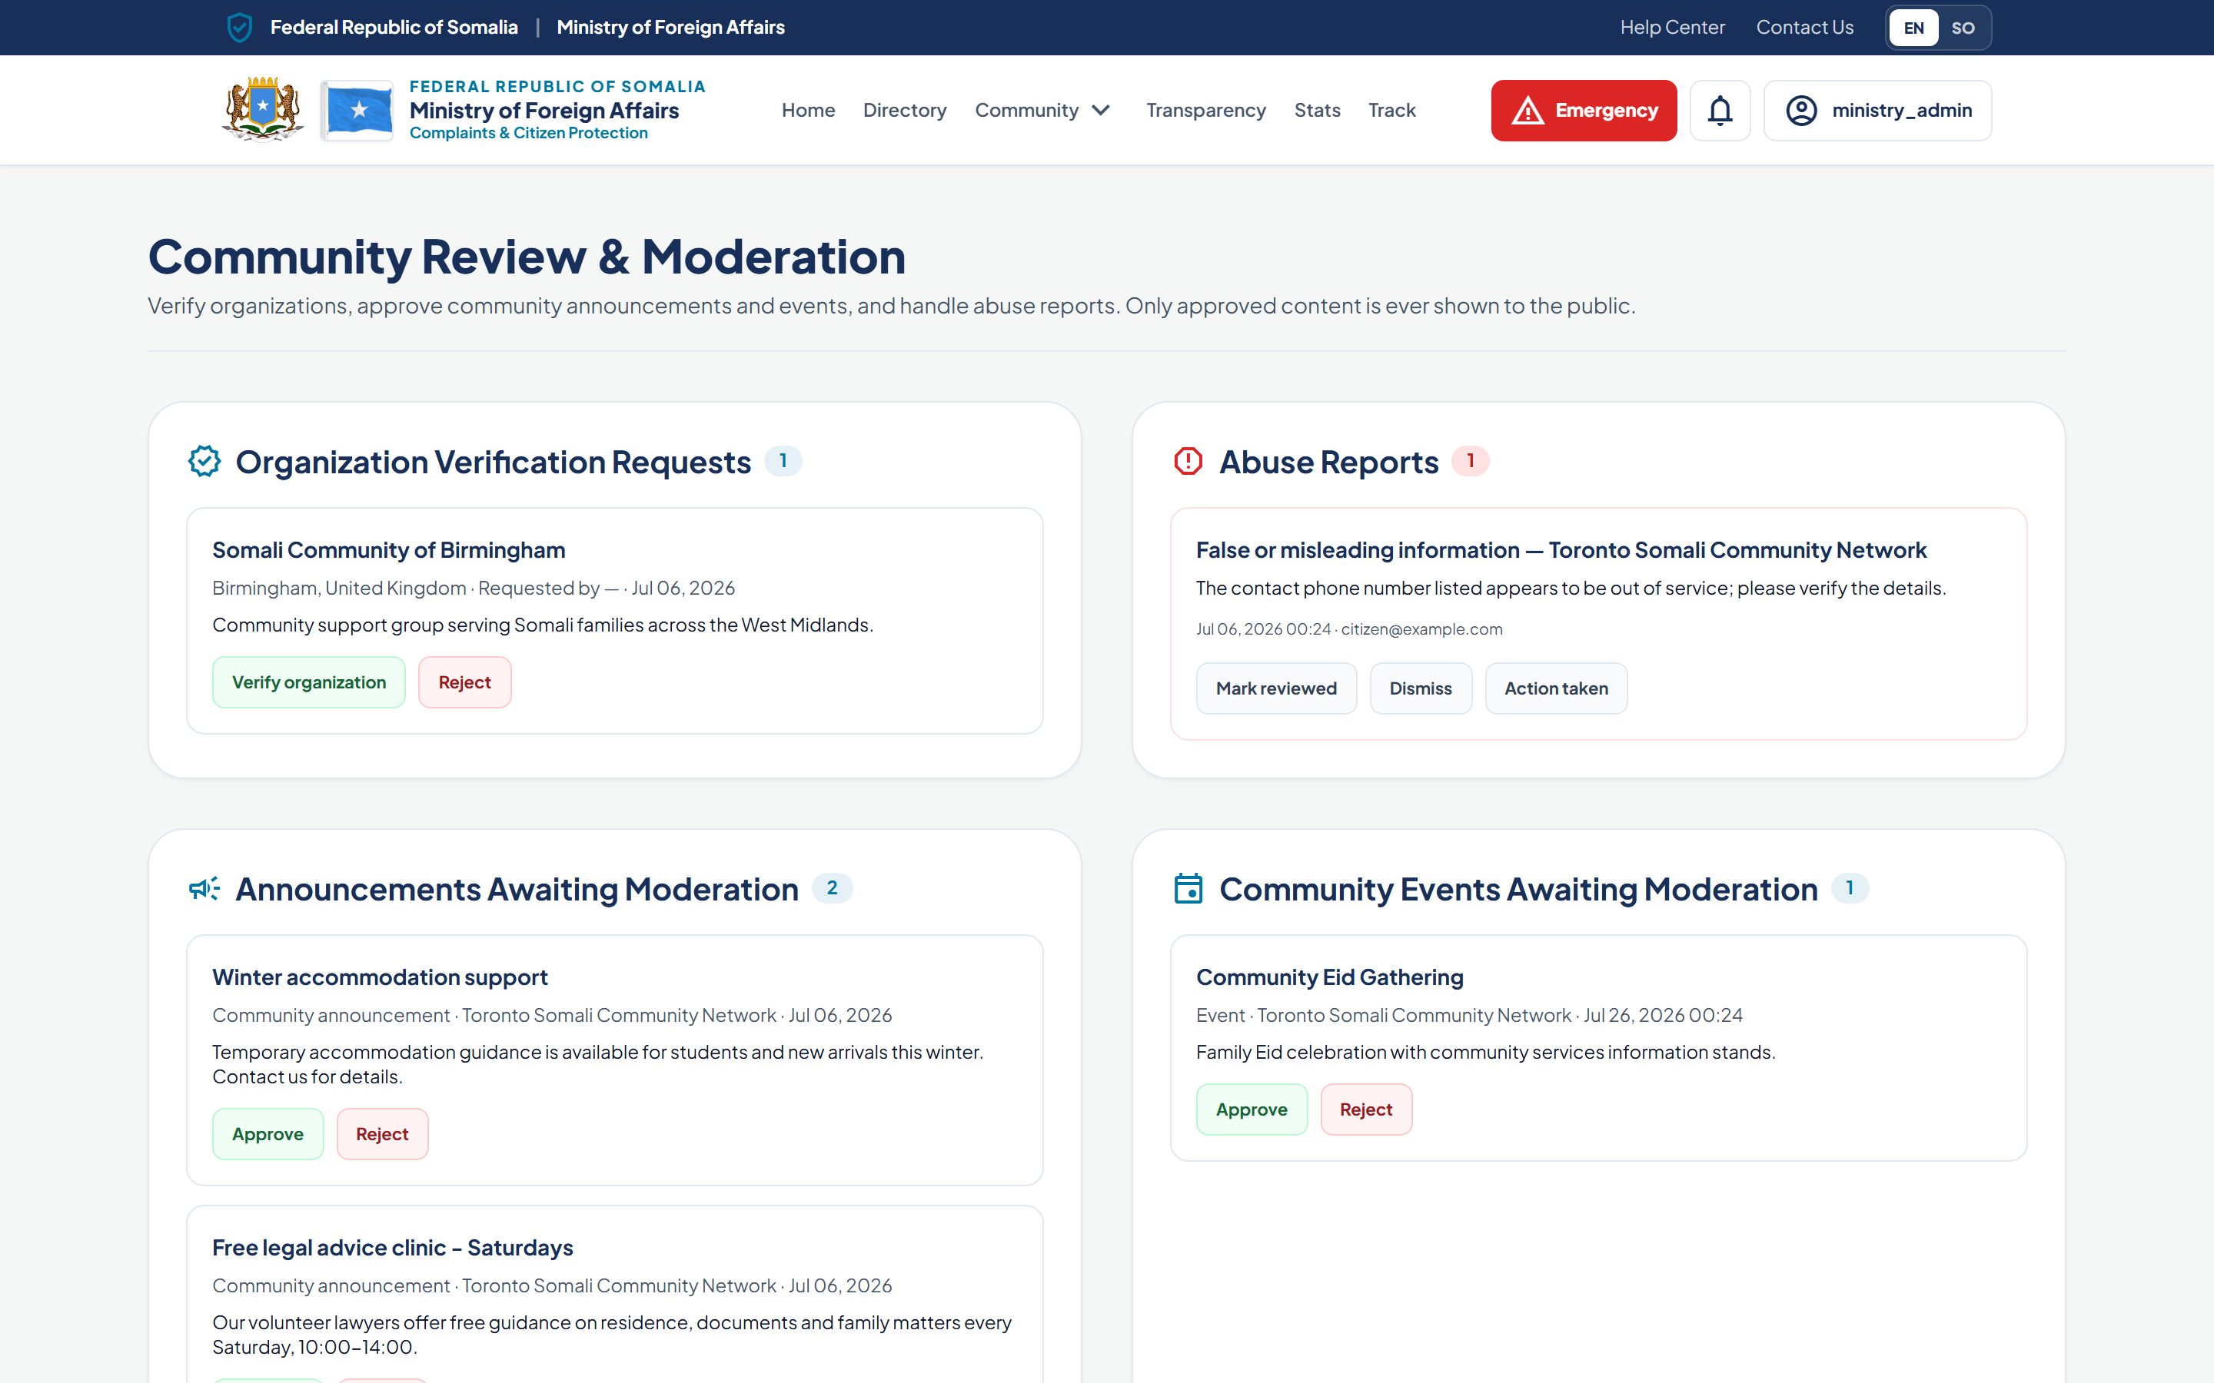
MINISTRY DASHBOARD
National oversight in real time
The Ministry sees the whole network — crises, delays, and performance — on one command centre.
Critical crisis queue across every mission
SLA escalation alerts for delayed cases
Global distribution & performance map
Review and moderate community organisations & content
Full national visibility for reviewers and administrators
Somali MFA — Digital Consular Services Platform
12
Notes:
At the national level, the Ministry gets an operations command centre. It shows the critical crisis queue across every mission, SLA escalation alerts for cases that are running late, and a global map of distribution and performance. The second screen is the moderation console, where the Ministry verifies community organisations and approves their announcements and events before anything is shown publicly. Ministry reviewers and administrators have full national visibility, according to their role.

Slide 13
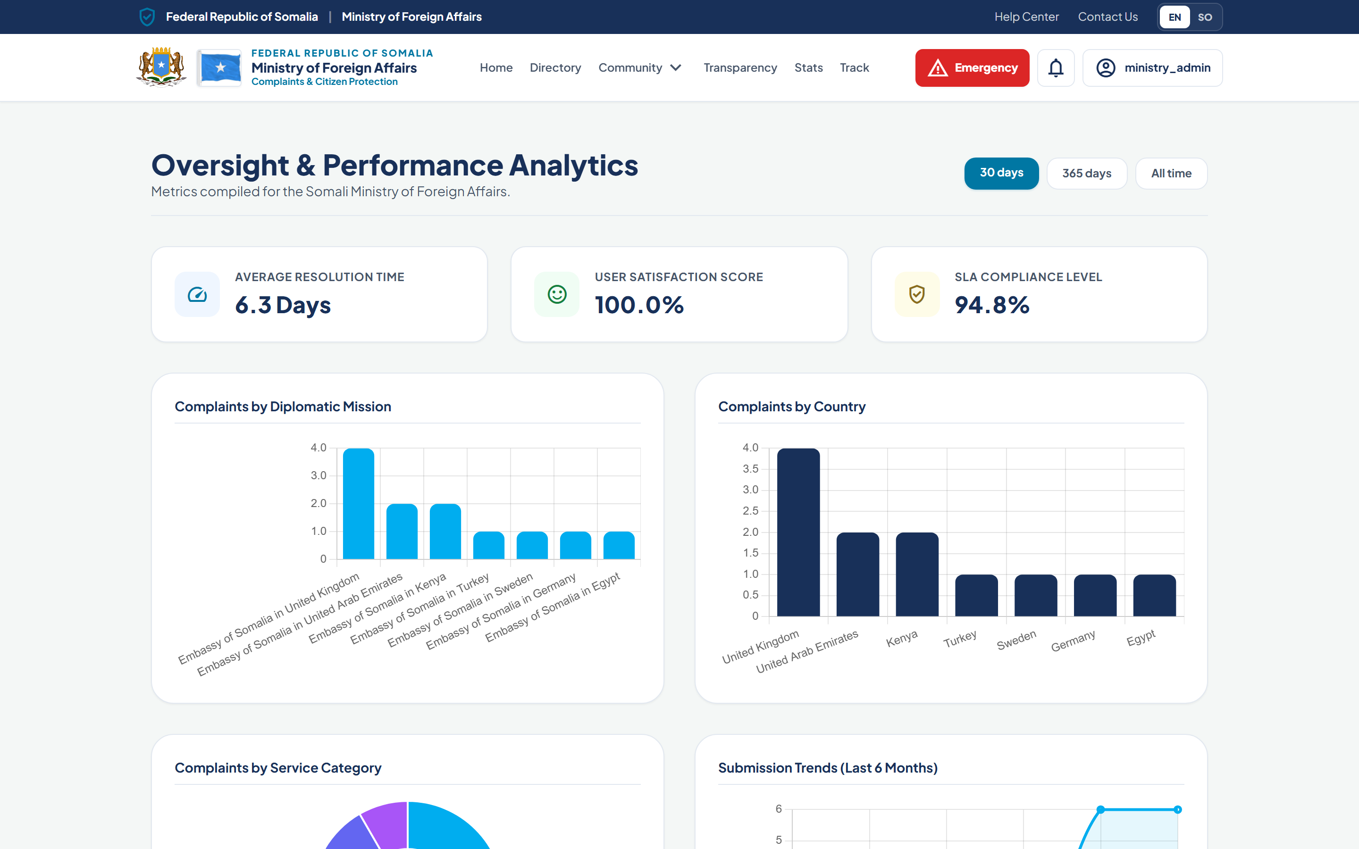
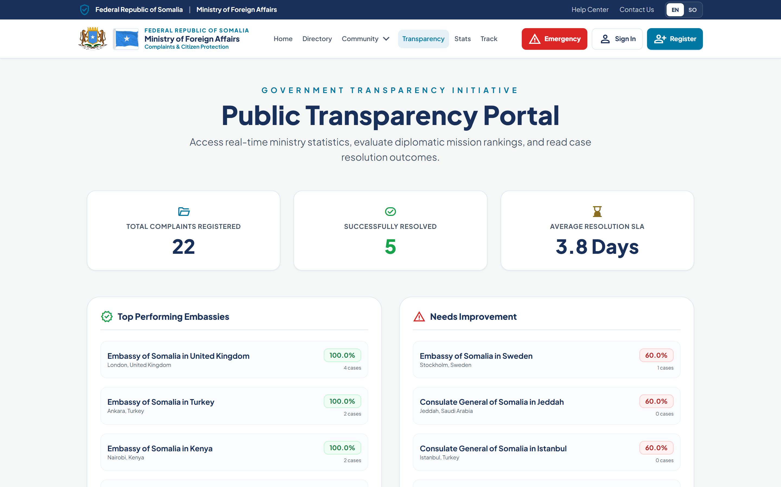
TRANSPARENCY & ANALYTICS
Evidence for better decisions and public trust
Rich analytics for the Ministry and an open transparency portal for the public — from the same live data.
Complaints by mission, country and category
Resolution time, satisfaction and SLA compliance
Submission trends over time
Public transparency portal with mission rankings
Export to CSV, Excel and PDF for reporting
Somali MFA — Digital Consular Services Platform
13
Notes:
All of this activity produces evidence. For the Ministry, the analytics dashboard breaks down complaints by mission, country and category, and tracks resolution time, satisfaction and SLA compliance over time. For the public, the transparency portal — the lower image — publishes mission rankings and resolution outcomes from the same live data. Reports can be exported to CSV, Excel and PDF. Transparency is not a slogan here; it is built into the product.

Slide 14
SECURITY & DATA PROTECTION
Built to protect citizens’ information
Security and privacy are designed into the platform, not added afterwards.
1
2
3
Role-based access
Mission-scoped data
Audit logging
Six roles — citizen, officer, manager, reviewer, administrator, community — each see only what they should.
Staff access is limited to their own mission; cross-mission access is blocked and tested.
Logins, exports and case actions are recorded with time, user and IP for accountability.
4
5
6
Data privacy
Secure authentication
Safe uploads
Anonymous complaints store no identity; the public sees only aggregate, approved information.
Hashed passwords, email verification, brute-force lockout and CSRF protection.
Evidence and logos are validated by type and size before they are stored.
Somali MFA — Digital Consular Services Platform
14
Notes:
For a government platform handling citizen data, security is foundational. Access is role-based: six distinct roles each see only what they should. Staff data is mission-scoped — an officer in one country cannot see another mission’s cases, and this is enforced and tested. Sensitive actions are recorded in an audit log with user, time and IP. Anonymous complaints store no identifying data, and the public only ever sees aggregate, approved information. Authentication uses hashed passwords, email verification and brute-force lockout, and all uploads are validated. Some items — an independent penetration test and live TLS — remain for the deployment phase, and I will be transparent about that.

Slide 15
BENEFITS
Value for everyone the Ministry serves
1
2
3
4
5
Citizens
Embassies
The Ministry
Government
The Diaspora
Faster service, clear requirements, and visibility of their own cases — in their language.
A single organised workspace, prioritised emergencies, and less manual follow-up.
Real-time national oversight, evidence-based decisions, and measurable service quality.
A modern, transparent public service that strengthens institutional credibility.
A trusted connection to home — community networks, events, and responsive support.
Somali MFA — Digital Consular Services Platform
15
Notes:
The benefits reach every stakeholder. Citizens get faster service, know what to bring, and can see their own cases in their own language. Embassies get one organised workspace with emergencies prioritised and less manual follow-up. The Ministry gains real-time national oversight and evidence for decisions. For the Government, it is a modern, transparent public service that strengthens credibility. And for the diaspora, it is a trusted connection to home. Everyone the Ministry serves is better off.

Slide 16
FUTURE VISION
A foundation ready to grow
The platform is architected so these enhancements can be added without rebuilding.
→
→
→
Smart AI Assistant
Mobile App
SMS Notifications
Upgrade the built-in guided assistant to AI-powered answers over consular knowledge.
Native apps building on the existing REST API for an even richer citizen experience.
Reach citizens without email; the notification channel is already interface-ready.
→
→
→
WhatsApp Updates
Digital Identity
Smart Analytics
Case and appointment updates on the channel citizens use most.
Integrate national digital ID for stronger verification and pre-filled services.
Predictive insight on demand, bottlenecks and emerging consular needs.
Somali MFA — Digital Consular Services Platform
16
Notes:
This is a foundation, not a finished endpoint. The architecture is deliberately built to grow. The guided citizen assistant can be upgraded to AI-powered answers. The existing REST API means native mobile apps can follow. The notification system is already interface-ready for SMS and WhatsApp, so we can reach citizens on the channels they actually use. Longer term, integration with national digital identity and predictive analytics. Each of these is an addition, not a rebuild — which protects the Ministry’s investment.

Slide 17
CONCLUSION
Modernising Somali consular services,
serving citizens worldwide.
A working, secure, bilingual platform that connects citizens, missions and the Ministry — ready for demonstration and staging today, and built to grow into the Ministry’s digital future.
Somali MFA — Digital Consular Services Platform
17
Notes:
To conclude: this platform modernises Somali consular services around the citizen. It is a real, working, secure and bilingual system that connects citizens, missions and the Ministry on one network. It is ready to demonstrate and to run in a staging environment today. A short list of items remains for full public launch — production hosting, a live security certificate, an independent penetration test and a native Somali language review — and I can walk you through that plan. Thank you for the opportunity to present it.

Slide 18
Thank You
Questions & Discussion
Ministry of Foreign Affairs • Federal Republic of Somalia
Digital Consular Services Platform
Notes:
Thank you. I welcome your questions, and I would be glad to give a live walkthrough of any part of the platform — booking an appointment, submitting an emergency case, or the Ministry oversight dashboards — on request.

