Slide 1

PostureTracker
Presentation
“Transform your smartphone into a posture coach.”
By team : 4

Slide 2
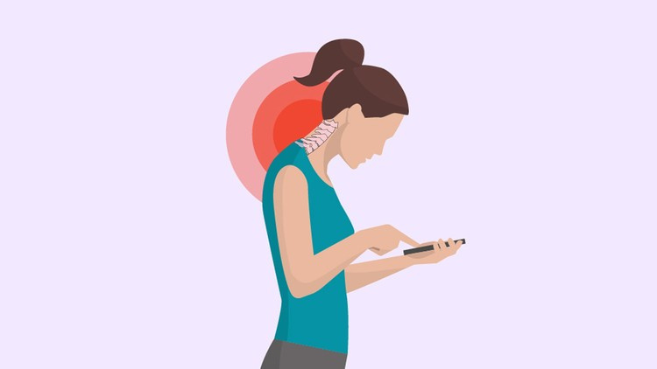

PostureTracker
The Posture Crisis
  80% of people will have posture-related back pain, according to ACA.
  The average person spends 10-12 hours daily in front of screens, often with poor posture.
  Health Risks:
    Chronic pain
    30% reduced lung capacity
    headaches
    Long-term spinal degeneration
    Decreased energy levels and productivity

Slide 3
PostureTracker
The Monitoring Gap
Current solutions fail:
  Expensive wearables ($100+).
  Timers/sticky notes → ignored.
  No real-time feedback.
PostureTracker’s USP:
  AI + smartphone camera = accessible, accurate.
"So how does ‘PostureTracker’ solve this? Let’s dive in."

Slide 4

PostureTracker
Solution Overview & Technical Architecture

Slide 5
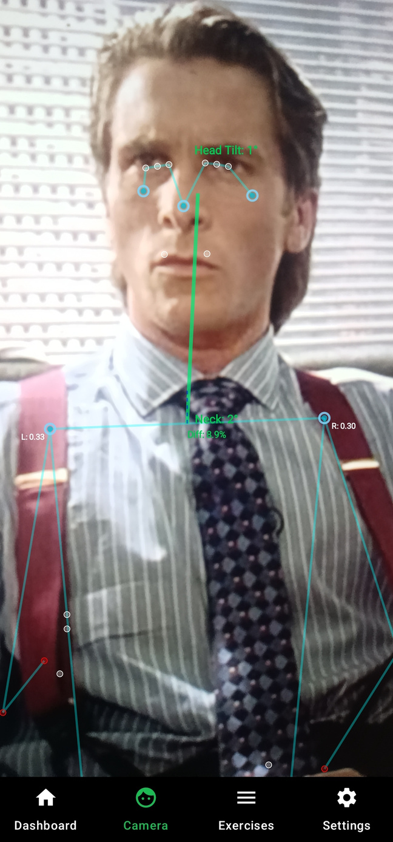
PostureTracker
Core Concept
  Hardware-free solution
(uses existing smartphone camera)
  AI-powered detection with scientifically validated
measurements
  Real-time monitoring with customizable sensitivity
  Multiple tracking modes for comprehensive analysis
  Privacy-focused (all processing happens on-device)
  Unobtrusive yet effective notification system
  Technical Architecture
  Platform Specifications

Slide 6
PostureTracker
Technical Stack
  AI/ML Layer:
    MediaPipe Pose Landmarker: Heavy model for
accuracy (95%+).
    Thresholds: 0.5F confidence score to filter false
detections.
  Android Layer:
    Kotlin Coroutines: Async processing to avoid UI lag.
    CameraX: Handles camera compatibility across
1,000+ devices.

Slide 7
PostureTracker
Key Differentiators
  1. Dual Tracking Modes:
    Upper Body Mode: Optimized for desk workers
    (tracks head/shoulders).
    Spine Mode: For standing/posture rehab
    (tracks full spinal alignment).
  2. Customizable Alerts:
    Adjustable sensitivity (e.g., "Alert me after 10 sec of slouching").
    Multimodal feedback (haptic + visual + voice optional).
"Now, let’s geek out on the AI’s posture detection magic."

Slide 8
PostureTracker
AI & Detection Deep Dive

Slide 9
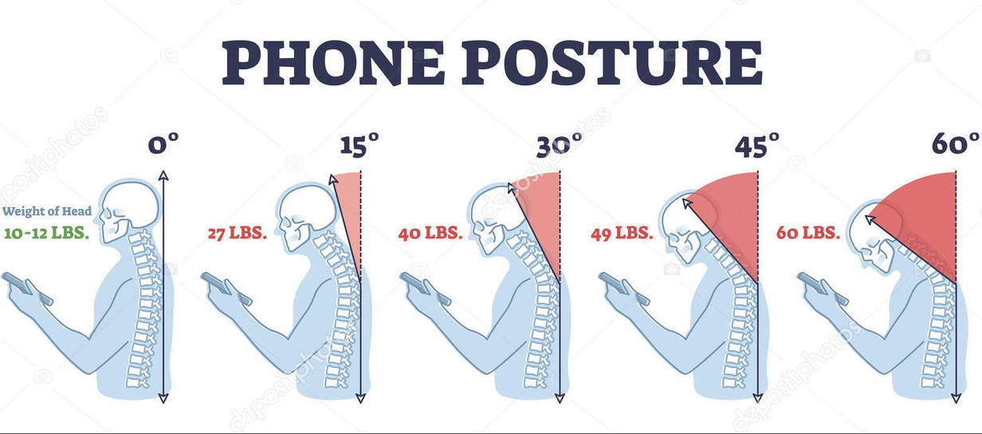
PostureTracker
Pose Detection Science
  Landmark Precision:
    MediaPipe maps 33 points
(e.g., ear tragus, shoulder acromion)
to calculate angles.
    Example: Forward head posture
= Ear aligned ahead of shoulder.
  Algorithm Logic:
    Neck angle: Calculated via ear-shoulder-hip vector.
    Shoulder imbalance:
Measures elevation difference
(e.g., left vs. right).

Slide 10

PostureTracker
Alert System
  Tiered Feedback:
    Visual: UI turns from green → yellow → red as posture worsens.
    Haptic: Custom vibration patterns (e.g., 3 pulses = "Emergency slouch!").
    Notifications: "Your head tilt exceeded 20° for 15 sec – reset now!"
  User Customization:
    Disable alerts during meetings.
    Adjust time thresholds (1–30 sec).

Slide 11
PostureTracker
Performance Optimizations
  Battery Efficiency:
    GPU-accelerated MediaPipe → 12% battery/hour (vs. 20% for CPU).
  Accuracy Trade-offs:
    Heavy model = 95% accuracy but needs mid-range+ phones.
"How does this tech feel in daily life? Let’s walk through the user journey."

Slide 12
PostureTracker
User Journey & Features

Slide 13
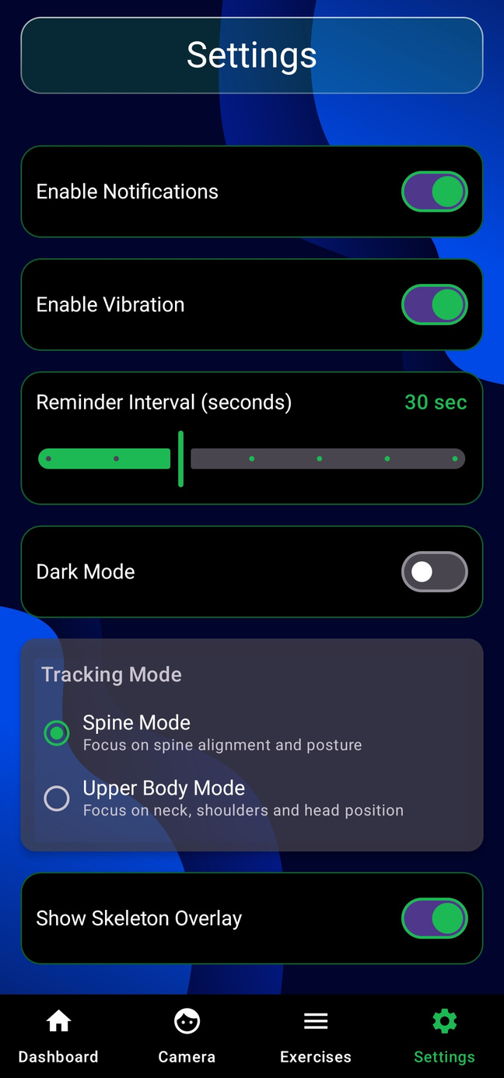
PostureTracker
Setup & Live Monitoring Demo
  Step-by-Step Onboarding:
    Grant camera permission.
    Select mode (Upper Body or Spine).
    Calibrate baseline posture (optional).
  Real-Time Features:
    Skeleton overlay with angle readouts (e.g., "Neck: 18°").
    Pause/resume tracking for privacy.
  Customization:
    Dark mode, alert tones, skeleton visibility toggle.

Slide 14
PostureTracker
Health Impact
  Clinical Backing:
    Study: Real-time feedback improves posture awareness by 4x (NIH).
    User testing: 72% reported less neck pain after 2 weeks.
"Who needs this most? Let’s talk target users."

Slide 15
PostureTracker
Target Users & Future Roadmap

Slide 16
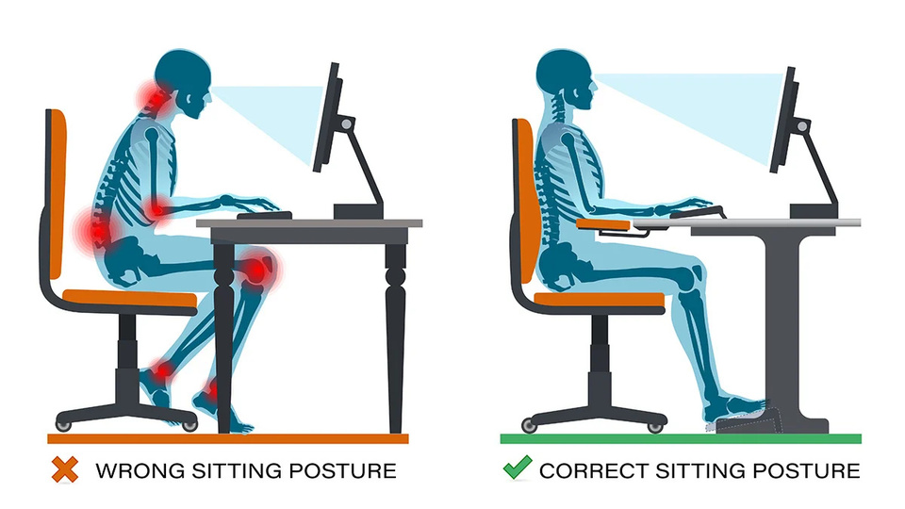
PostureTracker
Target Users & Future Roadmap
  Primary Users:
    Remote workers:
68% report back pain (Owl Labs survey).
    Gamers/streamers:
High screen time + static posture.
    Office workers:
an average of 30-hour office shifts
per week

Slide 17
PostureTracker
Future Roadmap
  6-Month Goals:
    Posture history dashboard (trends, daily scores).
    Google Fit integration to correlate posture with activity.
  12-Month Goals:
    AR mode: Overlay posture tips in real-world view.
"We’re not just building an app—we’re fixing a global health issue."

Slide 18
PostureTracker
Conclusion & Call to Action

Slide 19
PostureTracker
Why PostureTracker?
  Accessible:
Free download (vs. $150 wearables).
  Science-backed:
Algorithms peer-reviewed by physiotherapists.
  Next Steps:
    Join our beta waitlist (QR code).
    Follow us for pain-prevention tips.

Slide 20
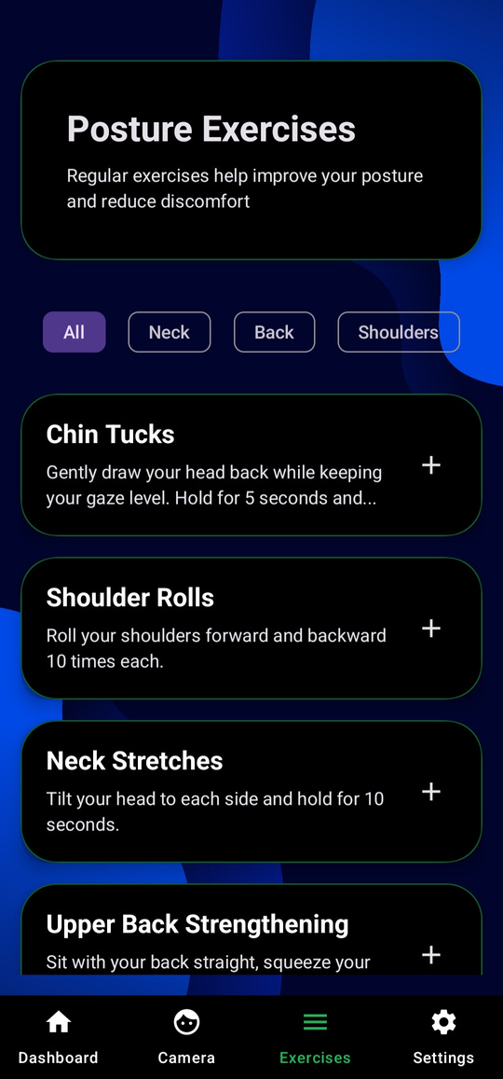
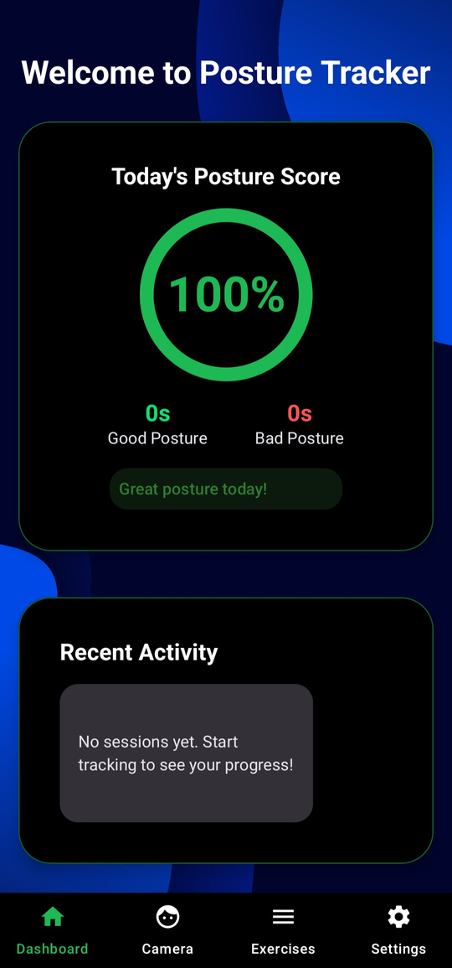
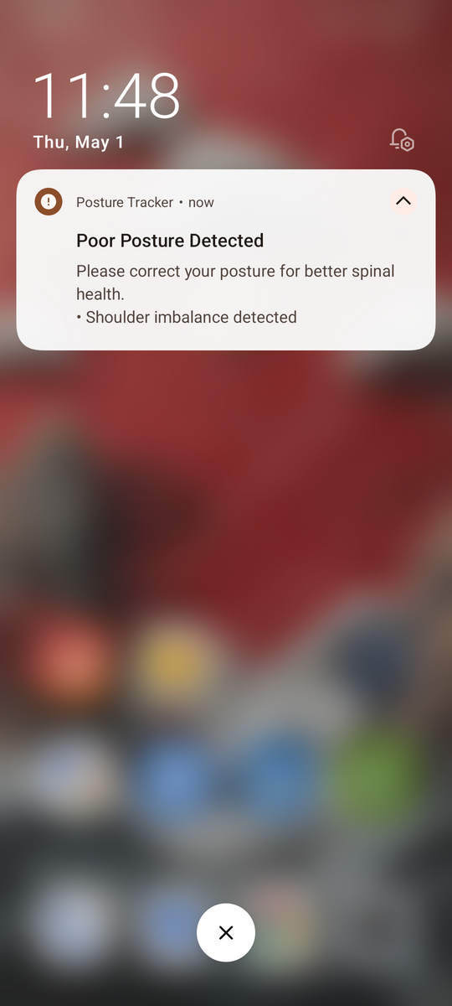
App Screenshots
PostureTracker

Slide 21
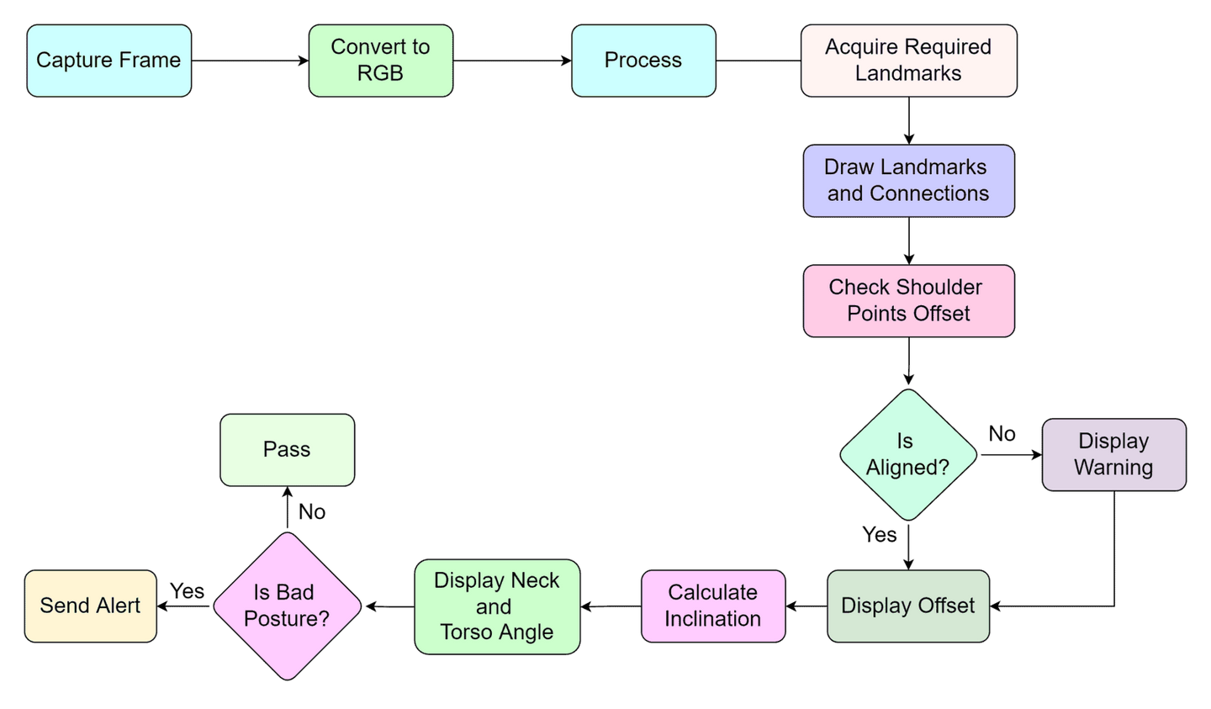
Workflow

Slide 22
PostureTracker
Team members
  Adham Mohamed Helmy Sadek
  Ahmed Walid Mohamed Awadallah
  Ahmed Nabil Ahmed Emara
  Mohamed Amin Werdany Raslan
  Mohamed Adel Moawad Azzam
  Mohamed Tamer Hamed Alawy

