Slide 1

Technology Trends & Analysis Presentation
Mohamed Saeed Taha
7-May-2024

Slide 2

OUTLINE
Executive Summary
Introduction
Methodology
Results
Visualization – Charts
Dashboard
Discussion
Findings & Implications
Conclusion
Appendix

Slide 3

EXECUTIVE SUMMARY
Trends in programming languages and
Databases
Demographics survey
Technological gap in countries
Gender gap in jobs

Slide 4

INTRODUCTION
About: Analyzing the trends in software development
Purpose: Identify skill requirements for the future
What are the top programming languages in demand?
What are the top database skills in demand?
What are the popular IDEs?
Audience: Human Resource and IT Head

Slide 5

METHODOLOGY
Data Collection Sources
Stack Overflow Developer 2019 Survey
GitHub Job Postings
Programming Languages Annual Salary
Data Exploration
Data Cleaning
Data Visualization
Presentation

Slide 6
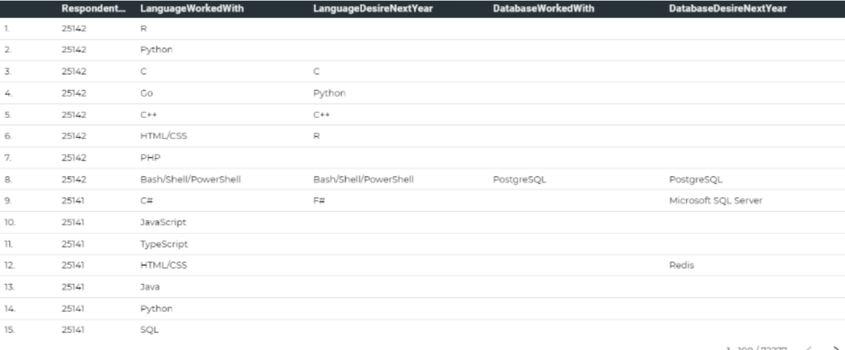
RESULTS

Slide 7
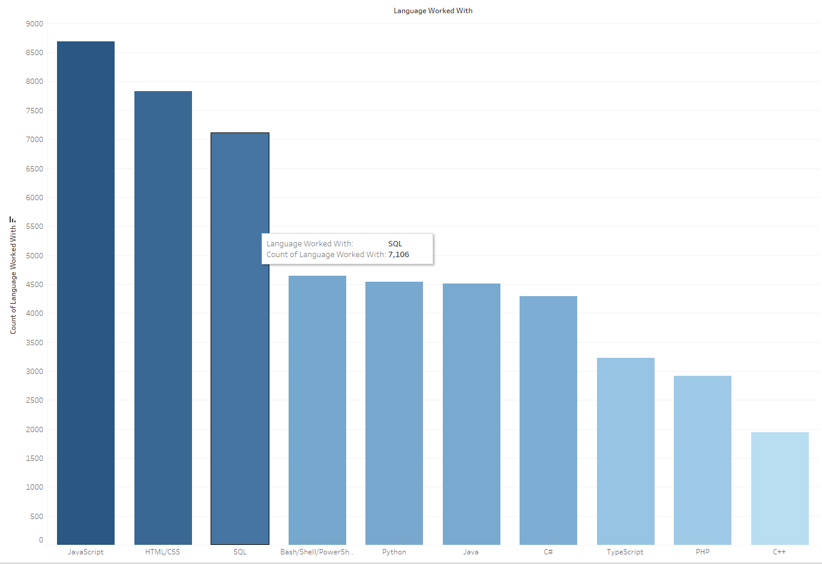
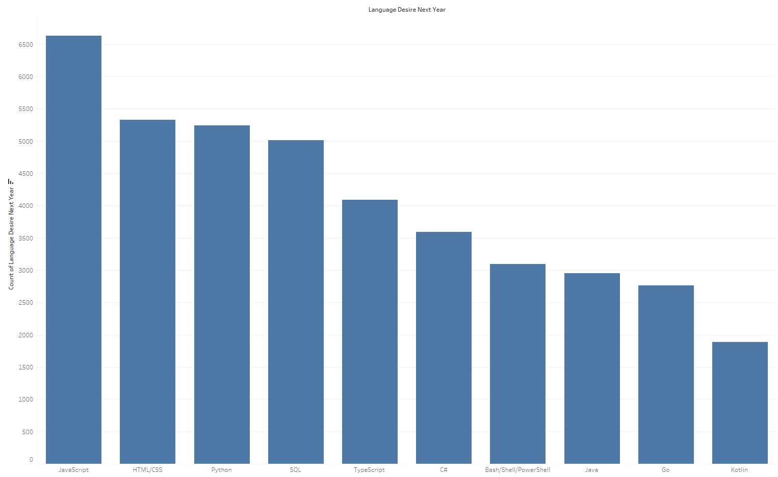
PROGRAMMING LANGUAGE TRENDS
Top 10 LanguageWorkedWith
’ Top 10 LanguageDesireNextYear

Slide 8
PROGRAMMING LANGUAGE TRENDS - FINDINGS & IMPLICATIONS
Findings:
JavaScript, HTML/CSS, and SQL are the top three languages in demand this year.
Python and TypeScript are expected to become more popular in the next year.
PowerShell is expected to be edged out in the coming year.
Implications
Web development skills remain in high demand.
Big Data technologies in companies still heavily rely on SQL.
With the rising demand for AI and ML, Python emerges as the best choice.

Slide 9
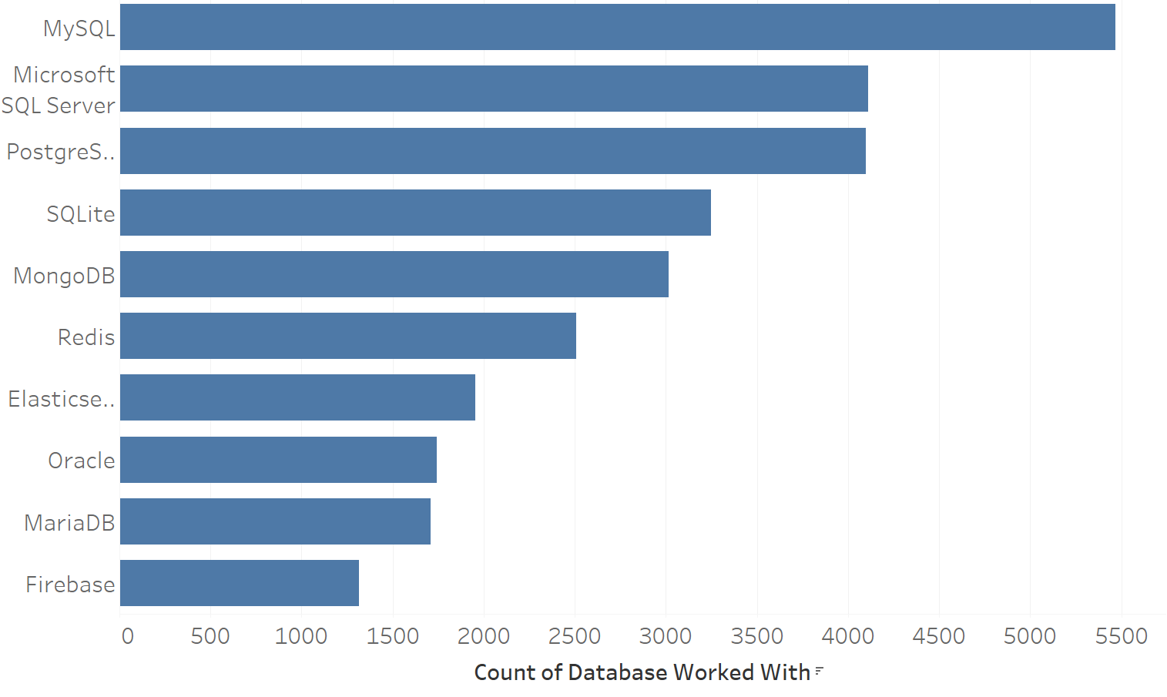
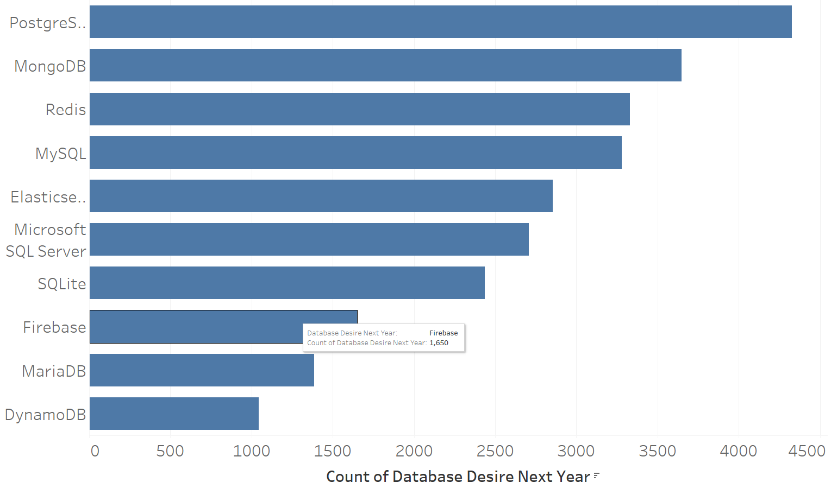
DATABASE TRENDS
Top 10 DatabaseWorkedWith
Top 10 DatabaseDesireNextYear
< Bar chart of top 10 databases for the current year goes here >
< Bar chart of top 10 databases for the next year goes here.>

Slide 10
DATABASE TRENDS - FINDINGS & IMPLICATIONS
Findings
MySQL remains the most popular database choice.
Following closely is Microsoft SQL.
MongoDB and Redis are emerging as favorites.
A newcomer to the scene is Elasticsearch.
Implications
Open-source databases continue to be preferred in companies.
NoSQL databases are gaining traction for storing non-relational data.
Redis supports abstract data types, enhancing its versatility.
Pre-tuned search solutions are increasingly valuable for websites, apps, and ecommerce stores.

Slide 11

DASHBOARD
https://github.com/Mohamed-Saeed-Kaiba/test1/issues/2

Slide 12
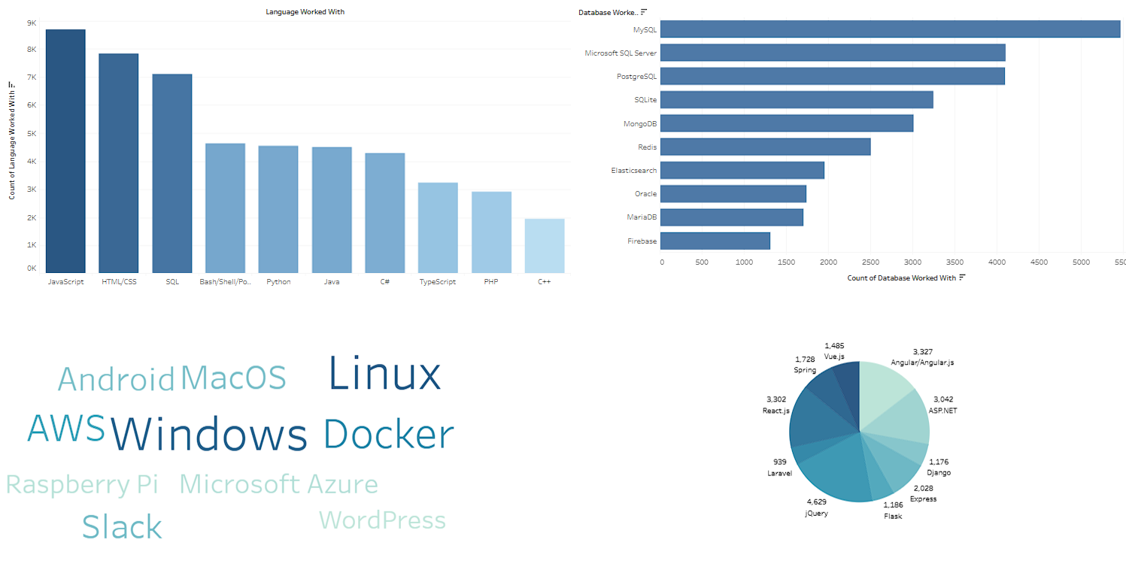
DASHBOARD TAB 1
Screenshot of dashboard tab 1 goes here

Slide 13
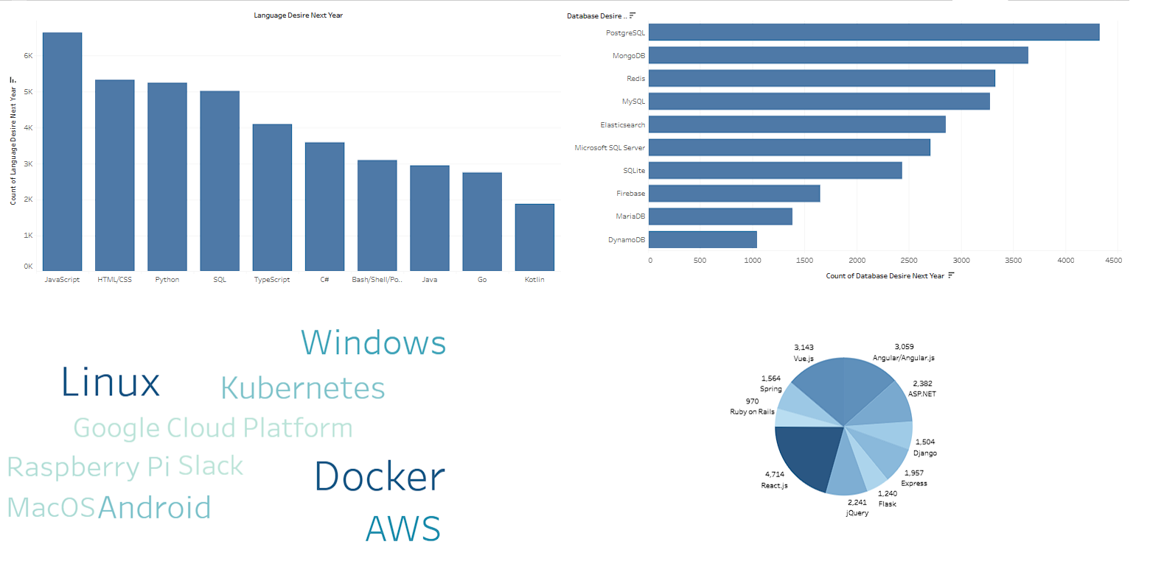
DASHBOARD TAB 2
Screenshot of dashboard tab 2 goes here

Slide 14
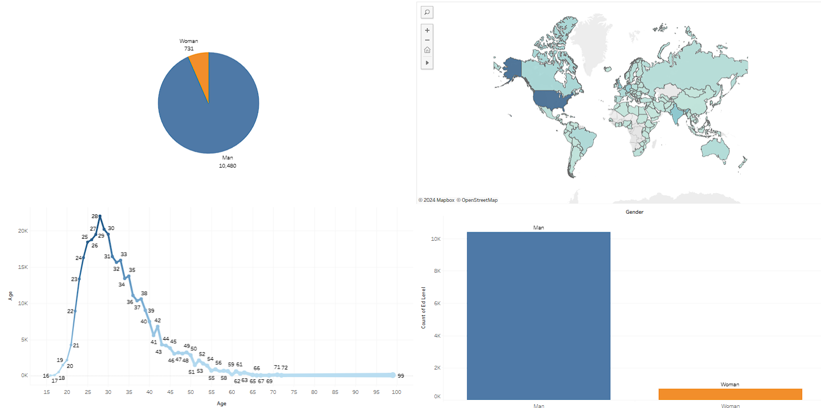
DASHBOARD TAB 3
Screenshot of dashboard tab 3 goes here

Slide 15
DISCUSSION
Technology Trends Now and in the Future
Training and reskilling workers to adapt to emerging technologies.
Increasing female participation in the technology field.
Bridging the technology gap in developing countries.
Eliminating age and education discrimination in employment.

Slide 16
OVERALL FINDINGS & IMPLICATIONS
Findings
Technology evolves rapidly every year.
There is a concentration of technology development in countries like the USA and India.
Gender gap persists in technology jobs.
Platforms such as Docker and AWS are experiencing significant growth.
Implications
Companies must remain adaptable to accommodate rapid technological changes.
There's a necessity to disseminate technology to countries lagging behind.
The impact of job hiring practices is significant.
Anticipate a shift towards faster application deployments and increased adoption of cloud services in the future.

Slide 17

CONCLUSION
Technology Trends for the Current and Next Year:
Overview of emerging programming languages, databases, and platforms.
Demographics Overview:
Analysis of demographic trends in the technology industry.
Actions to Be Taken:
Recommendations for adapting to current and future technology trends.
Future Considerations:
Incorporate machine learning to predict future trends and salaries in the technology sector.

Slide 18
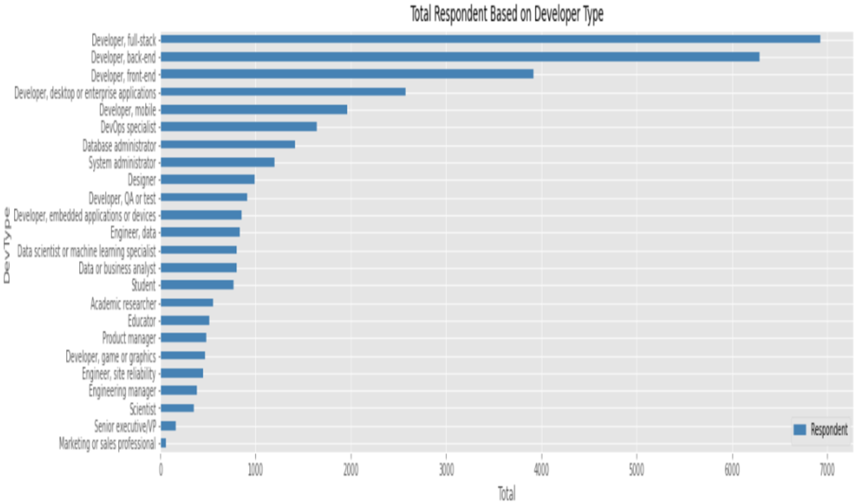
APPENDIX
Include any relevant additional charts, or tables that you may have created during the analysis phase.

Slide 19
JOB POSTINGS
In Module 1 you have collected the job posting data using Job API in a file named “job-postings.xlsx”. Present that data using a bar chart here. Order the bar chart in the descending order of the number of job postings.

Slide 20
POPULAR LANGUAGES
In Module 1 you have collected the job postings data using web scraping in a file named “popular-languages.csv”. Present that data using a bar chart here. Order the bar chart in the descending order of salary.

