Slide 1

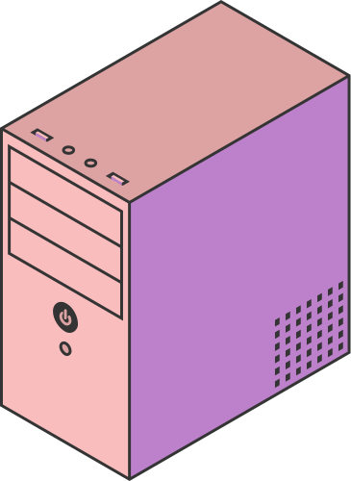
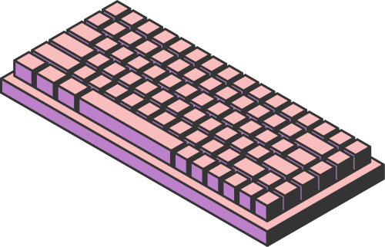
Implementing VPN Solutions with FortiGate
Page 01

Slide 2



GOAL OF THE PROJECT
To design and simulate a secure Enterprise VPN architecture using GNS3 and FortiGate, covering:
  Basic LAN/WAN setup
  IPsec site-to-site VPN (HQ ↔ Branch)
  SSL-VPN remote access
  SD-WAN for intelligent WAN routing and failover
Page 02

Slide 3
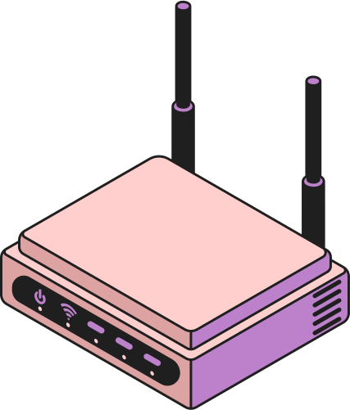
What is VPN
In this project, the VPN (Virtual Private Network) is the secure communication tunnel that connects the HQ network and the Branch network over the simulated public WAN.
We implement a site to site Ipsec VPN That connects
Two different LANS and the traffic between these Two lans are encrypted
Page 01

Slide 4
What is IPsec
IPsec is a set of protocols used to secure communication over untrusted networks
It creates a VPN tunnel that encrypts and protects data as it travels between two sites or devices.
How it works
Using of trusted connection between HQ and branch by creating a secure tunnel between both sides
Page 01

Slide 5
What is SSL
SSL is a protocol used to secure communication between a user and a server over the internet.
It encrypts the data being transmitted, ensuring confidentiality and protection from attackers.
How it works
When a remote user connects using SSL-VPN, the FortiGate creates a secure tunnel that protects the user’s traffic and allows safe access to the internal network (HQ or Branch).
Page 01

Slide 6
What is SD-WAN
SD-WAN improves WAN performance by dynamically selecting the best connection path for each type of traffic.
It uses real-time monitoring to optimize speed, reduce latency, and maintain reliability.
How it works
The firewall evaluates both WAN connections
(ISP-A and ISP-B). Based on latency, jitter, or packet loss, SD-WAN routes traffic through the best link and provides automatic failover if one ISP has issues.
Page 01

Slide 7
LAB TOPOLOGY
GOAL
Modeling of a duel-site network consisting of an HQ and a Branch. The setup includes WAN emulation, end-user LANs, and a dedicated management segment.
Components
  2 FortiGates (HQ & Branch)
  2 ISP clouds simulating WAN networks
  HQ LAN + Branch LAN PCs
  Management network (VMnet1) for GUI access
  WAN networks (VMnet2 & VMnet3)
  GNS3 VM to emulate FortiGate KVM appliances
Page 03

Slide 8
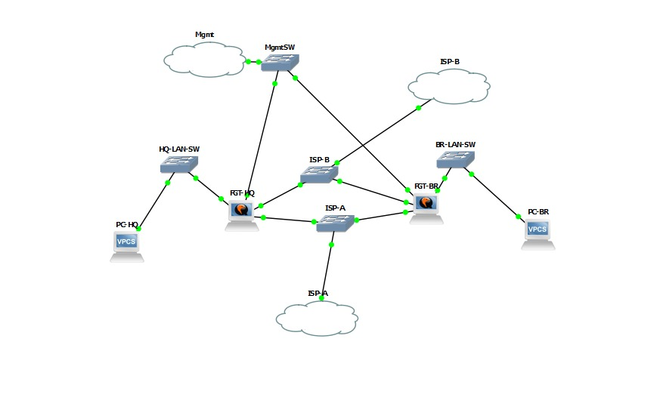
LAB TOPOLOGY
Management IP Addresses
Management access was established using the following IPs:
  HQ GUI: 172.16.1.10:8443
  Branch GUI: 172.16.1.11:8443
  Local PC: 172.16.1.1 (VMnet1)
HQ Site
  FGT-HQ (Firewall of HQ)
  HQ-LAN-SW(HQ SWITCH)
  PC-HQ(TESTING CONDUCTIVITY)
Branch Site
  FGT-BR(Firewall of branches)
  BR-LAN-SW(BR SWITCH)
  PC-BR(TESTING CONDUCTIVITY)
Wan Simulation
  ISP A and ISP B providing duel wan path
Page 03

Slide 9

WHAT WE SUCCESSFULLY BUILT
1.LAN Configuration
  HQ LAN: 10.0.1.0/24
  Branch LAN: 10.0.2.0/24
  PCs assigned:
    HQ PC: 10.0.1.10 / gateway 10.0.1.1
    Branch PC: 10.0.2.10 / gateway 10.0.2.1
2. WAN Simulation
Using VMware VMnet networks:
  WAN1 (ISP-A): 198.51.100.0/24
  WAN2 (ISP-B): 203.0.113.0/24
Ping between WAN networks and PC worked perfectly.
Page 04

Slide 10
WHAT WE SUCCESSFULLY BUILT
3. IPsec VPN (HQ ↔ Branch)
  Configured both Phase1 and Phase2
  Tunnel successfully established using DES-SHA256 (limited by VM license)
  HQ PC ↔ Branch PC communication worked through the tunnel
4. Management Network
  Separate mgmt interface (port4)
  Both FortiGates reachable via GUI
  Admin port moved from 443 → 8443 to avoid conflict with SSL-VPN
Page 04

Slide 11
WHAT WE COULD NOT COMPLETE
(because of FortiGate VM image limitations)
1.SSL-VPN
FortiClient failed with error (-5010): VPN server unreachable
Reason:
  The FortiGate image used was a limited/demo build, missing:
    sslvpnd daemon
    SSL-VPN debug commands
    Listener on port 443
    Full crypto support (AES missing)
Without the full VM license, SSL-VPN does not work.
2. SD-WAN
SD-WAN GUI did not show WAN interfaces (port2, port3).
Reason:
  SD-WAN feature is disabled in the limited/demo KVM image
  The image only showed mgmt interface as SD-WAN member
  Commands like config system virtual-wan-link partially worked but members never appeared
Conclusion:
SD-WAN requires the full-feature FortiGate VM image, not the minimal one.
Page 05

Slide 12
WHAT WE COULD NOT COMPLETE
(because of FortiGate VM image limitations)
3. Full Cryptography (AES)
IPsec proposals were limited to:
  DES-MD5
  DES-SHA1
  DES-SHA256
This is due to:
  Crypto restrictions in the demo/minimal FortiGate image
  No full license = no strong crypto
Page 05

Slide 13
WHY THESE FEATURES FAILED
The FortiGate qcow2 image used in the lab was a demo/minimal KVM build, which lacked several essential FortiOS modules.
Limitations of the demo image:
  SD-WAN engine not included
  SSL-VPN services disabled
  Limited cryptography (no AES)
  Missing advanced CLI/diagnostic tools
  Required background listener processes unavailable
  Not an officially licensed FortiGate VM
Solution:
Use the full-featured, licensed Fortinet VM image:
FGT_VM64_KVM-v7.x.x-FORTINET.out.kvm.zip
Page 06

Slide 14

WHAT WOULD WORK WITH THE FULL FORTIGATE VM LICENSE
Using the official VM image, we would be able to complete:
  Fully functional SSL-VPN
  Full SD-WAN configuration (WAN load balancing & failover)
  AES-256 IPsec tunnels
  Full diagnostic/debug commands
  SD-WAN monitoring
  SSL-VPN portal
  WAN link performance dashboards
Page 07

Slide 15

CONCLUSION
We successfully built the core VPN topology using GNS3 and FortiGate:
LAN environment
WAN simulation
Full IPsec tunnel HQ ↔ Branch
Management access & GUI functionality
But due to FortiGate VM license restrictions:
  SSL-VPN
  SD-WAN
  Advanced crypto
could not be completed.
With the official VM image, the entire project would run as designed.
Page 08

Slide 16



THANK YOU

