Slide 1
Credit Card Churn Prediction
Machine Learning for Proactive Customer Retention
By: Mohamed Mekawy

Slide 2
Table of contents
01
02
03
04
Business Problem
Understanding the Data & EDA
Pre-processing
AI & Modelling
05
Model Evaluation

Slide 3
Steps to apply AI in schools
Business Problem
EDA
Pre-processing
Credit Card Churn Prediction
Gathering insights from relavent graphs
Imputation, scaling, and encoding
Feature engineering
AI & Modelling
Model Evaluation
Adding new advantageous features for model
Using variety of algorithms for best prediction
Selecting Champion Model for real-world prediction

Slide 4
01
Business Problem
Why customer churn matters?

Slide 5
—axis-intelligence.com
“Approximately 20% of U.S. retail bank customers moved money away from their primary bank within the past three months as of early 2026”
“ Studies consistently show that acquiring a new customer can cost five to seven times more than retaining an existing one”

Slide 6
02
Understanding the Data
& EDA
How does the data look like?

Slide 7

Data Exploration & EDA
20,000
Customers analysed
60
Features including target
Churn
Target variable

Slide 8
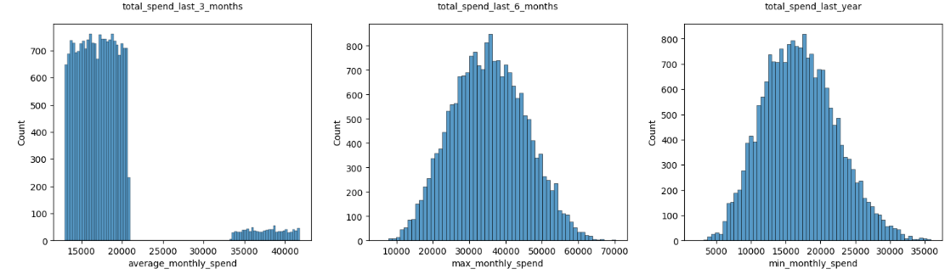
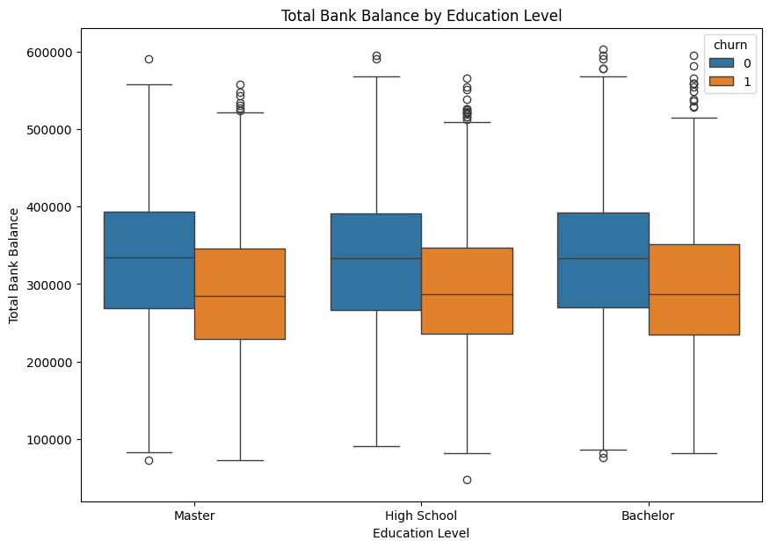
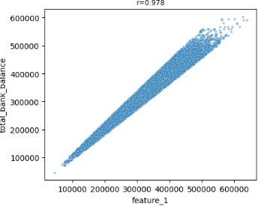
Trends & Insights

Slide 9
03
Pre-processing
How to clean the dataset?

Slide 10
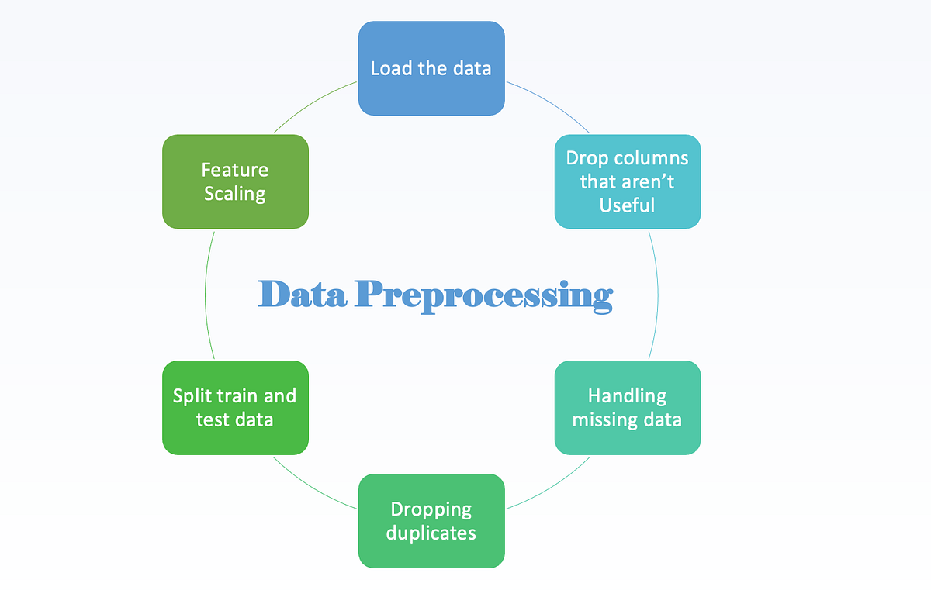
Pre-processing
Imputation
Scaling & Encoding
Feature Engineering
Use of iterative imputer
Scaling for numeric features: z-score standardization & Robust Scaler
Encoding using one-hot encoder and label encoding
Added new features:
Age tier
Category sum
balance_minus_limit

Slide 11
04
Modelling & Evaluation
Which models turned out the best?

Slide 12
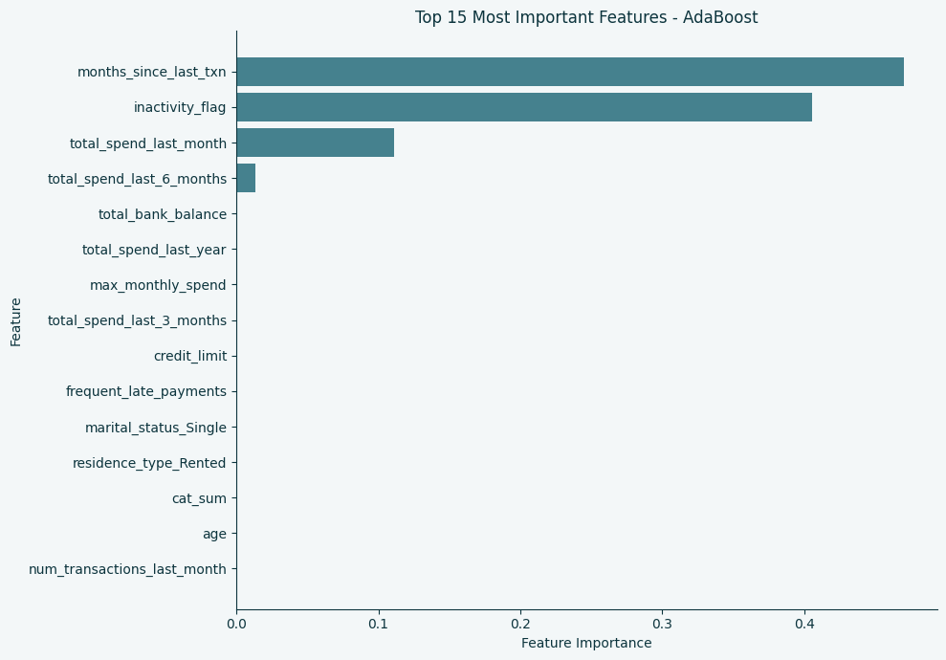
Feature Importance
Identifying the most useful features
We realize that the months_since_last_txn and the inactivity_flag in all of the models are of the most important features

Slide 13
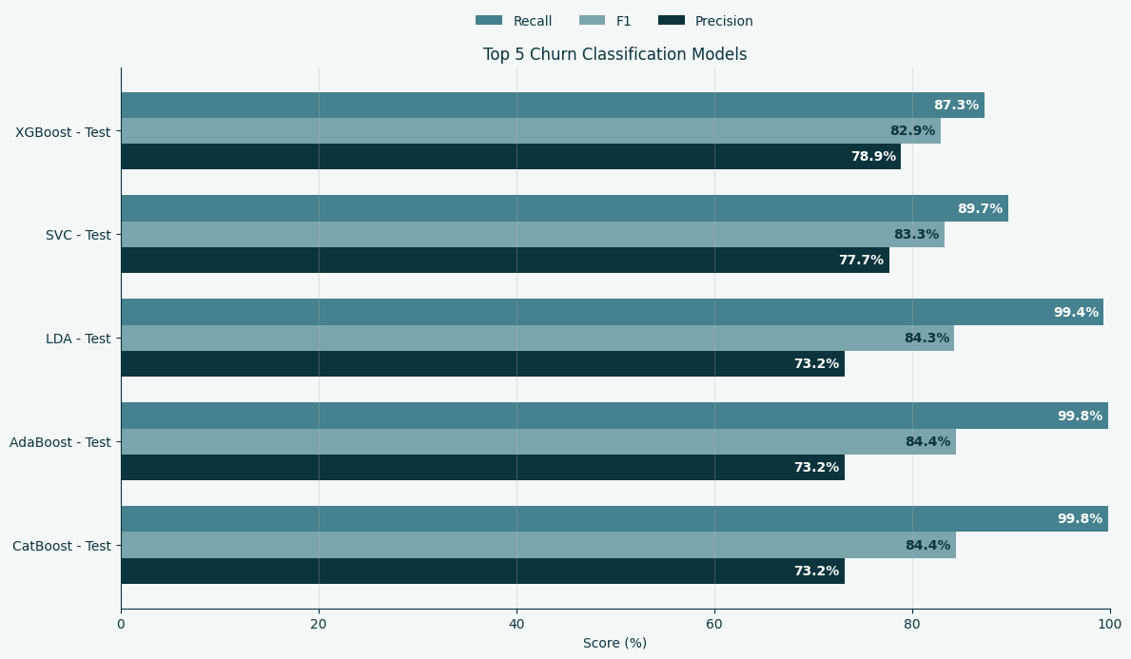
Model Evaluation
Identifying the Champion models

Slide 14

Deploymet & Future Use
Future work to be considered
Model to be used for deployment
Stacking
Voting
SMOTE (Balance)
Adaboost
Catboost

Slide 15
Resources
Did you like the resources in this template? Get them at these websites:
Facts
https://axis-intelligence.com/Gradient quantum illustration

Slide 16
Thanks!
Do you have any questions?
Mmekawy427@gmail.com
Please keep this slide for attribution

